Slide 1
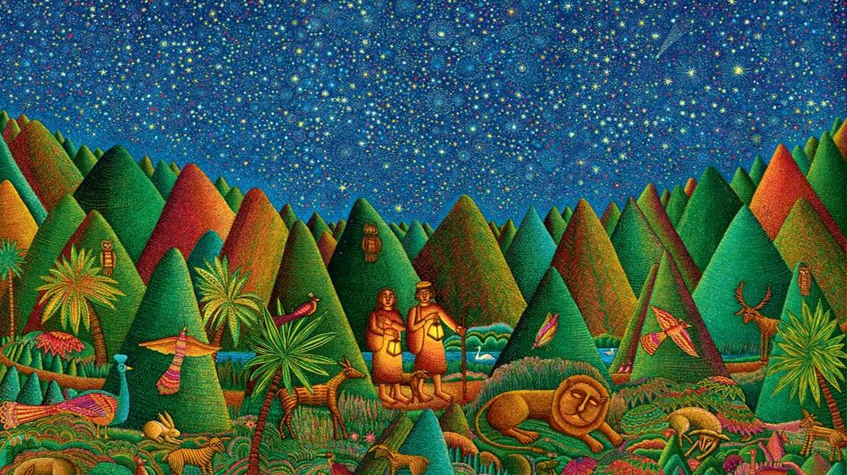
Fourth Sunday of Easter
Year B
Acts 4:5-12
Psalm 23
1 John 3:16-24
John 10:11-18

Slide 2
"…this man is standing before you in good health by the name of Jesus Christ of Nazareth..."
Acts 4:10a

Slide 3
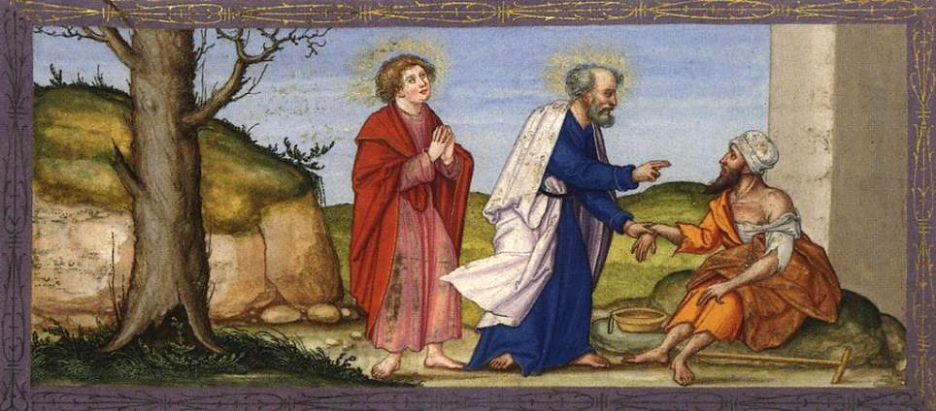
Peter Healing the Lame Man -- Matthias Gerung, Ottheinrich Folio, Bayerische Staatsbibliothek

Slide 4
"This Jesus is 'the stone that was rejected by you, the builders; it has become the cornerstone.'"
Acts 4:11

Slide 5
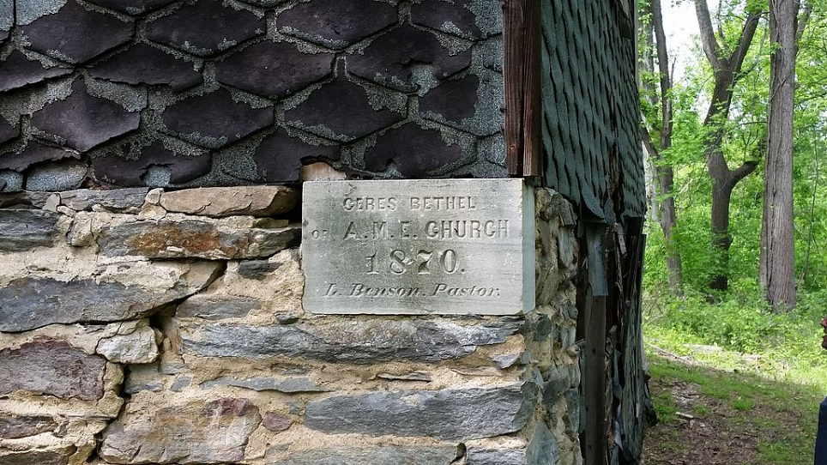
Cornerstone of Ceres Bethel African Methodist Episcopal Church, near Harper's Ferry, MD

Slide 6
How does God's love abide in anyone who has the world's goods and sees a brother or sister in need and yet refuses help?
1 John 3:17

Slide 7
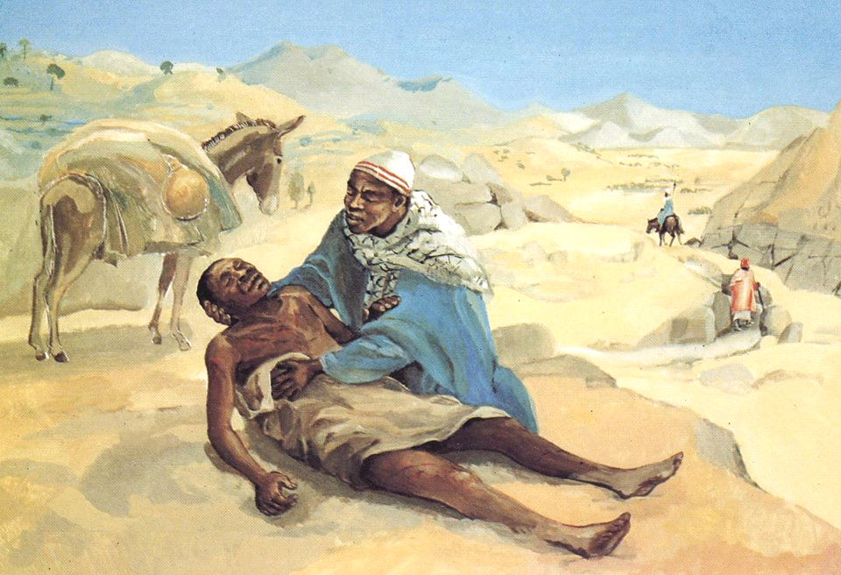
The Good Samaritan -- JESUS MAFA, Cameroon

Slide 8
Little children, let us love not in word or speech but in deed and truth.
1 John 3:18

Slide 9
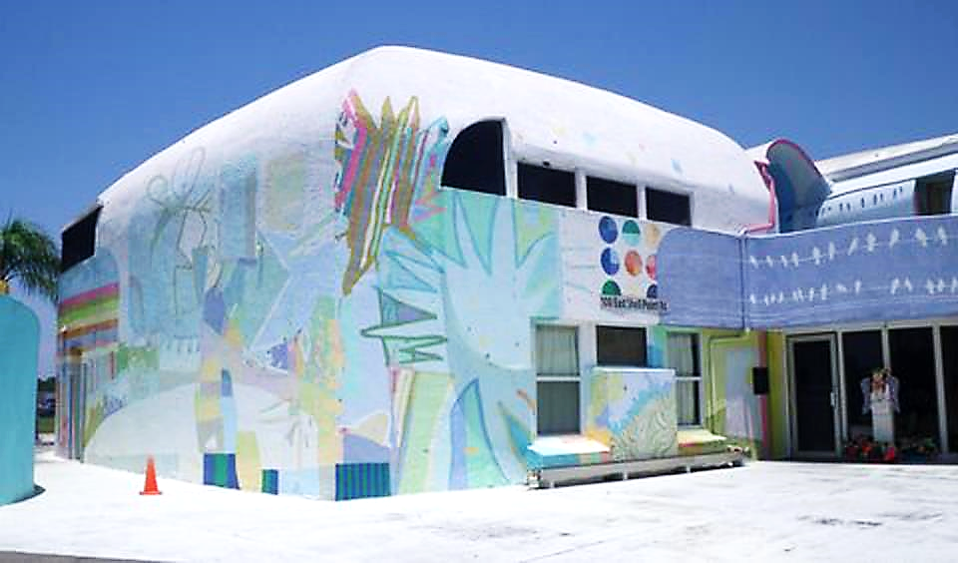
Mary and Martha Shelter for Domestic Violence -- Ruskin, FL

Slide 10
"I am the good shepherd.
The good shepherd lays down
his life for the sheep."
John 10:11

Slide 11
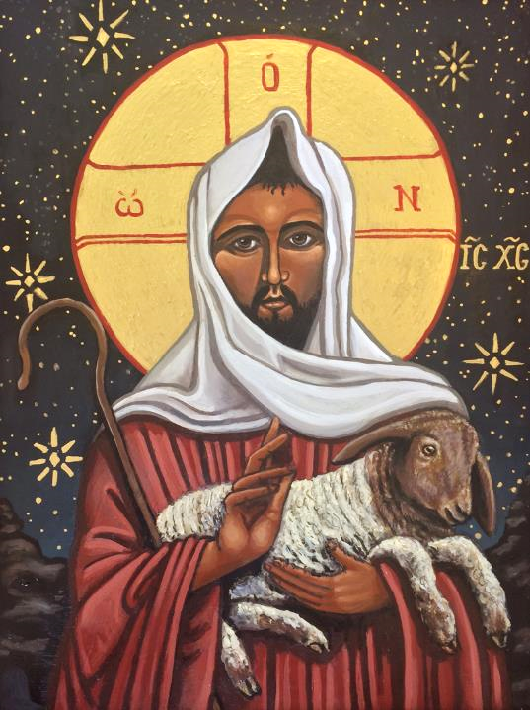
The Good Shepherd
Kelley Latimore

Slide 12
"I am the good shepherd. I know my own, and my own know me…. And I lay down my life for the sheep."
John 10:14, 15b

Slide 13
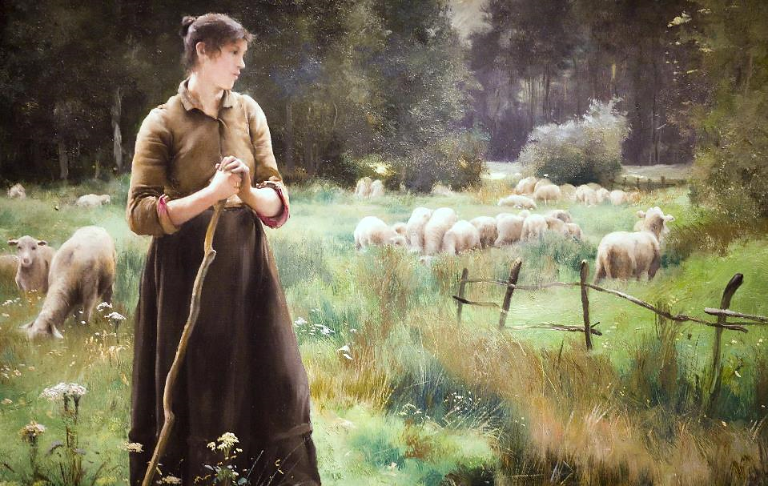
The Good Shepherd -- Julien Dupre, Legion of Honor Museum, San Francisco, CA

Slide 14
They will hunger no more and thirst no more…, for the Lamb at the center of the throne will be their shepherd…
Revelation 7:16a, 17a

Slide 15
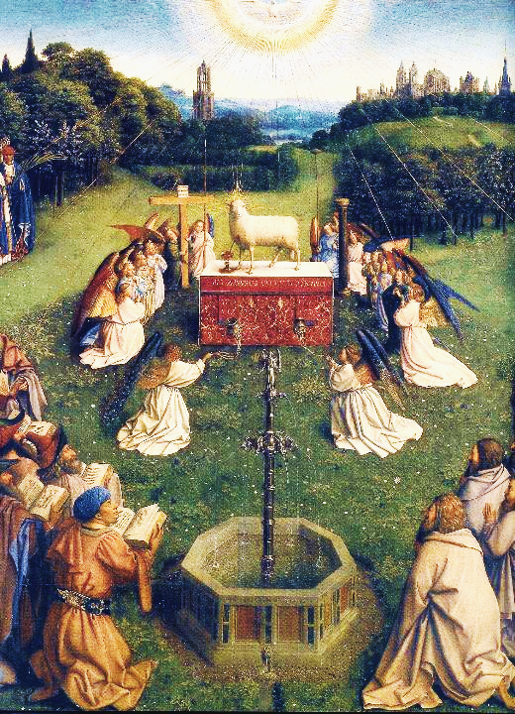
Adoration of the Lamb
Jan van Eyck
St Bavo
Ghent, Belgium

Slide 16
"My sheep hear my voice. I know them, and they follow me. I give them eternal life, and they will never perish."
John 10:27-28a

Slide 17
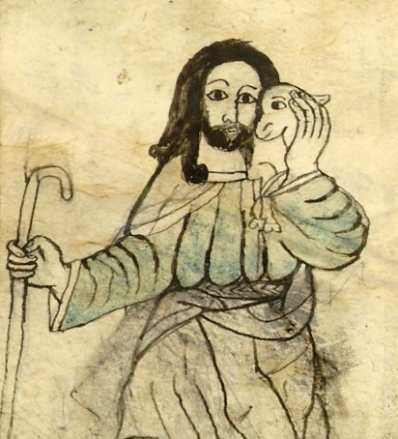
Ethiopian Portrayal of Christ as the Good Shepherd
Bibliotheque National
Paris, France

Slide 18
The LORD is my shepherd; I shall not want.
Psalm 23:1

Slide 19
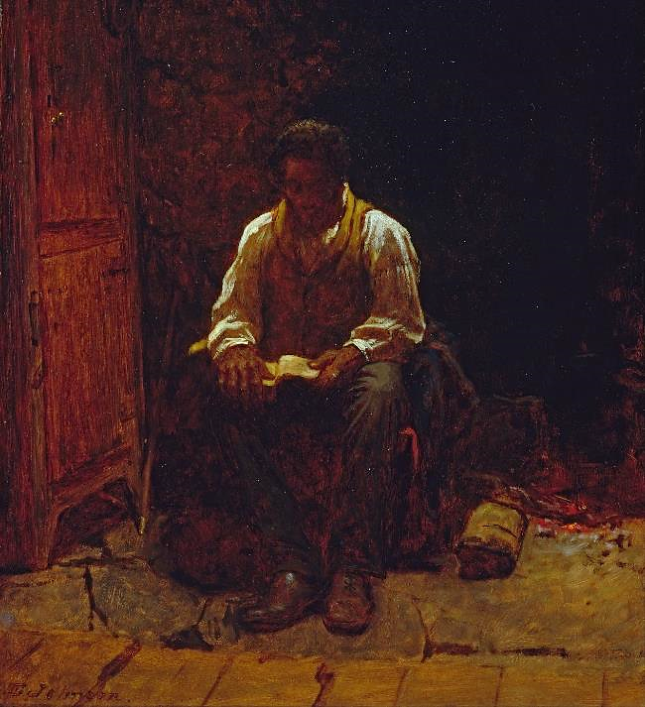
The Lord is My Shepherd
Eastman Johnson Smithsonian Museum of American Art Washington, DC

Slide 20
He makes me lie down in green pastures;
he leads me beside still waters...
Psalm 23:2

Slide 21
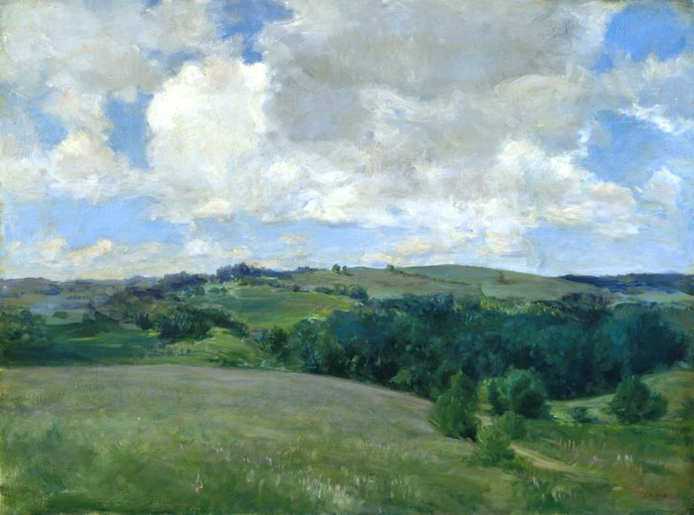
Clouds -- Charles Platt, Museum of Fine Arts, Boston, MA

Slide 22
...he restores my soul. He leads me in right paths for his name's sake.
Psalm 23:3

Slide 23
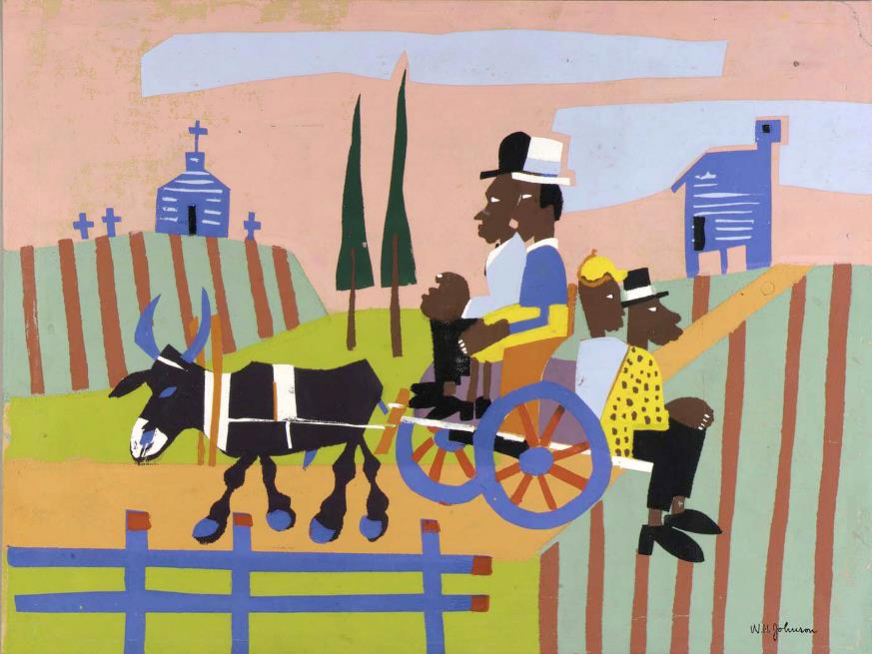
Going to Church -- William H. Johnson, Smithsonian Museum of American Art, Washington, DC

Slide 24
Even though I walk through the darkest valley, I fear no evil, for you are with me; your rod and your staff, they comfort me.
Psalm 23:4

Slide 25
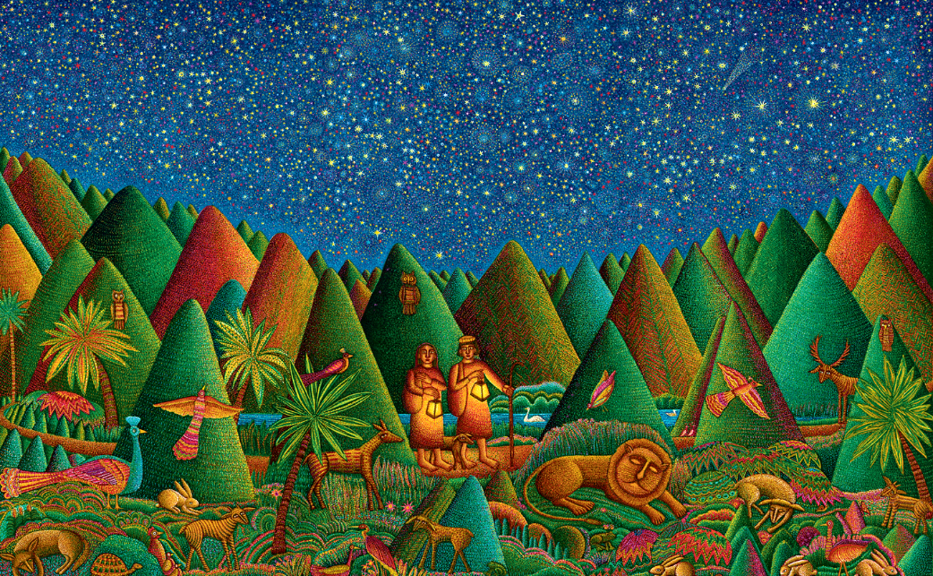
Psalm 23 -- John August Swanson

Slide 26
You prepare a table before me in the presence of my enemies; you anoint my head with oil; my cup overflows.
Psalm 23:5

Slide 27
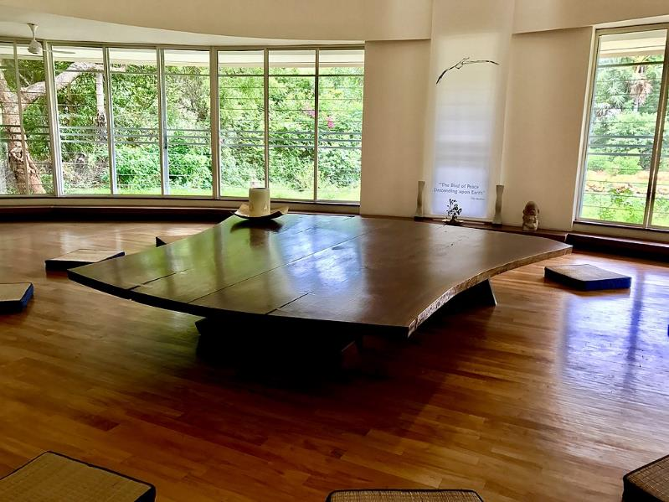
Peace Table for Asia -- George Nakashima, Hall of Peace, Auroville, India

Slide 28
Surely goodness and mercy shall follow me all the days of my life, and I shall dwell in the house of the LORD my whole life long.
Psalm 23:6

Slide 29
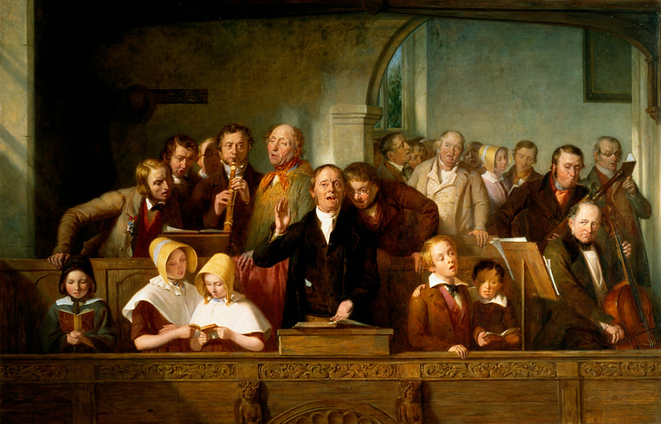
The Village Choir -- Thomas George Webster, Victoria and Albert Museum, London, England

Slide 30
Credits
New Revised Standard Version Updated Edition Bible, copyright 2022, Division of Christian Education of the National Council of the Churches of Christ in the United States of America. Used by permission. All rights reserved.
https://commons.wikimedia.org/wiki/File:Ottheinrich_Folio228v_Act3.jpg
https://commons.wikimedia.org/wiki/File:Ceres_Bethel_African_Methodist_Church,_cornerstone_(21604465715).jpg
http://diglib.library.vanderbilt.edu/act-imagelink.pl?RC=48381
https://commons.m.wikimedia.org/wiki/File:2009_-_COMMUNITY_MURAL-in-the-Round_PROJECT_Big_Draw_at_Mary_Martha_House_Store.JPG
https://kellylatimoreicons.com/contact/
http://www.flickr.com/photos/thomashawk/2202377733/
https://commons.wikimedia.org/wiki/File:Ghent_Altarpiece_D_-_Adoration_of_the_Lamb_2.jpg
http://commons.wikimedia.org/wiki/File:Bon_pasteur_BnF_Ethiopien_389_fol_1v.jpg
http://commons.wikimedia.org/wiki/File:Eastman_Johnson_-_The_Lord_Is_My_Shepherd_-_Google_Art_Project.jpg
https://commons.wikimedia.org/wiki/File:Charles_Adams_Platt_-_Clouds_(Landscape_near_Cornish)_-_37.1173_-_Museum_of_Fine_Arts.jpg
https://commons.wikimedia.org/wiki/File:Going_to_Church,_by_William_H._Johnson.jpg
www.JohnAugustSwanson.com - copyright 2010 by John August Swanson
https://commons.wikimedia.org/wiki/File:Table_of_Peace_in_Auroville_Township.jpg
http://commons.wikimedia.org/wiki/File:Thomas_Webster_-_A_Village_Choir.jpg
http://www.yorckproject.de
http://commons.wikimedia.org/wiki/File:Bon_pasteur_BnF_Ethiopien_389_fol_1v.jpg
Additional descriptions can be found at the Art in the Christian Tradition image library, a service of the Vanderbilt Divinity Library, http://diglib.library.vanderbilt.edu/. All images available via Creative Commons 3.0 License.

