Slide 1
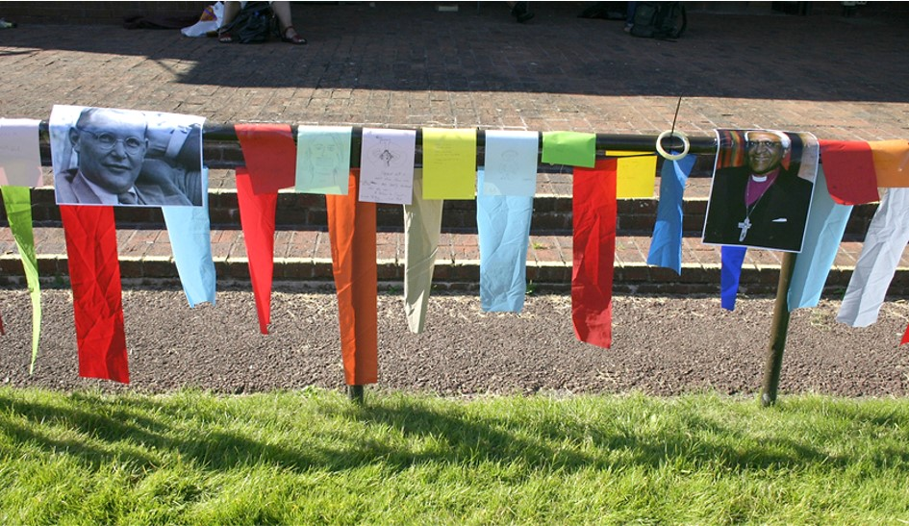
Fourth Sunday in Lent
Year B
Numbers 21:4-9
Psalm 107:1-3, 17-22
Ephesians 2:1-10
John 3:14-21

Slide 2
The people came to Moses and said, "We have sinned by speaking against the LORD and against you; pray to the LORD to take away the serpents from us."
Numbers 21:7a

Slide 3
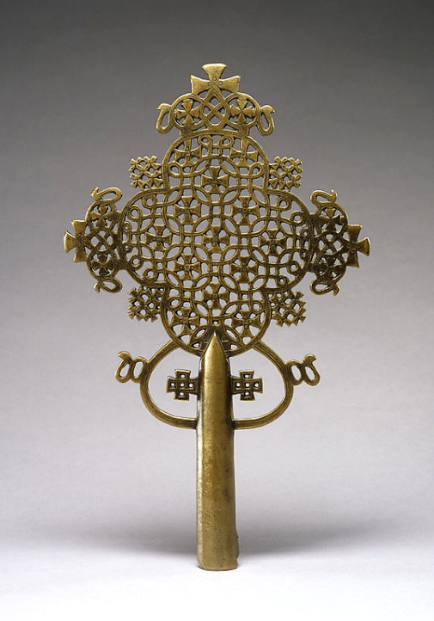
Processional Cross with Serpent Motif
Ethiopian
Walters Art Museum
Baltimore, MD

Slide 4
And the LORD said to Moses,
"Make a poisonous serpent, and set it on a pole; and everyone who is bitten shall look at it and live."
Numbers 21:8

Slide 5
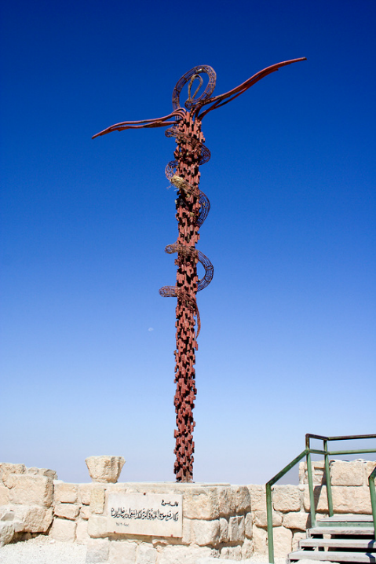
Brazen Serpent
Giovanni Fantoni
Mount Nebo,
Jordan

Slide 6
Then they cried to the LORD in their trouble, and he saved them from their distress; he sent out his word and healed them …
Psalm 107:19-20a

Slide 7
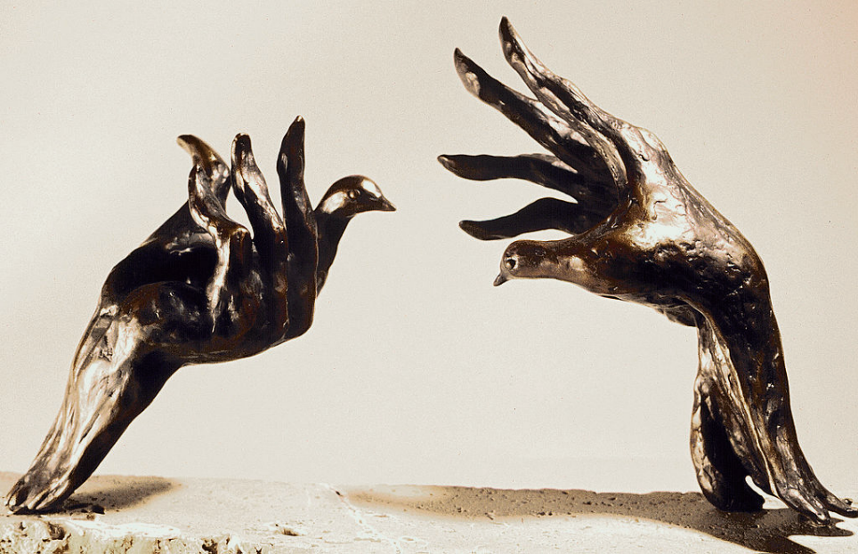
The Healing Touch -- Tim Holmes, Commissioned by the Physicians for Social Responsibility as their annual
PSR Peace Award

Slide 8
But God, who is rich in mercy, out of the great love with which he loved us even when we were dead through our trespasses,
Ephesians 2:4-5a

Slide 9
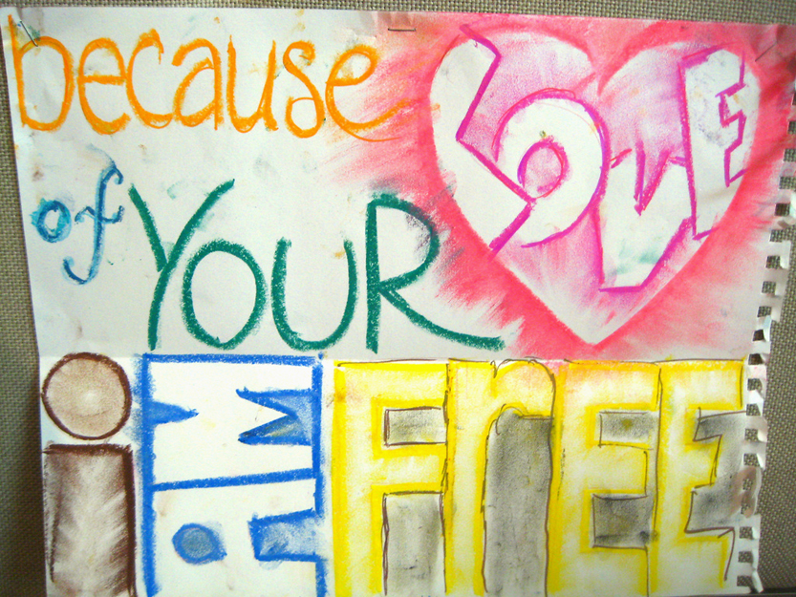
Drawing from a Christian fellowship meeting, Lingnan University, Hong Kong, China

Slide 10
made us alive together with Christ--by grace you have been saved …
Ephesians 2:5b

Slide 11
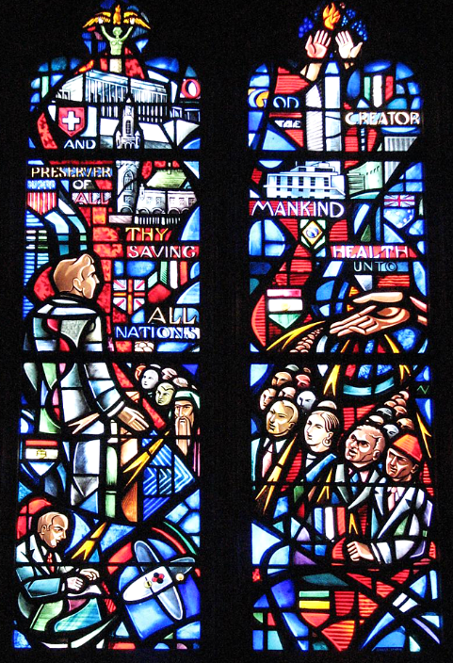
Saving Grace to All Humankind
Washington Cathedral
Washington, DC

Slide 12
"And just as Moses lifted up the serpent in the wilderness, so must the Son of Man be lifted up,
John 3:14

Slide 13
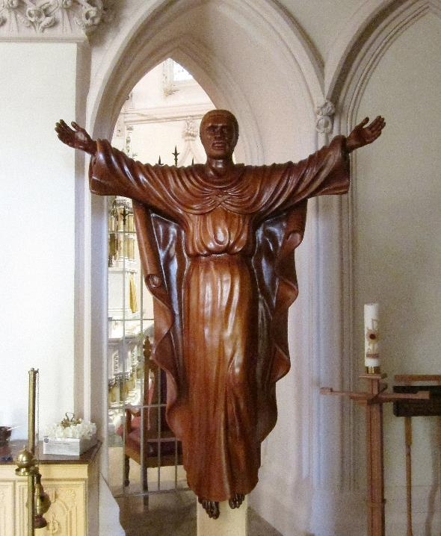
Ugandan Risen Christ
Basilica of Saint Mary of the Immaculate Conception
Norfolk, VA

Slide 14
that whoever believes in him may have eternal life.
John 3:15

Slide 15
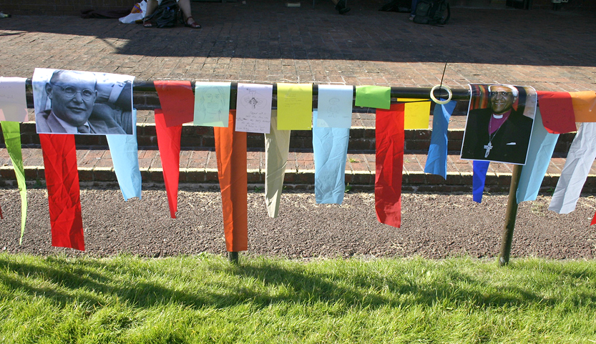
"Placing yourself in god's story, among the heroes of the faith on the arena rail..."
From an alternative worship service held at an emerging church festival in Cheltenham, UK

Slide 16
For God so loved the world that he gave his only Son, so that everyone who believes in him may not perish but may have eternal life.
John 3:16

Slide 17
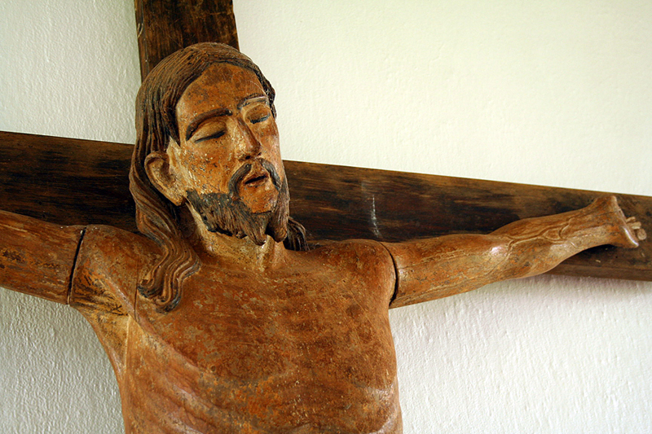
Christ on the Cross -- St. Miguel Arcanjo Church, St. Miguel, Brazil

Slide 18
Indeed, God did not send the Son into the world to condemn the world, but in order that the world might be saved through him.
John 3:17

Slide 19
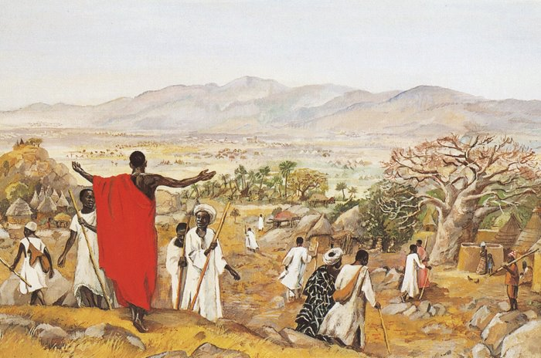
The Mission to the World -- JESUS MAFA

Slide 20
But those who do what is true come to the light, so that it may be clearly seen that their deeds have been done in God."
John 3:21

Slide 21
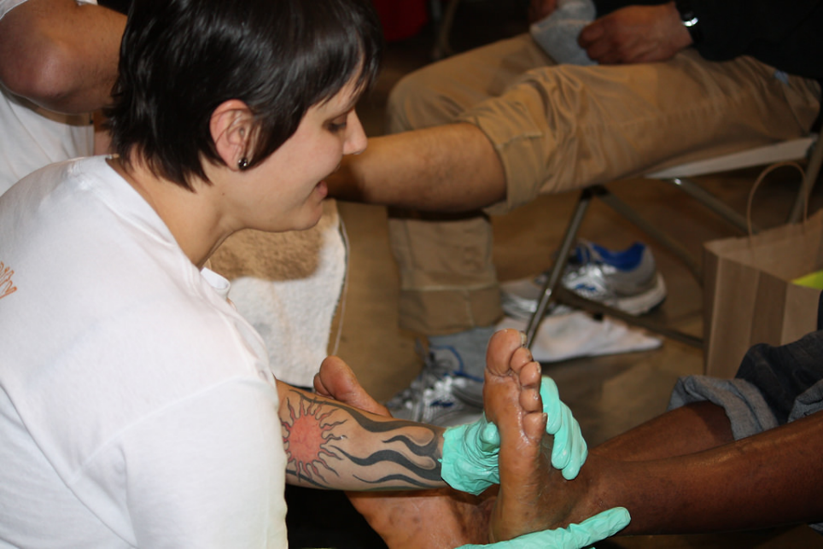
Footwashing -- Church of the Redeemer, United Way Resource Exchange, Seattle, WA

Slide 22
Credits
New Revised Standard Version Updated Edition Bible, copyright 2022, Division of Christian Education of the National Council of the Churches of Christ in the United States of America. Used by permission. All rights reserved.
https://commons.wikimedia.org/wiki/File:Ethiopian_-_Processional_Cross_-_Walters_542894_-_Side_A.jpg
http://commons.wikimedia.org/wiki/File:Brazen_Serpent_Sculpture.jpg
https://commons.wikimedia.org/wiki/File:The_Healing_Touch,_by_Tim_holmes.jpg
http://www.flickr.com/photos/mckln/4814377195/
http://www.flickr.com/photos/reabhecc/5422927891/
https://commons.wikimedia.org/wiki/File:Basilica_of_Saint_Mary_of_the_Immaculate_Conception_(Norfolk,_Virginia),_interior,_wooden_statue_of_the_risen_Christ,_from_Uganda.jpg
http://www.flickr.com/photos/smallritual/1280581974/
http://www.flickr.com/photos/mathieustruck/410120430/
http://diglib.library.vanderbilt.edu/act-imagelink.pl?RC=48314
https://www.flickr.com/photos/redeemer-kenmore/3563659541
Additional descriptions can be found at the Art in the Christian Tradition image library, a service of the Vanderbilt Divinity Library, http://diglib.library.vanderbilt.edu/. All images available via Creative Commons 3.0 License.

