Slide 1
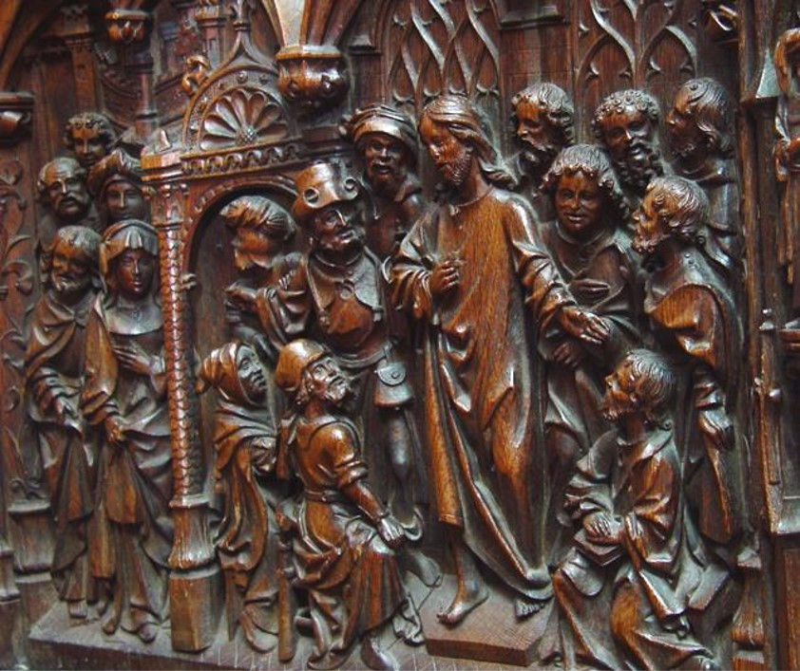
Fourth Sunday after the Epiphany
Year B
Deuteronomy 18:15-20 Psalm 111
1 Corinthians 8:1-13 Mark 1:21-28

Slide 2
"Then the LORD replied…, '…. I will raise up for them a prophet like you from among their own people; I will put my words in the mouth of the prophet…'"
Deuteronomy 18:17a, 18a

Slide 3
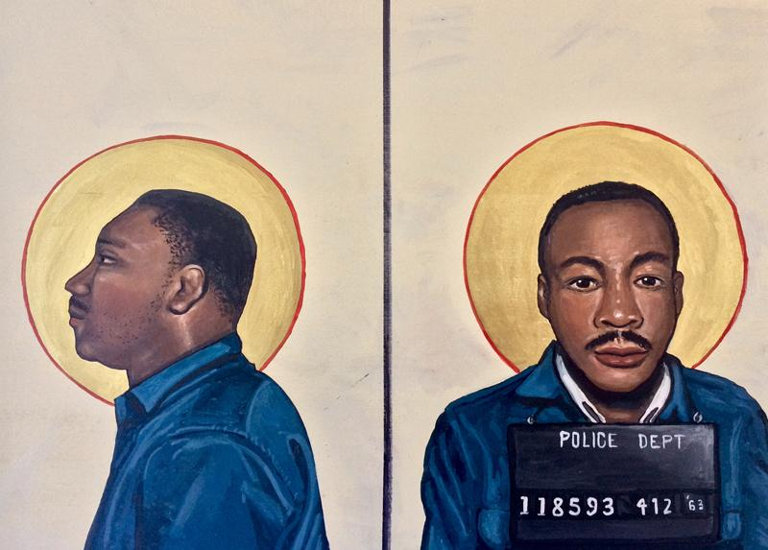
Martin Luther King, Jr. -- Kelly Latimore

Slide 4
Praise the LORD! I will give thanks to the LORD with my whole heart, in the company of the upright, in the congregation.
Psalm 111:1

Slide 5
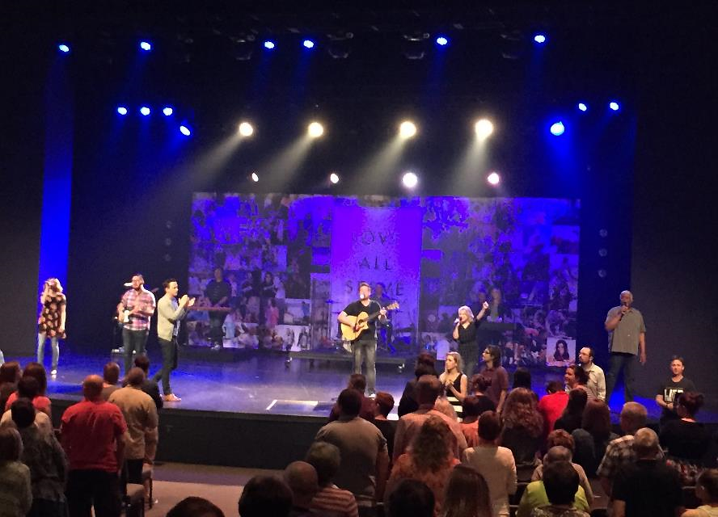
Praise Service -- James River Church, Springfield, MO

Slide 6
The fear of the LORD is the beginning of wisdom; all those who practice it have a good understanding. His praise endures forever.
Psalm 111:10

Slide 7
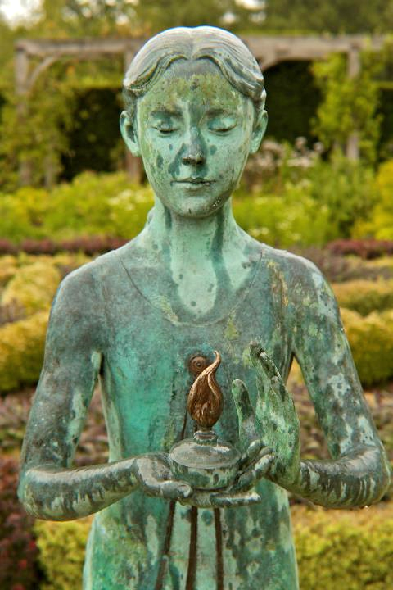
Lamp of Wisdom
Waterperry Gardens
Oxfordshire, England

Slide 8
Knowledge puffs up, but love builds up.
1 Corinthians 8:1b

Slide 9
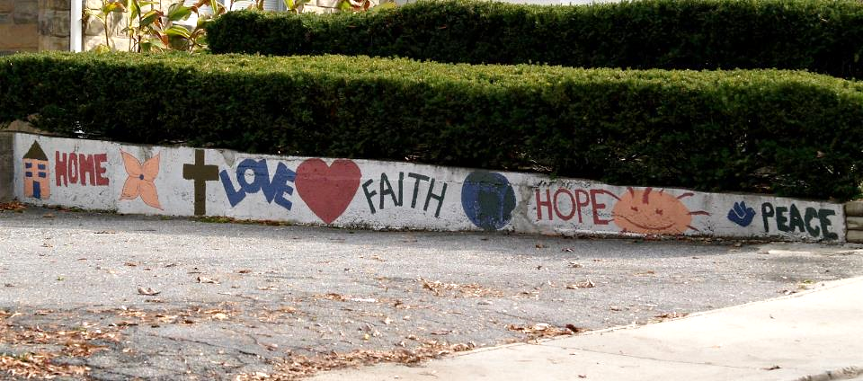
"Home, Love, Faith, Hope, Peace" Mural, Philadelphia Avenue, Takoma Park, MD

Slide 10
They went to Capernaum, and when the Sabbath came, he entered the synagogue and taught.
Mark 1:21

Slide 11
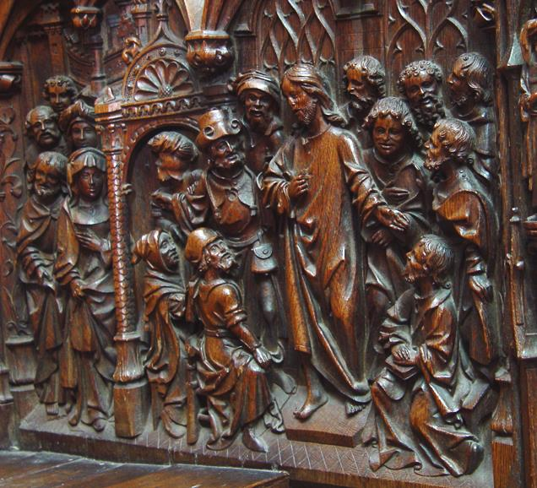
Jesus Teaches in the Temple
Amiens Cathedral Amiens, France

Slide 12
They were astounded at his teaching, for he taught them as one having authority and not as the scribes.
Mark 1:22

Slide 13
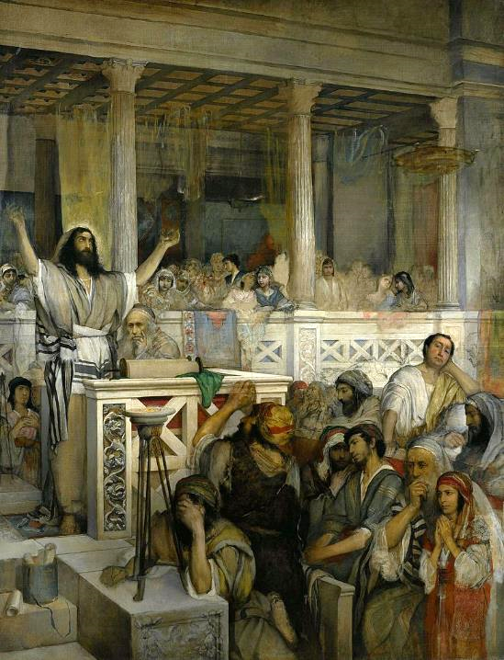
Christ Preaching at Capernaum
Maurycy Gottlieb
National Museum, Warsaw, Poland

Slide 14
…there was in their synagogue a man with an unclean spirit, and he cried out, "What have you to do with us, Jesus of Nazareth?"
Mark 1:23-24a

Slide 15
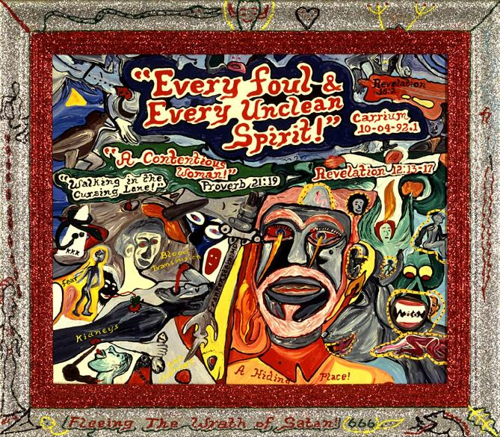
Every Foul and Every Unclean Spirit -- Xmeah ShaEla'ReEl, Smithsonian Museum of American Art, Washington, DC

Slide 16
But Jesus rebuked him, saying, "Be silent, and come out of him!"
Mark 1:25

Slide 17
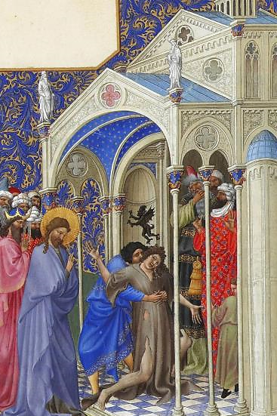
The Exorcism
Les Très Riches Heures du duc de Berry
Musée Condé
Chantilly, France

Slide 18
And the unclean spirit, convulsing him and crying with a loud voice, came out of him.
Mark 1:26

Slide 19
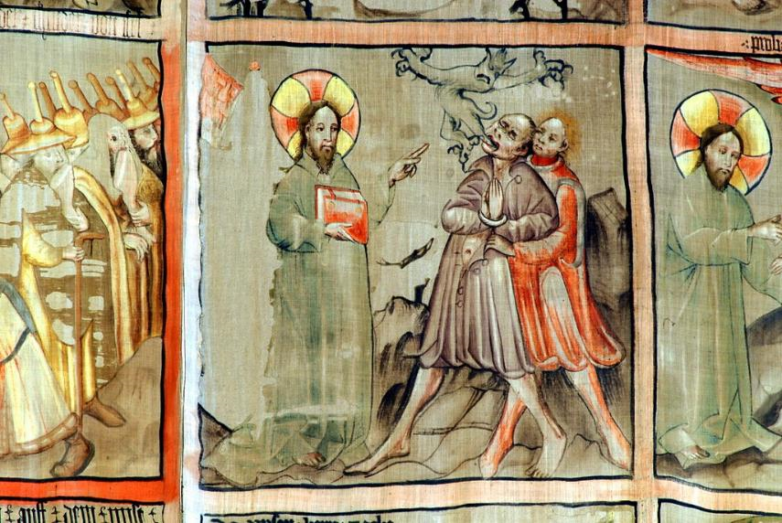
Jesus Christ Dispossesses -- Meister Konrad von Friesach, Cathedral of Gurk, Carinthia, Austria

Slide 20
They were all amazed…, "What is this? A new teaching—with authority! He commands even the unclean spirits, and they obey him."
Mark 1:27b

Slide 21
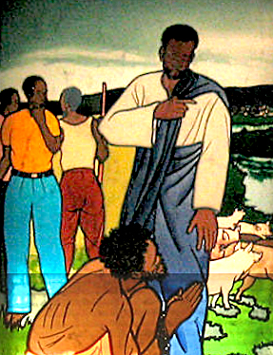
Jesus Heals the Man Possessed -- Mulungwishi Methodist Church, Mulungwishi, DRCongo

Slide 22
Credits
New Revised Standard Version Updated Edition Bible, copyright 2022, Division of Christian Education of the National Council of the Churches of Christ in the United States of America. Used by permission. All rights reserved.
Kelly Latimore Icons, https://kellylatimoreicons.com/
https://www.flickr.com/photos/amslerpix/16738861554
http://www.flickr.com/photos/rowanbank/5815103193/
https://www.flickr.com/photos/takomabibelot/300410877
http://diglib.library.vanderbilt.edu/act-imagelink.pl?RC=29391
https://commons.wikimedia.org/wiki/File:Maurycy_Gottlieb_-_Christ_preaching_at_Capernaum_-_Google_Art_Project.jpg
http://americanart.si.edu/collections/search/artwork/?id=36126
https://commons.wikimedia.org/wiki/File:Folio_166r_-_The_Exorcism.jpg
https://commons.wikimedia.org/wiki/File:Fastentuch_Gurker_Dom_Daemonenaustreibung_30032007.jpg - Padre Josef at the Cathedral of Gurk, Carinthia, Austria
https://www.flickr.com/photos/umccongo/2188556416
Additional descriptions can be found at the Art in the Christian Tradition image library, a service of the Vanderbilt Divinity Library, http://diglib.library.vanderbilt.edu/. All images available via Creative Commons 3.0 License.

