Slide 1
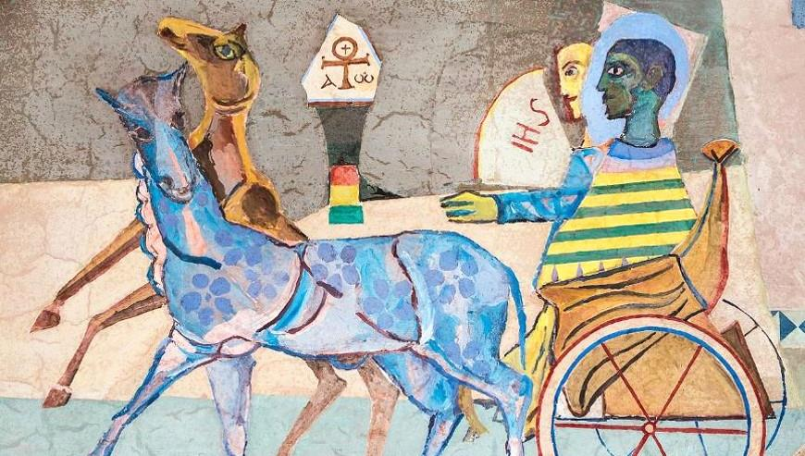
Fifth Sunday of Easter
Year B
Acts 8:26-40
Psalm 22:25-31
1 John 4:7-21
John 15:1-8

Slide 2
Now there was an Ethiopian eunuch....returning home; seated in his chariot, he was reading the prophet Isaiah.
Acts 8:27b, 28

Slide 3
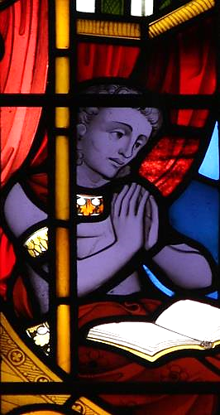
The Ethiopian Eunuch
Exeter College Chapel
Oxford, England

Slide 4
...Philip ran up...and heard him reading the prophet Isaiah. He asked, "Do you understand what you are reading?"
Acts 8:30

Slide 5
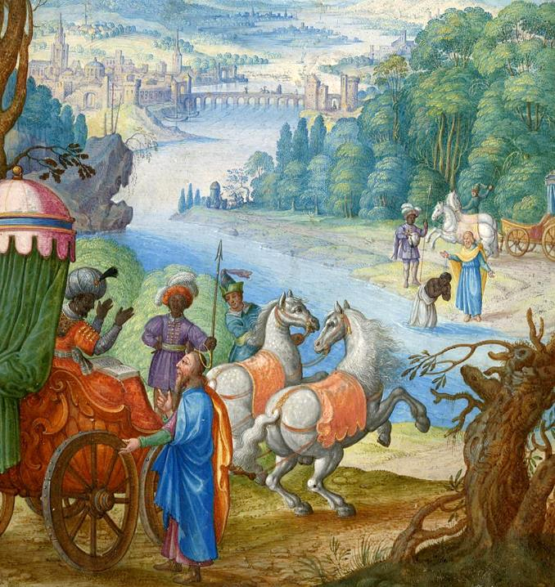
Ethiopian Eunuch and Philip
British Museum

Slide 6
Then Philip began to speak, and starting with this scripture he proclaimed to him the good news about Jesus.
Acts 8:35

Slide 7
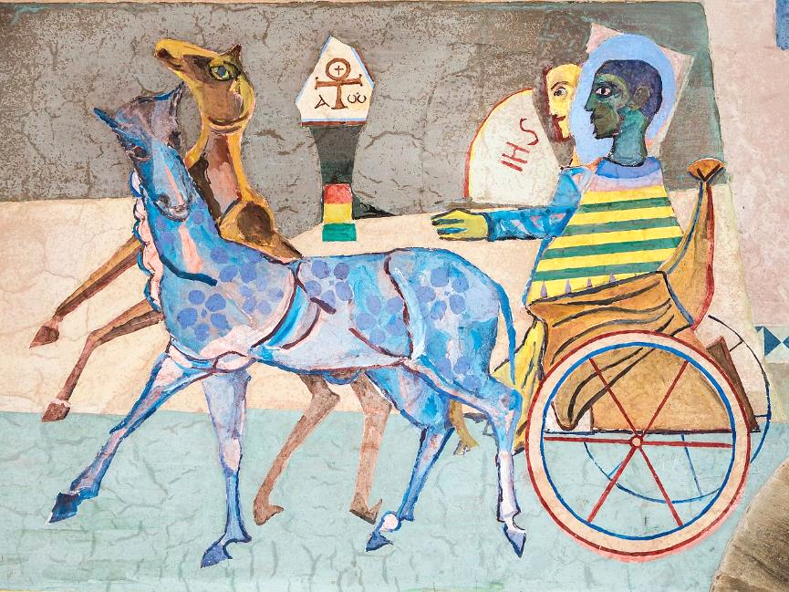
The Ethiopian and Philip, Angel's Chapel, Seckau Abbey, Styria, Austria

Slide 8
As they were going along the road, the eunuch said, "Look, here is water! What is to prevent me from being baptized?"
Acts 8:36

Slide 9
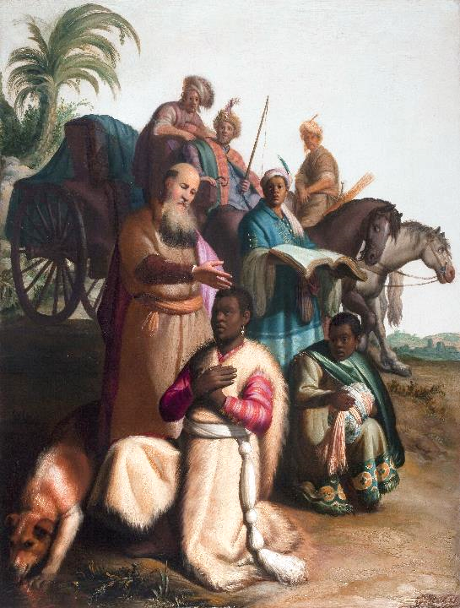
Baptism of the Ethiopian
Rembrandt Catharijneconvent
Utrecht, Netherlands

Slide 10
He commanded the chariot to stop, and…Philip and the eunuch, went down into the water, and Philip baptized him.
Acts 8:38

Slide 11
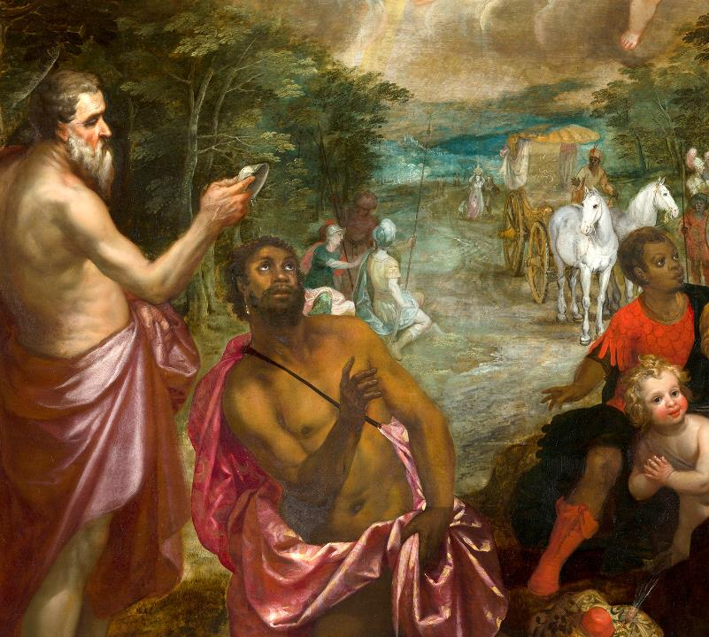
Philip Baptizes the Ethiopian
Mauritshuis
The Hague,
Netherlands

Slide 12
The poor shall eat and be satisfied; … May your hearts live forever!
Psalm 22:26

Slide 13
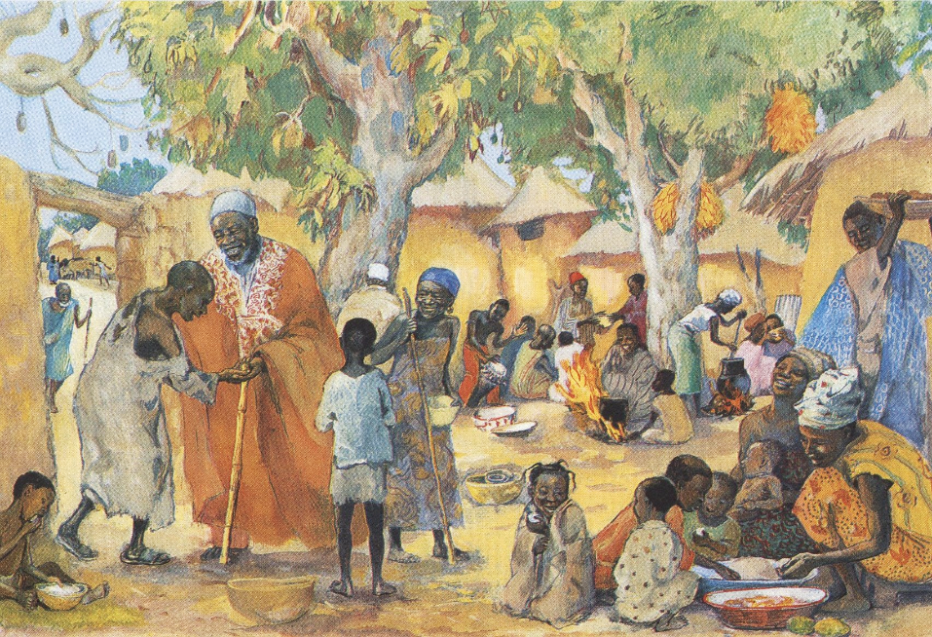
The Poor Invited to the Feast -- JESUS MAFA

Slide 14
Beloved, …everyone who loves is born of God and knows God….for God is love.
1 John 4:7b, 8b

Slide 15
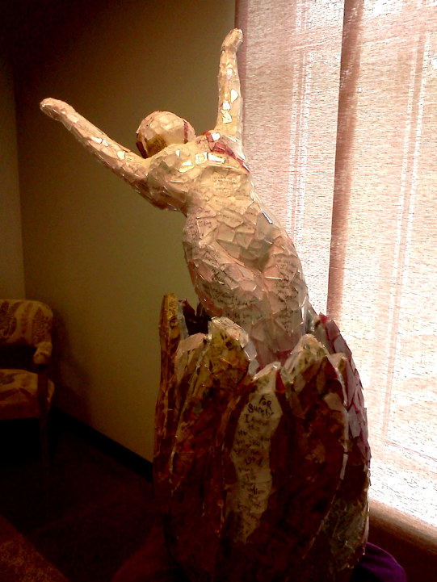
Beloved
Linda Crossan
Second Presbyterian Church
Nashville, TN

Slide 16
"I am the true vine, and my Father is the vinegrower."
John 15:1

Slide 17
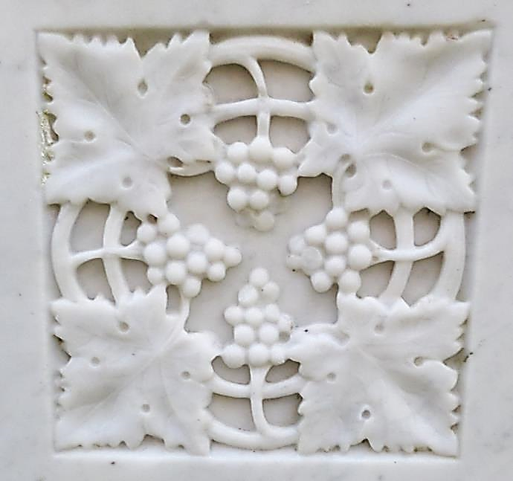
"I am the True Vine" Gravestone -- St Quivox, Scotland

Slide 18
"You have already been cleansed by the word that I have spoken to you."
John 15:3

Slide 19
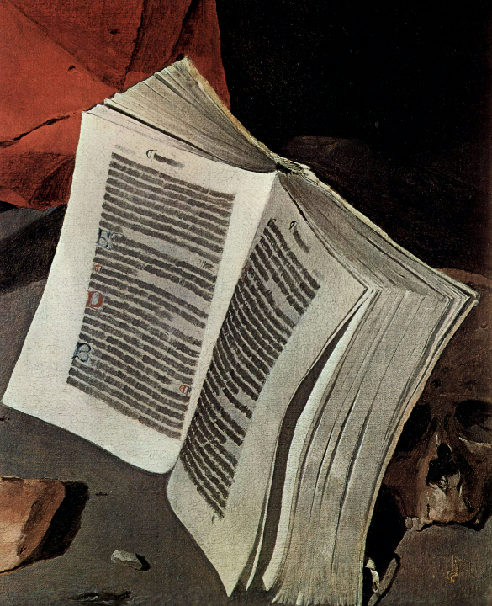
Atonement of Jerome, detail
Musee des Beaux-Arts
Genoble, France

Slide 20
"Abide in me as I abide in you."
John 15:4a

Slide 21
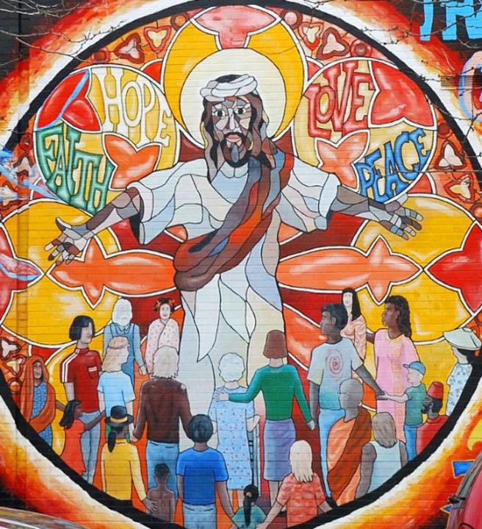
Jesus Mural of Faith, Hope, Love, and Peace

Slide 22
Credits
New Revised Standard Version Updated Edition Bible, copyright 2022, Division of Christian Education of the National Council of the Churches of Christ in the United States of America. Used by permission. All rights reserved.
https://www.flickr.com/photos/paullew/5712497198/ - Fr. Lawrence Lew
https://commons.wikimedia.org/wiki/File:Drawing_(BM_2009,7055.1).jpg
https://commons.wikimedia.org/wiki/File:Abtei_Seckau_Engelskapelle_Bekehrung_des_%C3%84thiopiers.jpg
https://commons.wikimedia.org/wiki/File:Rembrandt,_The_Baptism_of_the_Eunuch,_1626,_Museum_Catharijneconvent,_Utrecht.jpg
https://commons.wikimedia.org/wiki/File:The_Baptism_of_Queen_Candace%27s_Eunuch_attributed_to_Hendrick_van_Balen_and_Jan_Brueghel_(II)_Mauritshuis_282.jpg
http://diglib.library.vanderbilt.edu/act-imagelink.pl?RC=48397
http://diglib.library.vanderbilt.edu/act-imagelink.pl?RC=55303
https://commons.wikimedia.org/wiki/File:Gravestone_symbol_of_a_vine_with_grapes,_St_Quivox,_South_Ayrshire,_Scotland.jpg
http://diglib.library.vanderbilt.edu/act-imagelink.pl?RC=46758
https://www.flickr.com/photos/36847973@N00/3342340183
Additional descriptions can be found at the Art in the Christian Tradition image library, a service of the Vanderbilt Divinity Library, http://diglib.library.vanderbilt.edu/. All images available via Creative Commons 3.0 License.

