Slide 1
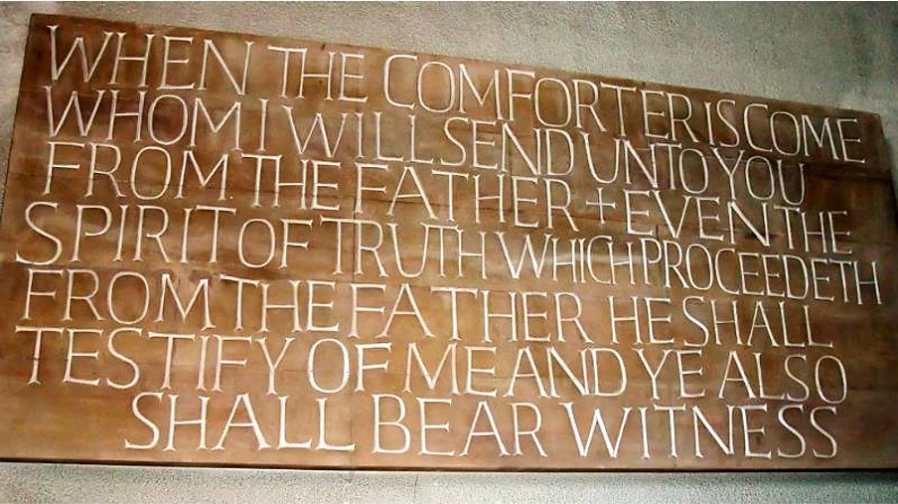
Easter Evening
Year B
Isaiah 25:6-9 • Psalm 114 • 1 Corinthians 5:6b-8 • Luke 24:13-49

Slide 2
Then the Lord GOD will wipe away the tears from all faces…
Isaiah 25:8b

Slide 3
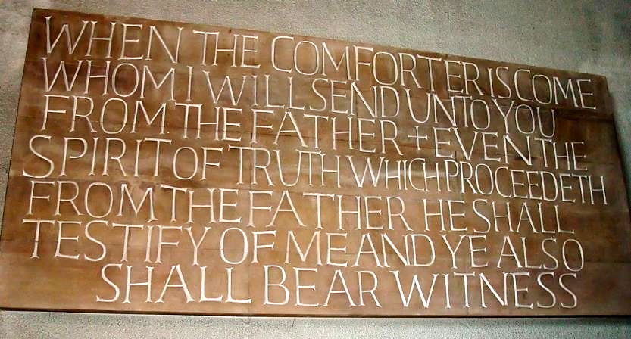
“When the comforter is come…” -- Coventry Cathedral, Coventry, England

Slide 4
The mountains skipped like rams,
the hills like lambs.
Why is it, O sea,
that you flee?
Psalm 114:4-5a

Slide 5
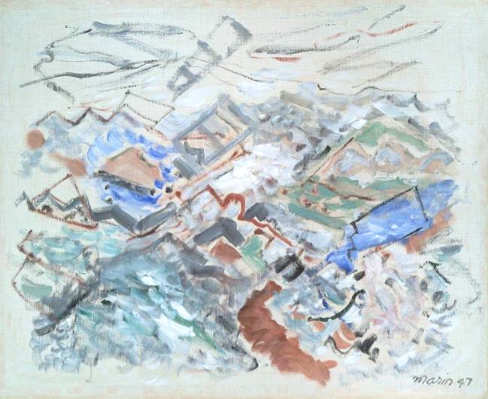
Movement – Sea or Mountain as You Will -- John Marin, Museum of Fine Arts, Boston, MA

Slide 6
…let us celebrate the festival, not with the old yeast, the yeast of malice and evil, but with the unleavened bread of sincerity and truth.
1 Corinthians 5:8

Slide 7
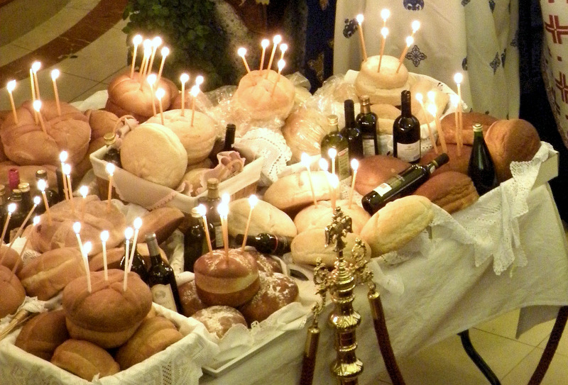
Breaking of Bread Service -- Annunciation Greek Orthodox Cathedral, Toronto, Canada

Slide 8
Now on that same day two of them were going to a village called Emmaus…. While they were talking and discussing, Jesus himself came near…
Luke 24:13a, 15a

Slide 9
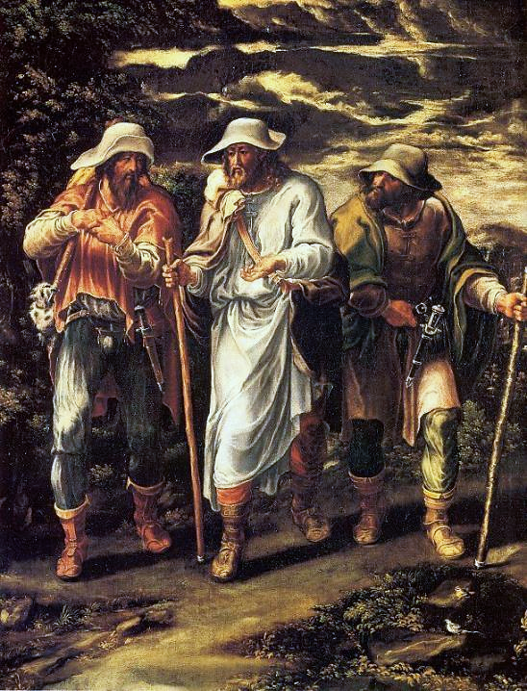
Road to Emmaus
Lelio Orsi
National Gallery, London

Slide 10
...and went with them, but their eyes were kept from recognizing him.
Luke 24:15b-16

Slide 11
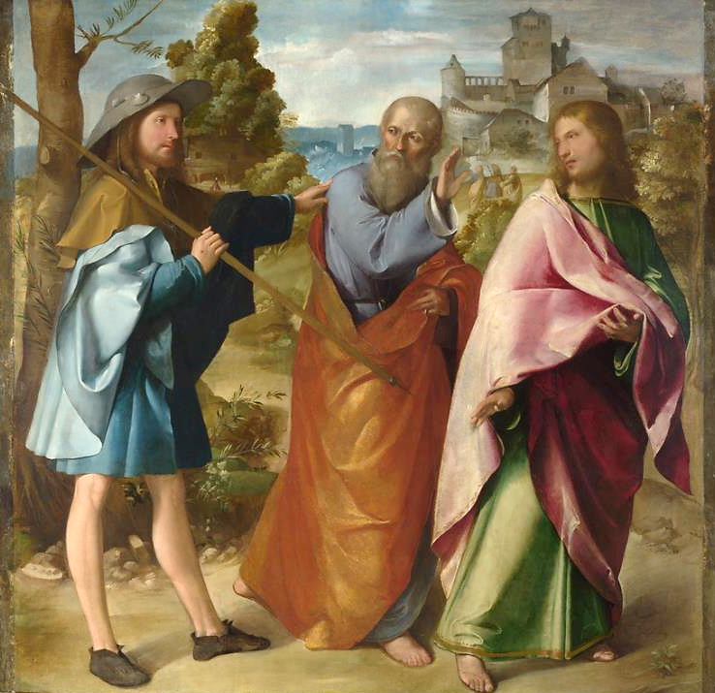
Road to Emmaus
Altobello Melone
National Gallery, London

Slide 12
And he said to them, "What are you discussing with each other while you walk along?" ….
"The things about Jesus of Nazareth, who was a prophet mighty in deed and word…"
Luke 24:17a, 19b

Slide 13
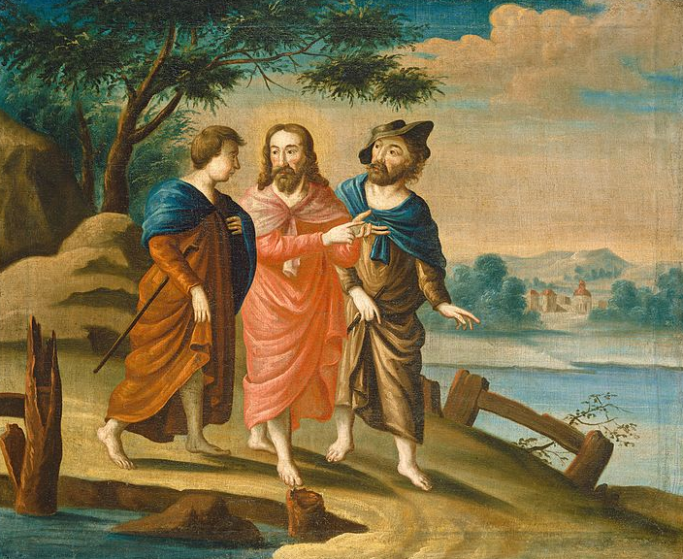
Road to Emmaus -- American, early 18th c., National Gallery of Art, DC

Slide 14
Then one of them…answered him, "Are you the only stranger in Jerusalem who does not know the things that have taken place…?"
Luke 24:18

Slide 15
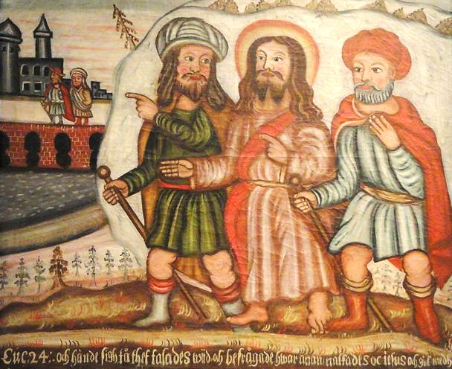
Road to Emmaus -- National Museum of Finland, Helsinki

Slide 16
Moreover, some women of our group astounded us. The…told us that they had indeed seen a vision of angels who said that he was alive.
Luke 24:22a, 23b

Slide 17
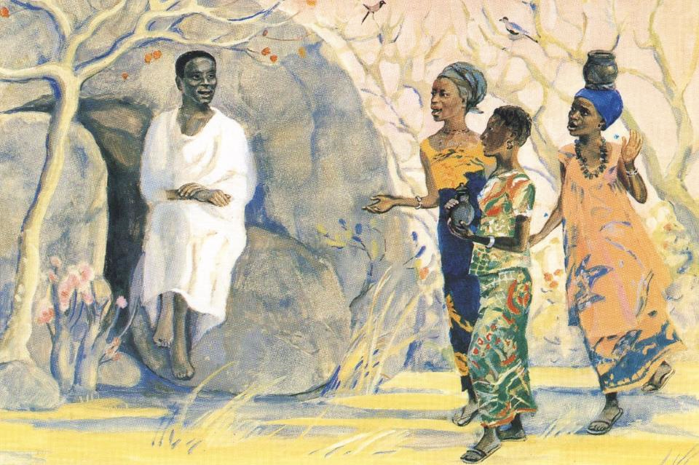
Women at the Tomb -- JESUS MAFA, Cameroon

Slide 18
Then he said to them, "…. Was it not necessary that the Messiah should suffer these things and then enter into his glory?"
Luke 24:25a, 26

Slide 19
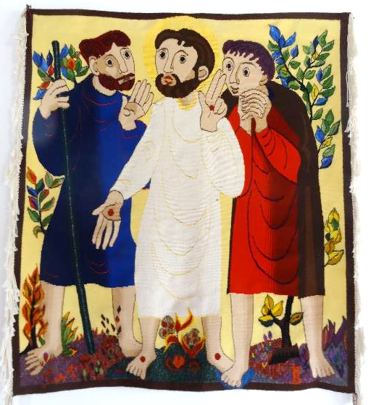
Road to Emmaus
Bose Orthodox Monastery Magnano, Italy

Slide 20
But they urged him strongly, saying, "Stay with us, because it is almost evening and the day is now nearly over."
Luke 24:29a

Slide 21
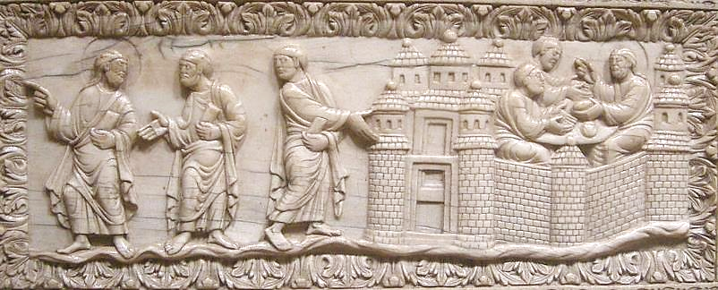
Road to Emmaus -- Carolingian, 9th c., Cloisters Museum, New York

Slide 22
When he was at the table with them, he took bread, blessed and broke it, and gave it to them.
Luke 24:30

Slide 23
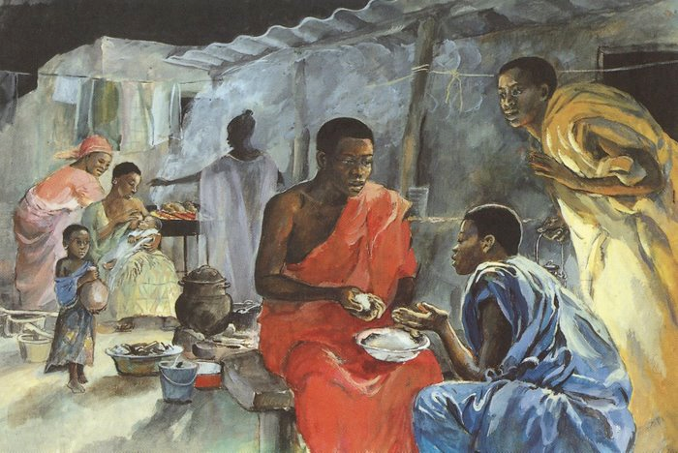
Jesus Appears at Emmaus -- JESUS MAFA, Cameroon

Slide 24
Then their eyes were opened...
Luke 24:31a

Slide 25
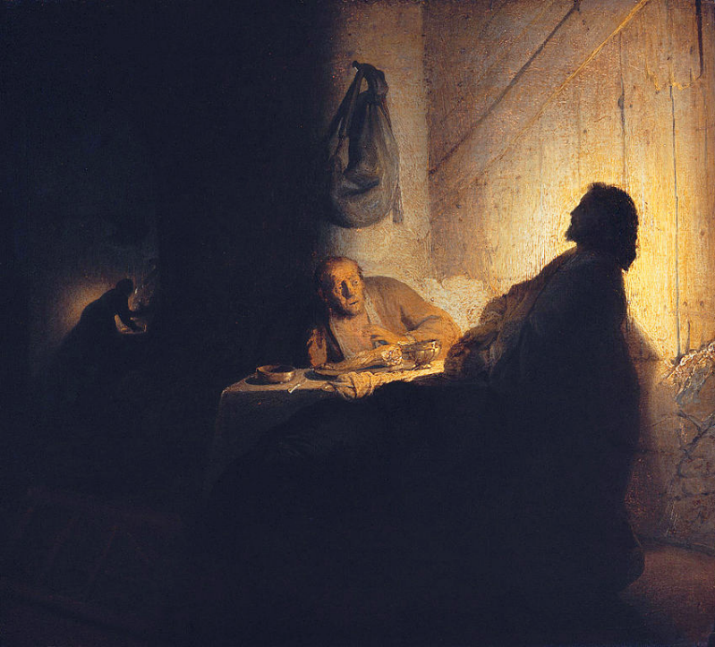
Supper at Emmaus
Rembrandt Musée Jacquemart-André, Paris

Slide 26
...and they recognized him...
Luke 24:31b

Slide 27
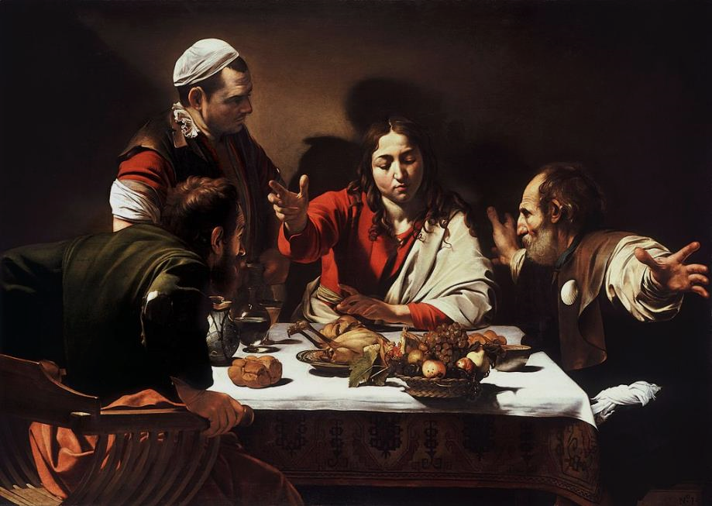
Supper at Emmaus -- Caravaggio, National Gallery, London

Slide 28
...and he vanished from their sight.
Luke 24:31c

Slide 29
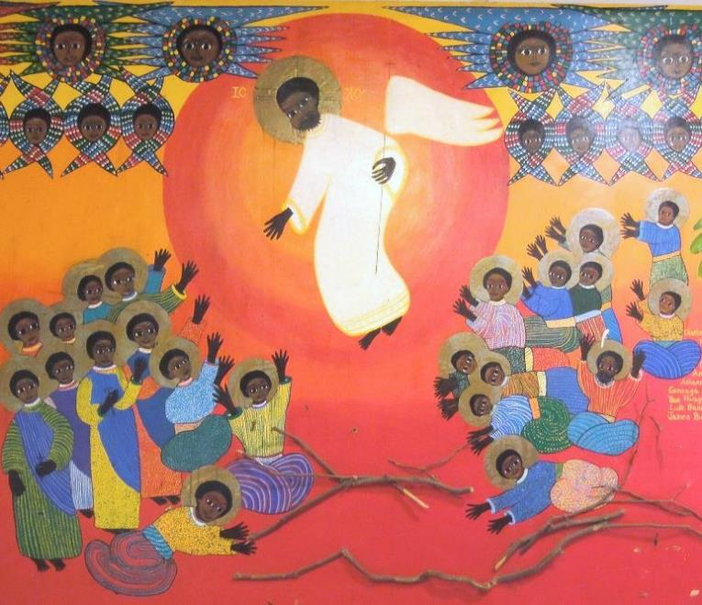
Emmaus House – Martyrs of Uganda, Kamapala, Uganda

Slide 30
That same hour they got up and returned to Jerusalem, and they found the eleven and their companions gathered together.
Luke 24:33

Slide 31
While they were talking about this, Jesus himself stood among them and said to them, "Peace be with you."
Luke 24:36

Slide 32
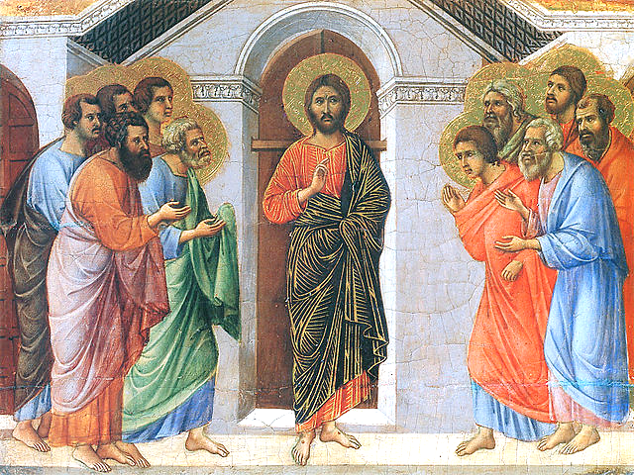
Christ Appears to the Apostles -- Duccio, Museo dell’Opera del Duomo, Siena, Italy

Slide 33
...and he said to them, "Thus it is written, that the Messiah is to suffer and to rise from the dead on the third day…. You are witnesses of these things."
Luke 24:46, 48

Slide 34
Credits
New Revised Standard Version Updated Edition Bible, copyright 2022, Division of Christian Education of the National Council of the Churches of Christ in the United States of America. Used by permission. All rights reserved.
http://www.flickr.com/photos/allyhook/3913720858/
http://www.mfa.org/
http://commons.wikimedia.org/wiki/File:2013-08-14--Artoklasia_during_Feast_of_the_Dormition_of_the_Virgin_Mary.JPG
https://commons.wikimedia.org/wiki/File:Lelio_Orsi_Camino_de_Ema%C3%BAs.jpg
https://commons.wikimedia.org/wiki/File:Christ_on_the_Road_to_Emmaus_G-001552-20120605.jpg
https://commons.wikimedia.org/wiki/File:On_the_Road_to_Emmaus_by_Lars_Gallenius,_1684,_Raahe_C
hurch_-_National_Museum_of_Finland_-_DSC04246.JPG
http://diglib.library.vanderbilt.edu/act-imagelink.pl?RC=48301
http://commons.wikimedia.org/wiki/File:Altobello_Melone_-_The_Road_to_Emmaus_-_Google_Art_Project.jpg
https://www.flickr.com/photos/jimforest/15277775371
https://commons.wikimedia.org/wiki/File:Lotharingia_(metz),_placca_d%27avorio_con_scene_a_emmaus,_850-900_circa_(carolingio).JPG
http://www.librairieemmanuel.fr
https://commons.wikimedia.org/wiki/File:The_Supper_at_Emmaus,_by_Rembrandt.jpg
https://commons.wikimedia.org/wiki/File:Supper_at_Emmaus-Caravaggio_(1601).jpg
https://www.flickr.com/photos/jimforest/5710252358
https://commons.wikimedia.org/wiki/File:Duccio_di_Buoninsegna_013.jpg
Additional descriptions can be found at the Art in the Christian Tradition image library, a service of the Vanderbilt Divinity Library, http://diglib.library.vanderbilt.edu/. All images available via Creative Commons 3.0 License.

