Slide 1
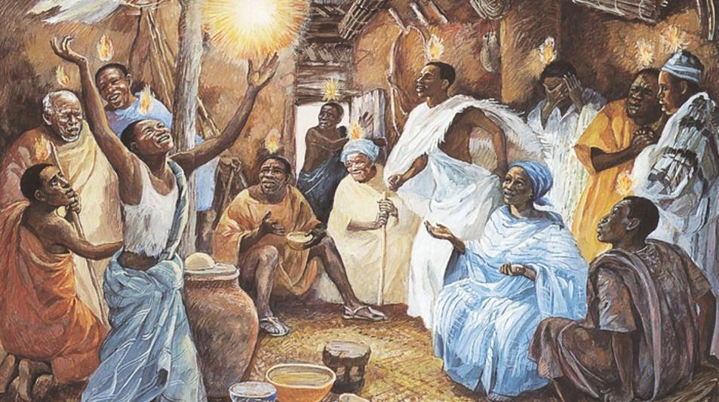
Day of Pentecost
Year B
Acts 2:1-21
or Ezekiel 37:1-14
Psalm 104:24-34, 35b
Romans 8:22-27
or Acts 2:1-21
John 15:26-27; 16:4b-15

Slide 2
When the day of Pentecost had come, they were all together in one place.
Acts 2:1

Slide 3
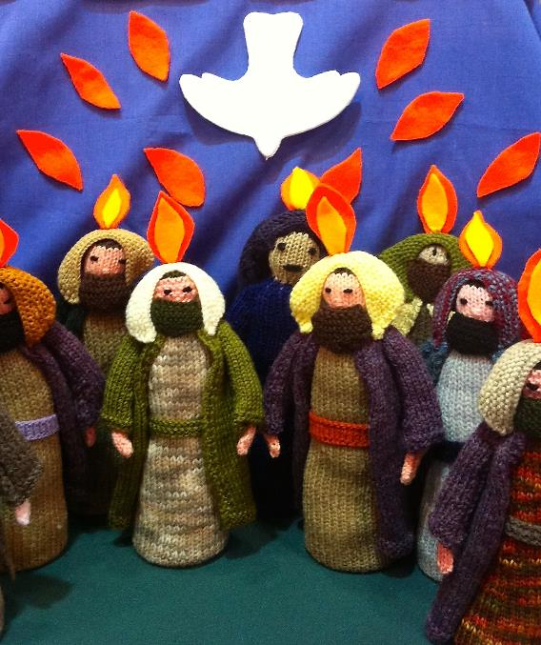
Knitted Apostles at Pentecost
Society for Promoting Christian Knowledge
Lower Green, England

Slide 4
And suddenly from heaven there came a sound like the rush of a violent wind, and it filled the entire house where they were sitting.
Acts 2:2

Slide 5
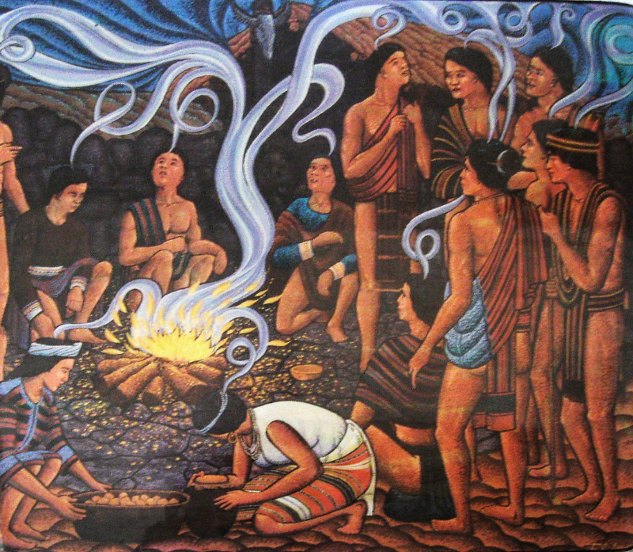
Pentecost
Bontoc Museum
Bontoc, Philippines

Slide 6
Divided tongues, as of fire, appeared among them, and a tongue rested on each of them.
Acts 2:3

Slide 7
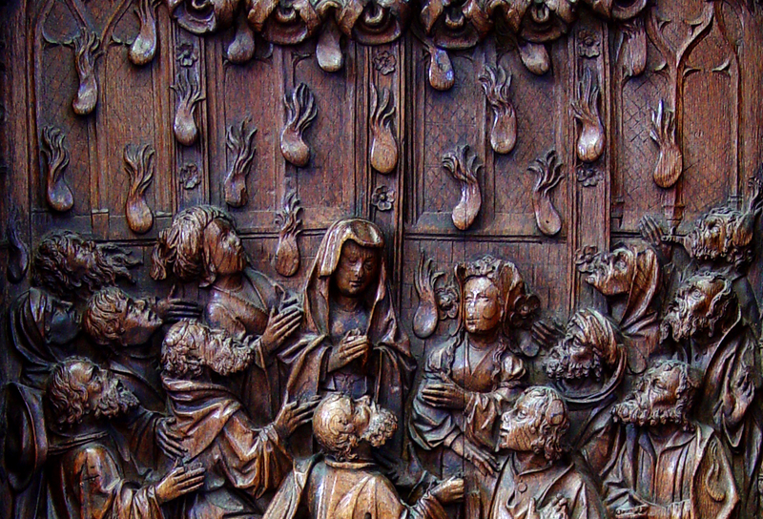
Pentecost -- Early 16th century Choirstall, Amiens Cathedral, Amiens, France

Slide 8
All of them were filled with the Holy Spirit and began to speak in other languages, as the Spirit gave them ability.
Acts 2:4

Slide 9
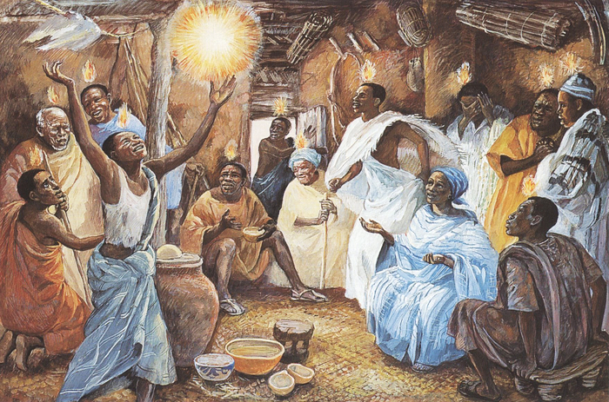
Pentecost -- JESUS MAFA, Cameroon

Slide 10
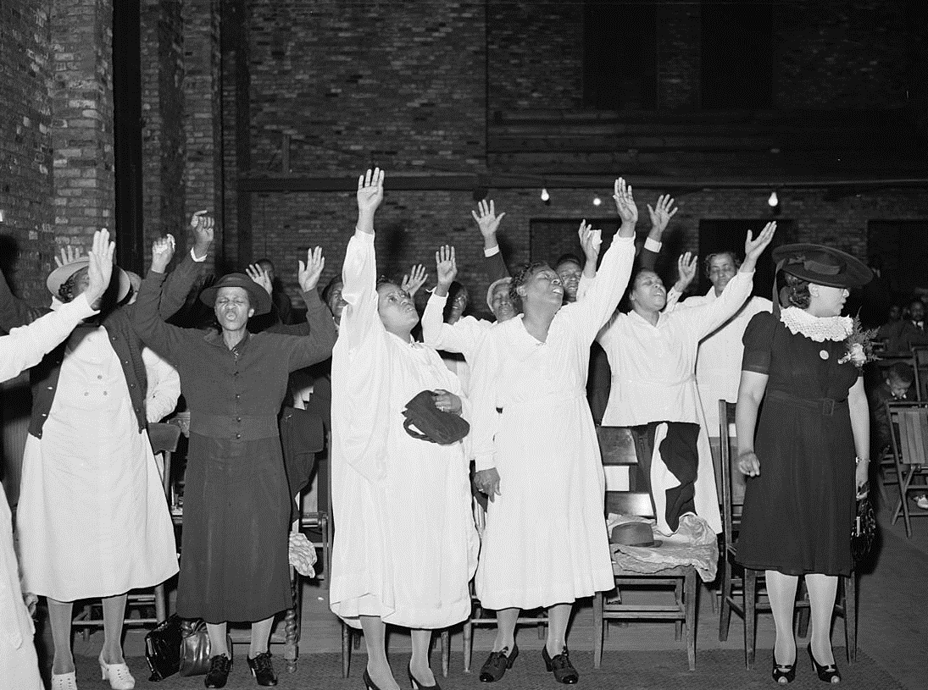
Pentecostal Worship -- Russell Lee, Chicago, IL

Slide 11
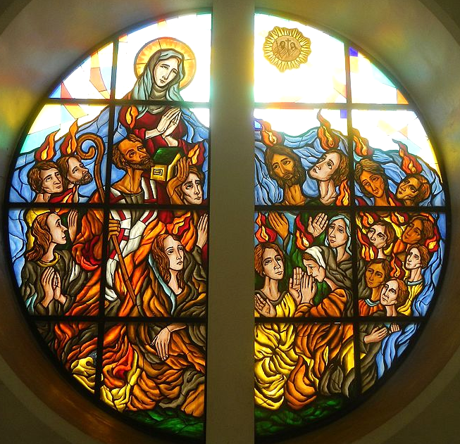
Pentecost
Our Lady of Pentecost Catholic Church Quezon City, Philippines

Slide 12
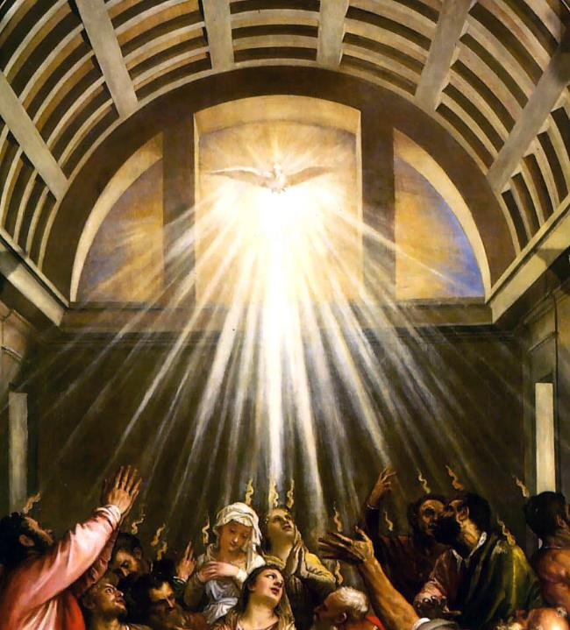
Pentecost, (detail)
Titian
St. Aloyius Somers Town London, England

Slide 13
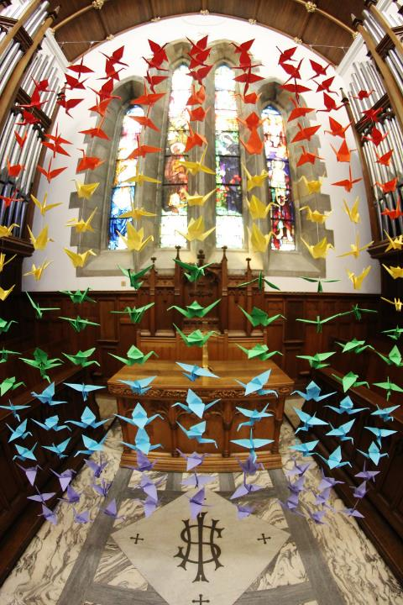
Pentecost, (detail)
Titian
St. Aloyius Somers Town London, England

Slide 14
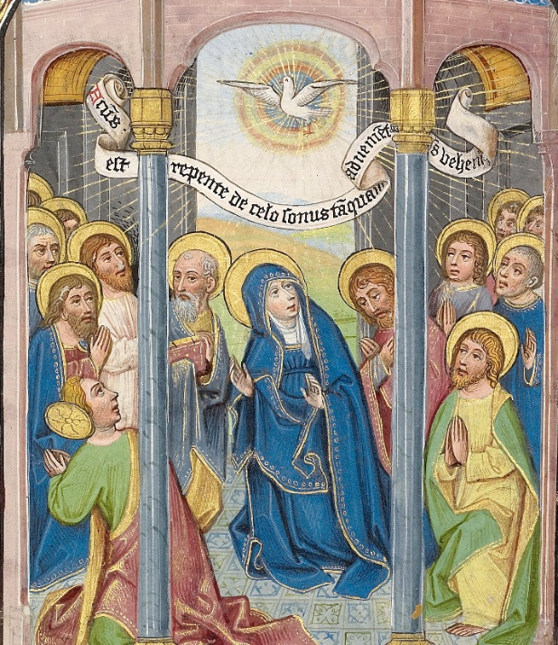
Pentecost
William Vrelant
Getty Center
Los Angeles, CA

Slide 15
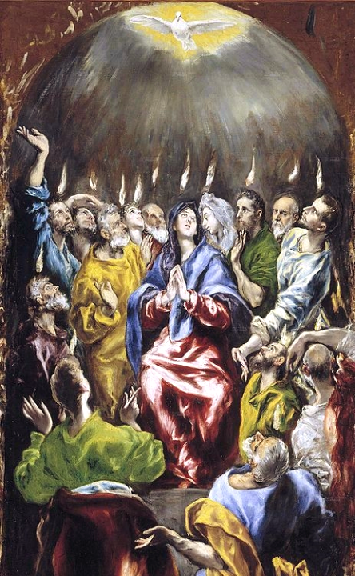
Pentecost, (detail)
El Greco
Prado Museum, Madrid, Spain

Slide 16
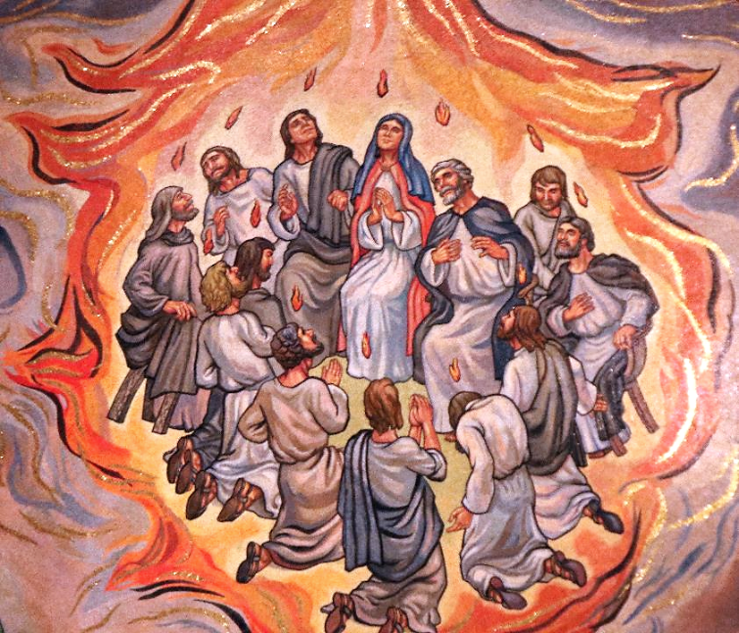
Pentecost
Cathedral of St. Louis
St. Louis, MO

Slide 17
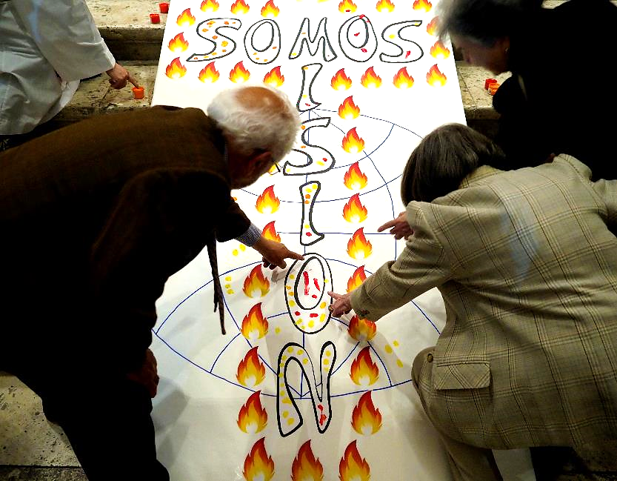
Pentecost -- Cathedral of Valladolid, Valladolid, Spain

Slide 18
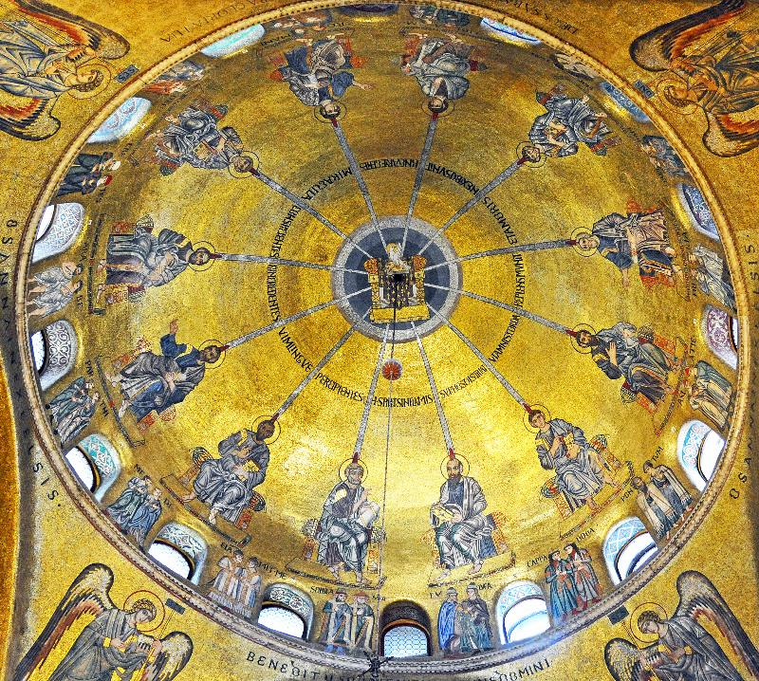
Pentecost
Mosaic
San Marco
Venice, Italy

Slide 19
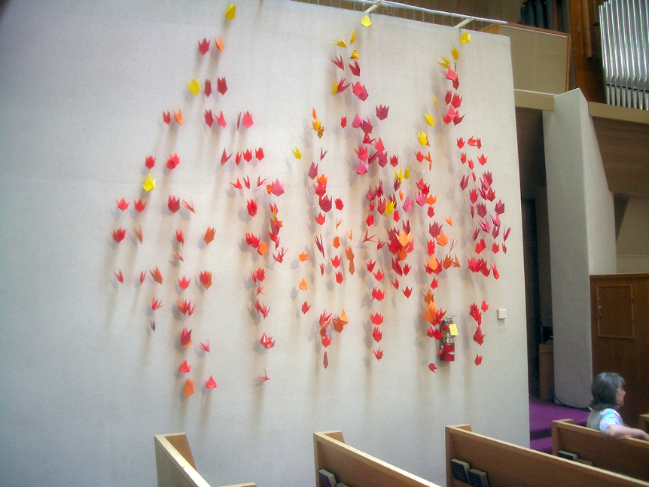
Pentecost -- First Presbyterian Church, Berkeley, CA

Slide 20
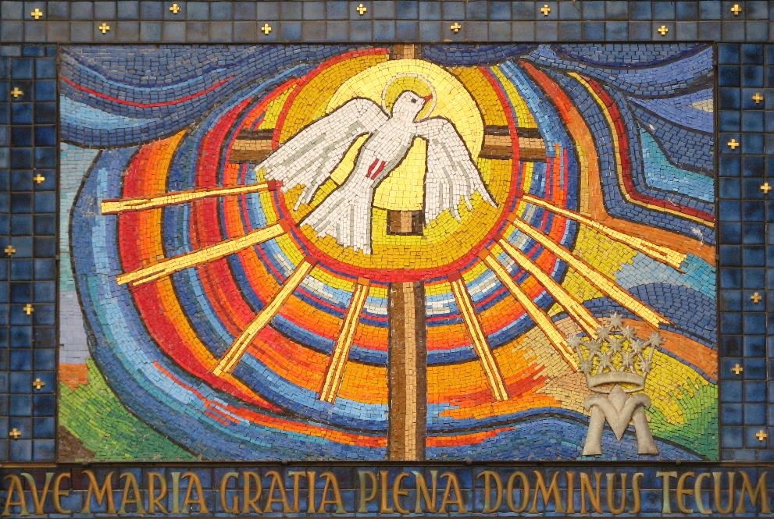
Pentecost -- Parish Church of the Mother of God, Vienna, Austria

Slide 21
Credits
New Revised Standard Version Updated Edition Bible, copyright 2022, Division of Christian Education of the National Council of the Churches of Christ in the United States of America. Used by permission. All rights reserved.
https://www.flickr.com/photos/funfilledgeorgie/14180019214/
https://www.flickr.com/photos/onbangladesh/4786279620
http://diglib.library.vanderbilt.edu/act-imagelink.pl?RC=51555
http://diglib.library.vanderbilt.edu/act-imagelink.pl?RC=48388
https://commons.wikimedia.org/wiki/File:Pentecostals_Praising.jpg
https://www.flickr.com/photos/glasgowamateur/9370166215/
https://commons.wikimedia.org/wiki/File:Willem_Vrelant_(Flemish,_died_1481,_active_1454_-_1481)_-_Pentecost_-_Google_Art_Project.jpg
https://www.flickr.com/photos/paullew/3580235485
http://www.flickr.com/photos/raymondyee/160345434/
https://www.flickr.com/photos/prayitnophotography/49932364521
https://commons.wikimedia.org/wiki/File:Pentecost%C3%A9s_(El_Greco,_1597).jpg
https://commons.m.wikimedia.org/wiki/File:Venice_SMarco_Vault2.jpg
https://commons.wikimedia.org/wiki/File:Buchengasse_11.JPG
https://commons.wikimedia.org/wiki/File:Pentecost_-_Google_Art_Project_(6793511).jpg
https://www.flickr.com/photos/archivalladolid/49428172298
Additional descriptions can be found at the Art in the Christian Tradition image library, a service of the Vanderbilt Divinity Library, http://diglib.library.vanderbilt.edu/. All images available via Creative Commons 3.0 License.

