Slide 1
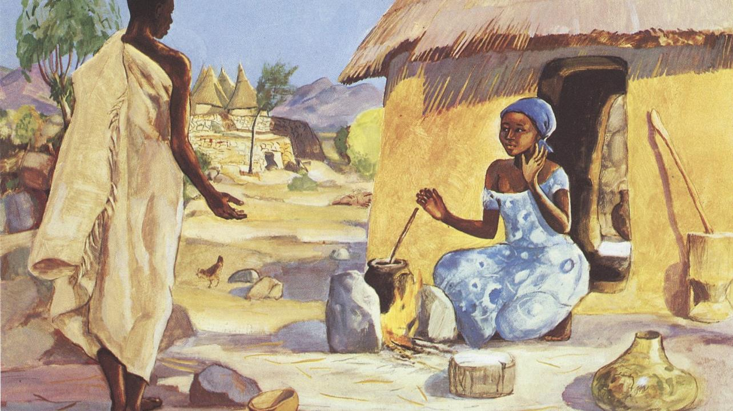
Annunciation of the Lord
Year B
Isaiah 7:10-14
Psalm 45
or Psalm 40:5-10
Hebrews 10:4-10
Luke 1:26-38

Slide 2
…the Lord himself will give you a sign. Look, the young woman is with child and shall bear a son, and shall name him Immanuel.
Isaiah 7:14

Slide 3
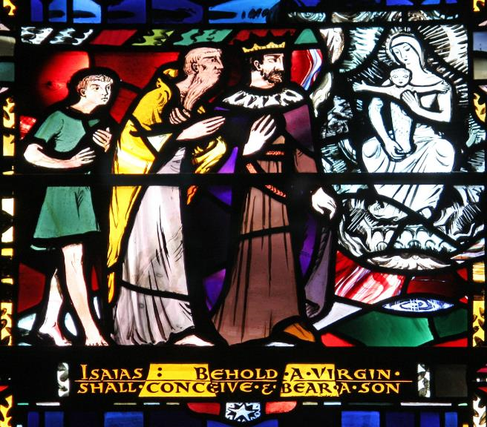
Isaiah Prophecies the Birth of Christ, Immanuel
Joseph Nuttgens, Church of St Etheldrelda, London, England

Slide 4
I will cause your name to be celebrated in all generations; therefore the peoples will praise you forever and ever.
Psalm 45:17

Slide 5
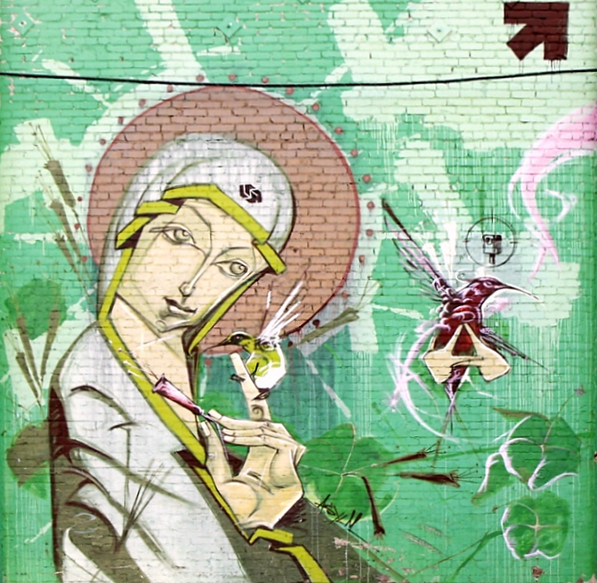
Madonna of the Hummingbirds
Mural
Los Angeles, CA

Slide 6

Mary's Song
Lauren Wright Pittman

Slide 7
"Here I am; in the scroll of the book it is written of me. I delight to do your will, O my God; your law is within my heart."
Psalm 40:7, 8

Slide 8
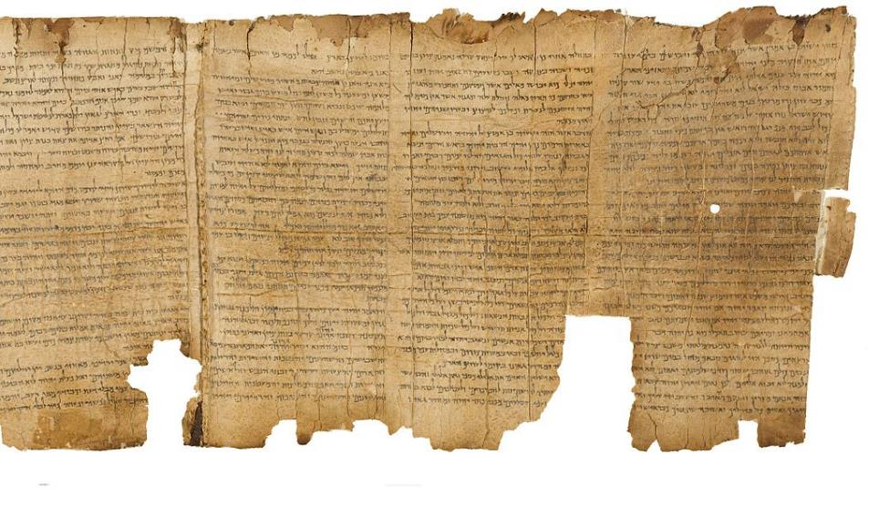
Great Isaiah Scroll -- Qumran, Israel Museum, Jerusalem, Israel

Slide 9
'See, God, I have come to do your will, O God' (in the scroll of the book it is written of me)."
Hebrews 10:7

Slide 10
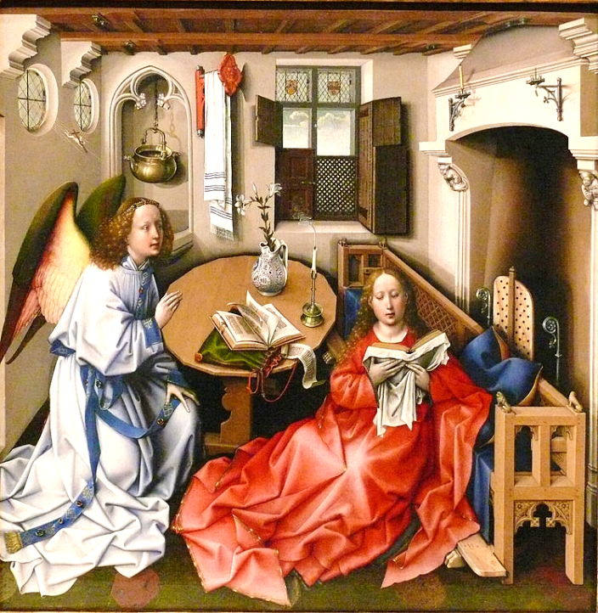
Merode Annunciation Altarpiece
Roger Campin
Metropolitan Museum of Art, New York

Slide 11
In the sixth month the angel Gabriel was sent by God to a town in Galilee called Nazareth,
Luke 1:26

Slide 12
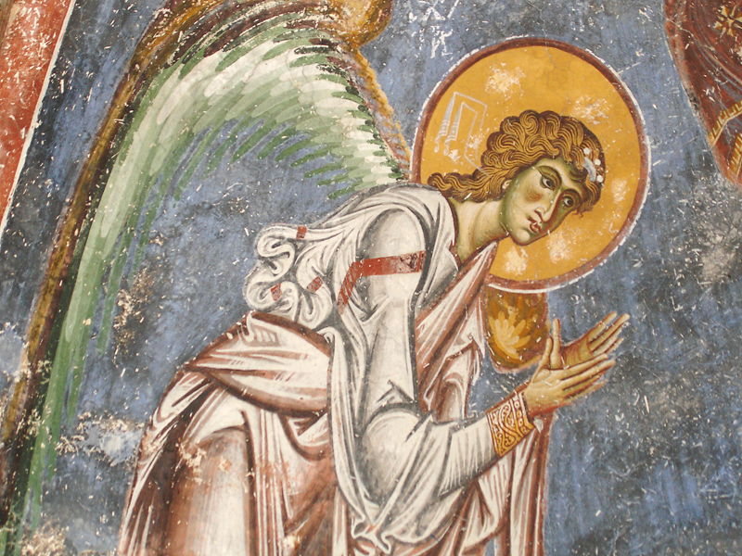
Gabriel -- St. George Church, Kurbinovo, Macedonia

Slide 13
…to a virgin engaged to a man whose name was Joseph, of the house of David.
Luke 1:27a

Slide 14
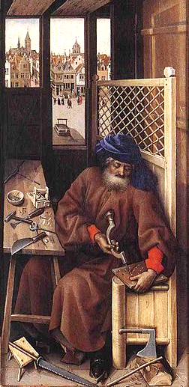
Joseph, right panel of Merode Annunciation Altarpiece
Roger Campin
Metropolitan Museum of Art, New York

Slide 15
The angel said to her, "Do not be afraid, Mary, for you have found favor with God.
Luke 1:30

Slide 16
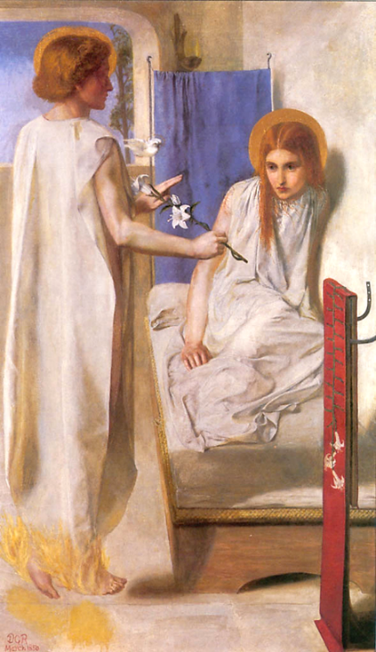
Behold the Lord’s Servant
Dante Rossetti
Tate Britain,
London

Slide 17
And now, you will conceive in your womb and bear a son, and you will name him Jesus.
Luke 1:31

Slide 18
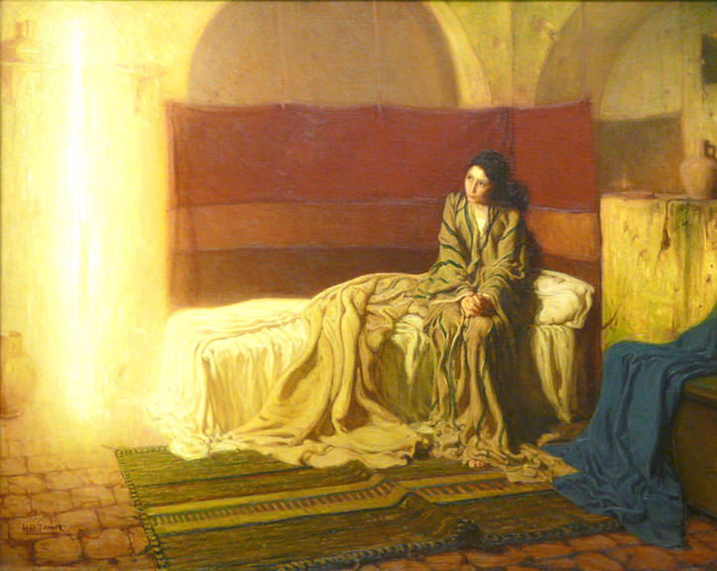
Annunciation -- Henry Ossawa Tanner, Philadelphia Museum of Art, Philadelphia, PA

Slide 19
“He will be great, and will be called the Son of the Most High, … and of his kingdom there will be no end."
Luke 1:32a, 33b

Slide 20
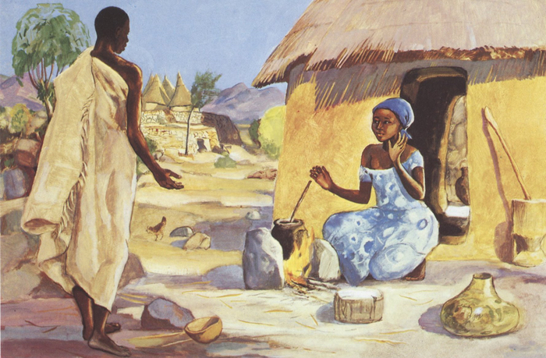
Annunciation -- JESUS MAFA, Cameroon

Slide 21
The angel said to her, "The Holy Spirit will come upon you, and the power of the Most High will overshadow you…
Luke 1:35a

Slide 22
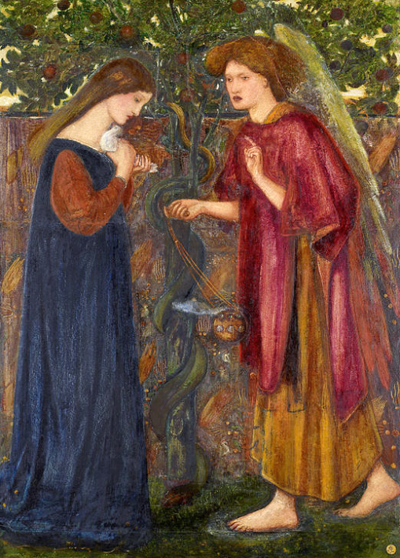
The Annunciation
Edward Burne-Jones Birmingham Museum Birmingham, England

Slide 23
…therefore the child to be born will be holy; he will be called Son of God.”
Luke 1:35b

Slide 24
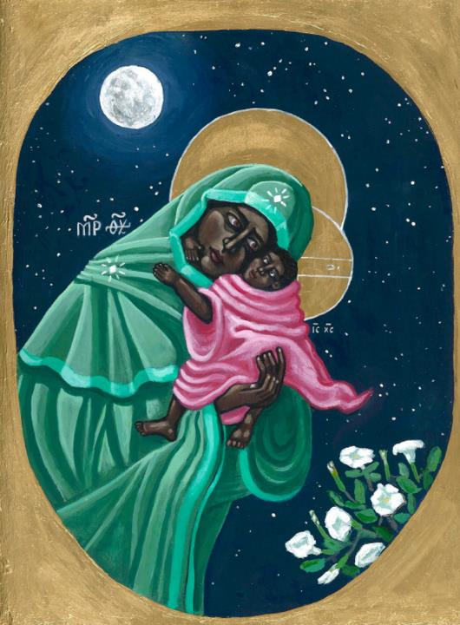
Madonna and Child
Kelly Latimore

Slide 25
“And now, your relative Elizabeth in her old age has also conceived a son; … For nothing will be impossible with God."
Luke 1:36a, 37

Slide 26

1:38 Then Mary said, "Here am I, the servant of the Lord; let it be with me according to your word."
Visit of Mary to Elizabeth
Keur Moussa Abbey
Senegal

Slide 27
Then Mary said, "Here am I, the servant of the Lord; let it be with me according to your word."
Luke 1:38a

Slide 28
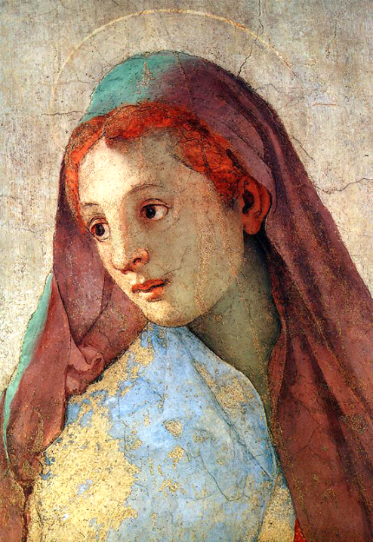
1:38 Then Mary said, "Here am I, the servant of the Lord; let it be with me according to your word."
Annunciation, detail of Mary
Jacopo da Pontormo
Chiesa di Santa Felicita,
Florence, Italy

Slide 29
Credits
New Revised Standard Version Updated Edition Bible, copyright 2022, Division of Christian Education of the National Council of the Churches of Christ in the United States of America. Used by permission. All rights reserved.
http://www.flickr.com/photos/paullew/2838876113 - Brother Lawrence, OP
http://www.flickr.com/photos/jondoeforty1/6948838498
http://www.lewpstudio.com - copyright by Lauren Wright Pittman
https://commons.wikimedia.org/wiki/File:The_Great_Isaiah_Scroll_MS_A_(1QIsa)_-_Google_Art_Project-x4-y0.jpg
http://commons.wikimedia.org/wiki/File:Kurbinovo_4.JPG
https://commons.wikimedia.org/wiki/File:Campin_Annunciation_triptych.jpg
https://commons.wikimedia.org/wiki/File:Campin_merode_altarpiece_right_panel.jpg
https://commons.wikimedia.org/wiki/File:Rossetti_Ecce_Ancilla.JPG
http://www.flickr.com/photos/ebarney/4762865759/
http://diglib.library.vanderbilt.edu/act-imagelink.pl?RC=48278
https://commons.wikimedia.org/wiki/File:Edward_Burne-Jones_-_The_Annunciation_-_Google_Art_Project.jpg
https://commons.wikimedia.org/wiki/File:A_japanese_madonna_-_1900_-_Helen_Hyde.jpg
https://kellylatimoreicons.com/contact/
https://commons.wikimedia.org/wiki/File:KeurMoussaAutel.jpg
http://www.flickr.com/photos/8545333@N07/2236199623/
Additional descriptions can be found at the Art in the Christian Tradition image library, a service of the Vanderbilt Divinity Library, http://diglib.library.vanderbilt.edu/. All images available via Creative Commons 3.0 License.

