Slide 1
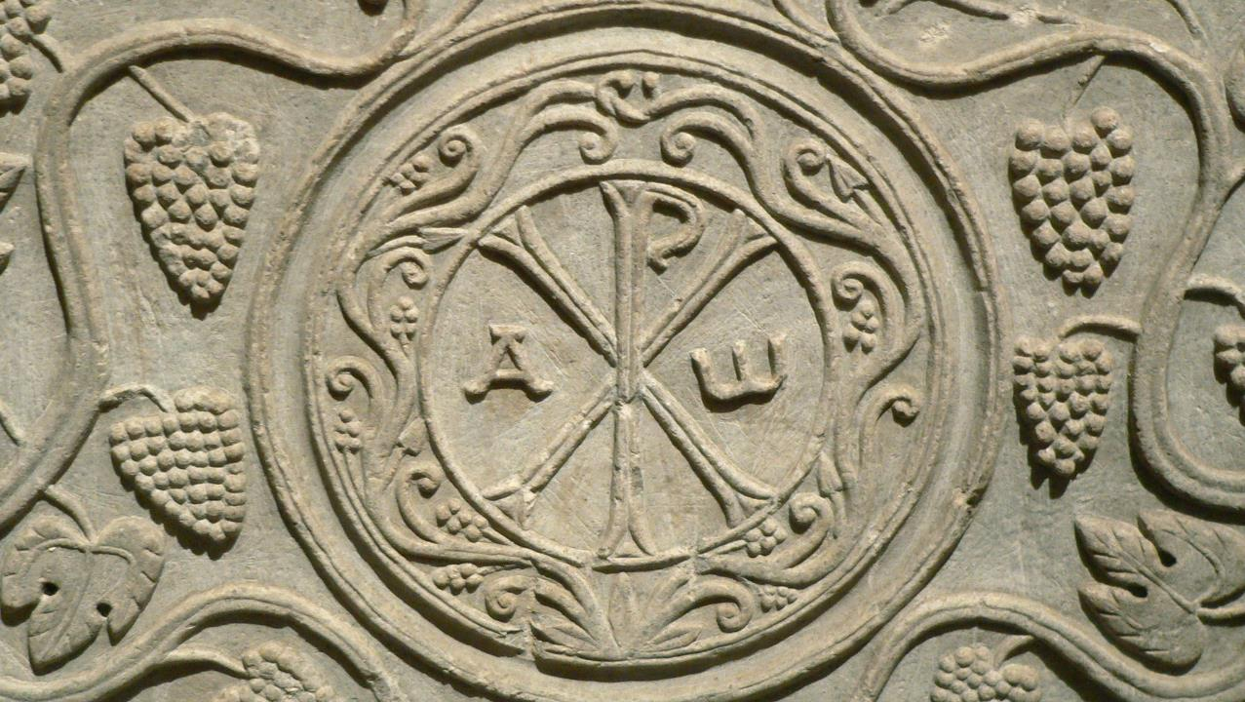
Trinity Sunday
Year A
Genesis 1:1-2:4a • Psalm 8 • 2 Corinthians 13:11-13
Matthew 28:16-20

Slide 2
When God began to create the heavens and the earth, the earth was complete chaos, and darkness covered the face of the deep…
Genesis 1:1-2a

Slide 3
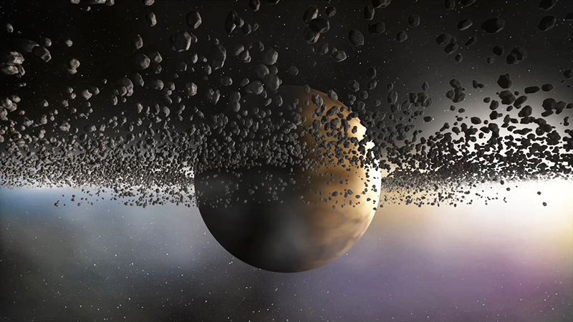
In the Beginning… -- Seth Drum, Digital work

Slide 4
Then God said, "Let there be light," and there was light. …God separated the light from the darkness.
Genesis 1:3, 4b

Slide 5
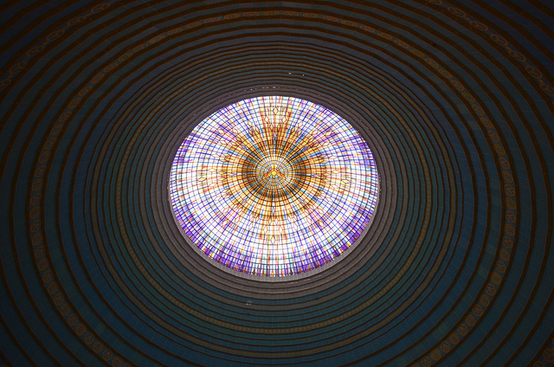
Basilica of Our Lady of Peace -- Yamoussoukro, Ivory Coast

Slide 6
And God said, “Let there be a dome in the midst of the waters, and let it separate the waters from the waters.” …. God called the dome Sky.
Genesis 1:6, 8a

Slide 7
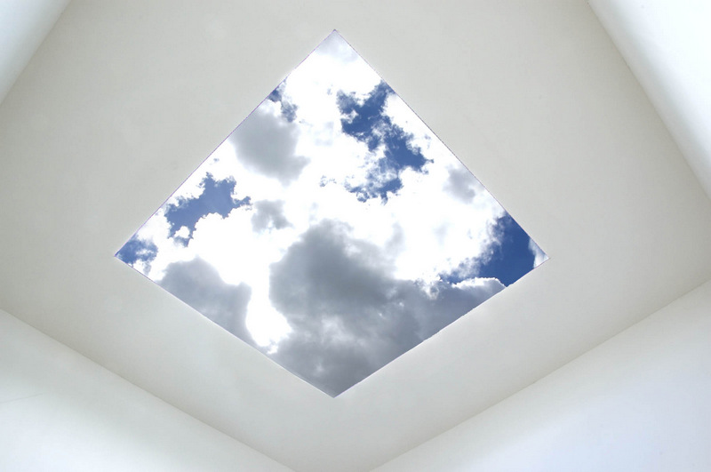
Skyspace -- James Turrell, Live Oak Meeting House, Society of Friends, Houston, TX

Slide 8
And God said, “…let the dry land appear. … Let the earth put forth vegetation: plants yielding seed and fruit trees of every kind…”
Genesis 1:9a, 11a

Slide 9
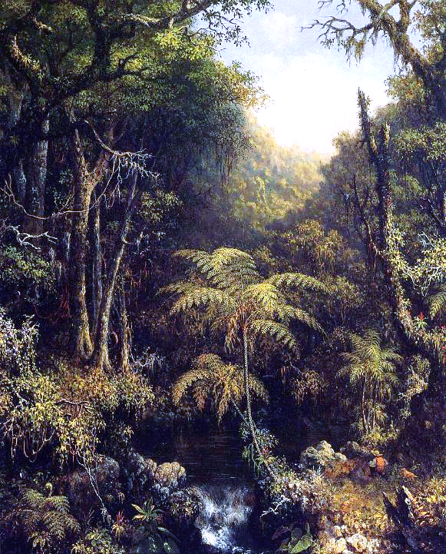
Brazilian Forest
Martin Johnson Heade
RISD Museum
Providence, RI

Slide 10
And God said, "Let there be lights in the dome of the sky to separate the day from the night...." God made the two great lights—the greater light to rule the day and the lesser light to rule the night…
Genesis 1:14a, 16a

Slide 11
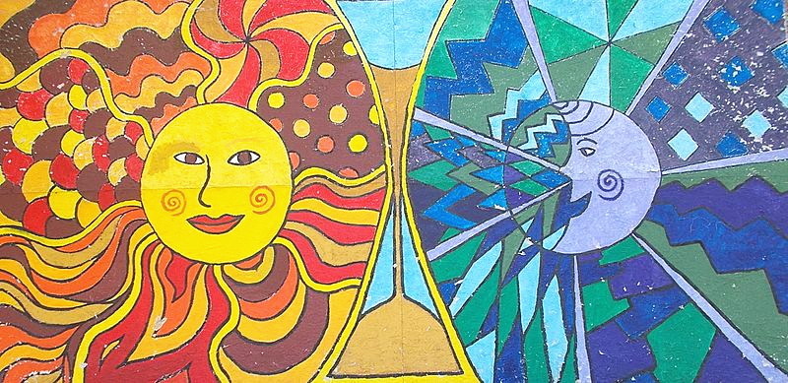
Sun and Moon -- Nagy Community Center, Budapest, Hungary

Slide 12
And God said, "Let the waters bring forth swarms of living creatures, and let birds fly above the earth across the dome of the sky."
Genesis 1:20

Slide 13
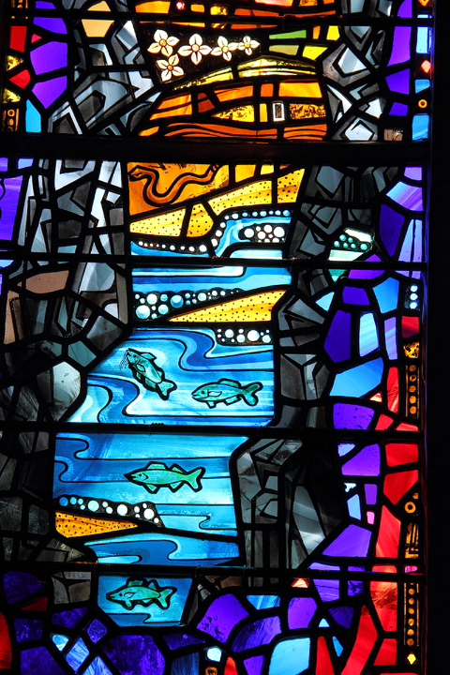
The Beauty of Creation
Irene and Rowan LeCompte
National Cathedral
Washington, DC

Slide 14
And God said, "Let the earth bring forth living creatures of every kind: cattle and creeping things and wild animals of the earth of every kind."
Genesis 1:24

Slide 15
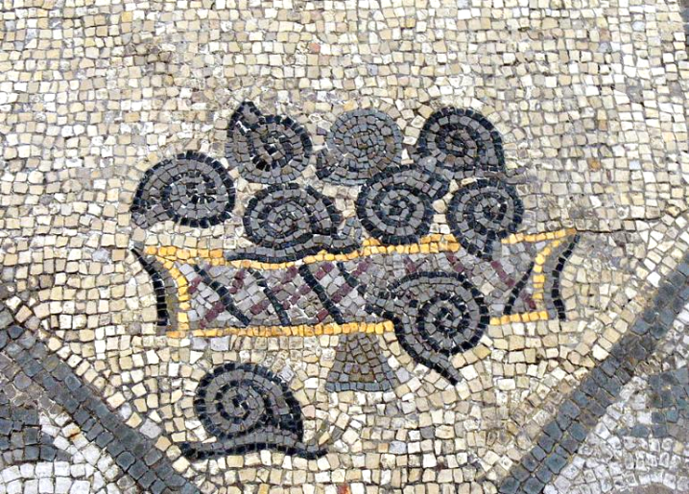
Snails -- Floor mosaic, Basilica of Aquileia, Aquileia, Udine, Italy

Slide 16
Then God said, "Let us make humans in our image, according to our likeness.... in the image of God he created them; male and female he created them.
Genesis 1:26a, 27b

Slide 17
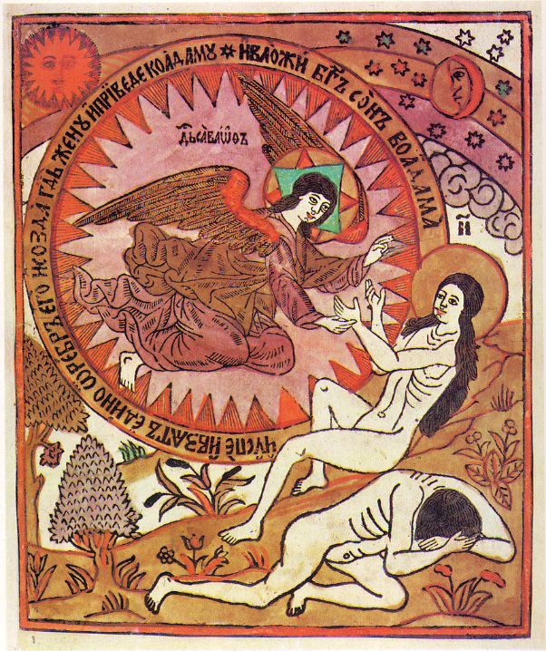
Creation of Adam and Eve
Russian Lubock Woodcut, 1792

Slide 18
And on the sixth day God finished the work that he had done, and he rested on the seventh day from all the work that he had done.
Genesis 2:2

Slide 19
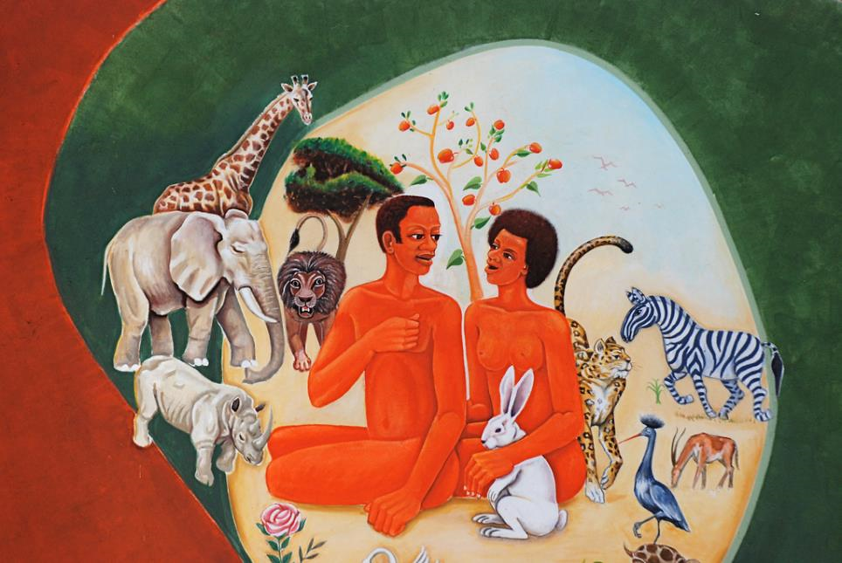
St. Mathias Mulumba Kalemba Metropolitan Cathedral, Songea, Tanzania

Slide 20
When I look at your heavens, the work of your fingers, the moon and the stars that you have established…. how majestic is your name in all the earth!
Psalm 8:3, 9b

Slide 21
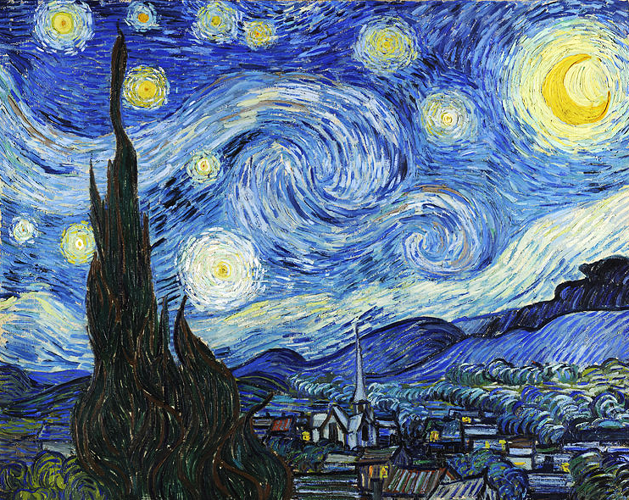
Starry Night -- Vincent van Gogh, Museum of Modern Art, New York, NY

Slide 22
Finally, brothers and sisters.… live in peace; and the God of love and peace will be with you.
2 Corinthians 13:11ac

Slide 23
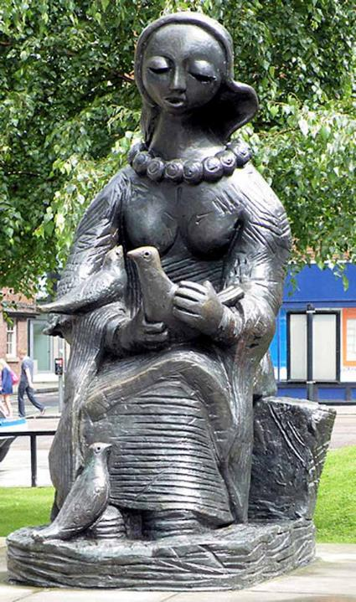
Messenger of Peace
Barbara Pearson
Manchester, England

Slide 24
"And remember, I am with you always, to the end of the age."
Matthew 28:20b

Slide 25
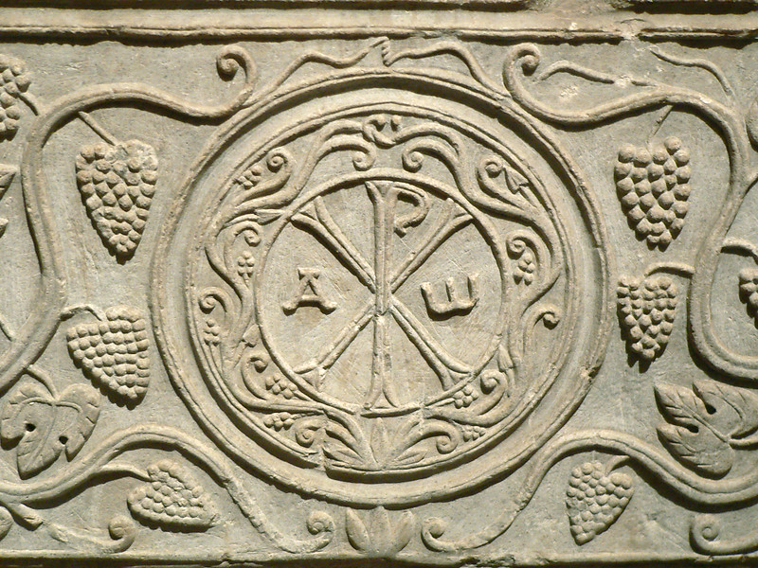
Alpha and Omega -- Drausin Sarcophagus, Louvre Museum, Paris, France

Slide 26
Credits
New Revised Standard Version Updated Edition Bible, copyright 2022, Division of Christian Education of the National Council of the Churches of Christ in the United States of America. Used by permission. All rights reserved.
https://www.flickr.com/photos/seth_drum/34308713902
https://www.flickr.com/photos/jbdodane/9626795639/
http://www.flickr.com/photos/21804434@N02/5394865139
https://commons.wikimedia.org/wiki/File:Brazilian_Forest.jpg
https://commons.wikimedia.org/wiki/File:Sun_and_Moon,_Nagy_Imre_Community_Centre,_2016_Csepel-Csillagtelep.jpg
https://commons.wikimedia.org/wiki/File:Stained_glass_window_Washington_National_Cathedral_2012_06.JPG - Caroline Lena Becker
https://commons.wikimedia.org/wiki/File:Aquileia_Basilica_-_Ausgrabungen_Mosaik_11.jpg – Wolfgang Sauber
https://commons.wikimedia.org/wiki/File:Adam_and_Eve_Lubok.jpg
https://www.flickr.com/photos/dominikkustra/4013203751
https://commons.wikimedia.org/wiki/File:Van_Gogh_-_Starry_Night_-_Google_Art_Project.jpg
https://commons.wikimedia.org/wiki/File:Messenger_of_Peace_-_geograph.org.uk_-_1419312.jpg
https://commons.wikimedia.org/wiki/Category:Drausin_sarcophagus#/media/File:Sarcophage_de_Drausin_03.JPG
Additional descriptions can be found at the Art in the Christian Tradition image library, a service of the Vanderbilt Divinity Library, http://diglib.library.vanderbilt.edu/. All images available via Creative Commons 3.0 License.

