Slide 1
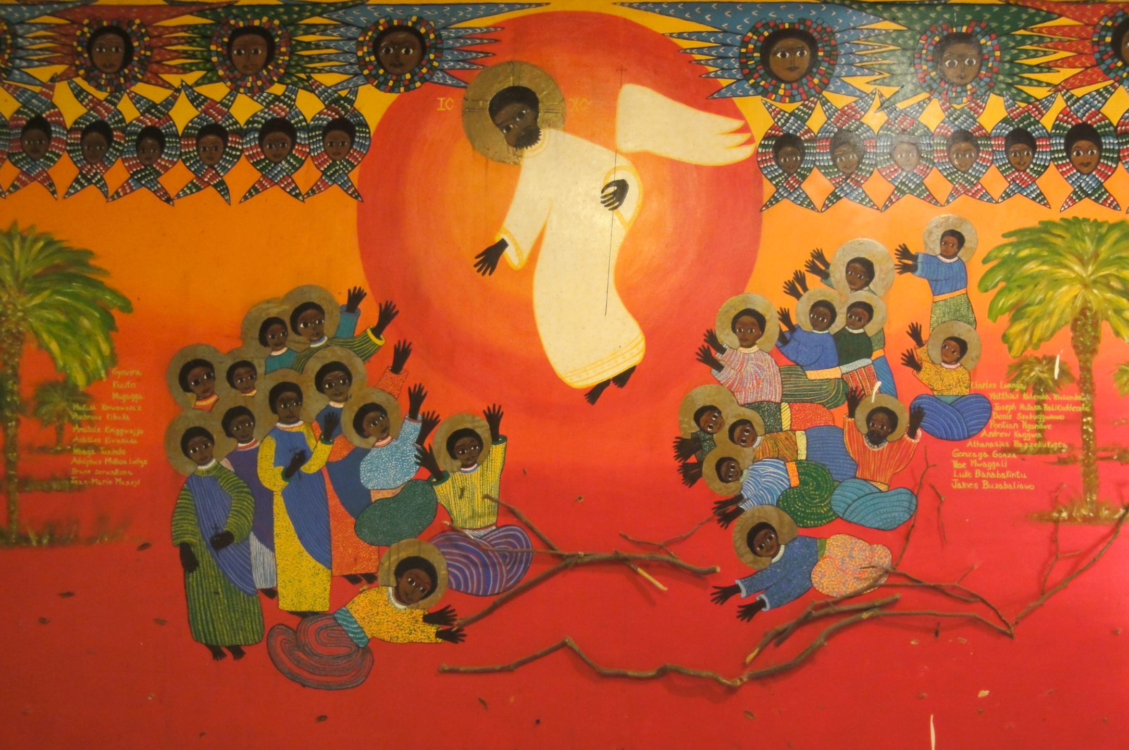
Third Sunday of Easter
Year A
Acts 2:14a, 36-41 • Psalm 116:1-4, 12-19 • 1 Peter 1:17-23
Luke 24:13-35

Slide 2
Peter said to them, "Repent, and be baptized…in the name of Jesus Christ…, and you will receive the gift of the Holy Spirit.”
Acts 2:38

Slide 3
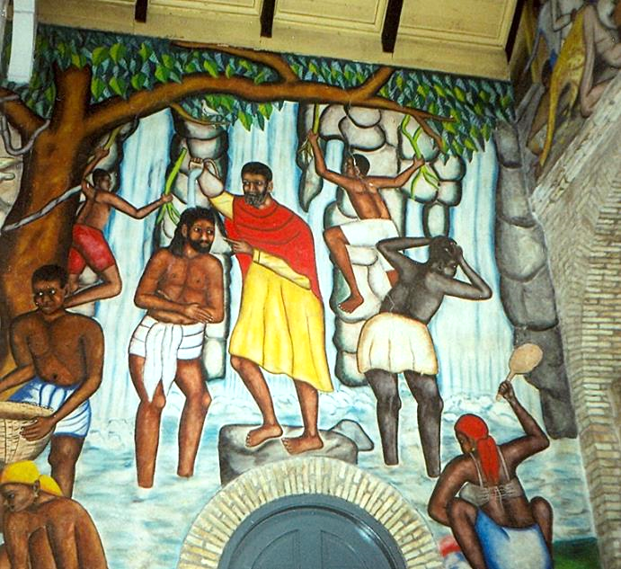
Baptism of Christ
Castera Bazile
Cathedrale de Sainte Trinite
Port-au-Prince, Haiti

Slide 4
O LORD, I am your servant; I am your servant, the child of your serving girl. You have loosed my bonds.
Psalm 116:16

Slide 5
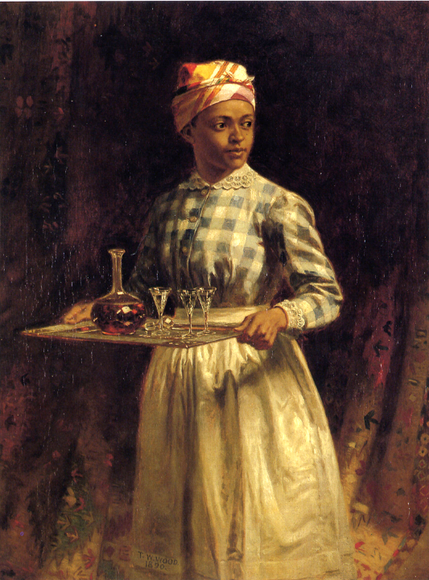
Sherry, Sir
Thomas Waterman Wood Detroit Institute of Art
Detroit, MI

Slide 6
Now that you have…genuine mutual affection, love one another deeply from the heart.
1 Peter 1:22a,c

Slide 7
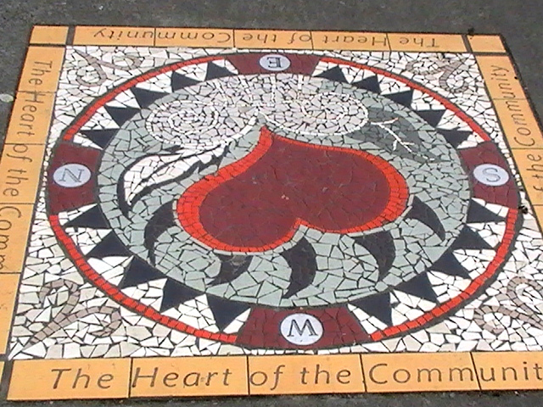
Heart of the Community Street mosaic, East Hastings, Vancouver

Slide 8
Now on that same day two of them were going to a village called Emmaus…. While they were talking and discussing, Jesus himself came near…
Luke 24:13a, 15a

Slide 9
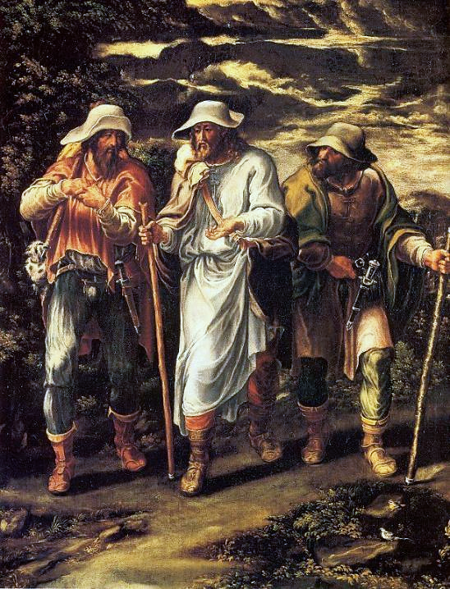
Road to Emmaus
Lelio Orsi,
National Gallery London

Slide 10
...and went with them, but their eyes were kept from recognizing him.
Luke 24:15c-16

Slide 11
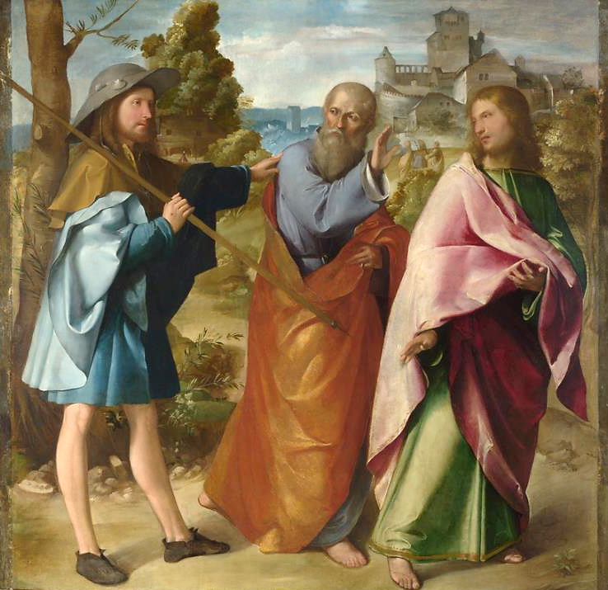
Road to Emmaus
Altobello Melone
National Gallery London

Slide 12
And he said to them, "What are you discussing with each other while you walk along?" …. "The things about Jesus of Nazareth, who was a prophet mighty in deed and word…"
Luke 24:17a, 19b

Slide 13
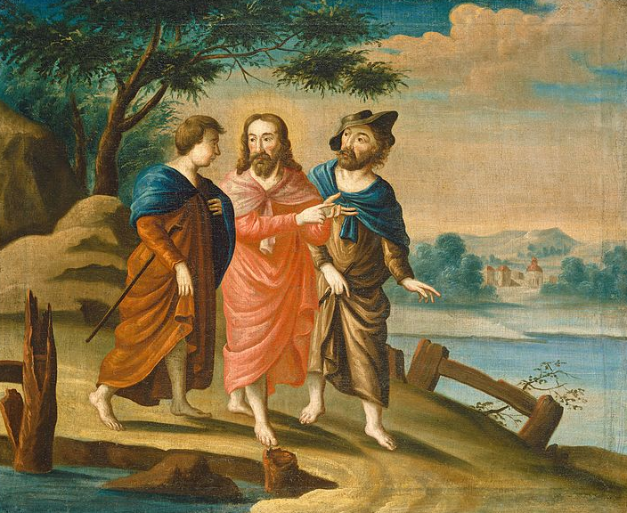
Road to Emmaus -- American, early 18th c., National Gallery of Art, DC

Slide 14
Then one of them…answered him, "Are you the only stranger in Jerusalem who does not know the things that have taken place…?”
Luke 24:18

Slide 15
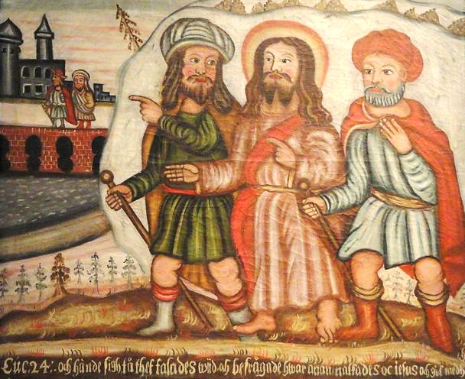
Road to Emmaus -- National Museum of Finland, Helsinki

Slide 16
Then he said to them, "…. Was it not necessary that the Messiah should suffer these things and then enter into his glory?"
Luke 24:25a, 26

Slide 17
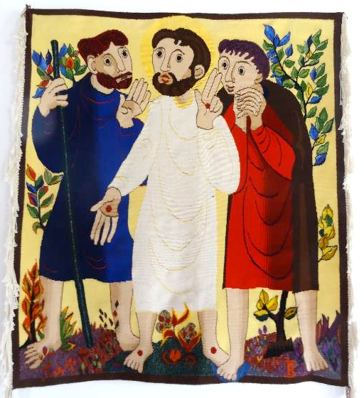
Road to Emmaus
Bose Orthodox Monastery Magnano, Italy

Slide 18
But they urged him strongly, saying, "Stay with us, because it is almost evening and the day is now nearly over."
Luke 24:29a

Slide 19
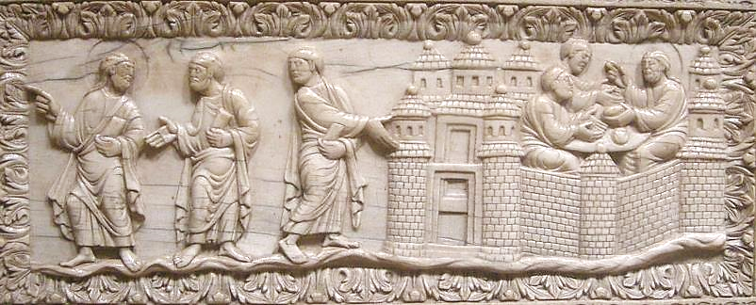
Road to Emmaus -- Carolingian, 9th c., Cloisters Museum, New York

Slide 20
When he was at the table with them, he took bread, blessed and broke it, and gave it to them.
Luke 24:30

Slide 21
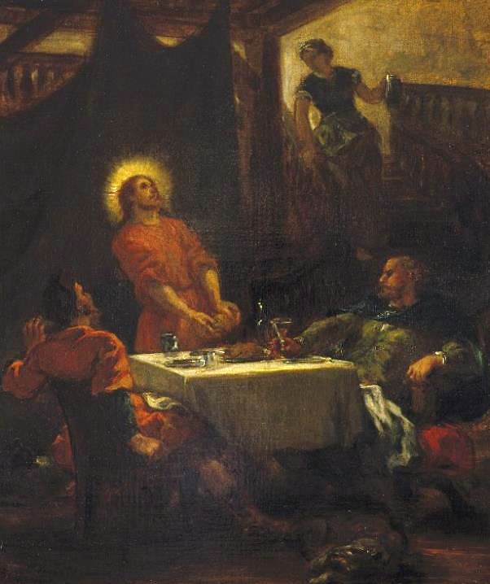
Disciples at Emmaus
Eugene Delacroix Brooklyn Museum
New York

Slide 22
Then their eyes were opened...
Luke 24:31a

Slide 23
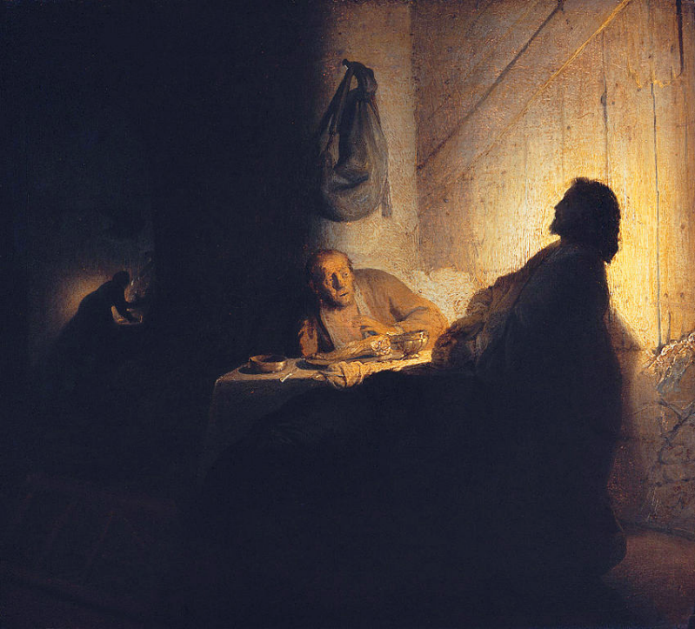
Supper at Emmaus
Rembrandt Musée Jacquemart-André
Paris, France

Slide 24
...and they recognized him...
Luke 24:31b

Slide 25
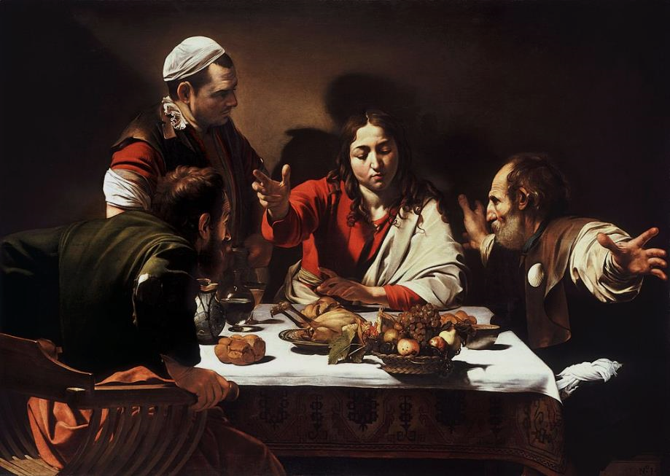
Supper at Emmaus -- Caravaggio, National Gallery, London

Slide 26
...and he vanished from their sight.
Luke 24:31c

Slide 27
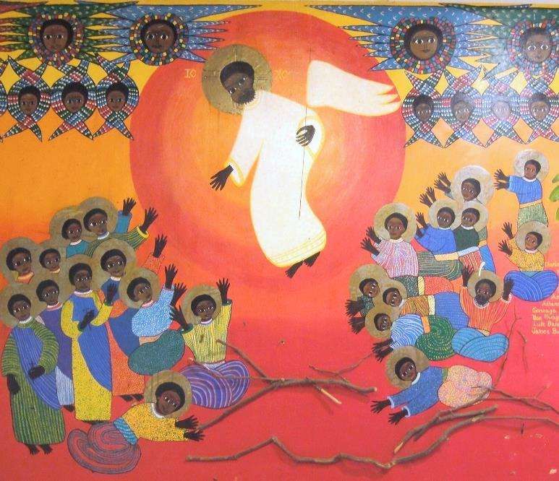
Martyrs of Uganda
Emmaus House Kamapala, Uganda

Slide 28
Credits
New Revised Standard Version Updated Edition Bible, copyright 2022, Division of Christian Education of the National Council of the Churches of Christ in the United States of America. Used by permission. All rights reserved.
http://commons.wikimedia.org/wiki/File:PortAuPrinceMural.jpg
http://www.flickr.com/photos/freeparking/2224821427/
https://commons.wikimedia.org/wiki/File:Heart_of_the_Community_mural.jpeg
https://commons.wikimedia.org/wiki/File:Lelio_Orsi_Camino_de_Ema%C3%BAs.jpg
https://commons.wikimedia.org/wiki/File:Christ_on_the_Road_to_Emmaus_G-001552-20120605.jpg
https://commons.wikimedia.org/wiki/File:On_the_Road_to_Emmaus_by_Lars_Gallenius,_1684,_Raahe_C
hurch_-_National_Museum_of_Finland_-_DSC04246.JPG
http://commons.wikimedia.org/wiki/File:Altobello_Melone_-_The_Road_to_Emmaus_-_Google_Art_Project.jpg
https://www.flickr.com/photos/jimforest/15277775371
https://commons.wikimedia.org/wiki/File:Lotharingia_(metz),_placca_d%27avorio_con_scene_a_emmaus,_850-900_circa_(carolingio).JPG
https://commons.wikimedia.org/wiki/File:Brooklyn_Museum_-_The_Disciples_at_Emmaus_or_The_Pilgrims_at_Emmaus_(Les_disciples_d%27Emma%C3%BCs_ou_Les_p%C3%A8lerins_d%27Emma%C3%BCs)_-_Eug%C3%A8ne_Delacroix.jpg
https://commons.wikimedia.org/wiki/File:The_Supper_at_Emmaus,_by_Rembrandt.jpg
https://commons.wikimedia.org/wiki/File:Supper_at_Emmaus-Caravaggio_(1601).jpg
https://www.flickr.com/photos/jimforest/5710252358
Additional descriptions can be found at the Art in the Christian Tradition image library, a service of the Vanderbilt Divinity Library, http://diglib.library.vanderbilt.edu/. All images available via Creative Commons 3.0 License.

