Slide 1
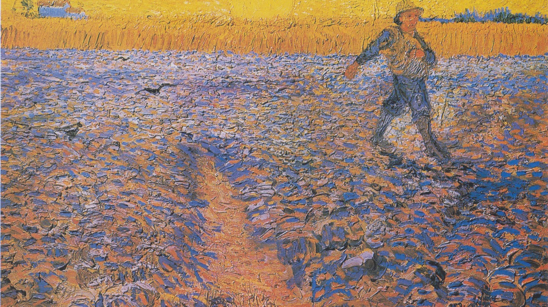
Thanksgiving Day
Year A
Deuteronomy 8:7-18 and Psalm 65 • 2 Corinthians 9:6-15 Luke 17:11-19

Slide 2
For the LORD your God is bringing you into a good land, …a land whose stones are iron and from whose hills you may mine copper.
Deuteronomy 8:7a, 9b

Slide 3

Miner, Pennsylvania
WPA Poster
Library of Congress
Washington, DC

Slide 4
Those who live at earth's farthest bounds are awed by your signs;
you make the gateways of the morning and the evening shout for joy.
Psalm 65:8

Slide 5
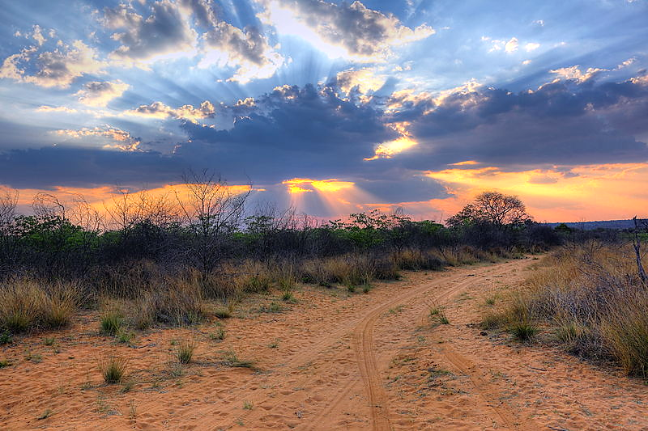
Sunset -- Heinrich Pniok, Waterberg Plateau, Namibia

Slide 6
The river of God is full of water;
you provide the people with grain,
for so you have prepared it.
Psalm 65:9b

Slide 7
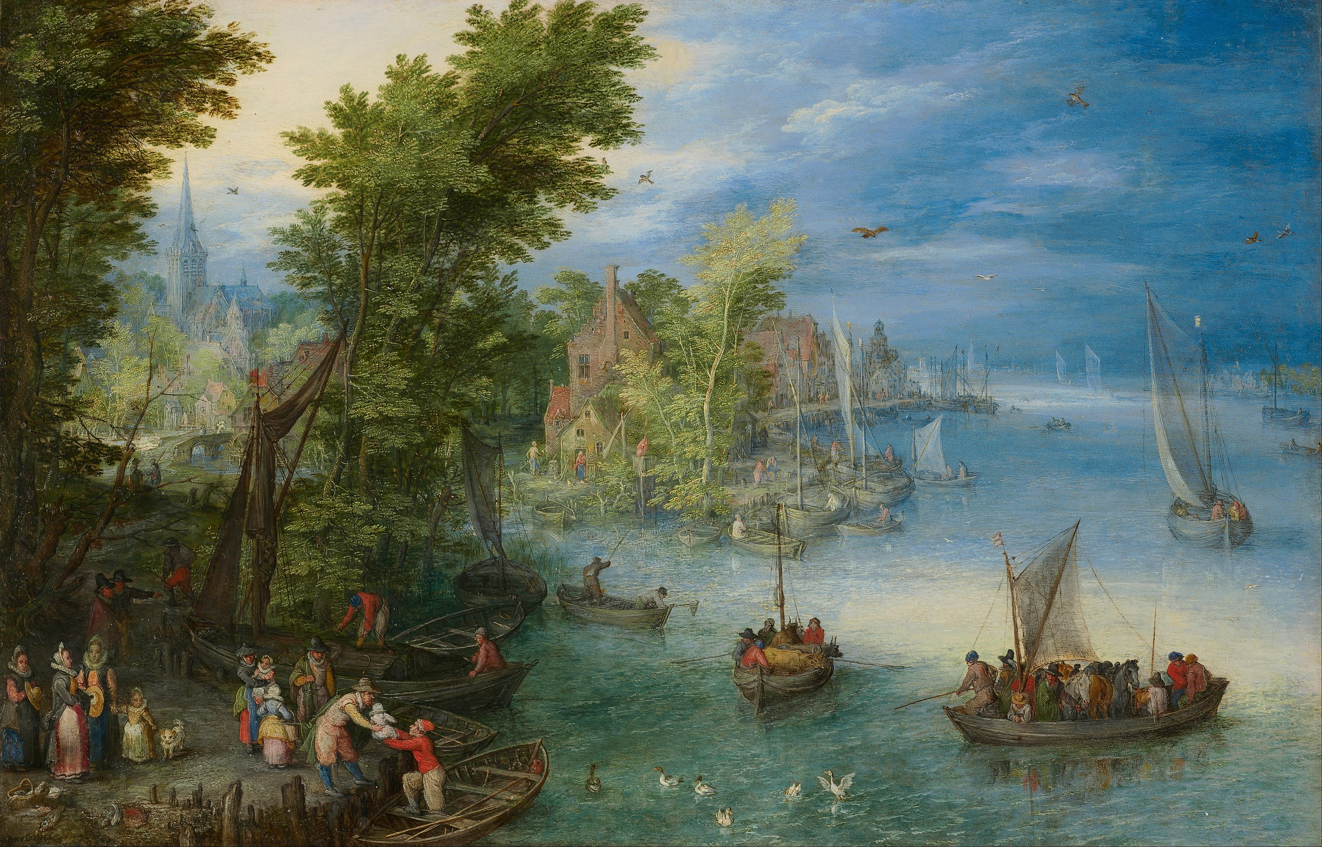
River Landscape -- Jan Bruegel

Slide 8
You water its furrows abundantly,
settling its ridges,
softening it with showers,
and blessing its growth.
Psalm 65:10

Slide 9
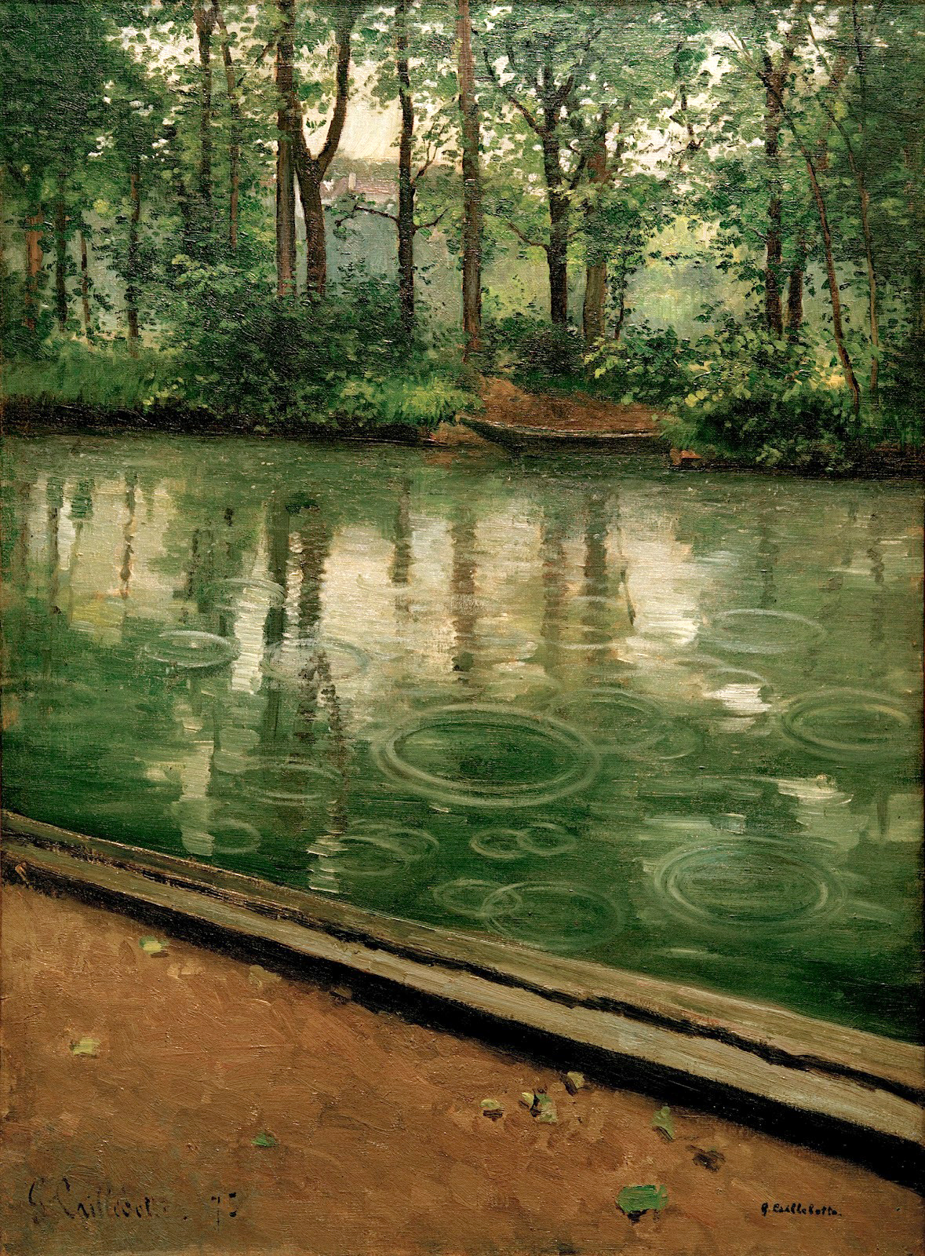
Yerres, the Effect of Rain
Gustave Caillebotte

Slide 10
The pastures of the wilderness overflow;
the hills gird themselves with joy;
Psalm 65:12

Slide 11
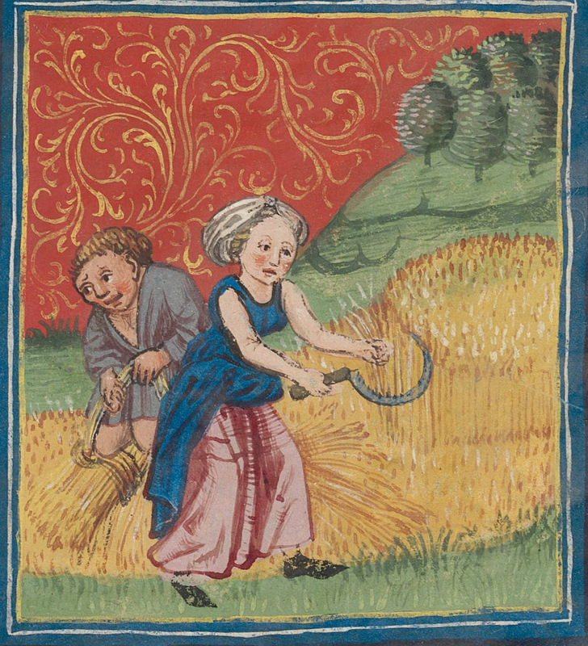
Scene from Labors of the Month, August
Manuscript illumination
Zentralbibliothek, Zurich

Slide 12
He who supplies seed to the sower and bread for food will supply and multiply your seed for sowing and increase the harvest of your righteousness.
2 Corinthians 9:10

Slide 13
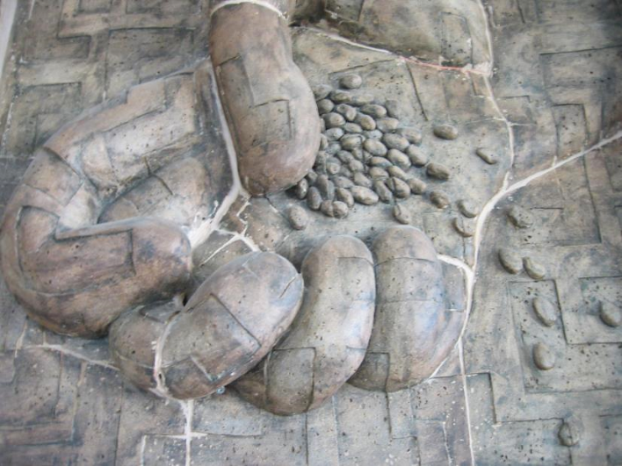
Sowing Seed -- Unidentified church sculpture, Taiwan

Slide 14
And God is able to provide you with every blessing in abundance, so that by always having enough of everything, you may share abundantly in every good work.
2 Corinthians 9:8

Slide 15
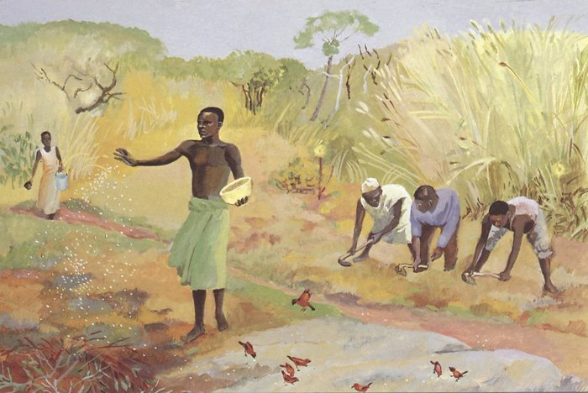
Parable of the Sower -- JESUS MAFA, Cameroon

Slide 16
Ten men with a skin disease called out, saying, “Jesus, Master, have mercy on us!”
Luke 17: 12a, 13

Slide 17
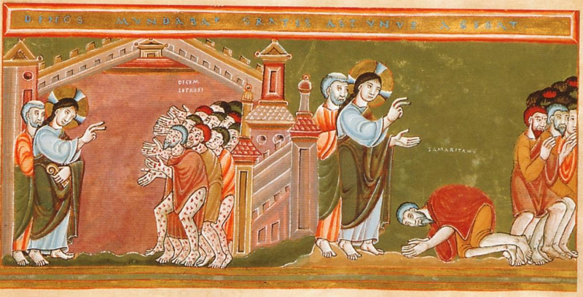
Christ and the Lepers -- From the Codex Aureus Epternacensis

Slide 18
Then Jesus asked, “Were not ten made clean? So where are the other nine? Did none of them return to give glory to God except this foreigner?
Luke 17:17-18

Slide 19
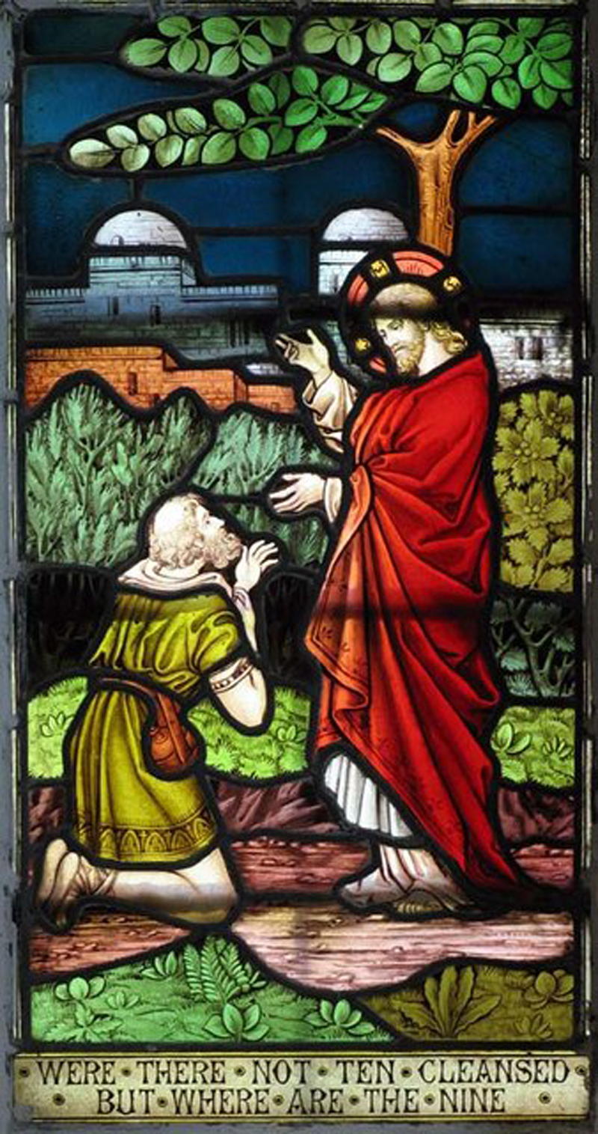
Christ with the Grateful Samaritan Leper
St. Andrew Church, United Kingdom

Slide 20
Credits
New Revised Standard Version Updated Edition Bible, copyright 2022, Division of Christian Education of the National Council of the Churches of Christ in the United States of America. Used by permission. All rights reserved.
https://commons.wikimedia.org/wiki/File:Van_Gogh_-_S%C3%A4mann_bei_untergehender_Sonne.jpeg
https://commons.wikimedia.org/wiki/File:Pennsylvania_LCCN98518434.tif
https://commons.m.wikimedia.org/wiki/File:Crepuscular_rays_at_Sunset_near_Waterberg_Plateau.jpg
http://commons.wikimedia.org/wiki/File:Jan_Brueghel_the_Elder_-_River_Landscape_-_Google_Art_Project.jpg
http://commons.wikimedia.org/wiki/File:G._Caillebotte_-_L%27Yerres,_pluie.jpg
https://diglib.library.vanderbilt.edu/act-imagelink.pl?RC=55881
https://www.flickr.com/photos/benny_lin/266525738
http://www.librairie-emmanuel.fr (contact page: https://www.librairie-emmanuel.fr/contact)
http://commons.wikimedia.org/wiki/File:CodexAureus_Cleansing_of_the_ten_lepers.jpg
https://commons.wikimedia.org/wiki/File:St_Andrew,_Buckland,_Herts_-_Window_-_geograph.org.uk_-_368076.jpg
Additional descriptions can be found at the Art in the Christian Tradition image library, a service of the Vanderbilt Divinity Library, http://diglib.library.vanderbilt.edu/. All images available via Creative Commons 3.0 License.

