Slide 1
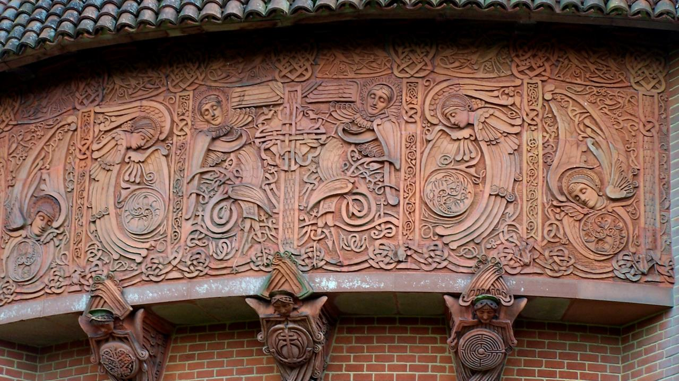
Sixth Sunday of Easter
Year A
Acts 17:22-31 • Psalm 66:8-20 • 1 Peter 3:13-22
John 14:15-21

Slide 2
"For 'In him we live and move and have our being'; … 'For we too are his offspring.'"
Acts 17:28

Slide 3
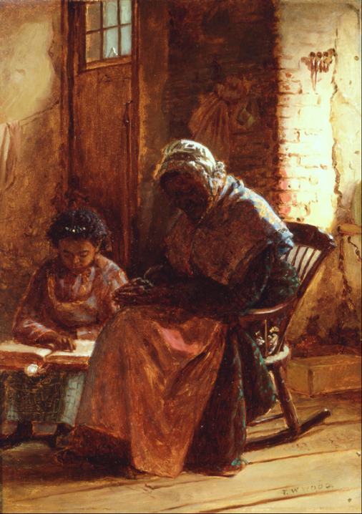
Sunday Morning
Thomas Wood
Smithsonian American Art Museum
Washington, DC

Slide 4
Come and hear, all you who fear God, and I will tell what he has done for me.
Psalm 66:16

Slide 5
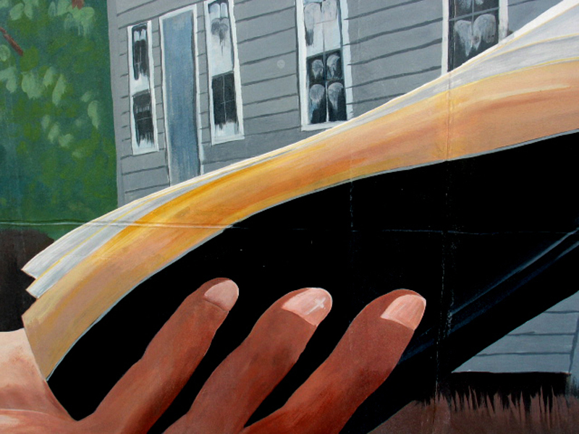
Billy Graham Preaching (detail) -- Palatka, FL

Slide 6
Always be ready to make your defense…yet do it with gentleness and respect.
1 Peter 3:15b, 16a

Slide 7
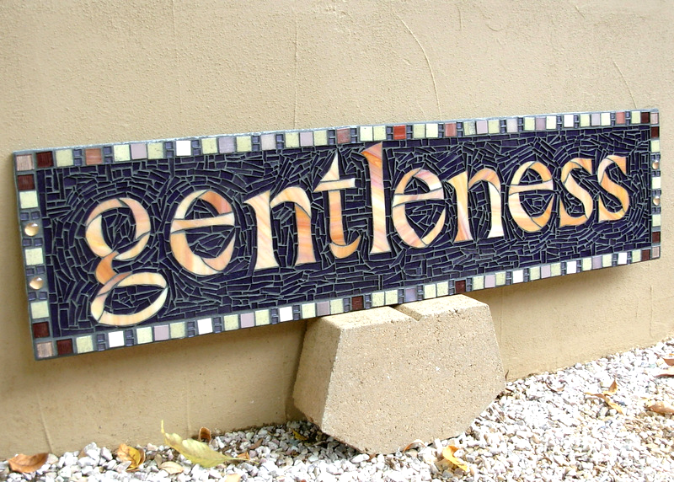
Gentleness, a Fruit of the Spirit -- Margaret Almon

Slide 8
“This is the Spirit of truth, whom the world cannot receive because it neither sees him nor knows him."
John 14:17a

Slide 9
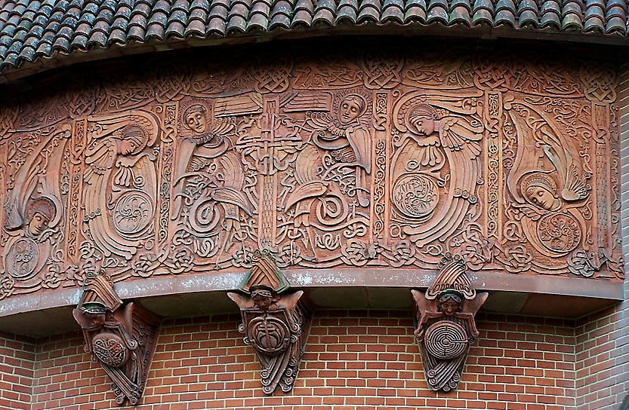
Spirit of Truth -- Mary S. Watts, Watts Chapel, Compton, England

Slide 10
"You know him because he abides with you, and he will be in you."
John 14:17b

Slide 11
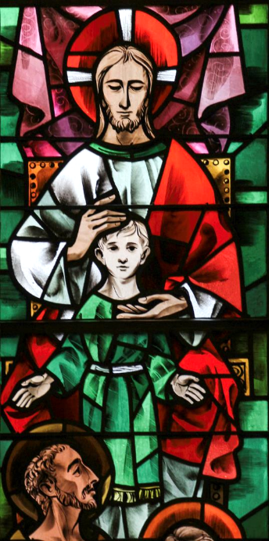
Remain in My Love
Church of St. Catherine of Siena
New York, NY

Slide 12
"I will not leave you orphaned; I am coming to you."
John 14:18

Slide 13
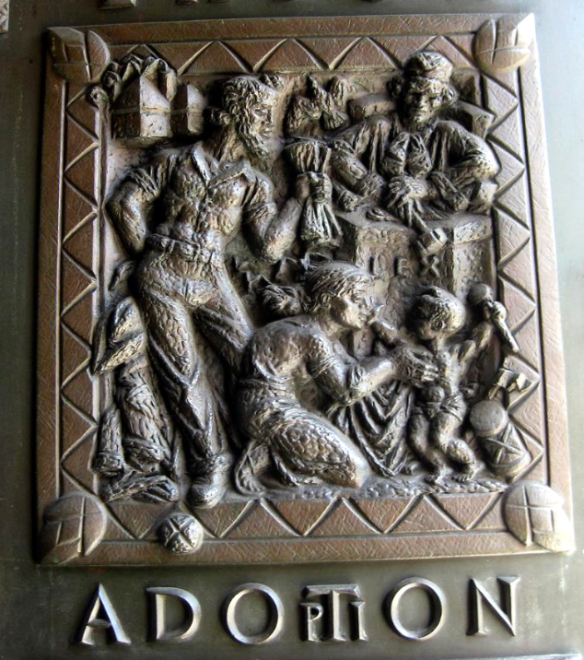
Adoption
Bronze Doors Panel
Grace Cathedral
San Francisco, CA

Slide 14
"In a little while the world will no longer see me, but you will see me..."
John 14:19a

Slide 15
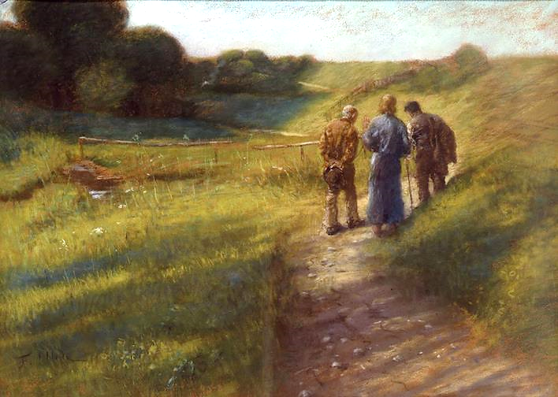
Road to Emmaus -- Fritz von Uhde, New Masters Gallery, Dresden, Germany

Slide 16
"...because I live, you also will live."
John 14:19b

Slide 17
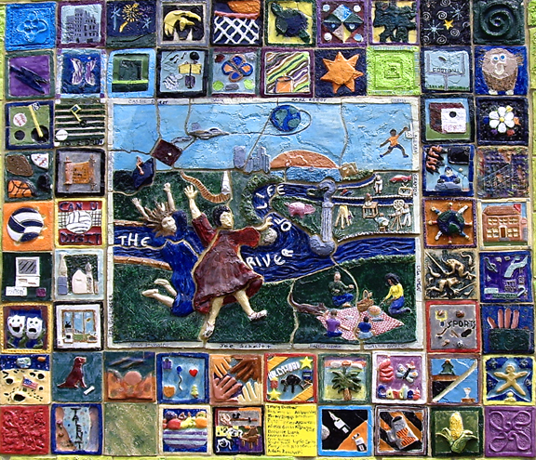
River of Life -- Corrine Peterson, Clay quilt, Community of Napierville, IL

Slide 18
"On that day you will know that I am in my Father, and you in me, and I in you."
John 14:20

Slide 19

Hands, All Together
Avondale Pattillo United Methodist Church
Decatur, GA

Slide 20
Credits
New Revised Standard Version Updated Edition Bible, copyright 2022, Division of Christian Education of the National Council of the Churches of Christ in the United States of America. Used by permission. All rights reserved.
http://commons.wikimedia.org/wiki/File:Thomas_Waterman_Wood_-_Sunday_Morning_-_Google_Art_Project.jpg
http://www.flickr.com/photos/csessums/5318762762/
https://www.flickr.com/photos/nutmegdesigns/6209753202
http://www.flickr.com/photos/nouveau/1871908002/
https://www.flickr.com/photos/paullew/14056717468/
http://www.flickr.com/photos/wallyg/3972631077/
https://commons.wikimedia.org/wiki/File:Fritz_von_Uhde_-_Der_Gang_nach_Emmaus_(1891).jpg
https://www.flickr.com/photos/22711505@N05/5818969367
http://www.flickr.com/photos/apmethodist/1678695596/
Additional descriptions can be found at the Art in the Christian Tradition image library, a service of the Vanderbilt Divinity Library, http://diglib.library.vanderbilt.edu/. All images available via Creative Commons 3.0 License.

