Slide 1

Seventh Sunday of Easter
Year A
Acts 1:6-14 • Psalm 68:1-10, 32-35
1 Peter 4:12-14; 5:6-11 • John 17:1-11

Slide 2
When he had said this, as they were watching, he was lifted up, and a cloud took him out of their sight.
Acts 1:9

Slide 3
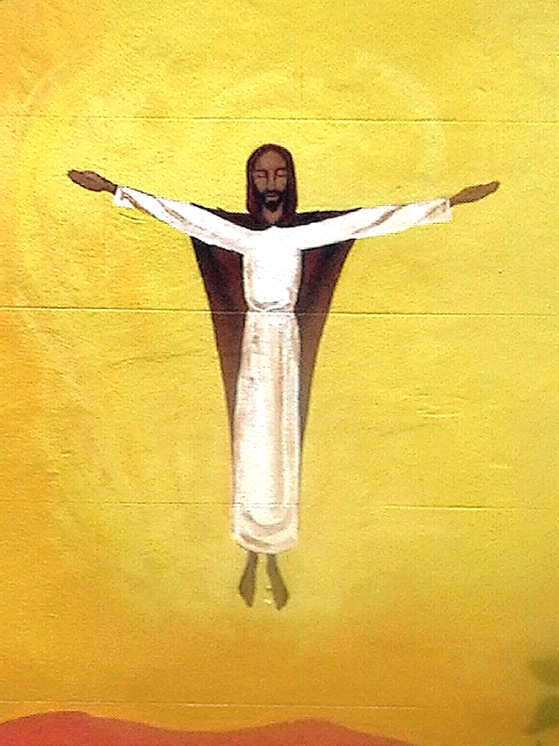
Ascension
Building Mural
Bristol, England

Slide 4
Sing to God, sing praises to his name; lift up a song to him who rides upon the clouds...
Psalm 68:4a

Slide 5
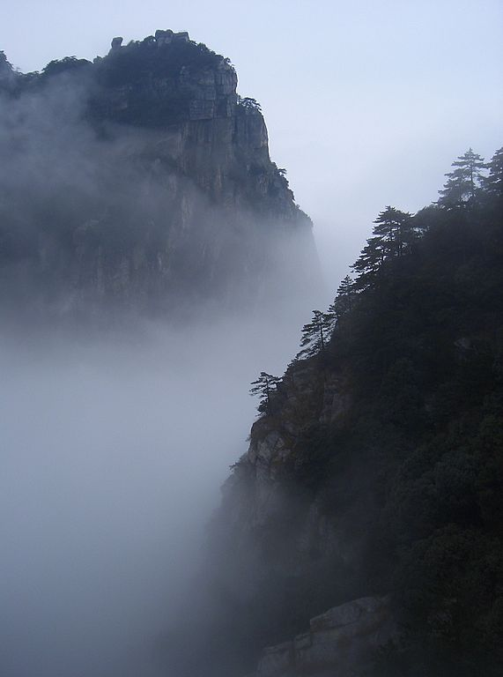
Fog
Mt. Lushan
Jiangxi Province, China

Slide 6
…the Spirit of God, is resting on you.
1 Peter 4:14b

Slide 7
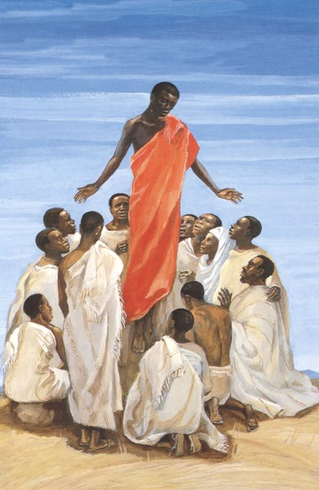
Ascension of Christ
JESUS MAFA, Cameroon

Slide 8
Cast all your anxiety on him, because he cares for you.
1 Peter 5:7

Slide 9
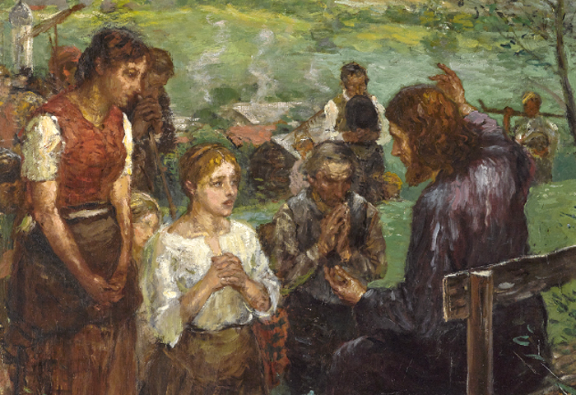
Christ Teaching -- Fritz von Uhde, Museum of Fine Arts, Budapest, Hungary

Slide 10
...the God of all grace…will himself restore, support, strengthen, and establish you.
1 Peter 5:10b

Slide 11
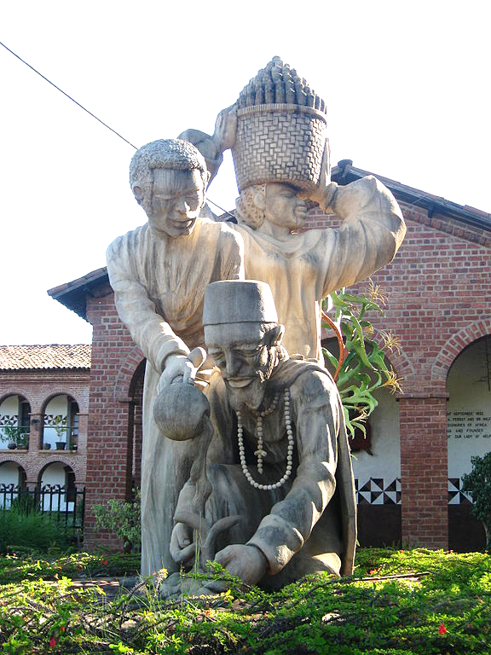
New Growth
Mua Mission Church Mua, Malawai

Slide 12
"Father, the hour has come; glorify your Son…. with the glory that I had in your presence before the world existed."
John 17:1b, 5

Slide 13
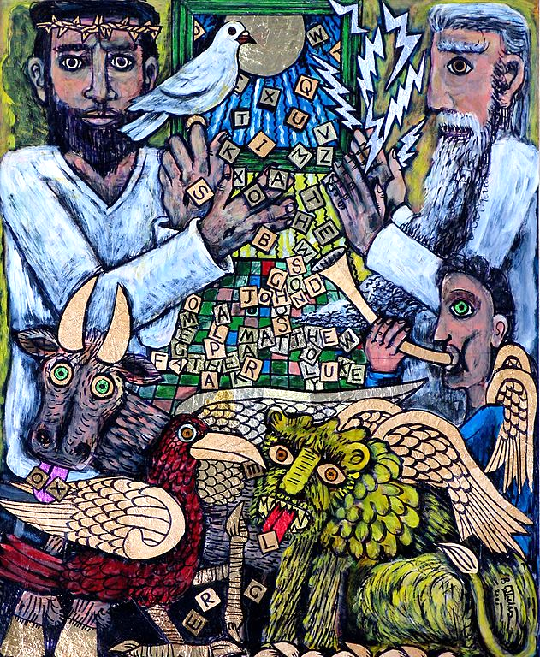
In the Beginning
Brian Whelan
Mixed media on board

Slide 14
"...the words that you gave to me I have given to them…"
John 17:8a

Slide 15
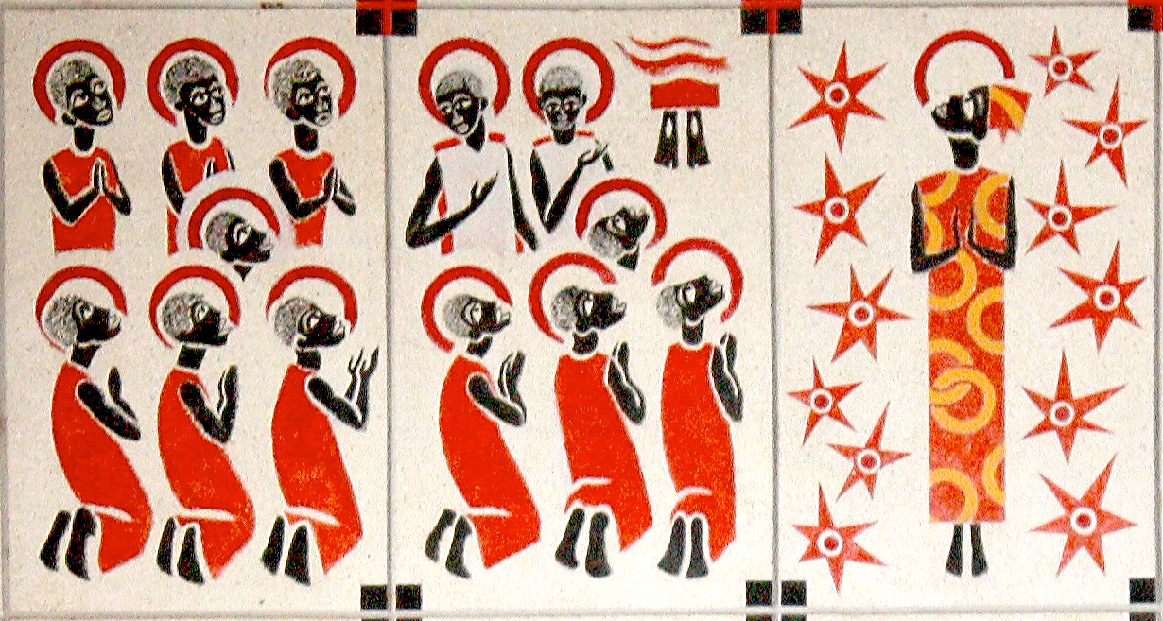
Ascension -- Keur Moussa Abbey, Keur Moussa, Senegal

Slide 16
"And now I am no longer in the world, but they are in the world, and I am coming to you."
John 17:11a

Slide 17
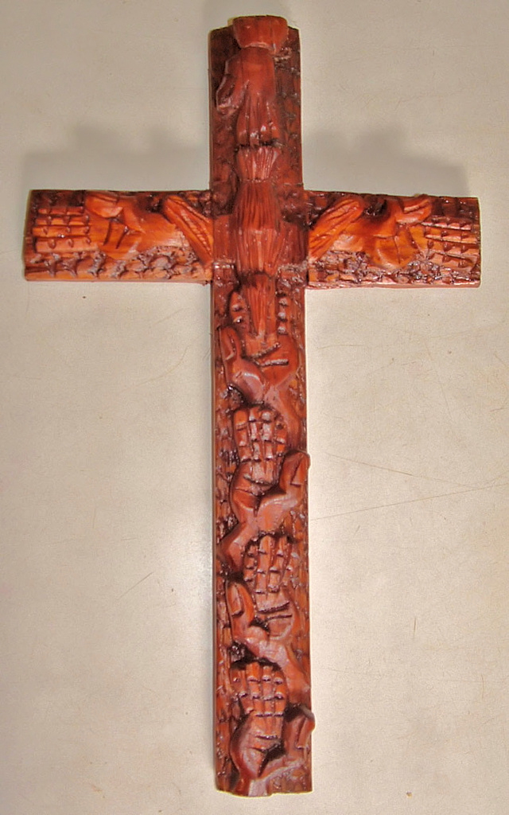
Cross of Hands
Mulungwishi Methodist Church
Democratic Republic of Congo

Slide 18
"...protect them… so that they may be one, as we are one.”
John 17:11b

Slide 19

Church Mural, Manchewe, Malawi

Slide 20
Credits
New Revised Standard Version Updated Edition Bible, copyright 2022, Division of Christian Education of the National Council of the Churches of Christ in the United States of America. Used by permission. All rights reserved.
http://www.flickr.com/photos/skip/111045024/
https://commons.wikimedia.org/wiki/File:Mount_Lushan_-_fog
http://diglib.library.vanderbilt.edu/act-imagelink.pl?RC=48398
https://commons.m.wikimedia.org/wiki/File:Fritz_von_Uhde_Bergpredigt.jpg#mw-jump-to-license
https://commons.wikimedia.org/wiki/File:Mua_Mission_sculpture.JPG
https://commons.wikimedia.org/wiki/File:Iin_the_beginning_34x28_by_Brian_Whelan.jpg - photographed by Wendy Roseberry with permission from Brian Whelan
https://commons.wikimedia.org/wiki/File:KeurMoussaAutel.jpg
https://www.flickr.com/photos/umccongo/2051227883
https://www.flickr.com/photos/kevincure/3222551382
Additional descriptions can be found at the Art in the Christian Tradition image library, a service of the Vanderbilt Divinity Library, http://diglib.library.vanderbilt.edu/. All images available via Creative Commons 3.0 License.

