Slide 1
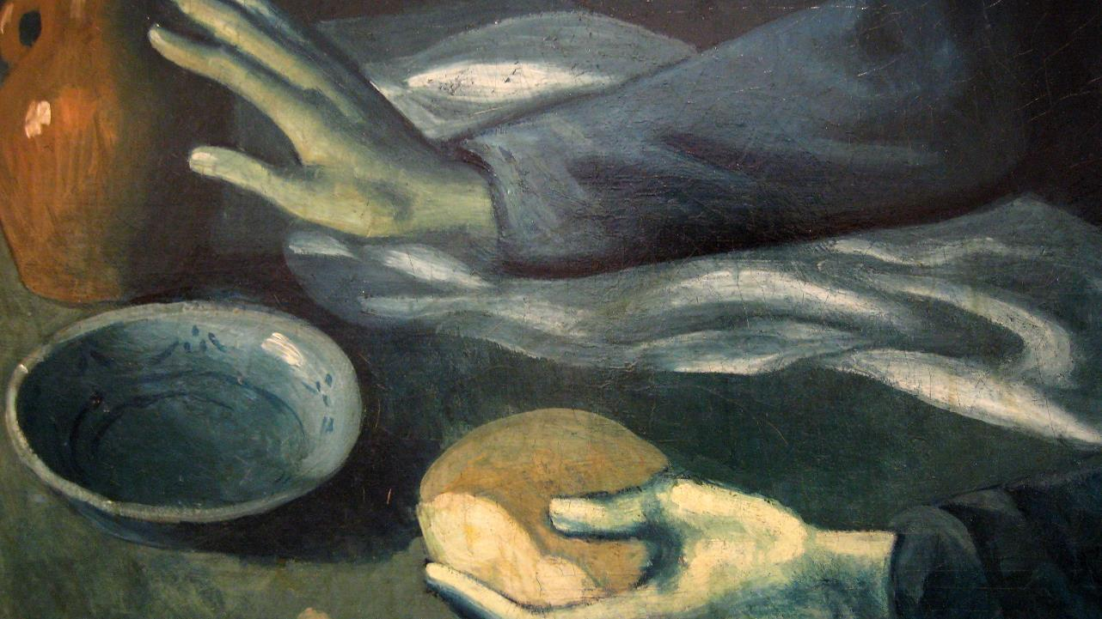
Seventh Sunday after Epiphany
Year A
Leviticus 19:1-2, 9-18
Psalm 119:33-40
1 Corinthians 3:10-11, 16-23
Matthew 5:38-48

Slide 2
"You shall not strip your vineyard bare or gather the fallen grapes of your vineyard; you shall leave them for the poor and the alien..."
Leviticus 19:10

Slide 3
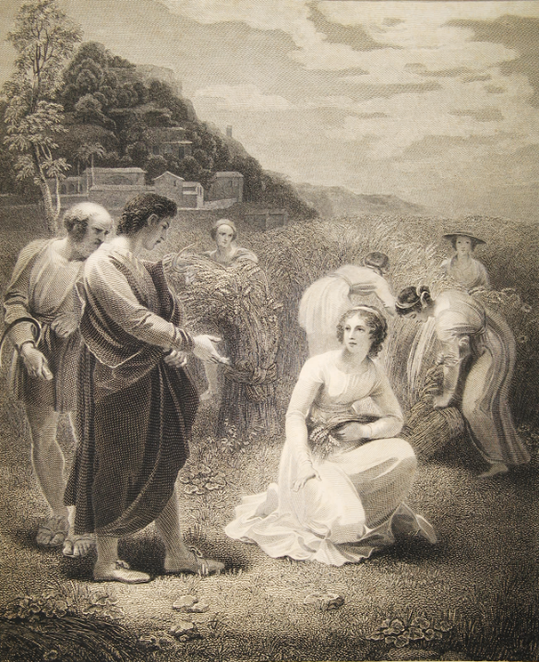
Ruth Gleaning in Boaz’ Fields
Thomas Stothard, Macklin Bible Heard Library, Nashville, TN

Slide 4
"…you shall not deal falsely; and you shall not lie to one another."
Leviticus 19:11b

Slide 5
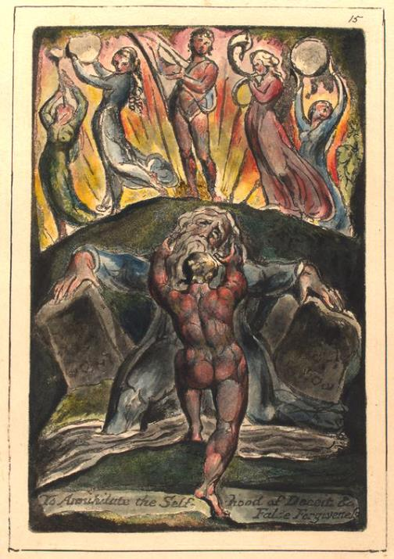
To Annihilate the Self-hood of Deceit and False Forgiveness
William Blake
New York Public Library

Slide 6

Guarding Words and Actions -- Stephen Poff, photographer

Slide 7
"You shall not revile the deaf or put a stumbling block before the blind..."
Leviticus 19:14a

Slide 8
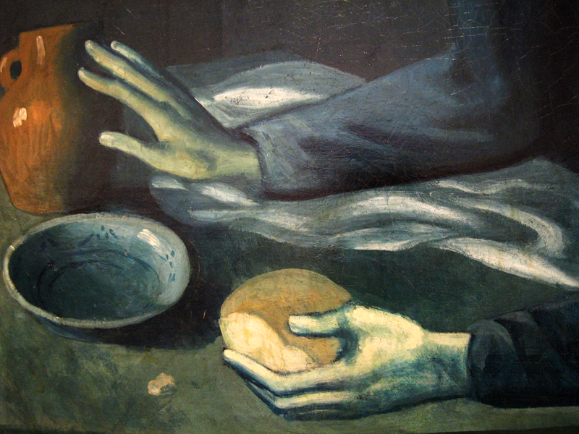
The Blind Man’s Meal -- Pablo Picasso, Metropolitan Museum of Art, New York

Slide 9
"…you shall love your neighbor as yourself..."
Leviticus 19:18b

Slide 10
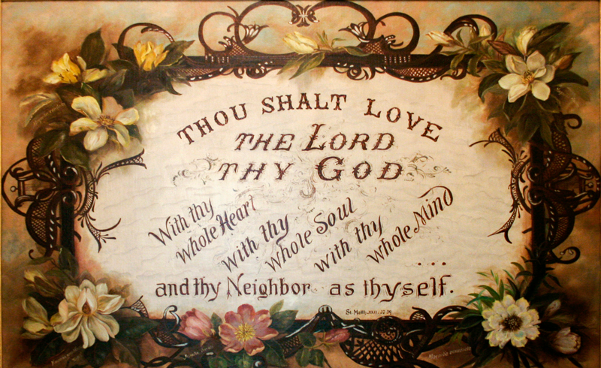
Thou Shalt Love -- Sister Maurice Schnell, Sisters of Providence, St. Mary-of-the-Woods, ID

Slide 11
Give me understanding, that I may keep your law and observe it with my whole heart.
Psalm 119:34

Slide 12
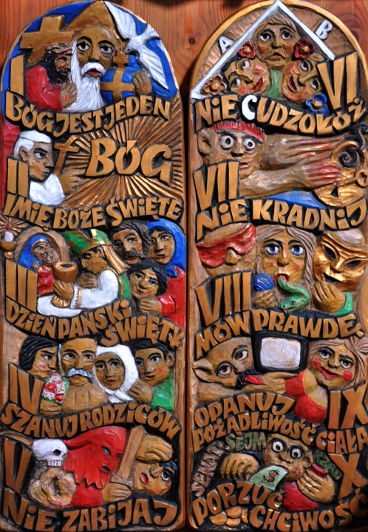
The Ten Commandments
Wood carving from a Catholic Church in southern Poland

Slide 13
…like a wise master builder I laid a foundation, and someone else is building on it.
1 Corinthians 3:10b

Slide 14
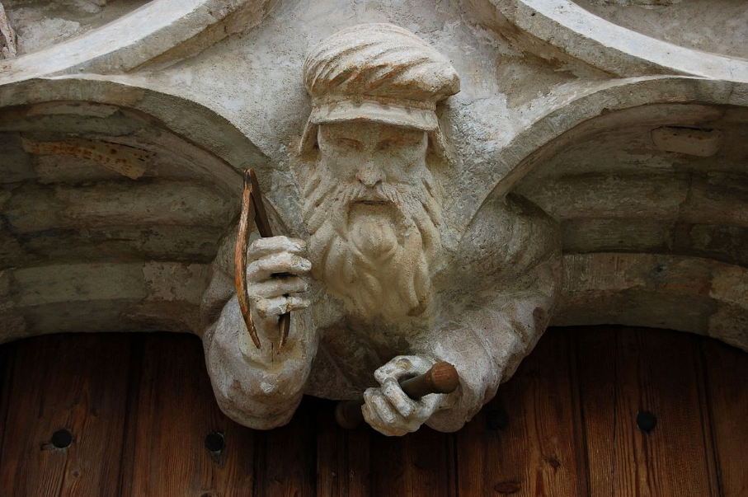
Master Builder -- Church of St. Peter, Aflenz Kurort, Austria

Slide 15
Do you not know that you are God's temple and that God's Spirit dwells in you?
1 Corinthians 3:16

Slide 16
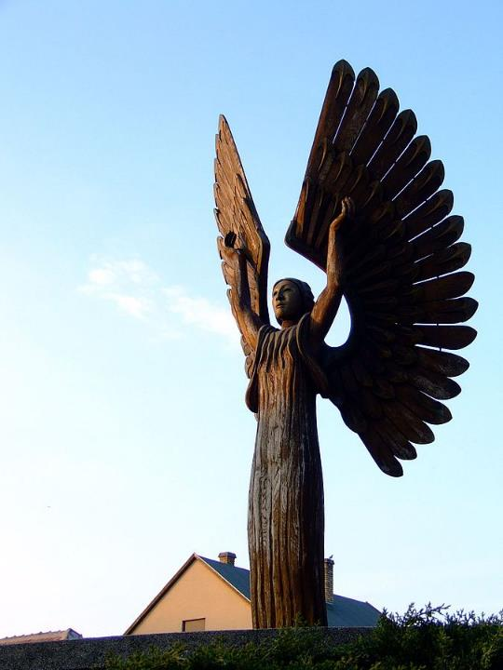
Holy Spirit
Laszlo Peterfy
Church of the Holy Spirit
Paks, Hungary

Slide 17
"…if anyone strikes you on the right cheek, turn the other also..."
Matthew 5:39b

Slide 18
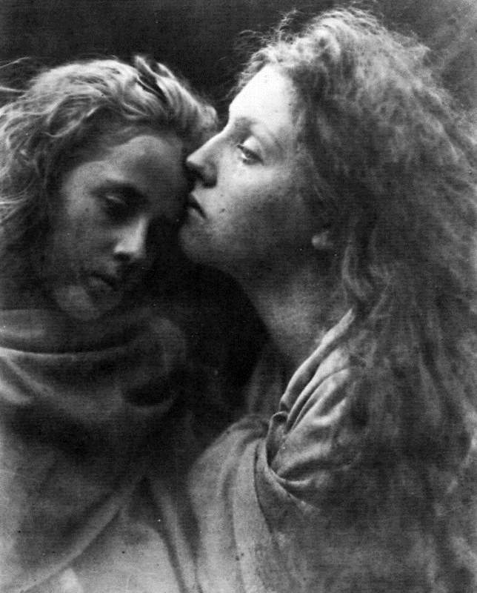
Kiss of Peace
Julia Margaret Cameron
Royal Photographic Society Bath, UK

Slide 19
"…and if anyone wants to…take your shirt, give your coat as well..."
Matthew 5:40

Slide 20
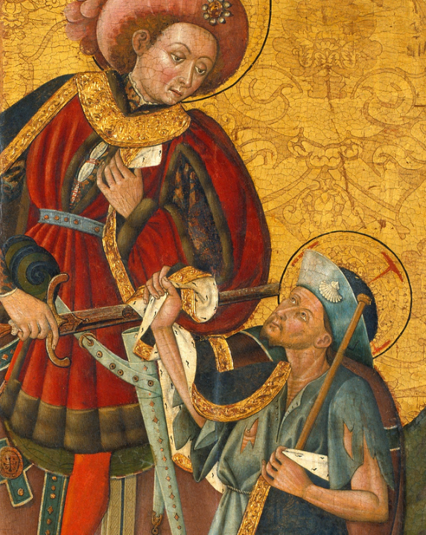
St. Martin Giving his Cloak to a Beggar
Blasco de Granen
Museu Nacional d’Art de Catalunya Barcelona, Spain

Slide 21
"But I say to you: Love your enemies…"
Matthew 5:44a

Slide 22
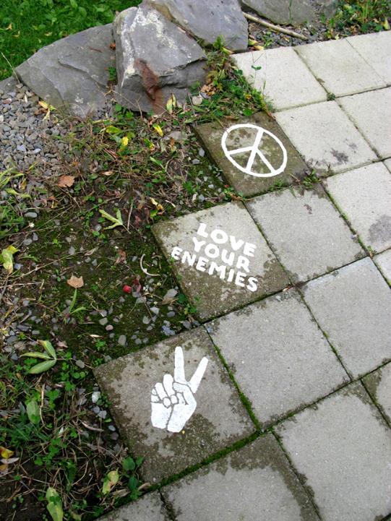
Love Your Enemies
Street art initiative, Green Buildings open house, Ithaca, NY

Slide 23
"...your Father in heaven…makes his sun rise on the evil and on the good..."
Matthew 5:45b

Slide 24
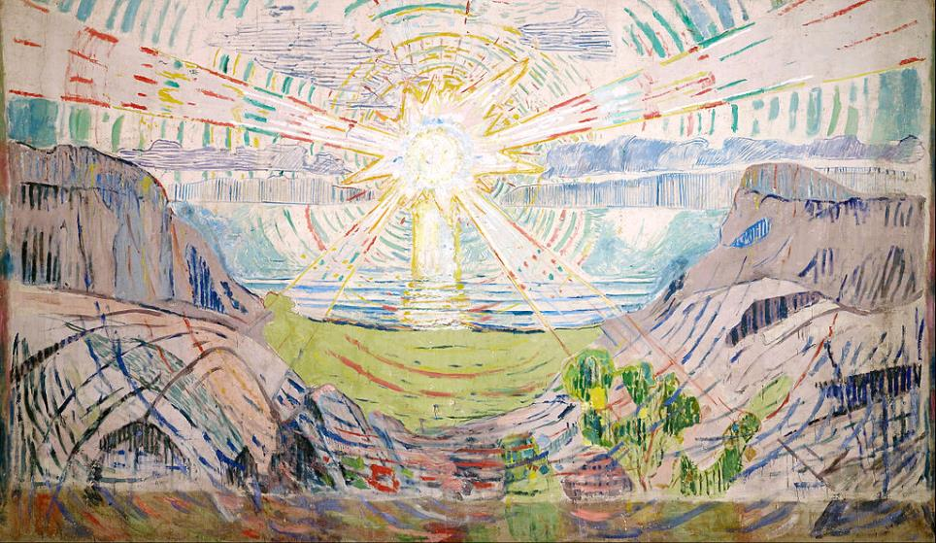
The Sun -- Edvard Munch, Munch Museum, Oslo, Norway

Slide 25
"...and sends rain on the righteous and on the unrighteous."
Matthew 5:45c

Slide 26
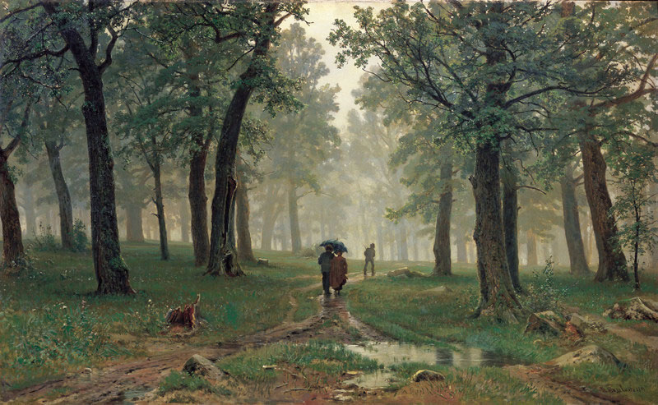
Rain in an Oak Forest -- Ivan Shishkin, Tretyakov State Gallery, Moscow

Slide 27
Credits
New Revised Standard Version Updated Edition Bible, copyright 2022, Division of Christian Education of the National Council of the Churches of Christ in the United States of America. Used by permission. All rights reserved.
http://diglib.library.vanderbilt.edu/act-imagelink.pl?RC=54106 – Czura Family
http://commons.wikimedia.org/wiki/File:To_annihilate_the_Self-hood_of_Deceit_and_Fals_Forgiveness_1804.jpg
http://www.flickr.com/photos/stephenpoff/3530640841/
http://www.flickr.com/photos/clairity/2232804348/
https://commons.m.wikimedia.org/wiki/File:Thou_Shalt_Love_-_Sister_Maurice_Schnell.jpg
http://www.flickr.com/photos/feargal/5096148585/
https://commons.wikimedia.org/wiki/File:Aflenz_Pfarrkirche_S-Portal_Detail.JPG – Wolfgang Glock
https://commons.wikimedia.org/wiki/File:Paks_Szentl%C3%A9lek-templom_szobor.JPG
http://commons.wikimedia.org/wiki/File:Cameron_Kuss_des_Friedens_1869.jpg
https://commons.wikimedia.org/wiki/File:Blasco_de_Gra%C3%B1%C3%A9n_-_Saint_Martin_Sharing_his_Cloak_-_Google_Art_Project.jpg
http://www.flickr.com/photos/boojee/2929823056/
https://commons.wikimedia.org/wiki/File:Edvard_Munch_-_The_Sun_-_Google_Art_Project.jpg
http://commons.wikimedia.org/wiki/File:Shishkin_DozVDubLesu_114.jpg
Additional descriptions can be found at the Art in the Christian Tradition image library, a service of the Vanderbilt Divinity Library, http://diglib.library.vanderbilt.edu/. All images available via Creative Commons 3.0 License.

