Slide 1
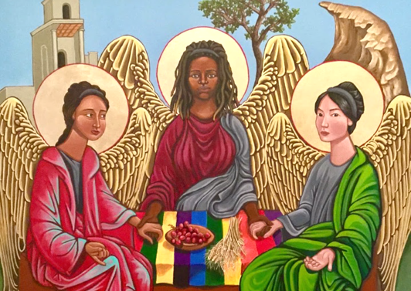
Second Sunday of Advent
Year A
Isaiah 11:1-10 • Psalm 72:1-7, 18-19 • Romans 15:4-13
Matthew 3:1-12

Slide 2
The spirit of the LORD shall rest on him, the spirit of wisdom and understanding…
Isaiah 11:2a

Slide 3
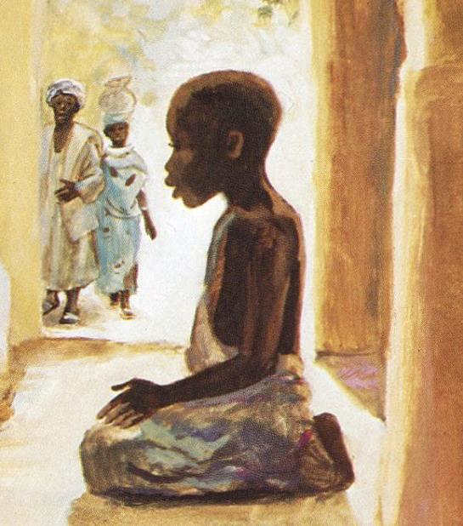
Jesus Among the Teachers -- JESUS MAFA, Cameroon

Slide 4
…with righteousness he shall judge for the poor and decide with equity for the oppressed of the earth…
Isaiah 11:4a

Slide 5
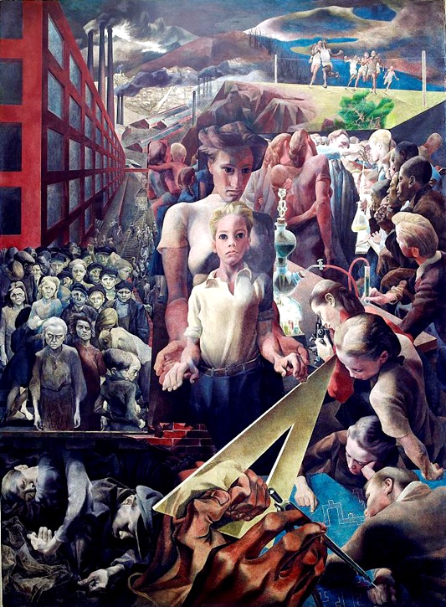
Contemporary Justice and Child
Symeon Shimin
Department of Justice, Washington, DC

Slide 6
The wolf shall live with the lamb;
the leopard shall lie down with the kid; the calf and the lion will feed together, and a little child shall lead them.
Isaiah 11:6

Slide 7
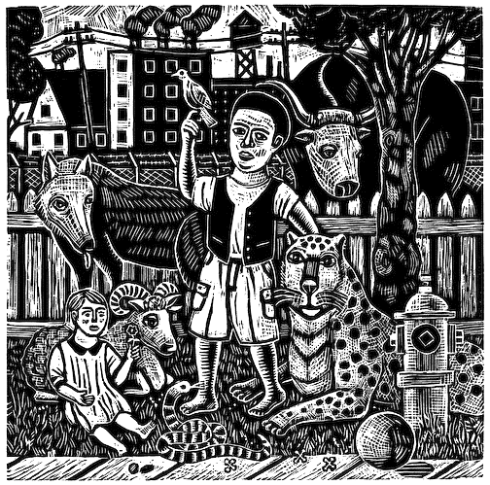
Peaceable Kingdom
Rick and Brenda
Beerhorst, woodcut

Slide 8
May the mountains yield prosperity for the people, and the hills, in righteousness.
Psalm 72:3

Slide 9
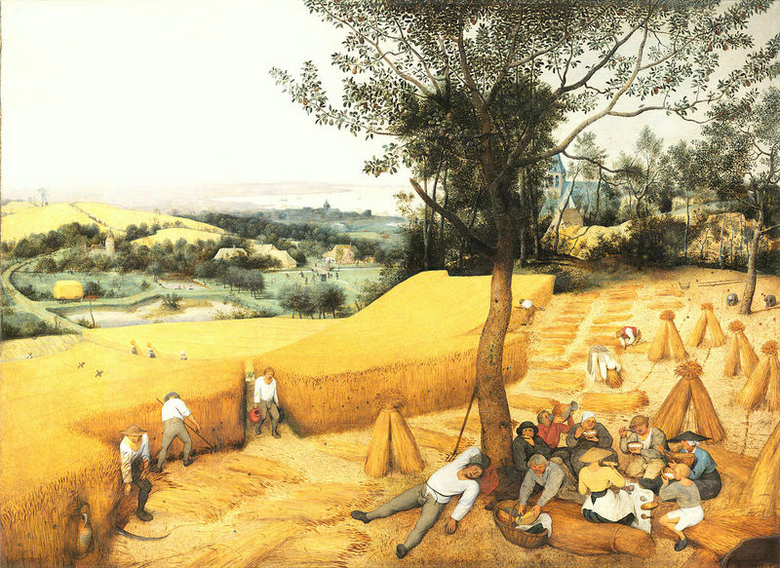
Harvesters -- Pieter Brueghel – Metropolitan Museum of Art

Slide 10
May he defend the cause of the poor of the people, give deliverance to the needy...
Psalm 72:4a

Slide 11

Haz Justicia! -- Honduran t-shirt slogan purchased on church mission trip

Slide 12
May he live while the sun endures and as long as the moon,
throughout all generations.
Psalm 72:5

Slide 13
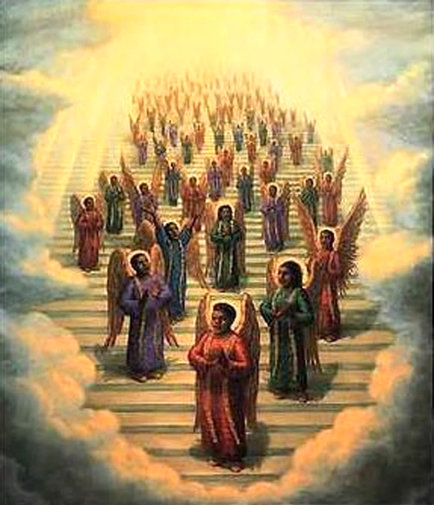
Gospel Choir of Angels
Tim Ashkar
Colored print

Slide 14
May he be like rain that falls on the mown grass, like showers that water the earth.
Psalm 72:6

Slide 15
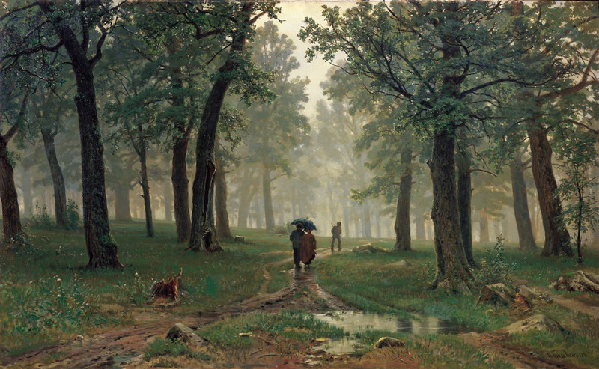
Rain in an Oak Forest -- Ivan Shishkin , Tretyakov Gallery, Moscow, Russia

Slide 16
May the God of hope fill you with all joy and peace in believing…
Romans 15:13a

Slide 17

Joyful Mountain Landscape – Paul Klee, Yale University Art Gallery, New Haven, CT

Slide 18
…so that you may abound in hope by the power of the Holy Spirit.
Romans 15:13b

Slide 19
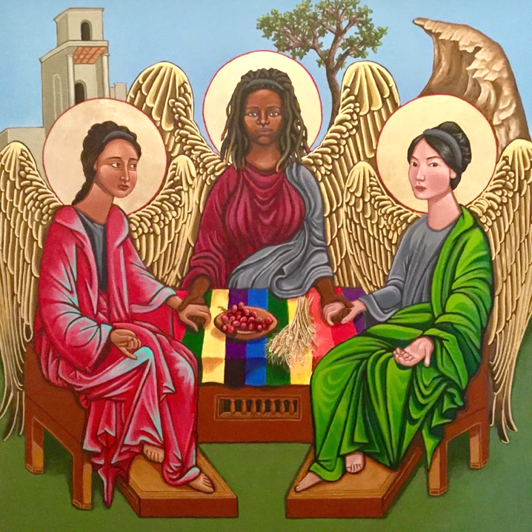
Holy Trinity
(Eastern Orthodox)
Kelly Latimore

Slide 20
"'Prepare the way of the Lord; make his paths straight.'"
Matthew 3:3b

Slide 21
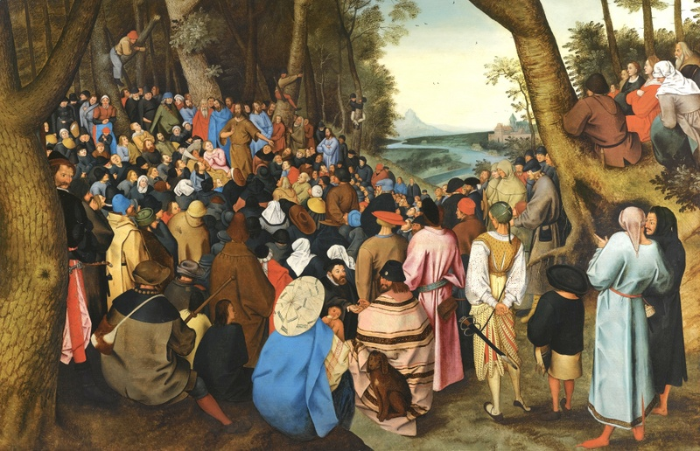
John the Baptist Preaching to the Masses – Pieter Brueghel the Younger

Slide 22
"I baptize you with water for repentance, but the one who is coming after me is more powerful..."
Matthew 3:11a

Slide 23
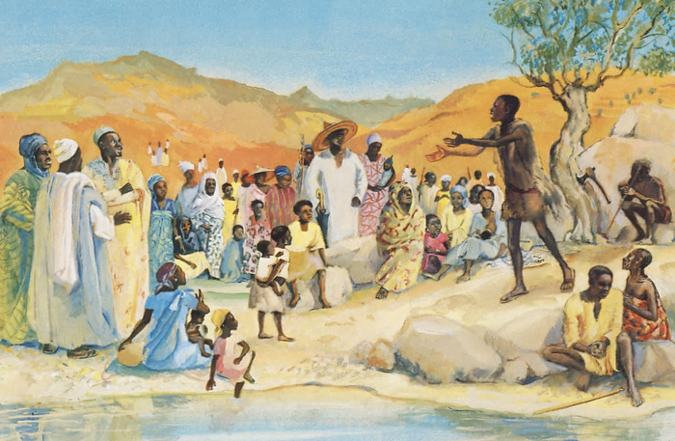
John the Baptist Preaching in the Desert – JESUS MAFA, Cameroon

Slide 24
"He will baptize you with
the Holy Spirit and fire."
Matthew 3:11c

Slide 25
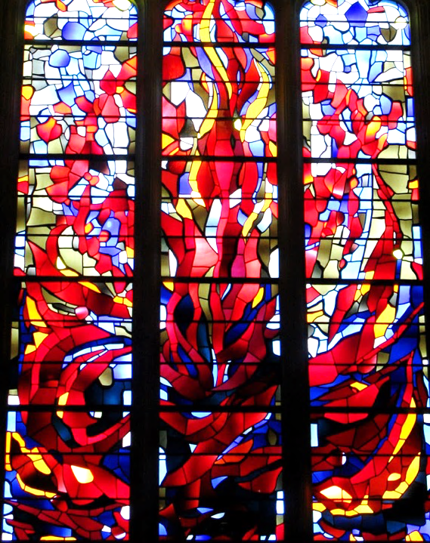
Fire
National Cathedral, Washington, DC

Slide 26
Credits
New Revised Standard Version Updated Edition Bible, copyright 2022, Division of Christian Education of the National Council of the Churches of Christ in the United States of America. Used by permission. All rights reserved.
http://www.librairie-emmanuel.fr (contact page: https://www.librairie-emmanuel.fr/contact)
http://lcweb2.loc.gov/service/pnp/highsm/02800/02898v.jpg
http://www.flickr.com/photos/74782490@N00/5816094892
http://commons.wikimedia.org/wiki/File:Pieter_Bruegel_the_Elder-_The_Harvesters_-_Google_Art_Project.jpg
http://www.flickr.com/photos/lorenabuena/343060350/
https://commons.wikimedia.org/wiki/File:19th_century_black_heaven.jpg
http://commons.wikimedia.org/wiki/File:Shishkin_DozVDubLesu_114.jpg
http://commons.wikimedia.org/wiki/File:Heitere_Gebirgslandschaft_by_Paul_Klee_1929.jpe
https://kellylatimoreicons.com/contact/
https://commons.wikimedia.org/wiki/File:Saint_John_the_Baptist_Preaching_to_the_Masses_in_the_Wilderness_oil_on_oak_panel_by_Pieter_Brueghel_the_Younger.jpg
http://diglib.library.vanderbilt.edu/act-imagelink.pl?RC=48386
http://www.flickr.com/photos/laurapadgett/3375617793
Additional descriptions can be found at the Art in the Christian Tradition image library, a service of the Vanderbilt Divinity Library, http://diglib.library.vanderbilt.edu/. All images available via Creative Commons 3.0 License.

