Slide 1
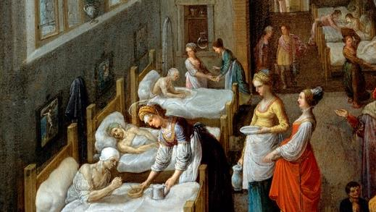
Eighteenth Sunday after Pentecost
Year A
Exodus 17:1-7 and Psalm 78:1-4, 12-16 • Ezekiel 18:1-4, 25-32 and Psalm 25:1-9 Philippians 2:1-13 • Matthew 21:23-32

Slide 2
…the people complained against Moses and said, "Why did you bring us out of Egypt, to kill us and our children and livestock with thirst?"
Exodus 17:3b

Slide 3
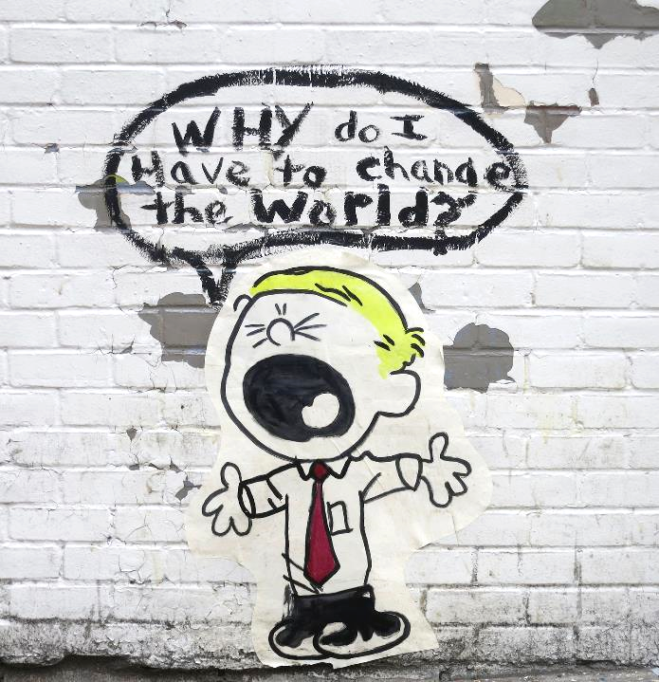
"Why Do I Have to Change the World?"
Manhattan
New York City, NY

Slide 4
I will open my mouth in a parable;
things...our ancestors have told us.
Psalm 78:2, 3b

Slide 5
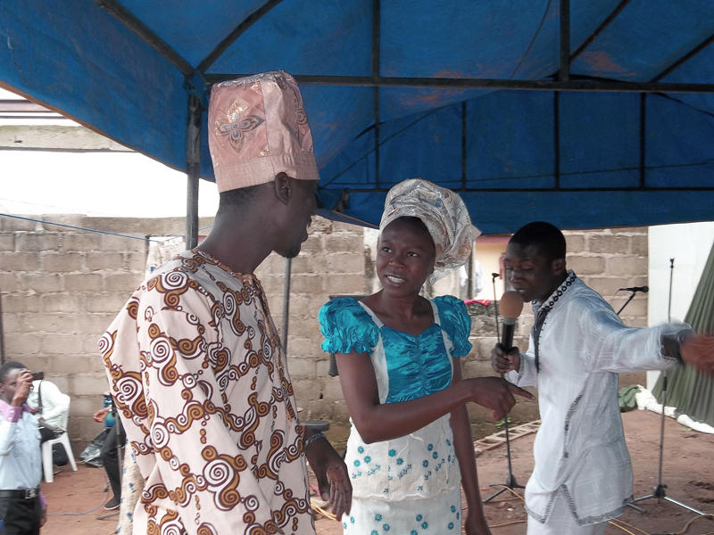
Ogbomosho university students acting in Bible drama at their church

Slide 6
…get yourselves a new heart and a new spirit! … Turn, then, and live.
Ezekiel 18:31b, 32c

Slide 7
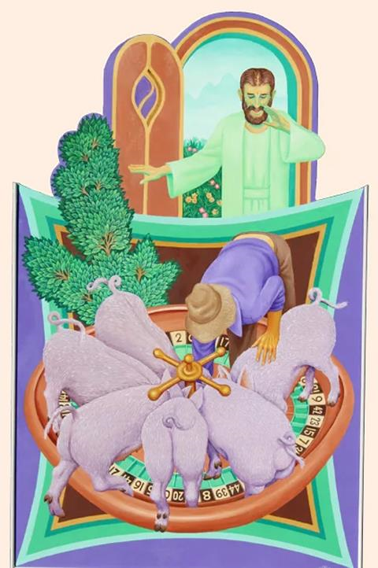
Prodigal and the Pigs
Peter Koenig

Slide 8
He leads the humble in what is right and teaches the humble his way.
Psalm 25:9

Slide 9

Clare and Francis
Poor Clares Holy Sacrament Monastery
Canide, Brazil

Slide 10
Let each of you look not to your own interests, but to the interests of others. …for it is God who is at work in you…
Philippians 2:4, 13a

Slide 11
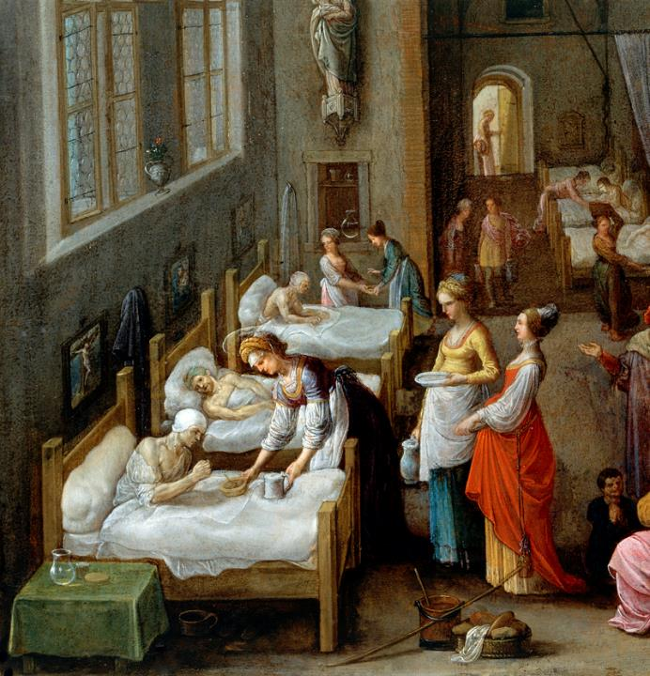
Elizabeth of Hungary Visiting a Hospital
Adam Elsheimer
Wellcome Collection
London, UK

Slide 12
"A man had two sons; he went to the first and said, 'Son, go and work in the vineyard today.'"
Matthew 21:28b

Slide 13
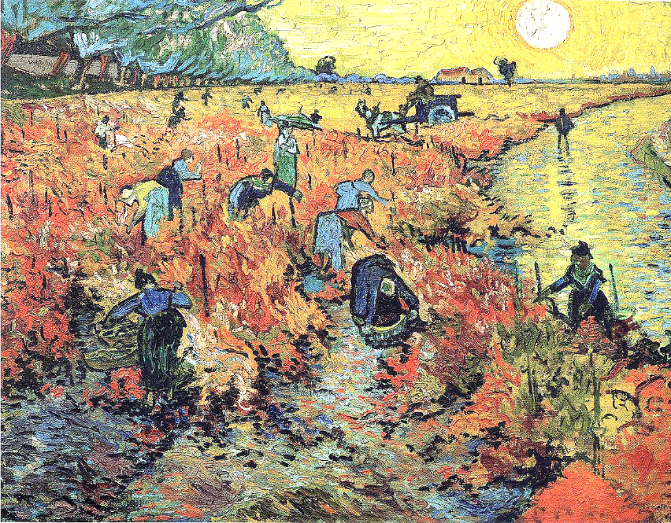
?
The Red Vineyard -- Vincent van Gogh, Pushkin Museum, Moscow, Russia

Slide 14
"He answered, 'I will not,' but later he changed his mind and went."
Matthew 21:29

Slide 15
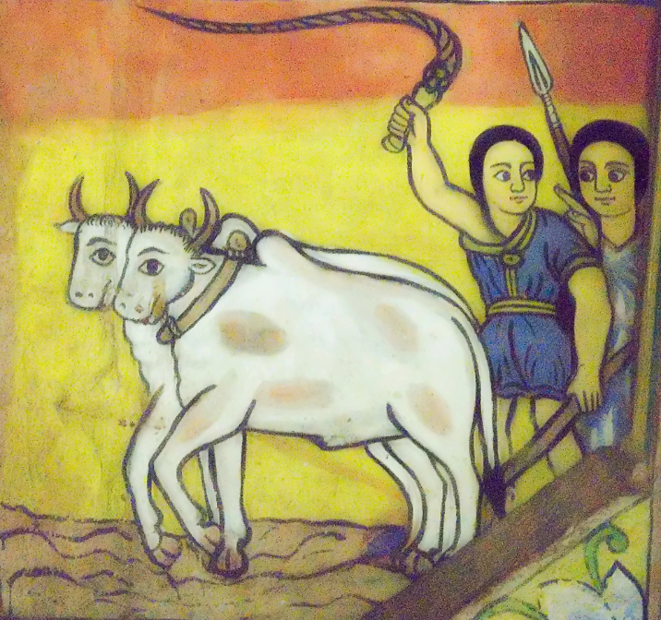
Plowing Fields -- Mural, Church of Ura Kidane Mihret, Lake Tana, Ethiopia

Slide 16
"The father went to the second and said the same, and he answered,
'I go, sir,' but he did not go."
Matthew 21:30

Slide 17
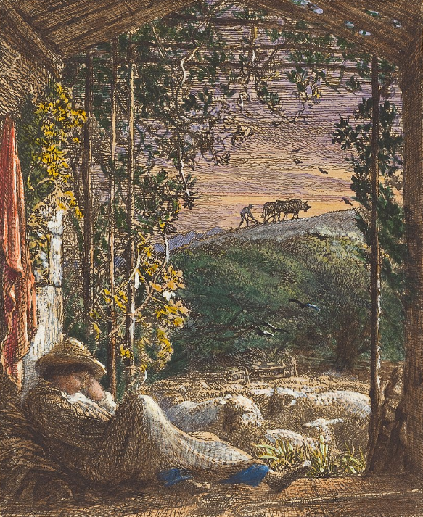
Sleeping Shepherd
Samuel Palmer
National Gallery of Art
Washington, DC

Slide 18
"Which of the two did the will of his father?" They said, "The first."
Matthew 21:31a

Slide 19
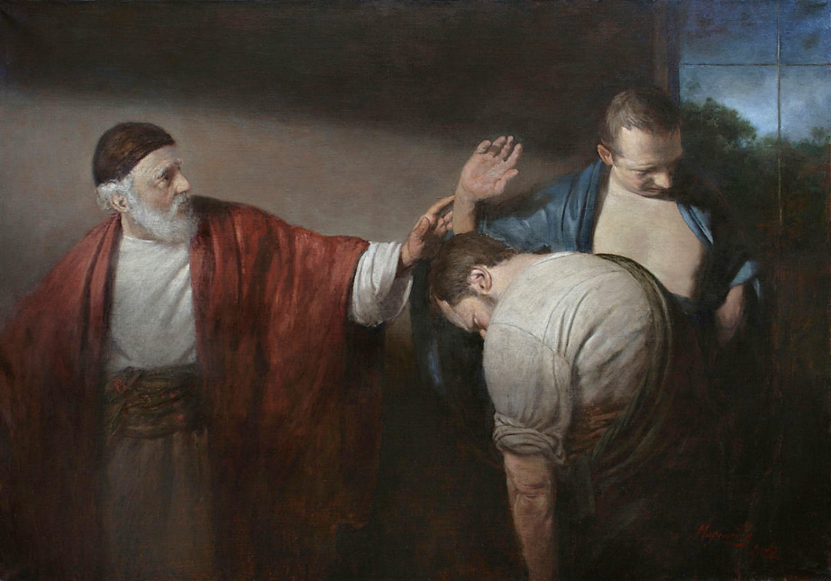
Parable of the Two Sons -- Andrey Mironov

Slide 20
"For John came to you in the way of righteousness, and you did not believe him, but the tax collectors and the prostitutes believed him…"
Matthew 21:32

Slide 21
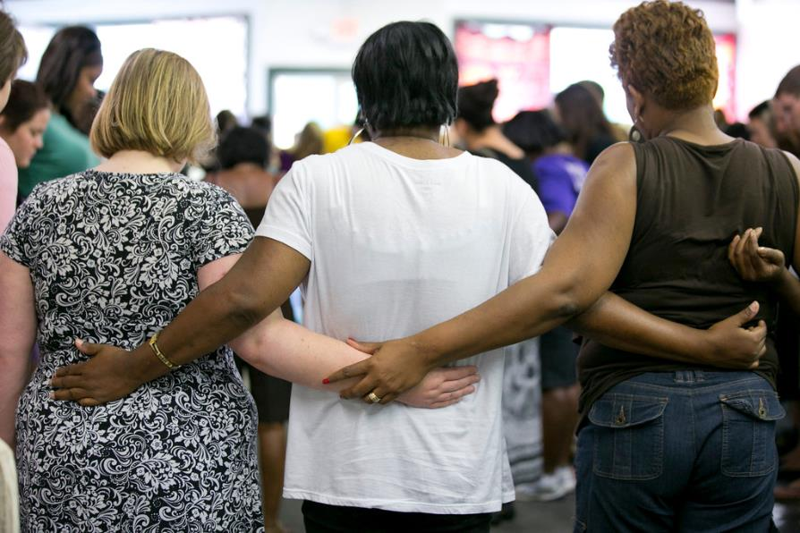
Praying Together, Thistle Farms Ministry -- Nashville, TN

Slide 22
Credits
New Revised Standard Version Updated Edition Bible, copyright 2022, Division of Christian Education of the National Council of the Churches of Christ in the United States of America. Used by permission. All rights reserved.
https://www.flickr.com/photos/tinaleggio/14902888760/ - Tina Leggio
https://commons.wikimedia.org/wiki/File:Drama_in_a_student_church.JPG
Peter Winfried (Canisius) Koenig, https://www.pwkoenig.co.uk/
https://commons.wikimedia.org/wiki/File:Holy_Sacrament_Monastery,_Canind%C3%A9,_Brazil_(Poor_Clares)_031.JPG
https://commons.wikimedia.org/wiki/File:St_Elizabeth_visiting_a_hospital._Wellcome_V0017201.jpg
https://commons.wikimedia.org/wiki/File:Red_vineyards.jpg
https://commons.wikimedia.org/wiki/File:Samuel_Palmer,_The_Sleeping_Shepherd;_Early_Morning,_1857,_NGA_9505.jpg
https://commons.wikimedia.org/wiki/File:Ethiopian_Church_Painting_(2261217481).jpg
Wikimedia Commons: Mironov, Parable of the Two Sons
https://www.flickr.com/photos/fteleaders/7455972304
Additional descriptions can be found at the Art in the Christian Tradition image library, a service of the Vanderbilt Divinity Library, http://diglib.library.vanderbilt.edu/. All images available via Creative Commons 3.0 License.

