Slide 1
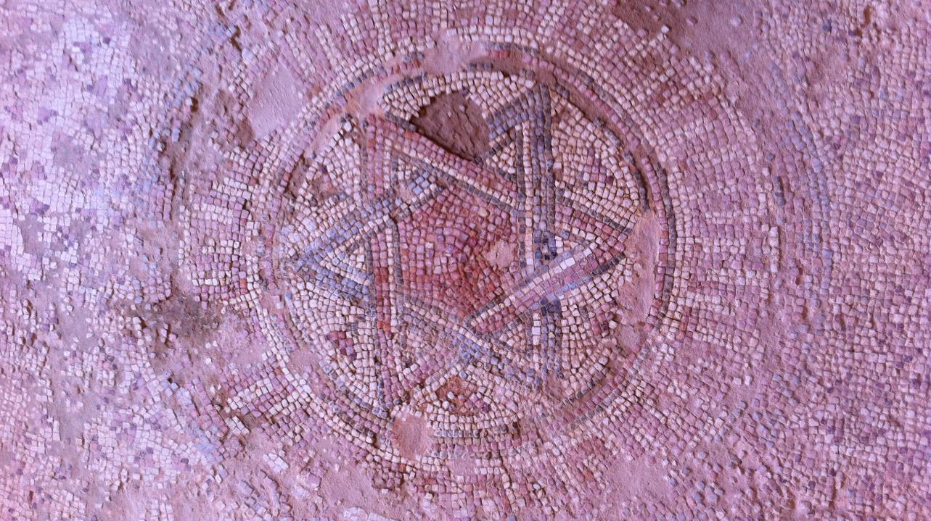
Sixteenth Sunday after Pentecost
Year A
Exodus 14:19-31 and Psalm 114 or Exodus 15:1b-11, 20-21 • Genesis 50:15-21 and Psalm 103:(1-7), 8-13
Romans 14:1-12 • Matthew 18:21-35

Slide 2
Then Moses stretched out his hand over the sea. The LORD drove the sea back…, and the waters were divided.
Exodus 14:21ac

Slide 3
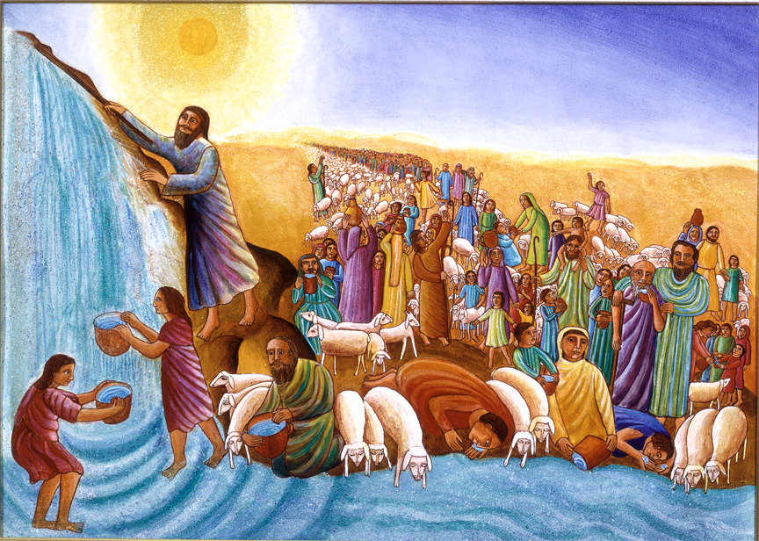
Moses and the Crossing of the Red Sea -- John August Swanson

Slide 4
The Israelites went into the sea on dry ground, the waters forming a wall for them on their right and on their left.
Exodus 14:22

Slide 5
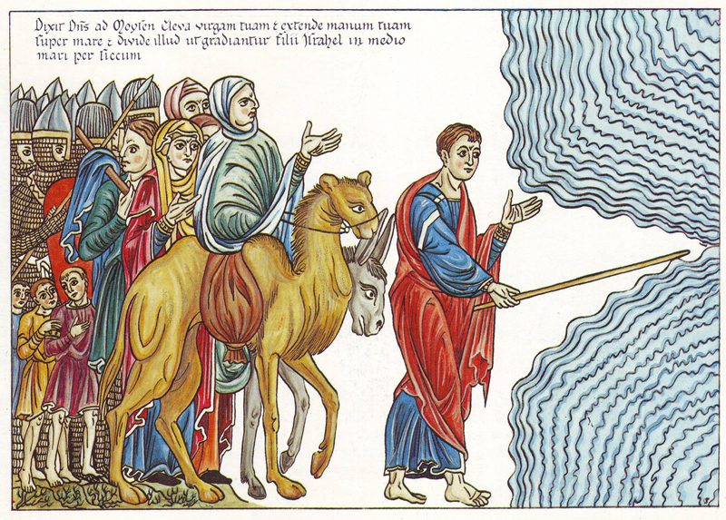
Crossing of the Red Sea -- Abbess of Hohenburg, Hortus Deliciarum

Slide 6
Thus the LORD saved Israel that day…
Exodus 14:30a

Slide 7
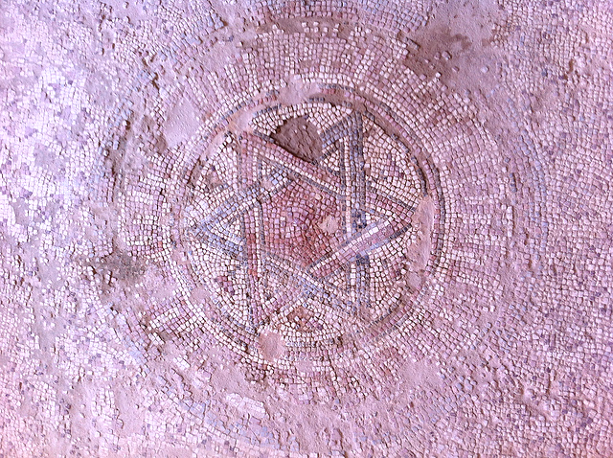
Star of David -- Fourth century C.E., Byzantine Basilica, Shilo, Israel

Slide 8
Then the prophet Miriam, Aaron's sister, took a tambourine in her hand, and all the women went out after her with tambourines and with dancing.
Exodus 15:20

Slide 9
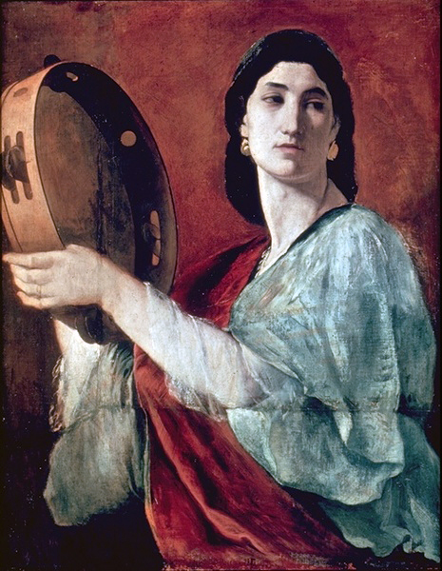
The Prophet Miriam
Anselm Feuerbach
Berlin State Museums
Berlin, Germany

Slide 10
Why is it, O sea, that you flee?
...
O mountains, that you skip like rams?
O hills, like lambs?
Psalm 114:5a, 6

Slide 11
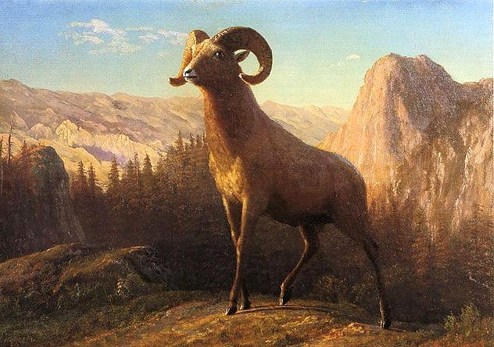
A Rocky Mountain Sheep, Ovis, Montana -- Albert Bierstadt, lithograph

Slide 12
The LORD is merciful and gracious… He does not deal with us according to our sins nor repay us according to our iniquities.
Psalm 103:8a, 10

Slide 13
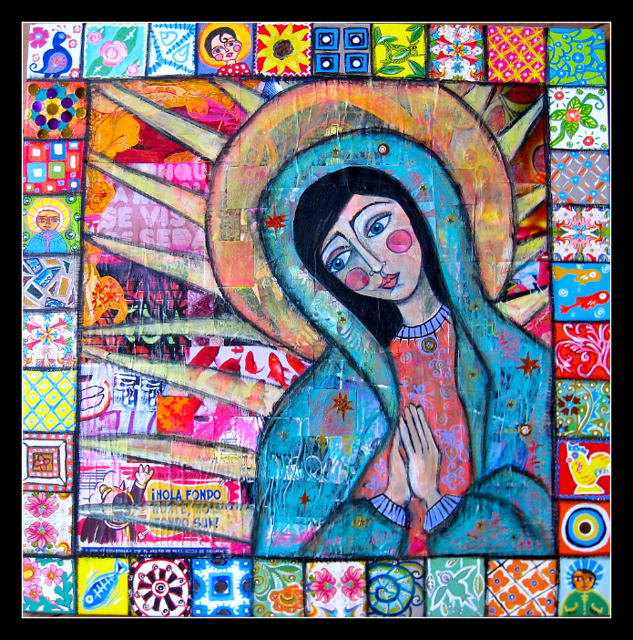
Merciful Mother
Multi-media

Slide 14
As a father has compassion for his children, so the LORD has compassion for those who fear him.
Psalm 103:13

Slide 15
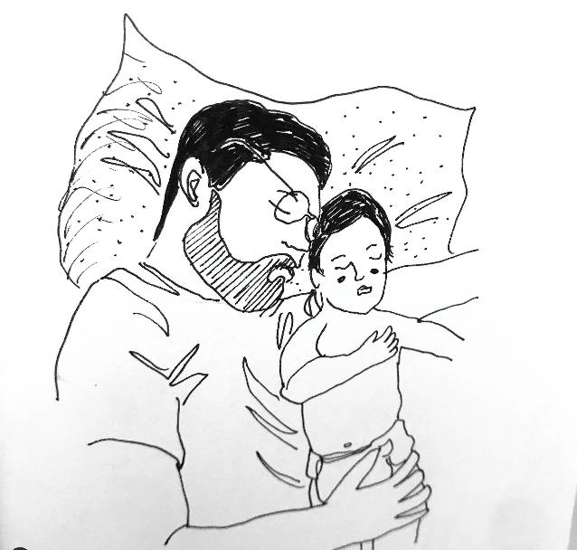
Depending on God -- Liz Valente

Slide 16
Why do you pass judgment on your brother or sister? Or you, why do you despise your brother or sister?
Romans 14:10a

Slide 17

Tangled Blessing - Jacob and Esau -- Lauren Wright Pittman

Slide 18
Then Peter came and said to him, "Lord, if my brother or sister sins against me, how often should I forgive? As many as seven times?"
Matthew 18:21

Slide 19
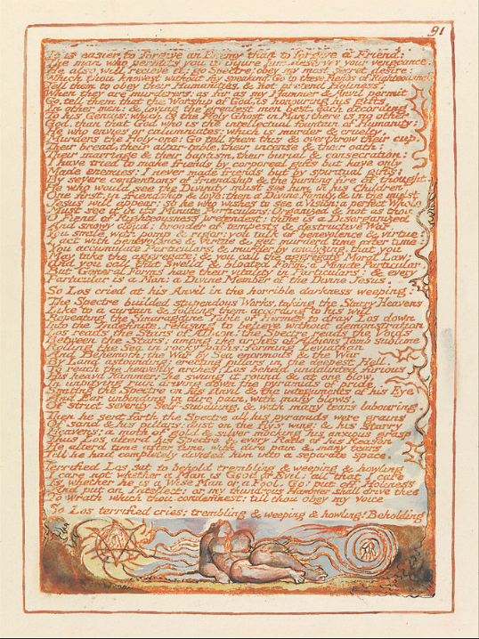
"It is easier to forgive an enemy than to forgive a friend…"
from Jerusalem
William Blake
Yale Center for British Art
New Haven, CT

Slide 20
Jesus said to him, "Not seven times, but, I tell you, seventy-seven times."
Matthew 18:22

Slide 21
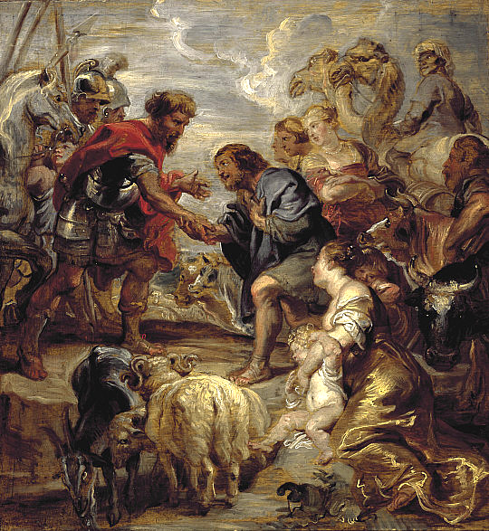
Reconciliation of Jacob and Esau
Peter Paul Rubens
National Gallery
Edinburgh, Scotland

Slide 22
"And out of pity for him, the lord of that slave released him and forgave him the debt."
Matthew 18:27

Slide 23
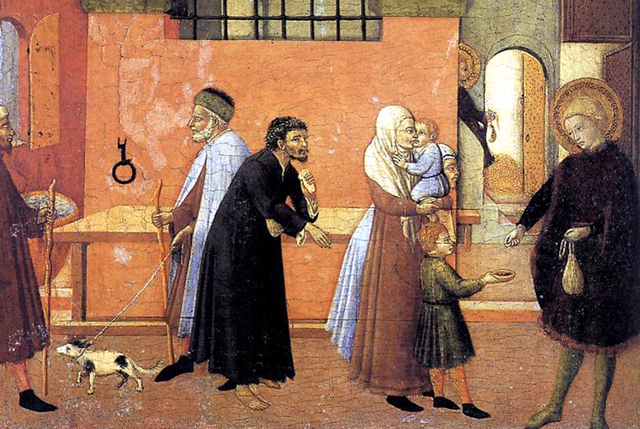
St. Lawrence Distributing the Riches of the Church -- Master of the Osservanza, National Gallery, Washington, DC

Slide 24
"But that same slave, as he went out, came upon one of his fellow slaves…, and seizing him by the throat, he said, 'Pay what you owe.'"
Matthew 18:28ac

Slide 25
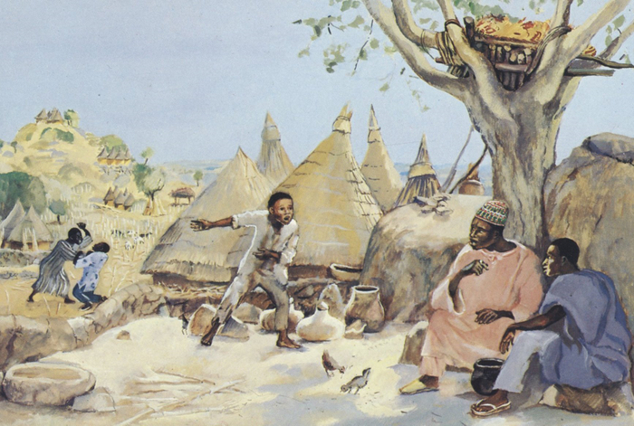
The Unforgiving Servant -- JESUS MAFA, Cameroon

Slide 26
"Then his lord summoned him and said to him… 'Should you not have had mercy on your fellow slave, as I had mercy on you?'"
Matthew 18:32a, 33

Slide 27
Credits
New Revised Standard Version Updated Edition Bible, copyright 2022, Division of Christian Education of the National Council of the Churches of Christ in the United States of America. Used by permission. All rights reserved.
www.JohnAugustSwanson.com - copyright 1983 by John August Swansons
https://commons.wikimedia.org/wiki/File:Hortus_Deliciarum,_Moses_f%C3%BChrt_das_Volk_Israel_durch_das_Rote_Meer.JPG
https://www.flickr.com/photos/zeevveez/8043033236 - Ze'ev Barkan
https://www.flickr.com/photos/paullew/33172410852
https://commons.wikimedia.org/wiki/File:Feuerbach_Mirjam_2.jpg
https://commons.wikimedia.org/wiki/File:Bierstadt_Albert_A_Rocky_Mountain_Sheep_Ovis_Montana.jpg
https://www.flickr.com/photos/angelisms/4679661269 - Jessica Jane Lynch
Liz Valente, https://www.instagram.com/donalizvalente/
Lauren Wright Pittman, http://www.lewpstudio.com/
https://commons.wikimedia.org/wiki/File:William_Blake_-_Jerusalem,_Plate_91,_%22It_is_easier_to_forgive_an_enemy....%22_-_Google_Art_Project.jpg
http://commons.wikimedia.org/wiki/File:Rubens_Reconciliation_of_Jacob_and_Esau.jpg
http://commons.wikimedia.org/wiki/File:Master_Of_The_Osservanza_-_St_Anthony_Distributing_his_Wealth_to_the_Poor_-_WGA14603.jpgs
http://www.librairie-emmanuel.fr (contact page: https://www.librairie-emmanuel.fr/contact)
Additional descriptions can be found at the Art in the Christian Tradition image library, a service of the Vanderbilt Divinity Library, http://diglib.library.vanderbilt.edu/. All images available via Creative Commons 3.0 License.

