Slide 1
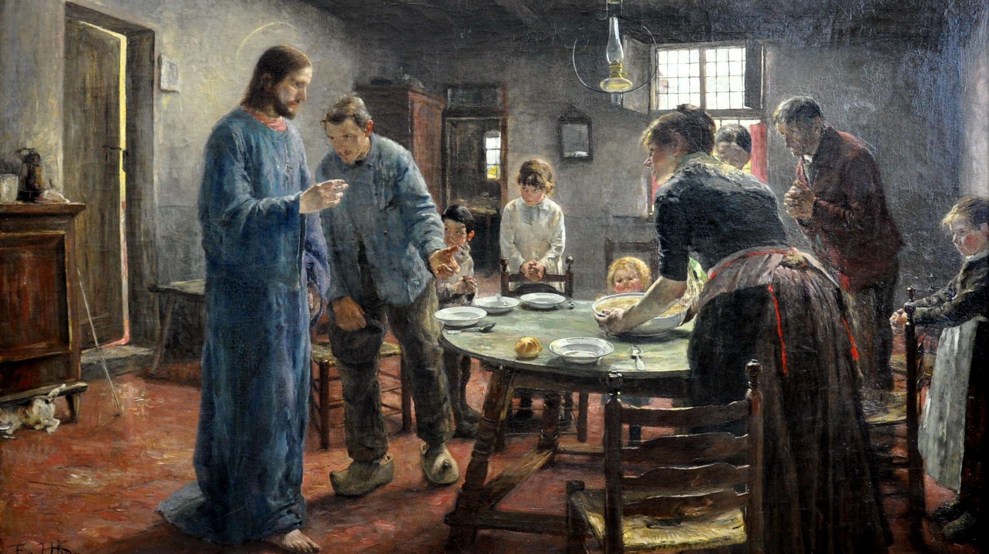
Fifthteenth Sunday after Pentecost
Year A
Exodus 12:1-14 and Psalm 149 • Ezekiel 33:7-11 and Psalm 119:33-40 • Romans 13:8-14 • Matthew 18:15-20

Slide 2
The LORD said to Moses and Aaron in the land of Egypt…, "Tell the whole congregation of Israel that…they are to take a lamb for each family…"
Exodus 12:1, 3a

Slide 3
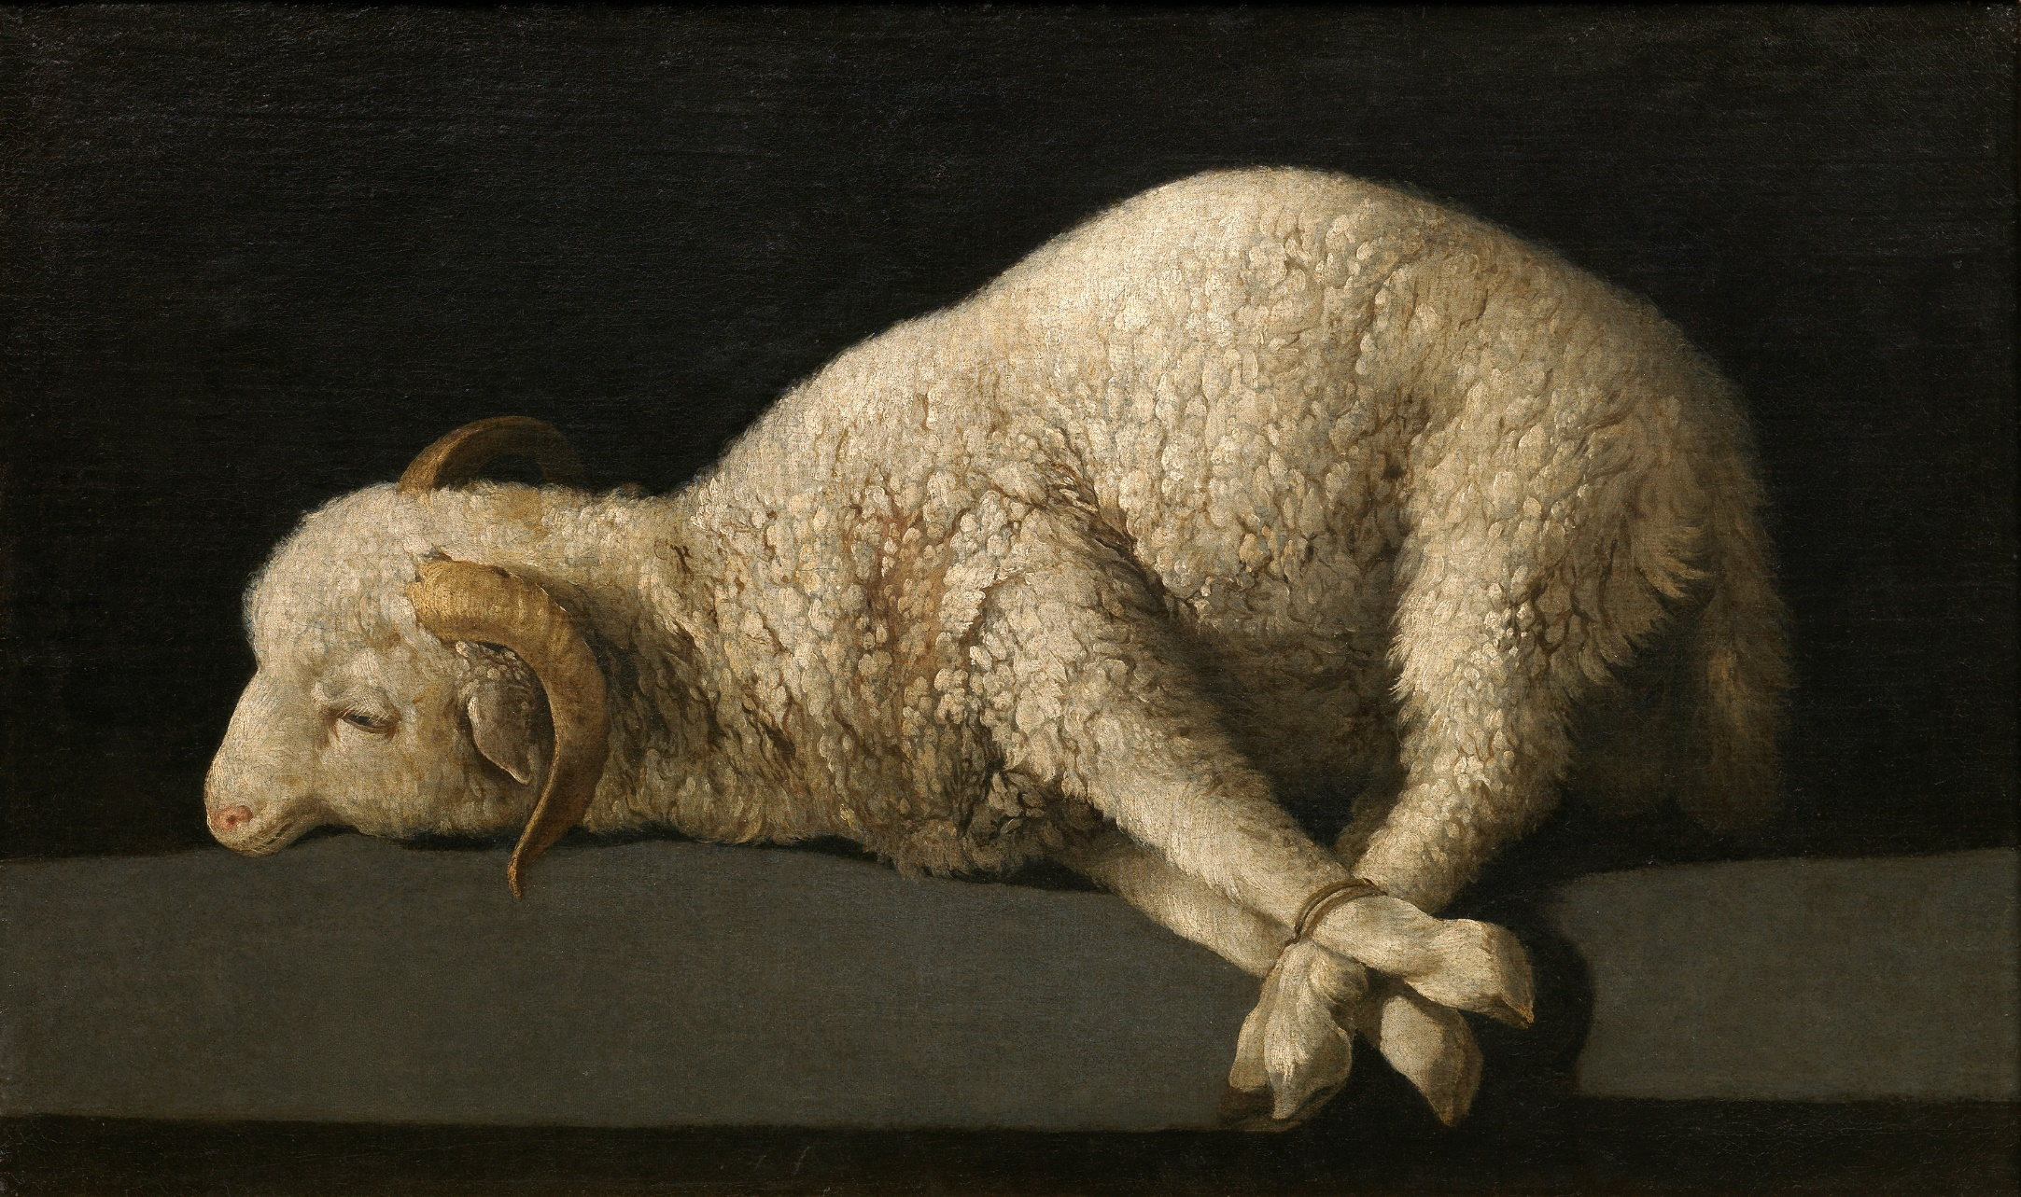
A Lamb -- Francisco Zurbaran, Prado Museum, Madrid, Spain

Slide 4
"They shall take some of the blood and put it on the two doorposts and the lintel of the houses in which they eat it."
Exodus 12:7

Slide 5
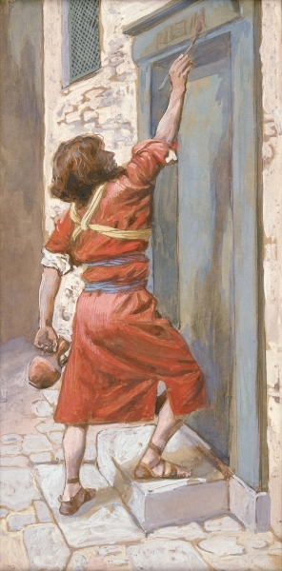
Signs on the Door -- James Tissot, Jewish Museum, New York City

Slide 6
"...when I see the blood, I will pass over you, and no plague shall destroy you when I strike the land of Egypt."
Exodus 12:13

Slide 7
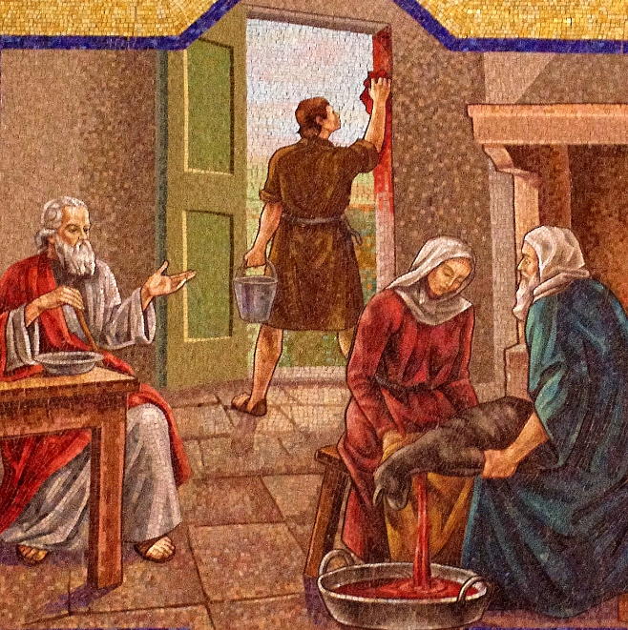
Blood of the Paschal Lamb Applied to Doorpost -- St. Mary Magdalene, Columbus, OH

Slide 8
"This day shall be a day of remembrance for you. …throughout your generations you shall observe it as a perpetual ordinance."
Exodus 12:14

Slide 9
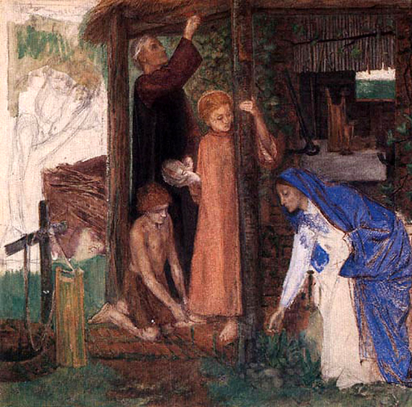
The Passover in the Holy Family -- Dante Rossetti, Tate Britain, London, England

Slide 10
For the LORD takes pleasure in his people; he adorns the humble with victory.
Psalm 149:4

Slide 11
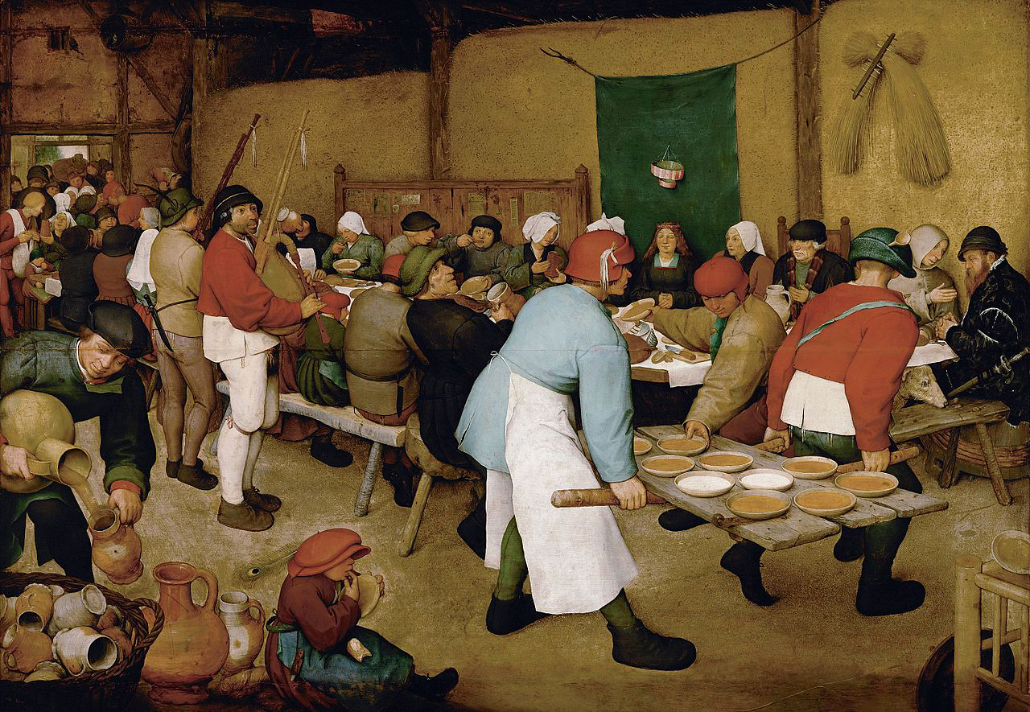
Peasant Wedding-- Pieter Brueghel, Kunsthistorisches Museum, Vienna, Austria

Slide 12
Let the high praises of God be in their throats…
Psalm 149:6

Slide 13
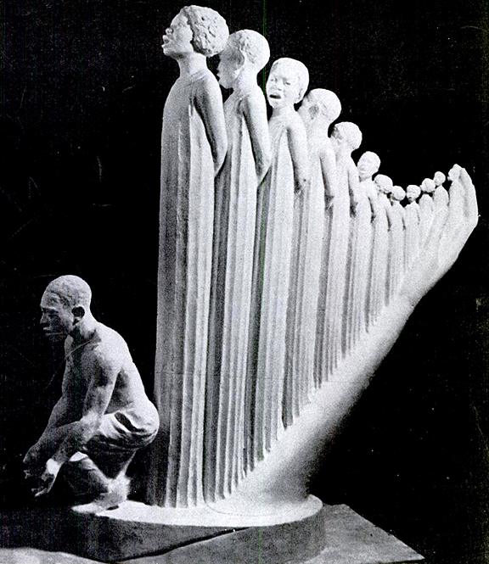
Lift Every Voice and Sing
Augusta Savage
1939 New York World’s Fair

Slide 14
As I live, says the Lord GOD, I have no pleasure in the death of the wicked but that the wicked turn from their ways and live…
Ezekiel 33:11b

Slide 15
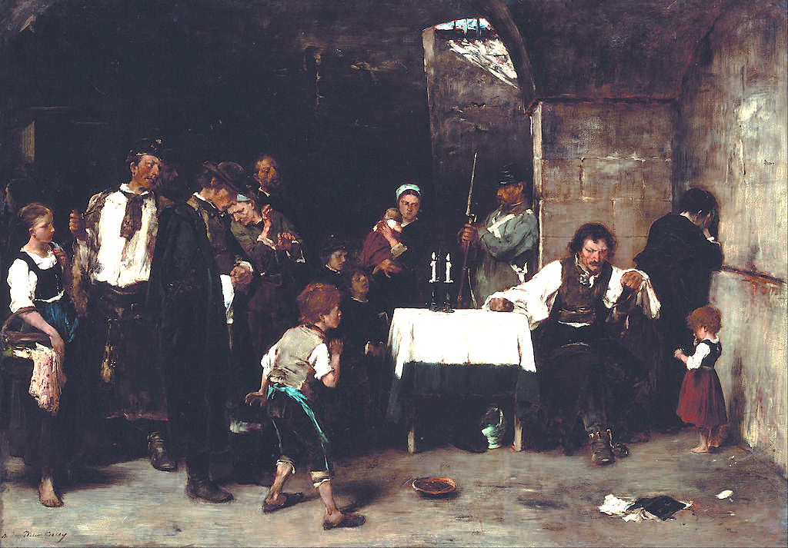
Cell of the Condemned -- Mihaly Munkacsy, Hungarian National Gallery, Budapest, Hungary

Slide 16
Give me understanding, that I may keep your law and observe it with my whole heart.
Psalm 119:34

Slide 17
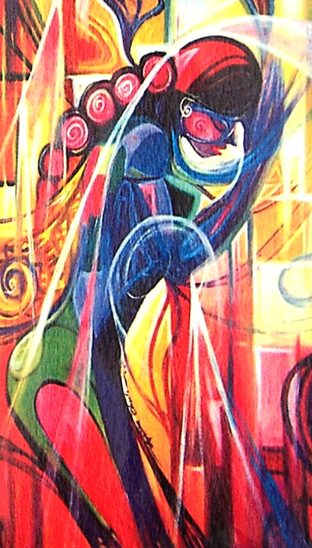
Woman Asking God for Wisdom
David Ayibiowu Olusola

Slide 18
The commandments…are summed up in this word, "You shall love your neighbor as yourself."
Romans 13:9ac

Slide 19
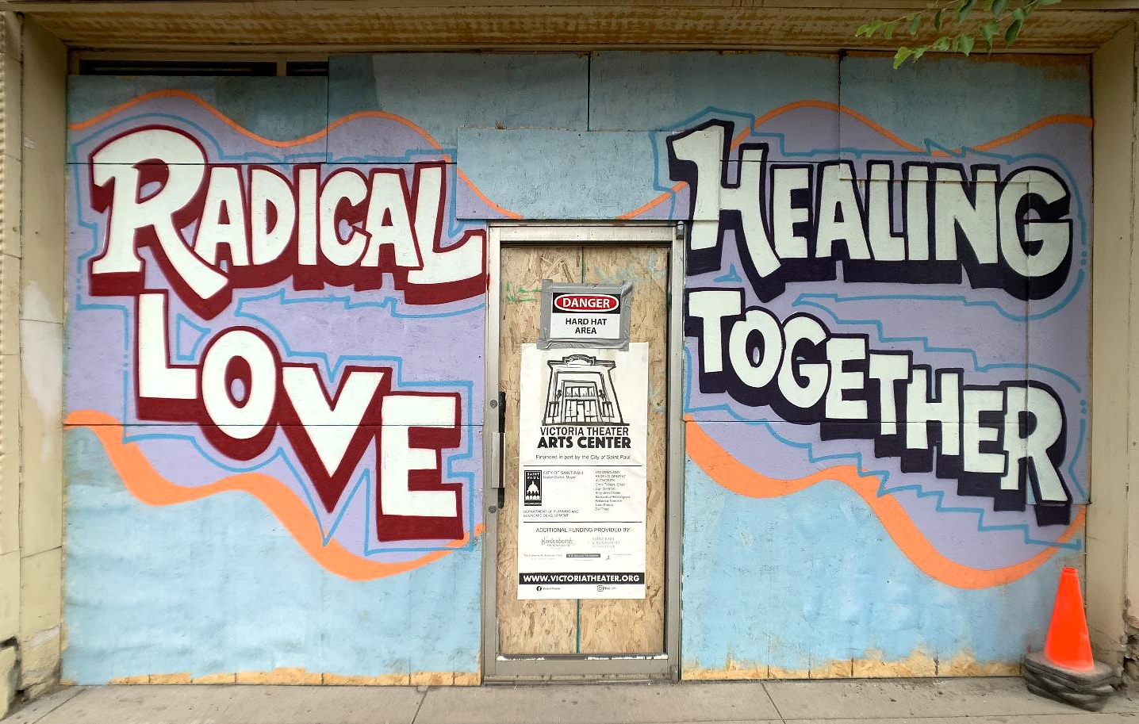
Street Art Response to George Floyd’s Death -- St. Paul, MN

Slide 20
"For where two or three are gathered in my name, I am there among them."
Matthew 18:20

Slide 21
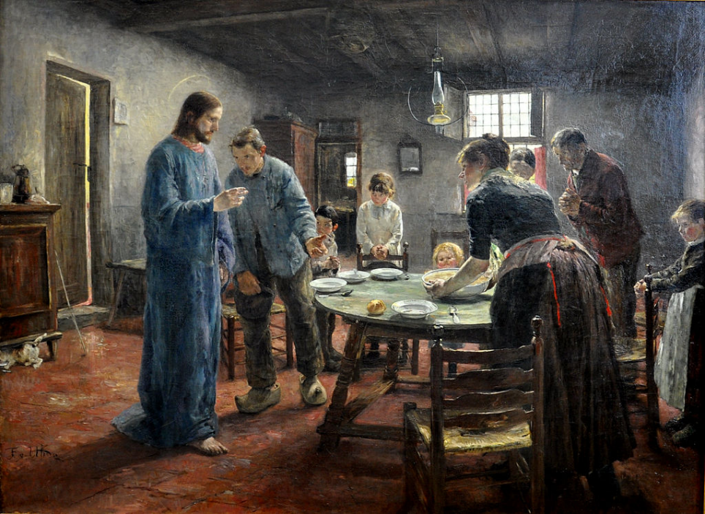
The Mealtime Prayer -- Fritz von Uhde, Alte Nationalgalerie, Berlin, Germany

Slide 22
Credits
New Revised Standard Version Updated Edition Bible, copyright 2022, Division of Christian Education of the National Council of the Churches of Christ in the United States of America. Used by permission. All rights reserved.
https://commons.wikimedia.org/wiki/File:Francisco_de_Zurbar%C3%A1n_006.jpg
http://commons.wikimedia.org/wiki/File:Tissot_The_Signs_on_the_Door.jpg
https://commons.wikimedia.org/wiki/File:Saint_Mary_Magdalene_Church_(Columbus,_Ohio)_-_mosaic,_Israelites_apply_blood_of_the_paschal_lamb_to_the_doorpost.jpg
http://www.flickr.com/photos/28268439@N04/3478029092/
https://commons.wikimedia.org/wiki/File:Dante_Gabriel_Rossetti_-_The_Passover_in_the_Holy_Family.jpg
https://commons.wikimedia.org/wiki/File:Pieter_Bruegel_the_Elder_-_Peasant_Wedding_-_Google_Art_Project_2.jpg
https://books.google.com/books?id=5VoEAAAAMBAJ&printsec=frontcover&dq=the+crisis+magazine+1939&hl=en&sa=X&ved=0ahUKEwiy8rT1_d_QAhVL8WMKHWw1AKA4ChDoAQgZMAA#v=onepage&q&f=false
https://commons.wikimedia.org/wiki/File:Munk%C3%A1csy,_Mih%C3%A1ly_-_Condemned_Cell_I_-_Google_Art_Project.jpg
https://commons.wikimedia.org/wiki/File:Artist_Olusola_David_Ayibiowu_Title_WISDOM.jpg
https://www.flickr.com/photos/number7cloud/50022634161
https://upload.wikimedia.org/wikipedia/commons/b/bb/Fritz_von_Uhde_Das_Tischgebet_01.jpg
Additional descriptions can be found at the Art in the Christian Tradition image library, a service of the Vanderbilt Divinity Library, http://diglib.library.vanderbilt.edu/. All images available via Creative Commons 3.0 License.

