Slide 1
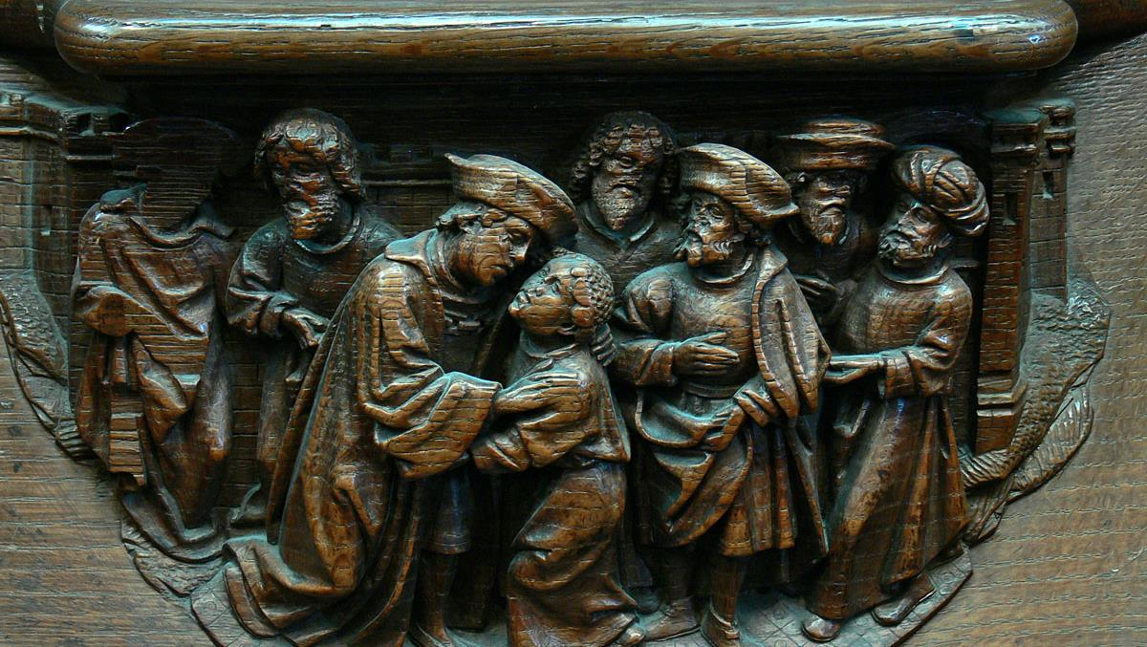
Twelfth Sunday after Pentecost
Year A
Genesis 45:1-15 and Psalm 133
Isaiah 56:1, 6-8 and Psalm 67 • Romans 11:1-2a, 29-32 Matthew 15: (10-20), 21-28

Slide 2
Then Joseph said to his brothers, "Come closer to me. ... I am your brother, Joseph, whom you sold into Egypt."
Genesis 45:4

Slide 3
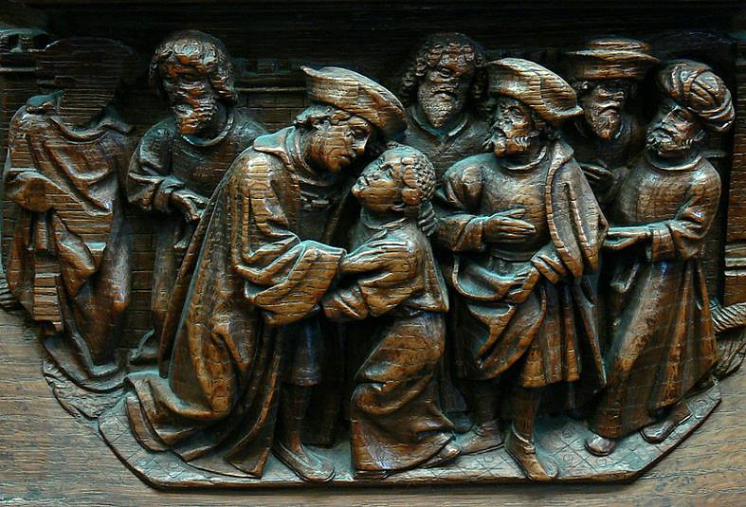
Joseph Meets His Brothers -- Choirstall woodcarving, Amiens Cathedral

Slide 4
"…do not be distressed or angry with yourselves because you sold me … it was not you who sent me here, but God."
Genesis 45:5a, 8a

Slide 5
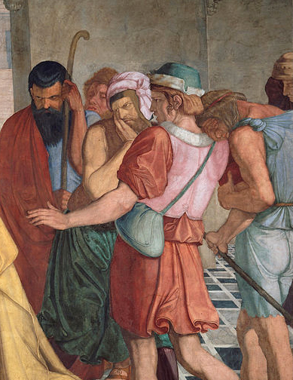
Joseph Welcomes his Brothers (detail)
Peter von Cornelius Deutsche Akademie Villa Massimo
Rome, Italy

Slide 6
Then he fell upon his brother Benjamin's neck and wept, while Benjamin wept upon his neck. And he kissed all his brothers and wept upon them...
Genesis 45:14-15a

Slide 7
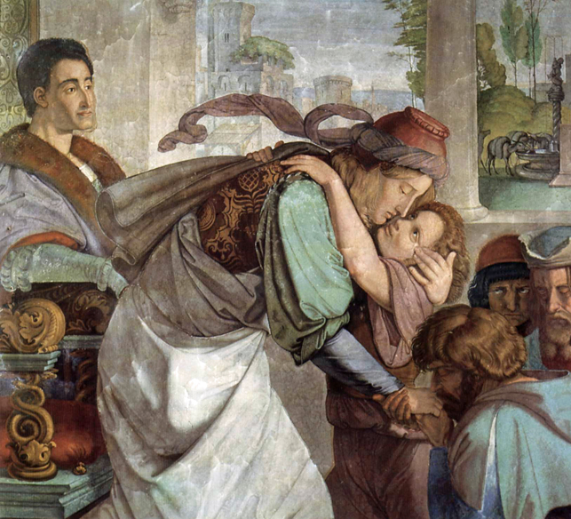
Joseph Embraces His Brothers -- Peter von Cornelius, Deutsche Akademie Villa Massimo, Rome, Italy

Slide 8
How very good and pleasant it is
when kindred live together in unity!
Psalm 133:1

Slide 9
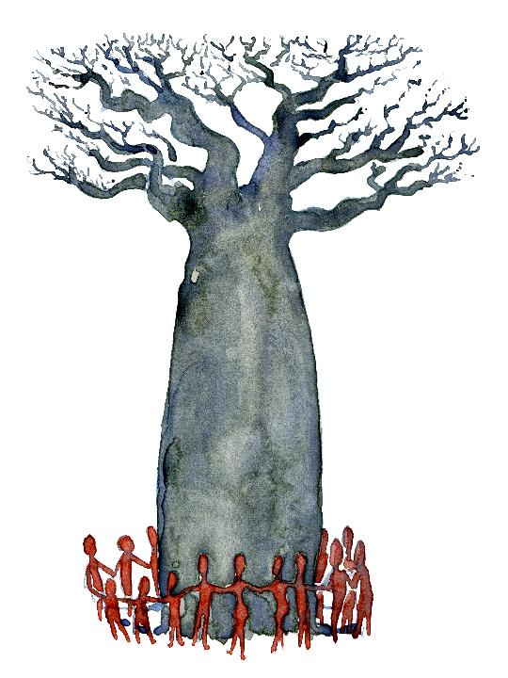
People Around a Baobob Tree
Fritz Ahlefeldt

Slide 10
Thus says the LORD: Maintain justice, and do what is right…
Isaiah 56:1

Slide 11
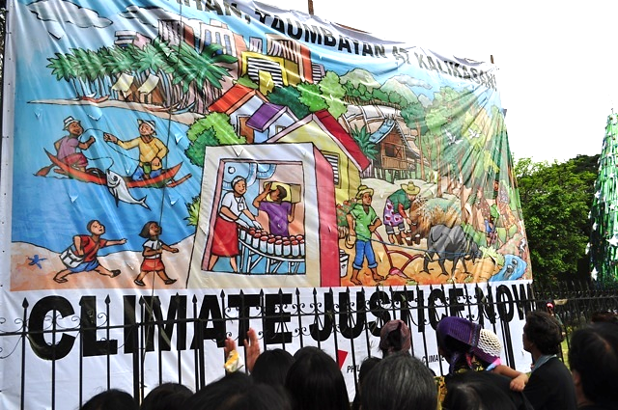
Philippine Movement for Climate Justice -- International Meeting, Cancun, Mexico

Slide 12
Let the nations be glad and sing for joy, for you judge the peoples with equity and guide the nations upon earth.
Psalm 67:4

Slide 13
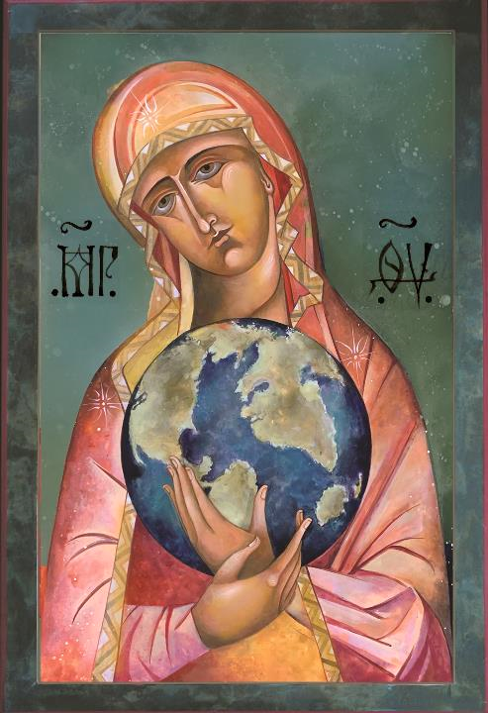
A Mother's Love Holds the World
Mary Jane Miller

Slide 14
...for the gifts and the calling of God
are irrevocable.
Romans 11:29

Slide 15
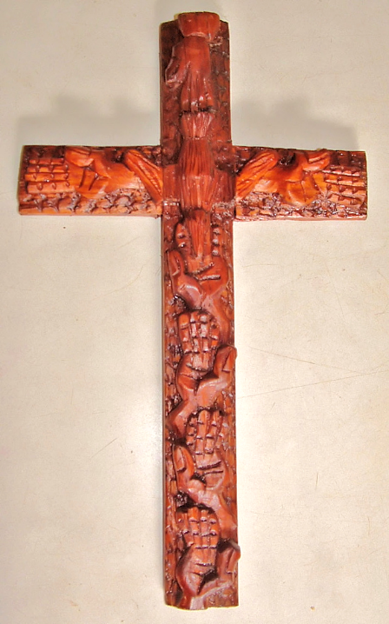
"Hands" Cross
Mulungwishi Chapel, Mulungwishi,
Democratic Republic of Congo

Slide 16
Then he called the crowd to him and said … "Listen and understand:
it is not what goes into the mouth that defiles a person, but … what comes out of the mouth..."
Matthew 15:10-11

Slide 17

Guarding Words and Action -- Stephen Poff

Slide 18
Just then a Canaanite woman … came out and started shouting, "Have mercy on me, Lord, Son of David; my daughter is tormented by a demon."
Matthew 15:22

Slide 19
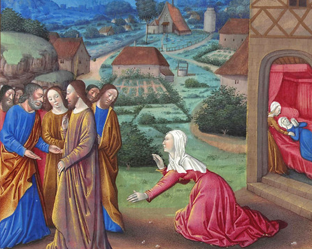
Christ and the Canaanite Woman -- Limbourg Brothers, Musee Conde, Chantilly, France

Slide 20
…she came and knelt before him, saying, "Lord, help me."
Matthew 15:25

Slide 21
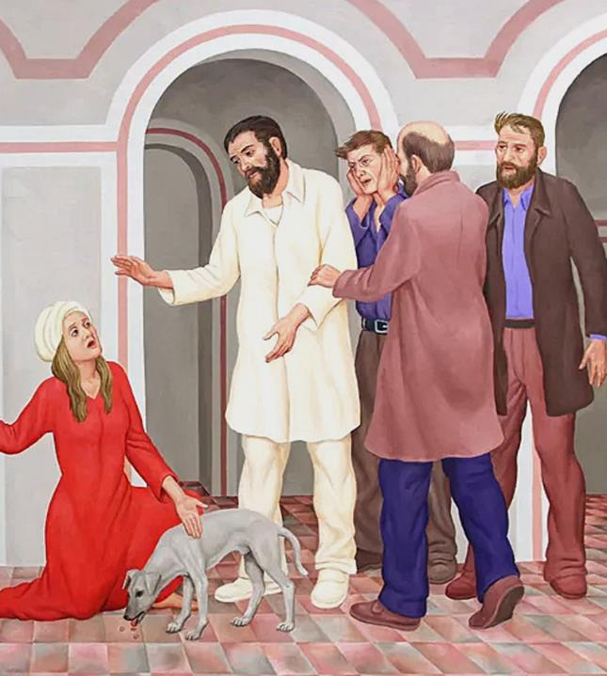
The Daughter of the Canaanite Woman
Peter Koenig

Slide 22
…Jesus answered her, "Woman, great is your faith! Let it be done for you as you wish." And her daughter was healed from that moment.
Matthew 15:28

Slide 23
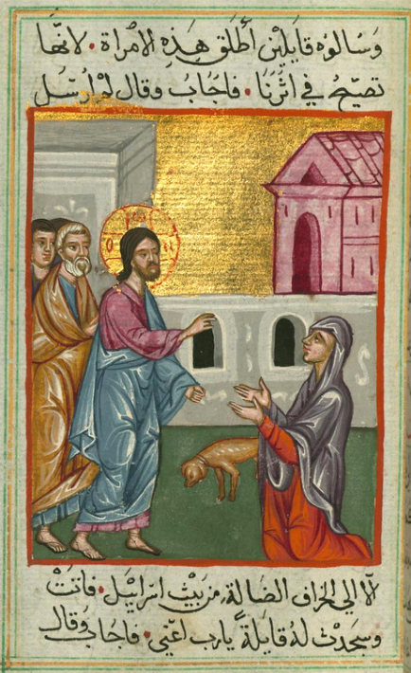
Christ and the Canaanite Woman
Ilyas Basim Khuri Bazzi Rahib
Walters Art Museum
Baltimore, MD

Slide 24
Credits
New Revised Standard Version Updated Edition Bible, copyright 2022, Division of Christian Education of the National Council of the Churches of Christ in the United States of America. Used by permission. All rights reserved.
https://www.flickr.com/photos/overton_cat/5751959348/
http://commons.wikimedia.org/wiki/File:Peter_von_Cornelius_004.jpg
http://commons.wikimedia.org/wiki/File:Peter_von_Cornelius_004.jpg
https://commons.wikimedia.org/wiki/File:Watercolor-baobab-tree-with-people-group-painting-by-frits-ahlefeldt.jpg
https://www.flickr.com/photos/foei/5226217052
https://www.millericons.com/
https://www.flickr.com/photos/umccongo/2051227883
http://www.flickr.com/photos/stephenpoff/3530640841/
http://commons.wikimedia.org/wiki/File:Folio_164r_-_The_Canaanite_Woman.jpg
http://americanart.si.edu/collections/search/artwork/?id=26809
http://commons.wikimedia.org/wiki/File:Ilyas_Basim_Khuri_Bazzi_Rahib_-_Jesus_and_the_Canaanite_Woman_-_Walters_W59243A_-_Full_Page.jpg
Additional descriptions can be found at the Art in the Christian Tradition image library, a service of the Vanderbilt Divinity Library, http://diglib.library.vanderbilt.edu/. All images available via Creative Commons 3.0 License.

