Slide 1
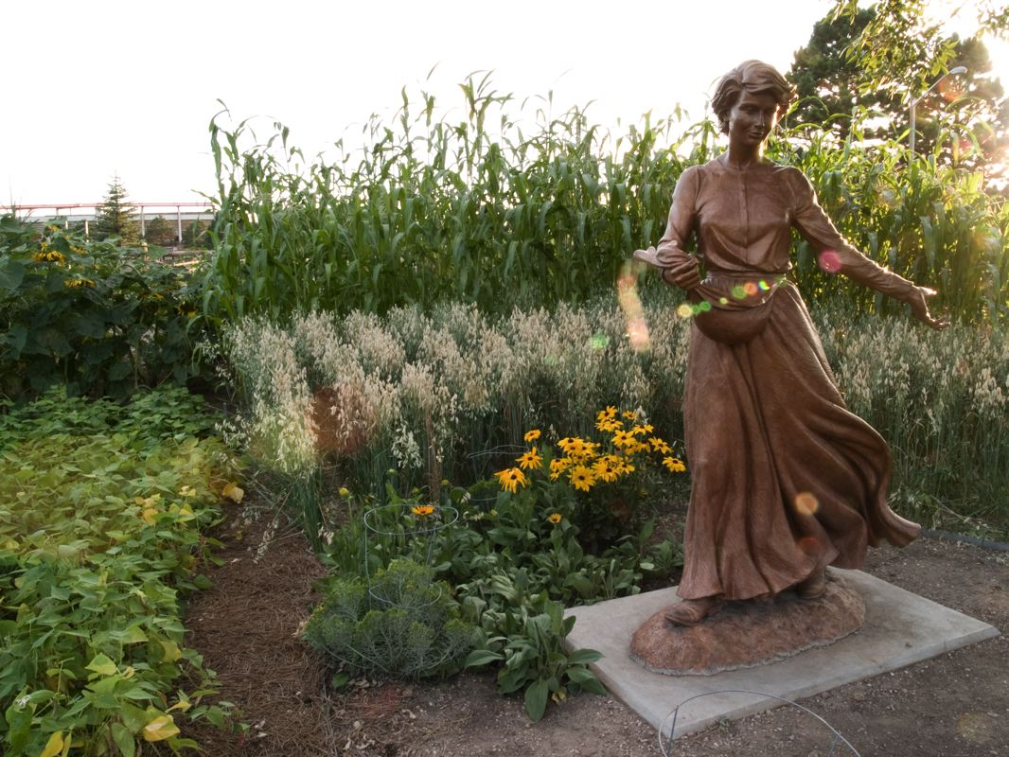
Seventh Sunday after Pentecost
Year A
Genesis 25:19-34 and Psalm 119:105-112
Isaiah 55:10-13 and Psalm 65:(1-8), 9-13 Romans 8:1-11
Matthew 13:1-9, 18-23

Slide 2
When her time to give birth was at hand, there were twins in her womb. The first…Esau. Afterward his brother… with his hand gripping Esau's heel…named Jacob.
Genesis 25:24, 25ac, 26ab

Slide 3
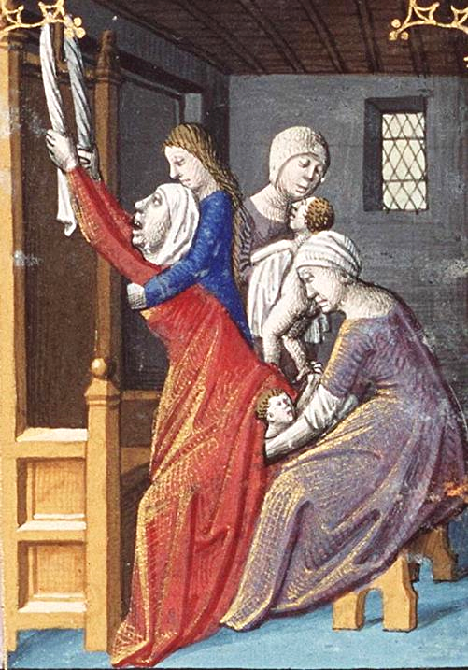
Birth of Esau and Jacob
Manuscript of Augustine's "City of God"
Francois Maitre
Museum Meermanno Westreenianum
The Hague, Netherlands

Slide 4
Esau said to Jacob, "Let me eat some of that red stuff, for I am famished!" ... Jacob said, "First sell me your birthright."
Genesis 25:30a, 31

Slide 5
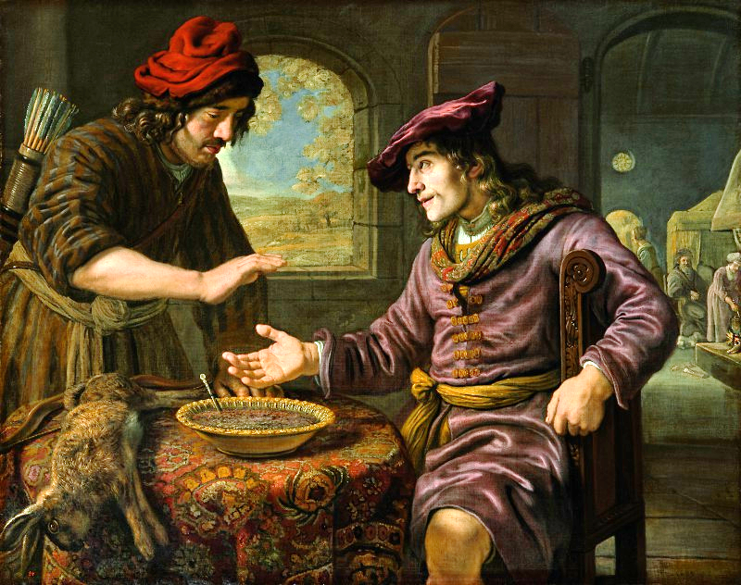
Esau, Jacob, and the Bowl of Pottage -- Jan Victor, Palace on the Water, Warsaw, Poland

Slide 6
Your word is a lamp to my feet and a light to my path.
Psalm 119:105

Slide 7
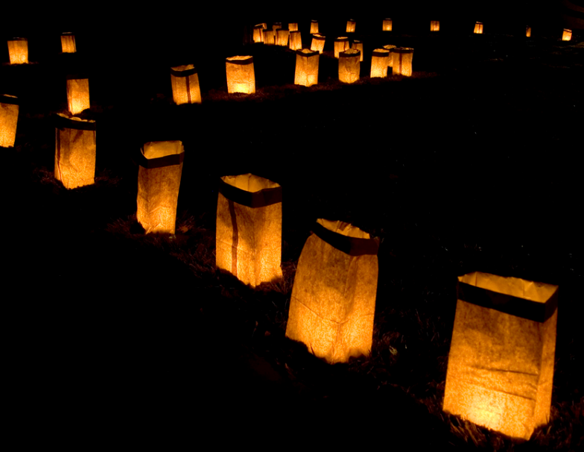
Luminarias Along the Path -- Danae Hurst, Albuquerque, NM

Slide 8
For as the rain and the snow … have watered the earth, making it bring forth and sprout, giving seed to the sower … so shall my word be.
Isaiah 55:10, 11a

Slide 9
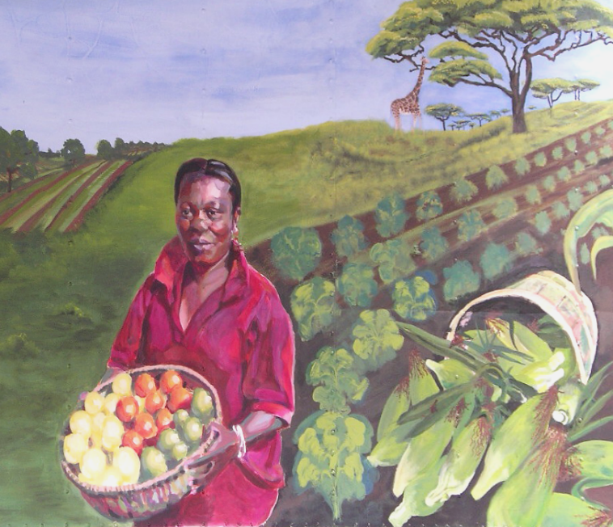
Seaona Ban Ngufor, New Entry Sustainable Farm, Dracut, MA

Slide 10
You visit the earth and water it; you greatly enrich it; … you provide the people with grain, for so you have prepared it.
Psalm 65:9

Slide 11
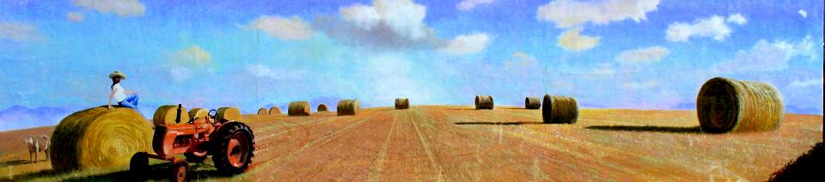
Farm Mural, adjacent to Federal Land Bank Bldg, Columbia, SC

Slide 12
… to set the mind on the Spirit is life and peace.
Romans 8:6b

Slide 13
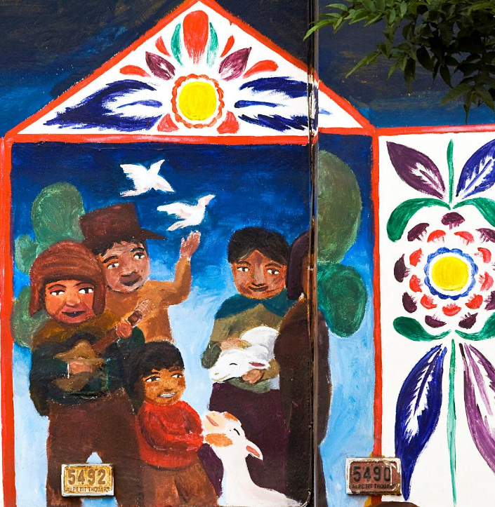
Peruvian Street Art
Lima, Peru

Slide 14
And he told them many things in parables, saying: "Listen! A sower went out to sow."
Matthew 13:3

Slide 15
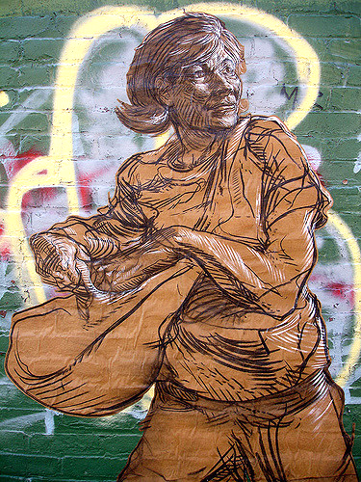
Sally Sows
Street mural, Brooklyn, NY

Slide 16
"And as he sowed, some seeds fell on a path, and the birds came and ate them up."
Matthew 13:4

Slide 17
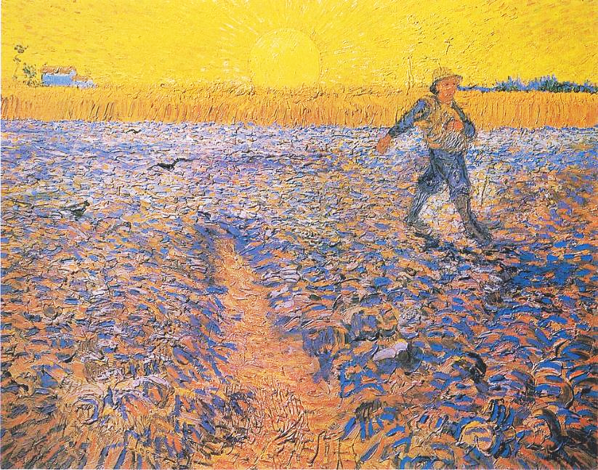
Sower at Sunset -- Vincent van Gogh, Kroller-Muller Museum, Otterlo, Netherlands

Slide 18
"Other seeds fell on rocky ground, where they did not have much soil, and they sprang up quickly, since they had no depth of soil."
Matthew 13:5

Slide 19
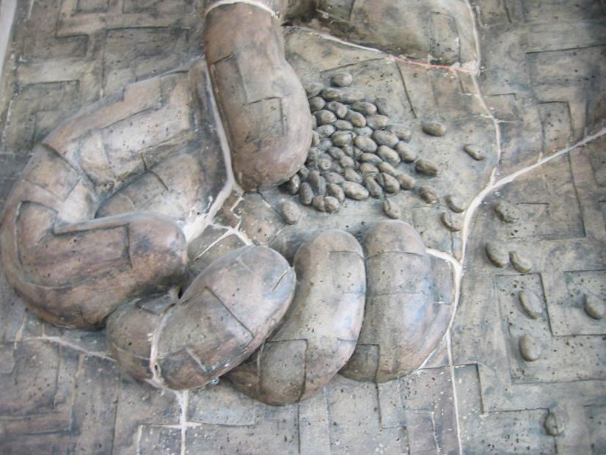
Sowing Seed -- Unidentified church sculpture

Slide 20
"But when the sun rose, they were scorched, and since they had no root, they withered away."
Matthew 13:6

Slide 21
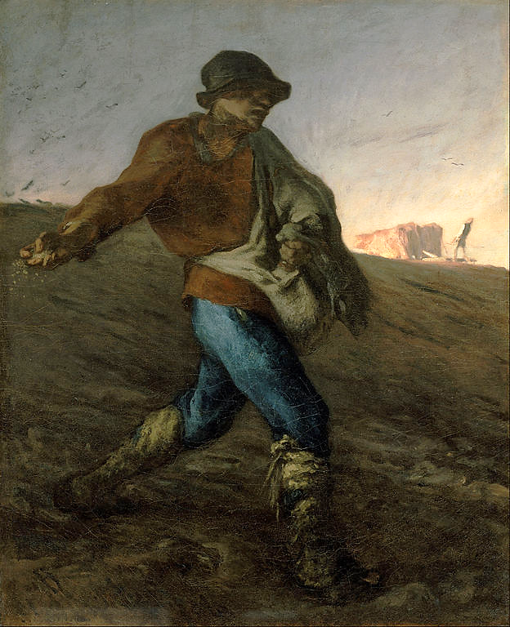
The Sower
Jean-Francois Millet Boston Museum of Fine Arts, Boston, MA

Slide 22
"Other seeds fell among thorns, and the thorns grew up and choked them."
Matthew 13:7

Slide 23
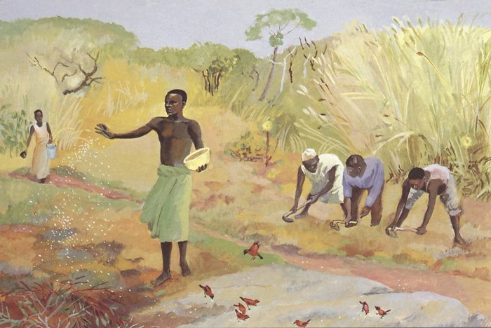
Parable of the Sower -- JESUS MAFA, Cameroon

Slide 24
"Other seeds fell on good soil and brought forth grain, some a hundredfold, some sixty, some thirty."
Matthew 13:8

Slide 25
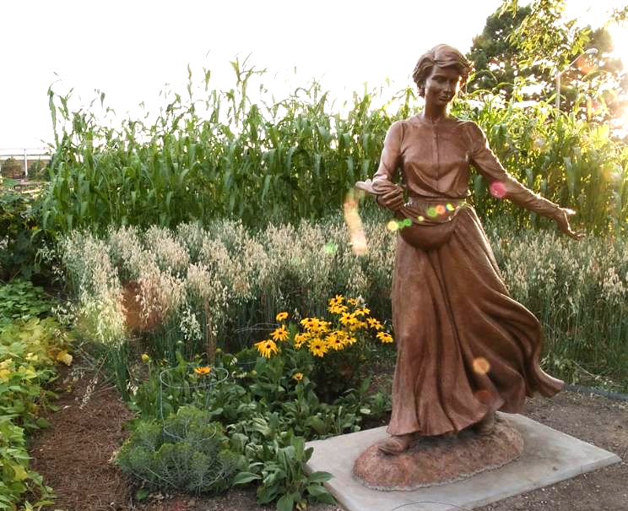
Seed and the Sower -- Cheyenne Botanic Gardens, Cheyenne, WY

Slide 26
"But as for what was sown on good soil, this is the one who hears the word and understands it, who indeed bears fruit and yields …"
Matthew 13:23a

Slide 27
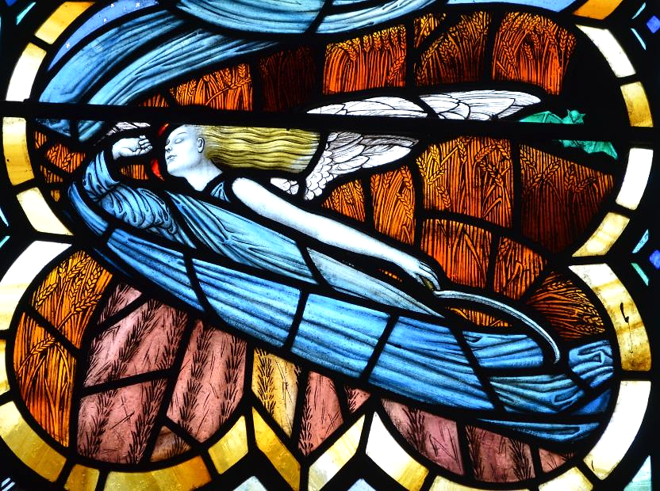
The Reaper -- William Morris & Co., Marden, UK

Slide 28
Credits
New Revised Standard Version Updated Edition Bible, copyright 2022, Division of Christian Education of the National Council of the Churches of Christ in the United States of America. Used by permission. All rights reserved.
http://commons.wikimedia.org/wiki/File:Maitre_Birth_of_Esau_and_Jacob_(detail).jpg
https://commons.m.wikimedia.org/wiki/File:Victors_Esau_and_the_mess_of_pottage.jpg
http://www.flickr.com/photos/jadexjustice/2637698911/
https://www.flickr.com/photos/wbur/3853749773/
https://www.flickr.com/photos/geraldbrazell/4104767964
https://www.flickr.com/photos/ru_boff/15040117527
https://www.flickr.com/photos/guy_on_the_streets/185485832/
https://commons.wikimedia.org/wiki/File:Van_Gogh_-_S%C3%A4mann_bei_untergehender_Sonne.jpeg
https://www.flickr.com/photos/benny_lin/266525738
https://commons.wikimedia.org/wiki/File:Jean-Fran%C3%A7ois_Millet_-_The_Sower_-_Google_Art_Project.jpg
http://diglib.library.vanderbilt.edu/act-imagelink.pl?RC=48309
https://www.flickr.com/photos/ljguitar/1099799640/
https://www.flickr.com/photos/jpguffogg/12618857873/
Additional descriptions can be found at the Art in the Christian Tradition image library, a service of the Vanderbilt Divinity Library, http://diglib.library.vanderbilt.edu/. All images available via Creative Commons 3.0 License.

