Slide 1
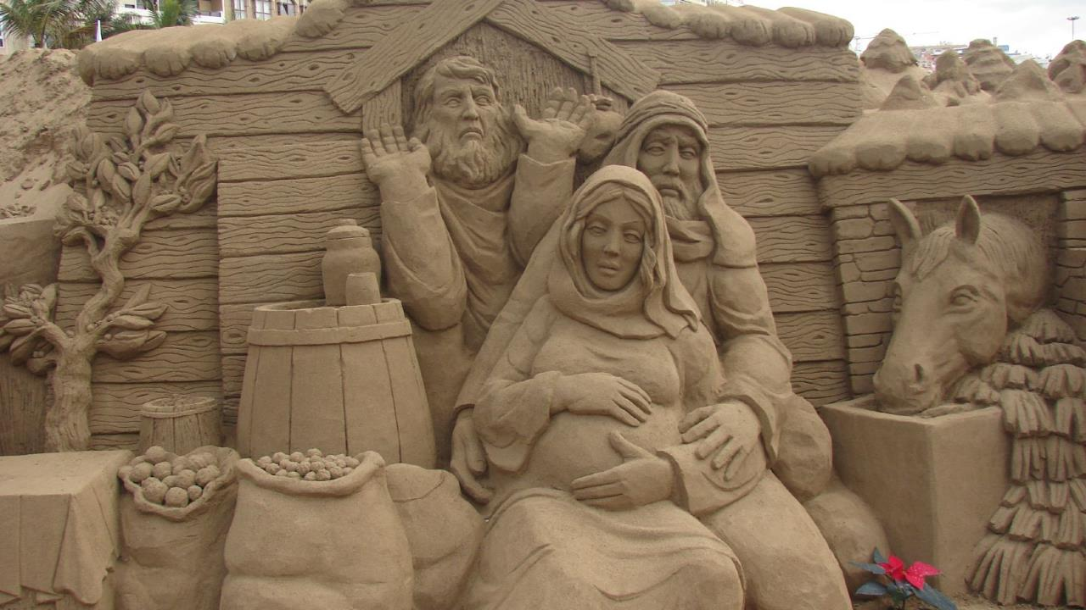
Nativity of the Lord I
Year A
Isaiah 9:2-7
Psalm 96
Titus 2:11-14
Luke 2:1-14, (15-20)

Slide 2
The people who walked in darkness have seen a great light; those who lived in a land of deep darkness—
on them light has shined.
Isaiah 9:2

Slide 3
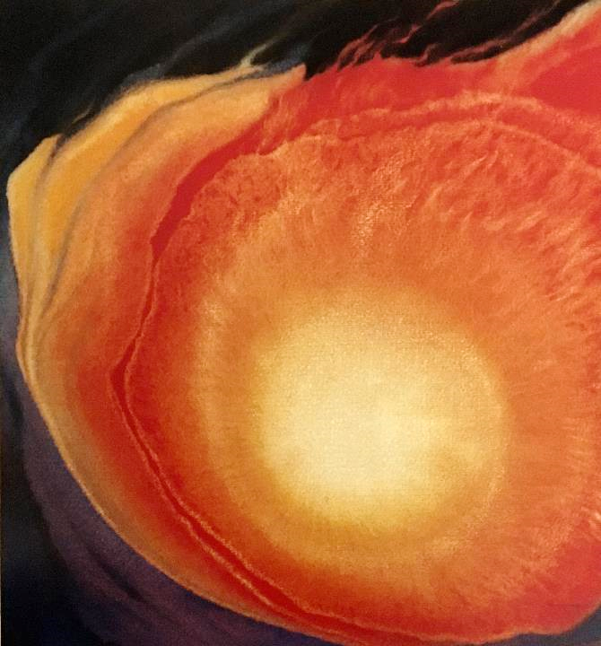
Churinga –
Pure Light, Glory of God
Frank Wesley

Slide 4
For a child has been born for us, a son given to us; authority rests upon his shoulders...
Isaiah 9:6a

Slide 5
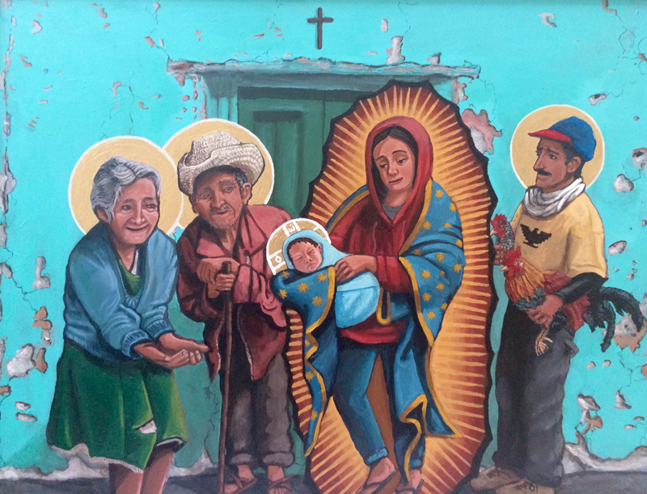
Presentation of the Christ Child -- Kelly Latimore, Longview, TX

Slide 6
...and he is named Wonderful Counselor, Mighty God, Everlasting Father, Prince of Peace.
Isaiah 9:6b

Slide 7
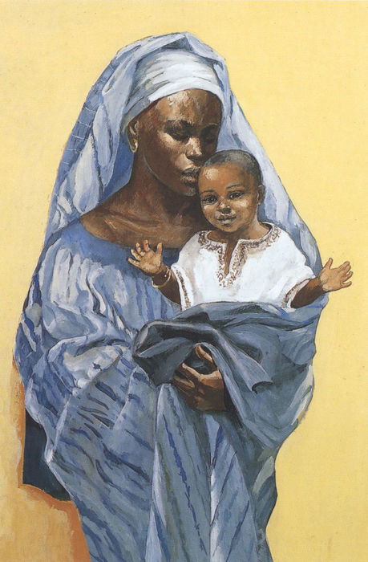
Madonna and Child
JESUS MAFA
Cameroon

Slide 8
…there shall be endless peace for the throne of David and his kingdom. He will establish and uphold it with justice…
Isaiah 9:7b

Slide 9
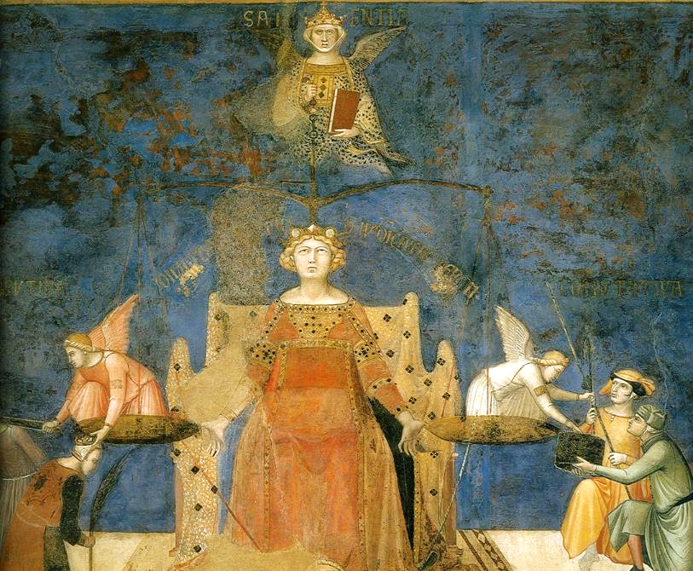
Good Government
Ambrogio Lorenzetti
Palazzo Pubblico
Siena

Slide 10
O sing to the LORD a new song; sing to the LORD, all the earth.
Psalm 96:1

Slide 11
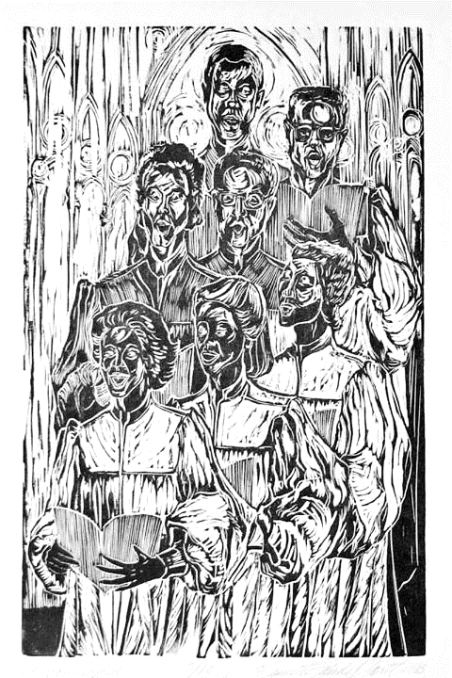
Choir
Annette Gandy Fortt
Silver Spring, MD

Slide 12
Let the heavens be glad, and let the earth rejoice; let the sea roar and all that fills it...
Psalm 96:11

Slide 13
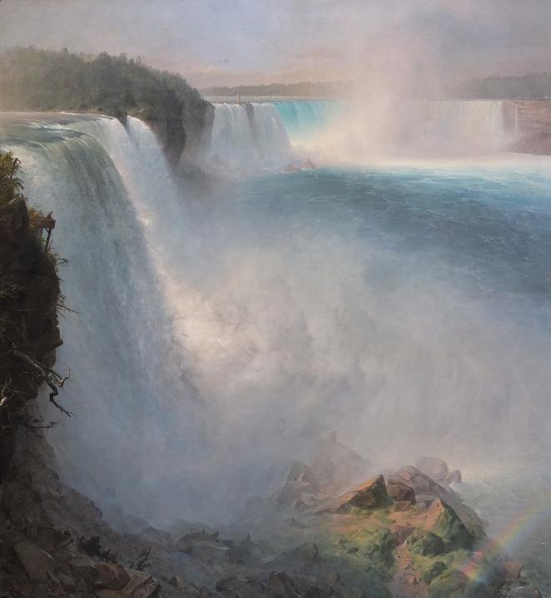
Niagara Falls
Frederick Church Scottish National Gallery

Slide 14
…let the field exult and everything in it. Then shall all the trees of the forest sing for joy…
Psalm 96:12

Slide 15
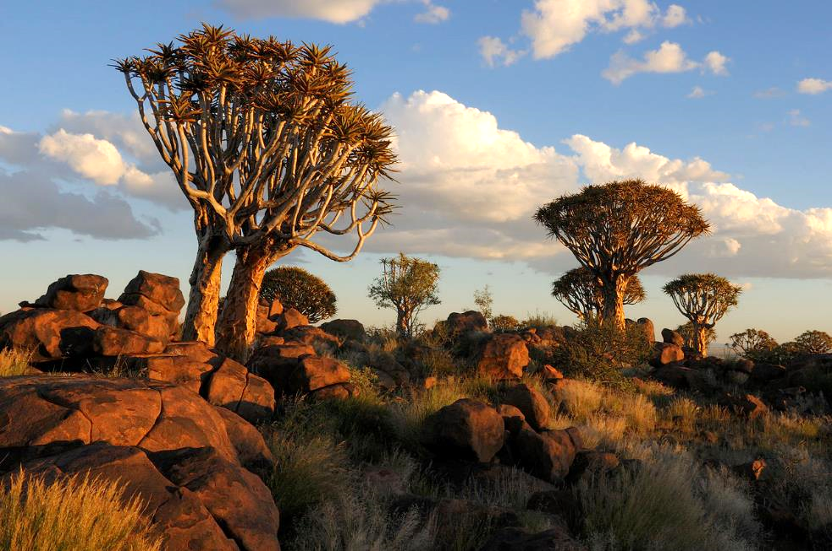
Quiver Tree Forest -- Hans Steiglitz, Keetmanshoop, Namibia

Slide 16
He will judge the world with righteousness and the peoples with his truth.
Psalm 96:13b

Slide 17
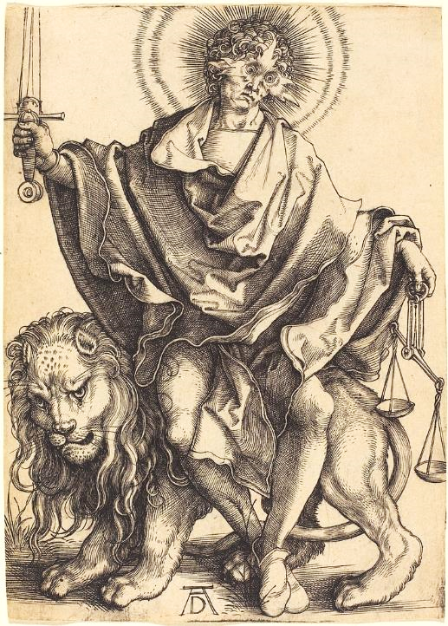
Sun of Righteousness
Albrecht Durer National Gallery of Art
Washington, DC

Slide 18
For the grace of God has appeared, bringing salvation to all…
Titus 2:11

Slide 19
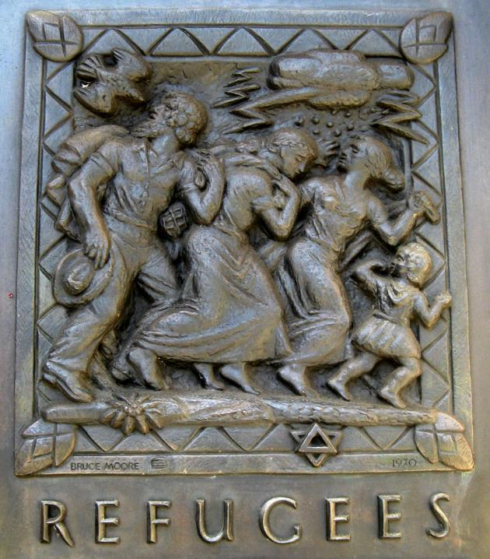
Refugees
Bronze door panel Grace Cathedral
San Francisco, CA

Slide 20
And she gave birth to her firstborn son and wrapped him in bands of cloth and laid him in a manger, because there was no place in the guest room.
Luke 2:7

Slide 21
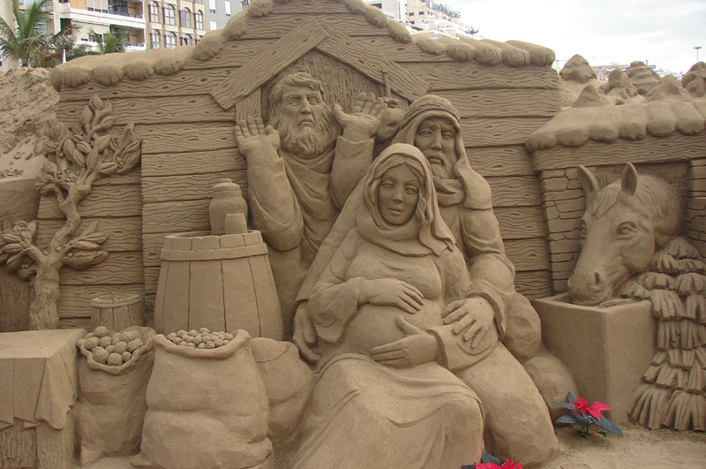
No Room at the Inn -- Peter Busch, Canary Islands, Spain

Slide 22
"Do not be afraid, for see, I am bringing you good news of great joy for all the people: to you is born this day in the city of David a Savior, who is the Messiah, the Lord.”
Luke 2:10b-11

Slide 23
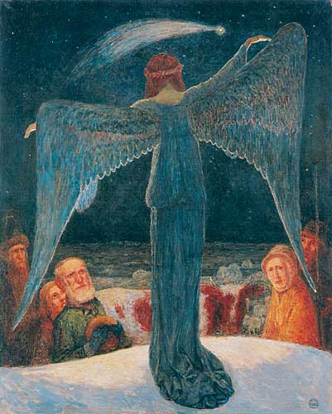
Annunciation to the Shepherds
Heinrich Vogeler

Slide 24
So they went with haste and found Mary and Joseph and the child lying in the manger.
Luke 2:16

Slide 25
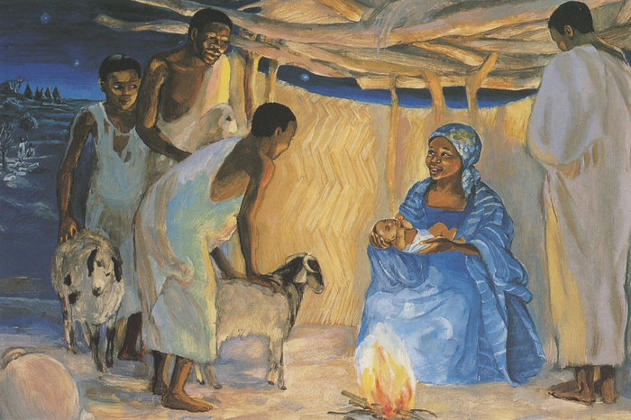
Birth of Jesus with the Shepherds -- JESUS MAFA, Cameroon

Slide 26
Credits
New Revised Standard Version Updated Edition Bible, copyright 2022, Division of Christian Education of the National Council of the Churches of Christ in the United States of America. Used by permission. All rights reserved.
http://commons.wikimedia.org/wiki/File:Study-for-Mural_Douglas.jpg
https://kellylatimoreicons.com/contact/
http://diglib.library.vanderbilt.edu/act-imagelink.pl?RC=48380
https://commons.wikimedia.org/wiki/File:Lorenzetti_Amb._good_government_det..jpg
annettefortt.com
https://commons.wikimedia.org/wiki/File:Edinburgh_NGS_Frederic_Church_Niagara_American_side.JPG
https://commons.wikimedia.org/wiki/File:Fra_Filippo_Lippi_-_The_Adoration_in_the_Forest_-_Google_Art_Project.jpg
https://commons.wikimedia.org/wiki/File:Albrecht_D%C3%BCrer_-_Sol_Iustitiae_(Sun_of_Righteousness)_(NGA_1943.3.3484).jpg
http://www.flickr.com/photos/wallyg/3972632149/
http://www.flickr.com/photos/mercywatch/2095491207/
https://commons.wikimedia.org/wiki/File:Heinrich_Vogeler_Verk%C3%BCndigung_an_die_Hirten_1902.jpg
http://diglib.library.vanderbilt.edu/act-imagelink.pl?RC=48387
Additional descriptions can be found at the Art in the Christian Tradition image library, a service of the Vanderbilt Divinity Library, http://diglib.library.vanderbilt.edu/. All images available via Creative Commons 3.0 License.

