Slide 1
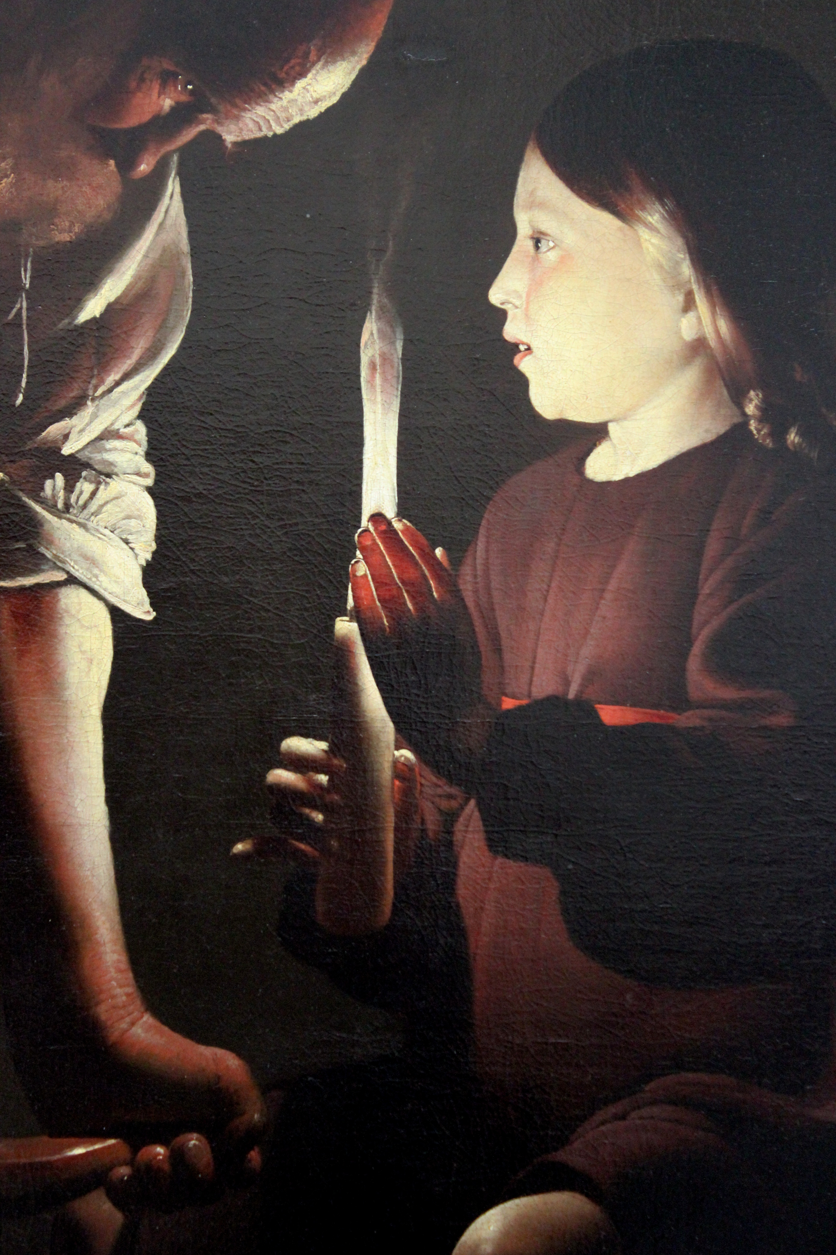
Fourth Sunday of Advent
Year A
Isaiah 7:10-16
Psalm 80:1-7, 17-19
Romans 1:1-7
Matthew 1:18-25

Slide 2
Look, the young woman is with child and shall bear a son and shall name him Immanuel.
Isaiah 7:14b

Slide 3
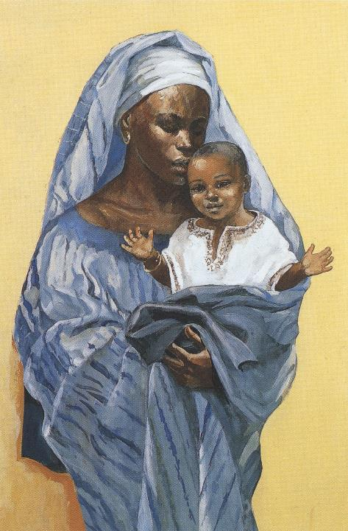
Mary and the Christ Child
JESUS MAFA
Cameroon

Slide 4
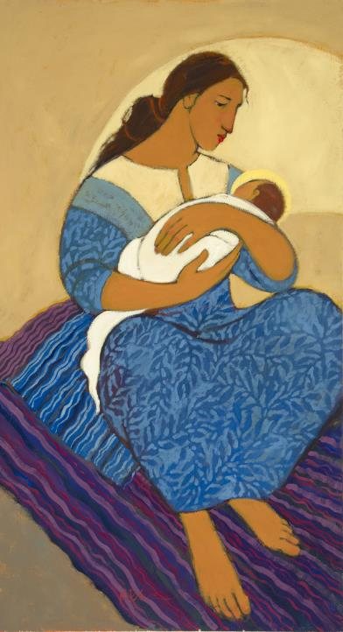
Mary and Baby Jesus
Kathleen Peterson
Spring City, UT

Slide 5
Give ear, O Shepherd of Israel, you who lead Joseph like a flock!
Psalm 80:1

Slide 6
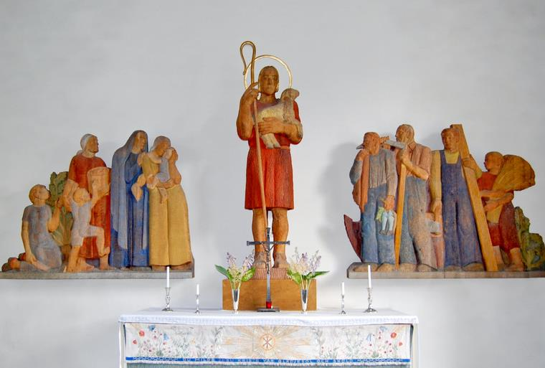
Good Shepherd – Gunnar Torhamn, Soderakra Church, Soderakra, Sweden

Slide 7
Restore us, O God;
let your face shine,
that we may be saved.
Psalm 80:3

Slide 8
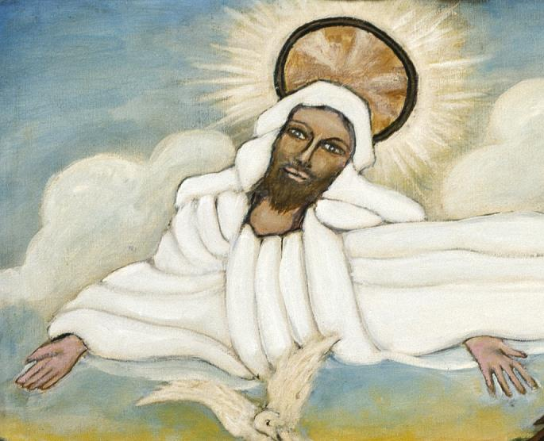
God, from Baptism of Jesus -- Lorenzo Scott, Smithsonian American Art Museum, Washington, DC

Slide 9
…the gospel concerning his Son, who was descended from David…which he promised beforehand through his prophets in the holy scriptures…
Romans 1:3a, 2

Slide 10
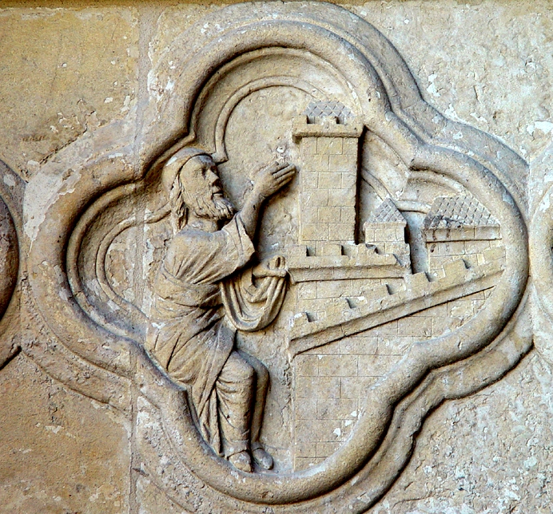
Isaiah Prophesying the Adoration of Christ
Amiens Cathedral

Slide 11
...Jesus Christ our Lord, through whom we have received grace and apostleship…
Romans 1:4c, 5a

Slide 12
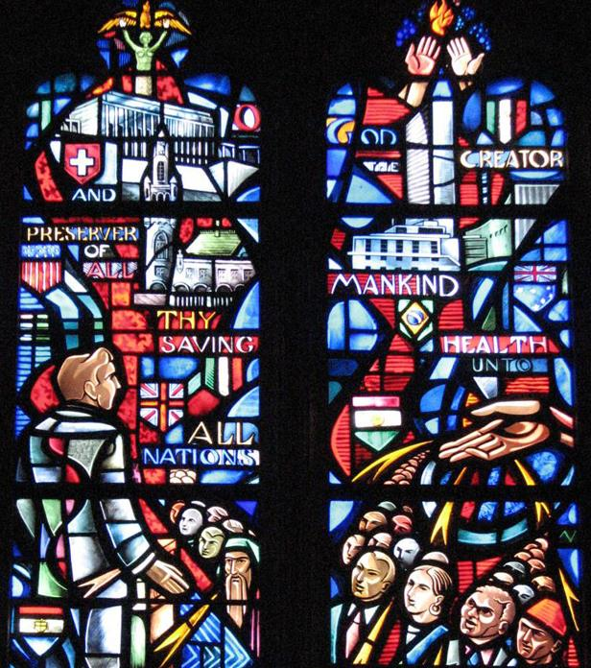
Saving Grace to All Humankind
National Cathedral Washington DC

Slide 13
Grace to you and peace from God our Father and the Lord Jesus Christ.
Romans 1:7b

Slide 14
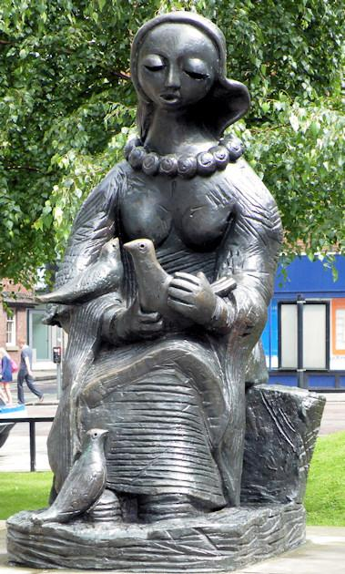
Messenger of Peace
Barbara Pearson
Manchester, England

Slide 15
…she was found to be pregnant from the Holy Spirit.
Matthew 1:18c

Slide 16
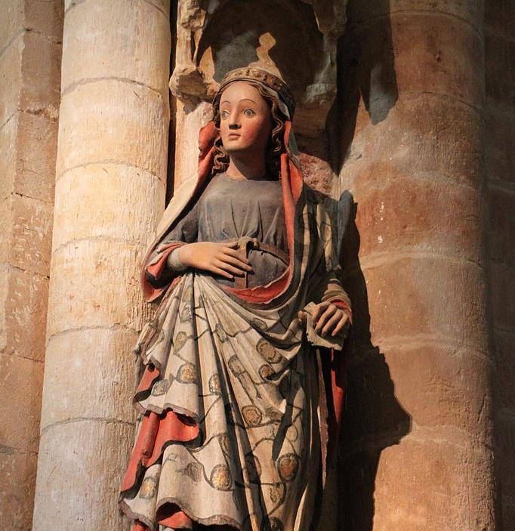
Mary with Child
Collegiate Church of Saint Mary
Toro, Spain

Slide 17
Her husband Joseph, being a righteous man and unwilling to expose her to public disgrace, planned to divorce her quietly.
Matthew 1:19

Slide 18
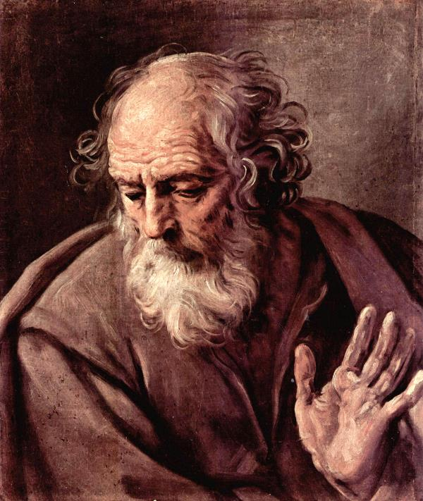
Joseph
Guido Reni
Palazzo Barberini Rome, Italy

Slide 19
…an angel of the Lord appeared to him in a dream and said, "Joseph, son of David, do not be afraid to take Mary as your wife, for the child conceived in her is from the Holy Spirit.”
Matthew 1:20b

Slide 20
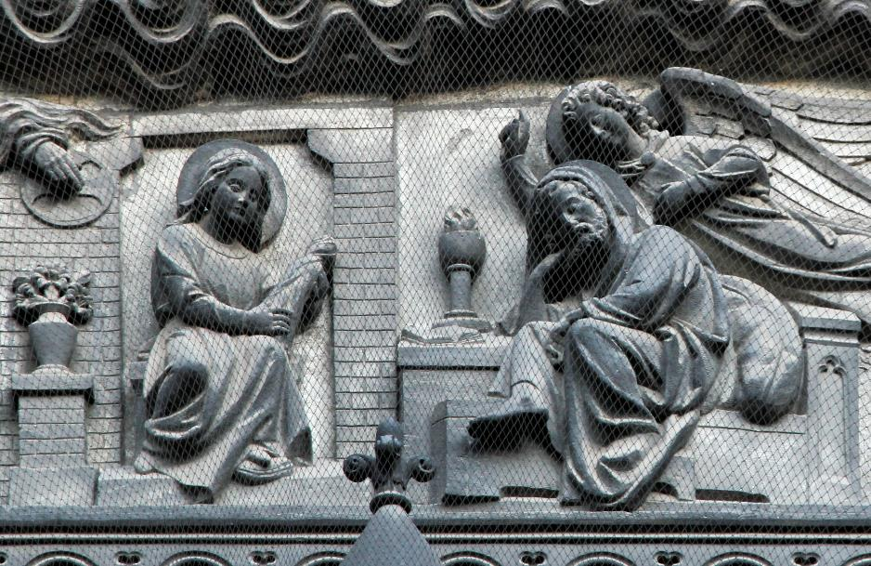
Joseph’s Dream -- Lille Cathedral, Lille, France

Slide 21
"She will bear a son, and you are to name him Jesus…"
Matthew 1:21a

Slide 22
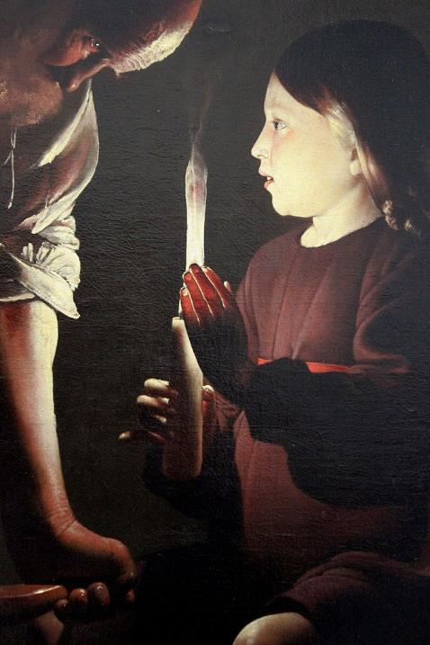
Joseph the Carpenter
Georges de la Tour
Louvre Museum

Slide 23
All this took place to fulfill what had been spoken by the Lord through the prophet:
“Look, the virgin shall become pregnant and give birth to a son, and they shall name him Emmanuel,” which means, "God is with us."
Matthew 1:22-23

Slide 24
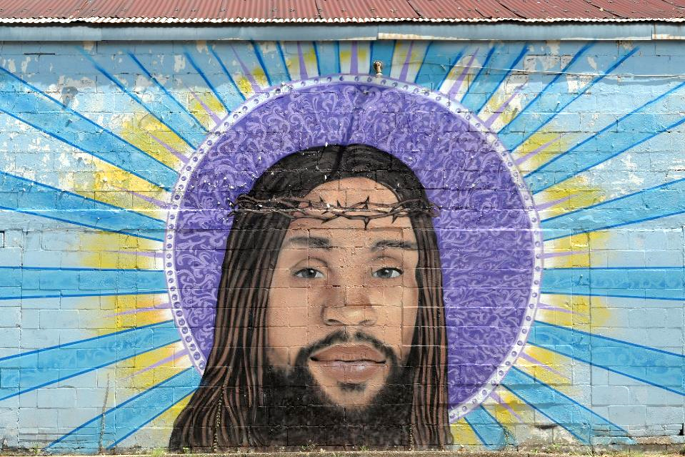
Jesus Christ -- Mural from The Way Jesus Christ Christian Church, New Orleans, LA

Slide 25
When Joseph awoke from sleep, he did as the angel of the Lord commanded him; he took her as his wife...
Matthew 1:24

Slide 26
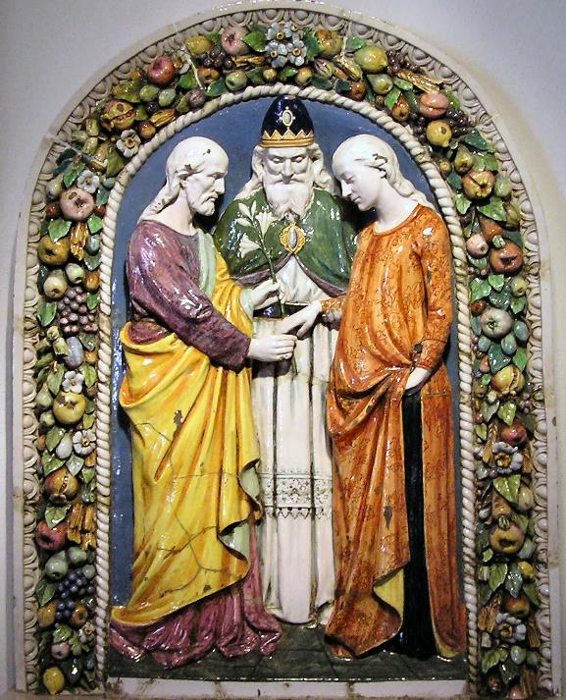
Marriage of Joseph and Mary
Andrea della Robbia Malmo, Sweden

Slide 27
Credits
New Revised Standard Version Updated Edition Bible, copyright 2022, Division of Christian Education of the National Council of the Churches of Christ in the United States of America. Used by permission. All rights reserved.
http://www.librairie-emmanuel.fr
https://www.kathleenpetersonart.com
http://commons.wikimedia.org/wiki/File:S%C3%B6der%C3%A5kra_kyrka04.JPG
https://americanart.si.edu/artwork/baptism-jesus-33953
http://diglib.library.vanderbilt.edu/act-imagelink.pl?RC=29209
http://www.flickr.com/photos/reabhecc/5422927891/
https://commons.wikimedia.org/wiki/File:Messenger_of_Peace_-_geograph.org.uk_-_1419312.jpg
https://commons.wikimedia.org/wiki/File:Virgen_encinta,_Colegiata_de_Sta_M%C2%AA_La_Mayor,_Toro.JPG
http://diglib.library.vanderbilt.edu/act-imagelink.pl?RC=46511
https://www.flickr.com/photos/paullew/23745541071, Fr Lawrence Lew
https://commons.wikimedia.org/wiki/File:Carpintero_La_Tour_03.JPG
https://www.flickr.com/photos/volvob12b/48740737607/
https://commons.wikimedia.org/wiki/File:Andrea_della_Robbia-Malm%C3%B8.jpg, Gunnar Pederson
Additional descriptions can be found at the Art in the Christian Tradition image library, a service of the Vanderbilt Divinity Library, http://diglib.library.vanderbilt.edu/. All images available via Creative Commons 3.0 License.

