Slide 1
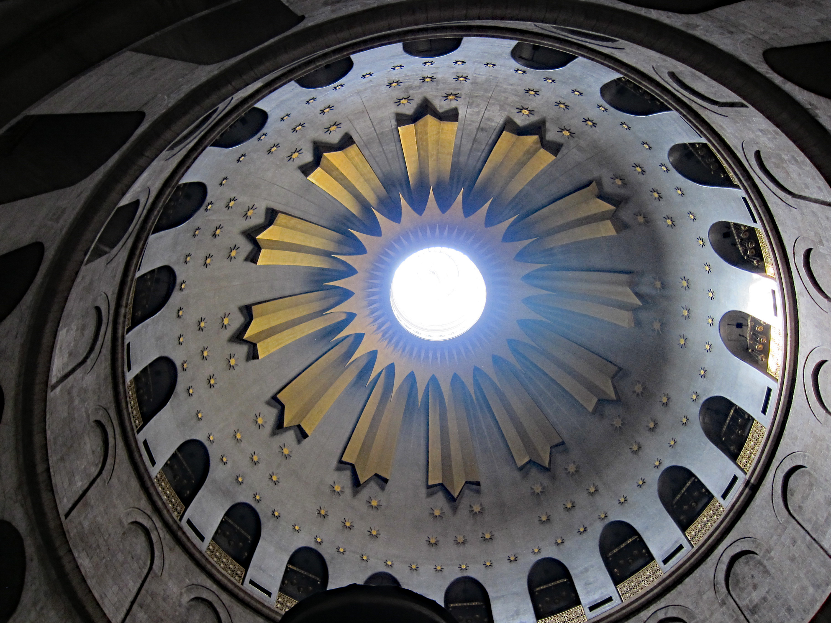
Ascension of the Lord
Year A
Acts 1:1-11 • Psalm 47 or Psalm 93 • Ephesians 1:15-23 Luke 24:44-53

Slide 2
When he had said this, as they were watching, he was lifted up, and a cloud took him out of their sight.
Acts 1:9

Slide 3
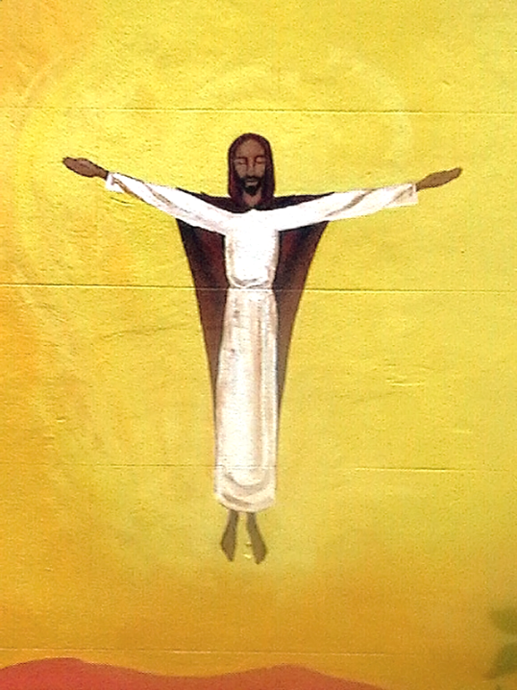
Ascension
Building Mural
Bristol, England

Slide 4
Clap your hands, all you peoples; shout to God with loud songs of joy.
Psalm 47:1

Slide 5
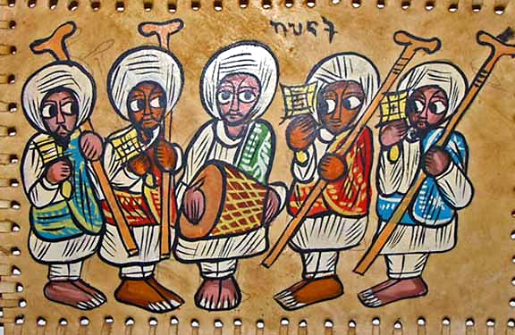
Ethiopian Orthodox Choir -- Paint on leather, 20th century

Slide 6
God put this power to work in Christ…, far above all rule and authority…
Ephesians 1:20a, 21a

Slide 7
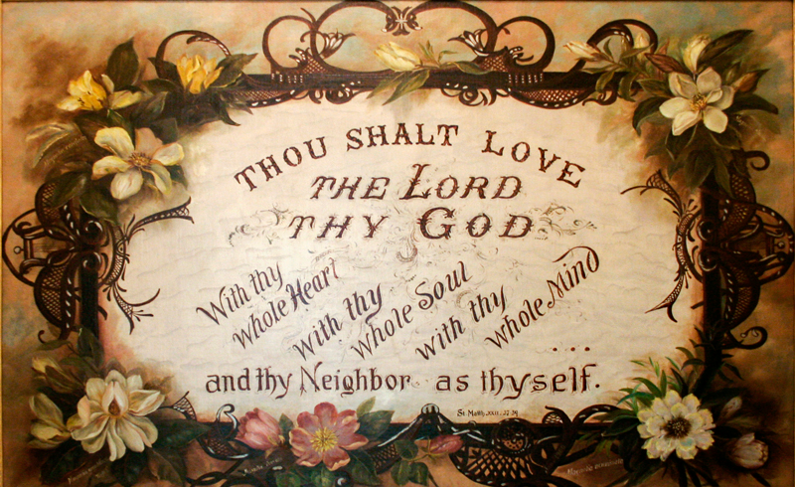
Thou Shalt Love the Lord Thy God -- Sister Maurice Schnell, St. Mary-of-the-Woods, Idaho

Slide 8
…and he said to them, “Thus it is written, that the Messiah is to suffer and to rise from the dead on the third da…”
Luke 24:46

Slide 9
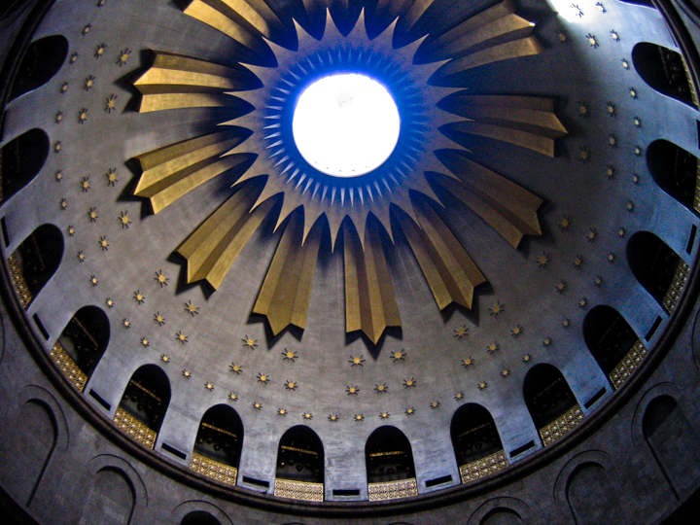
Church of the Holy Sepulchre -- Jerusalem

Slide 10
…repentance and forgiveness of sins is to be proclaimed in his name to all nations...
Luke 24:47a

Slide 11
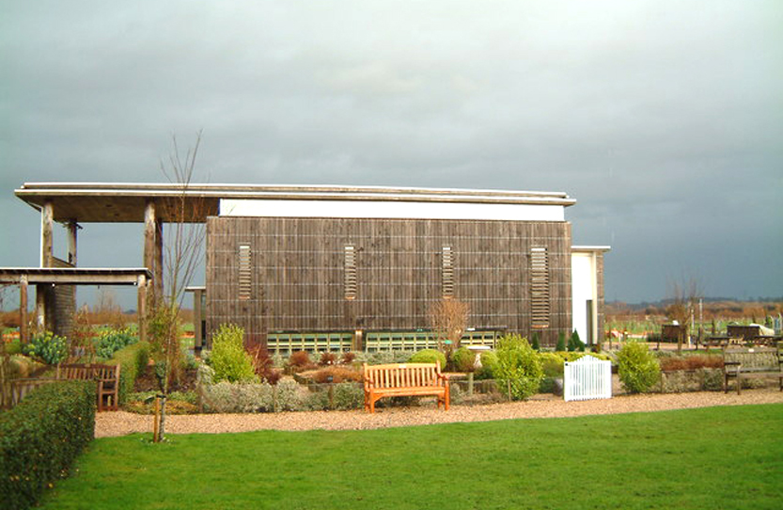
Millenium Chapel of Peace and Forgiveness, Alrewas, England

Slide 12
Then he led them out as far as Bethany, and, lifting up his hands, he blessed them.
Luke 24:50

Slide 13
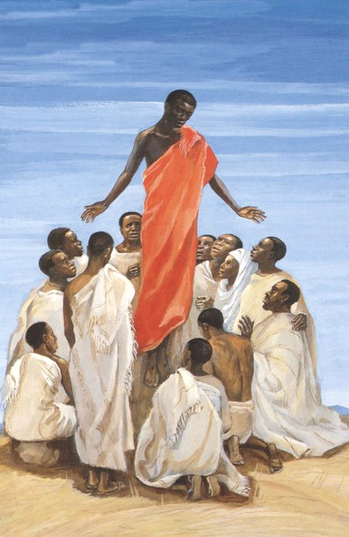
Ascension of Christ
JESUS MAFA, Cameroon

Slide 14
While he was blessing them, he withdrew from them and was carried up into heaven.
Luke 24:51

Slide 15
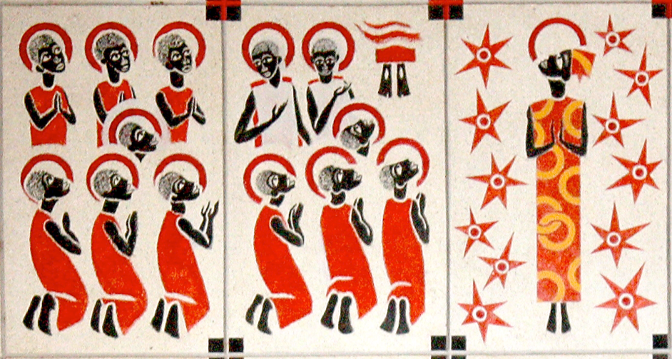
Ascension -- Keur Moussa Abbey, Keur Moussa, Senegal

Slide 16
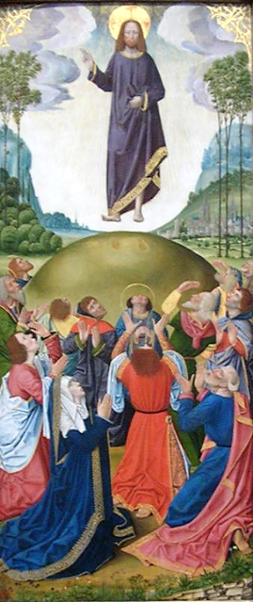
Ascension
French, c. 1500
Art Institute of Chicago Chicago, IL

Slide 17
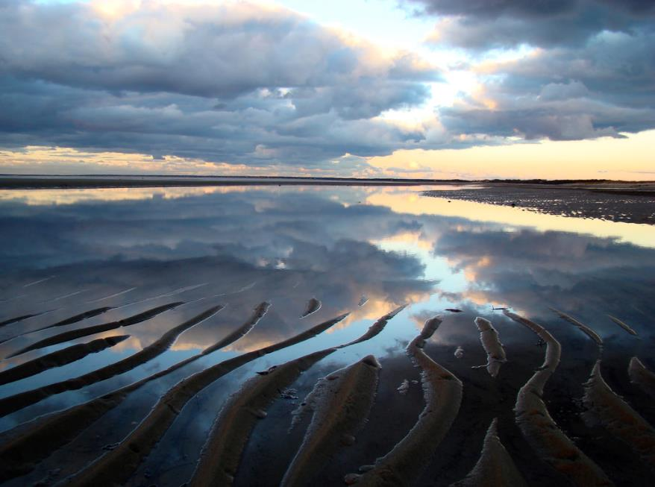
Ascension -- Joanna Vaughn, Cape Cod Bay

Slide 18
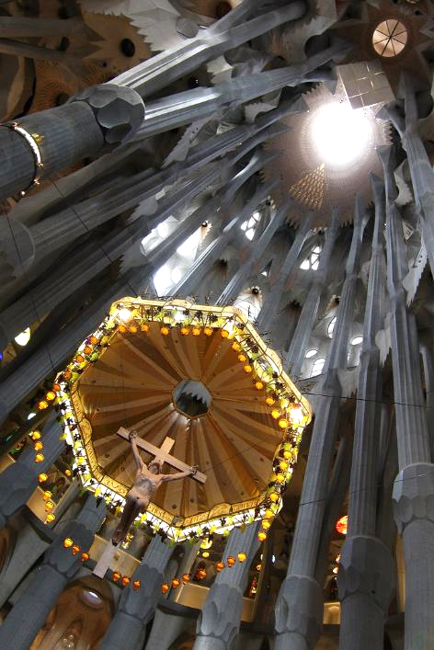
Ascension
Bousure
Sagrada Familia
Barcelona, Spain

Slide 19
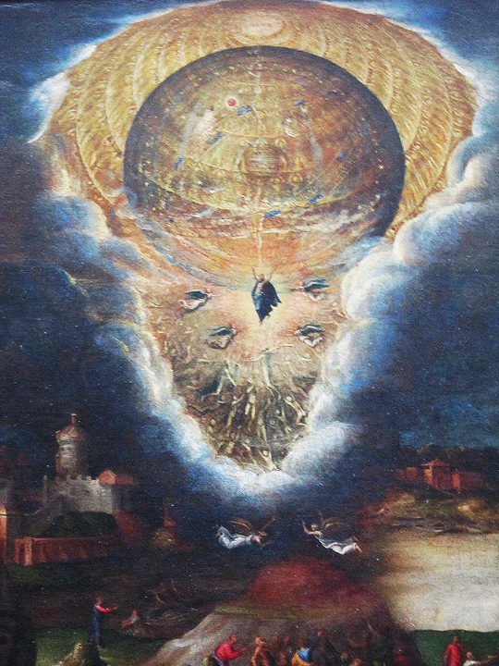
Mysteries of the Passion, Resurrection, and Ascension of Christ (detail)
Antonio Campi
Louvre Museum, Paris

Slide 20
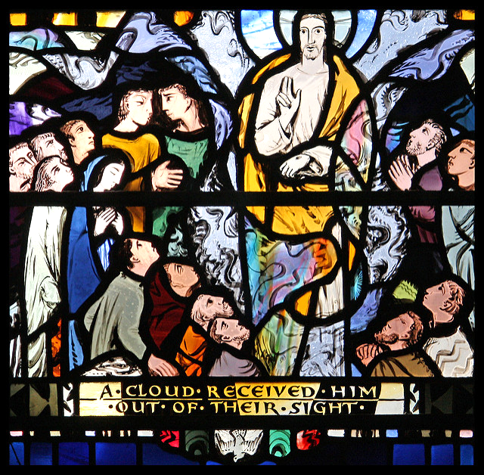
Ascension
Church of St Elthedreda London, England

Slide 21
And they worshiped him and returned to Jerusalem with great joy...
Luke 24:52

Slide 22
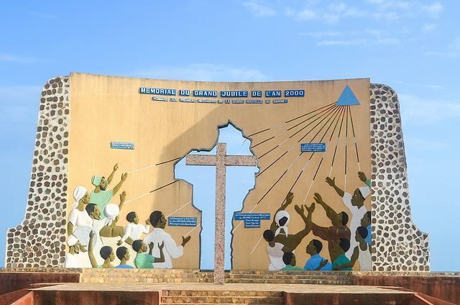
Jubilee Monument -- Ouidah, Benin

Slide 23
Credits
New Revised Standard Version Updated Edition Bible, copyright 2022, Division of Christian Education of the National Council of the Churches of Christ in the United States of America. Used by permission. All rights reserved.
http://www.flickr.com/photos/skip/111045024/
http://commons.wikimedia.org/wiki/File:Ethiopian_painting_of_Ethiopian_Orthodox_choir.png
https://commons.m.wikimedia.org/wiki/File:Thou_Shalt_Love_-_Sister_Maurice_Schnell.jpg
callme tim, Flickr Creative Commons
http://commons.wikimedia.org/wiki/File:The_Millennium_Chapel_of_Peace_and_Forgiveness,_at_the_National_Memorial_Arboretum,_Alrewas,_Staffordshire._-_geograph.org.uk_-_814782.jpg
http://diglib.library.vanderbilt.edu/act-imagelink.pl?RC=48398
https://commons.wikimedia.org/wiki/File:KeurMoussaAutel.jpg
https://www.flickr.com/photos/akma/733188124/
https://www.flickr.com/photos/joannavaughanphotography/1909248290/
https://www.flickr.com/photos/30430801@N06/5871511887/
https://www.flickr.com/photos/mhbishop/7061390583/
https://www.flickr.com/photos/paullew/3558979922/
https://www.flickr.com/photos/jbdodane/10310585524/
Additional descriptions can be found at the Art in the Christian Tradition image library, a service of the Vanderbilt Divinity Library, http://diglib.library.vanderbilt.edu/. All images available via Creative Commons 3.0 License.

