Slide 1
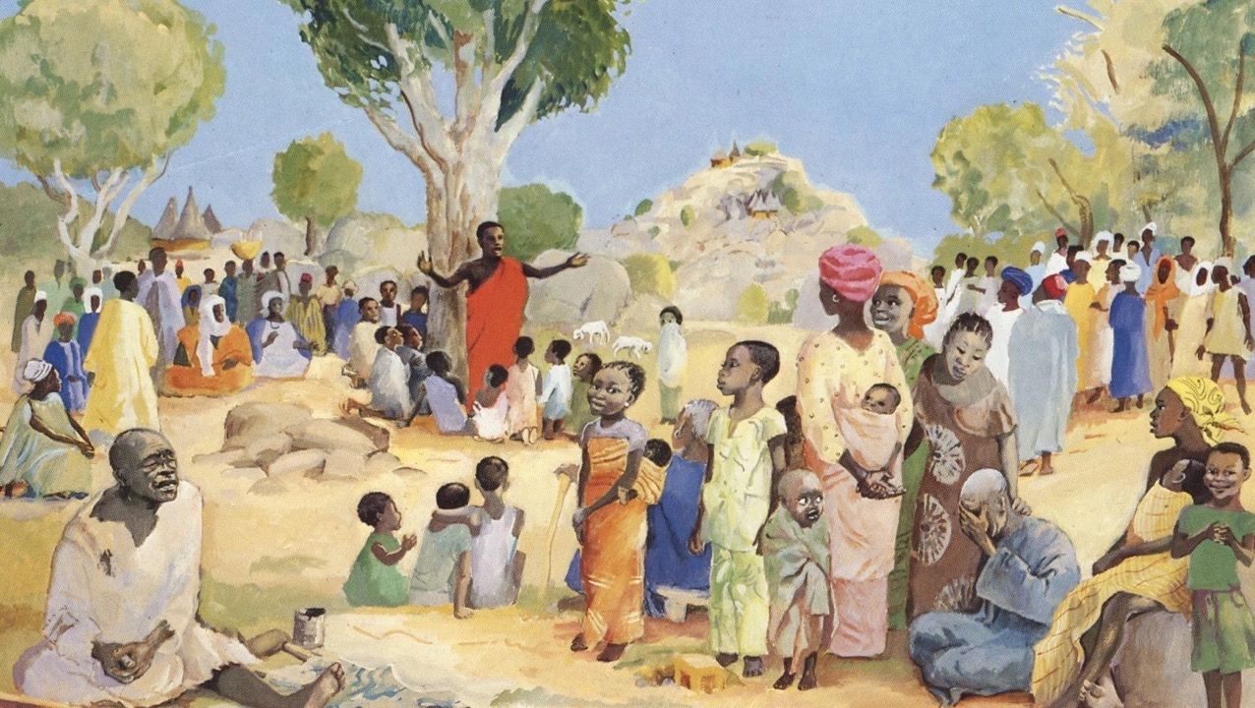
All Saints Day
Year A
Revelation 7:9-17 and Psalm 34:1-10, 22 • 1 John 3:1-3 • Matthew 5:1-12

Slide 2
"…for the Lamb…will be their shepherd, and he will guide them…, and God will wipe away every tear from their eyes."
Revelation 7:17

Slide 3
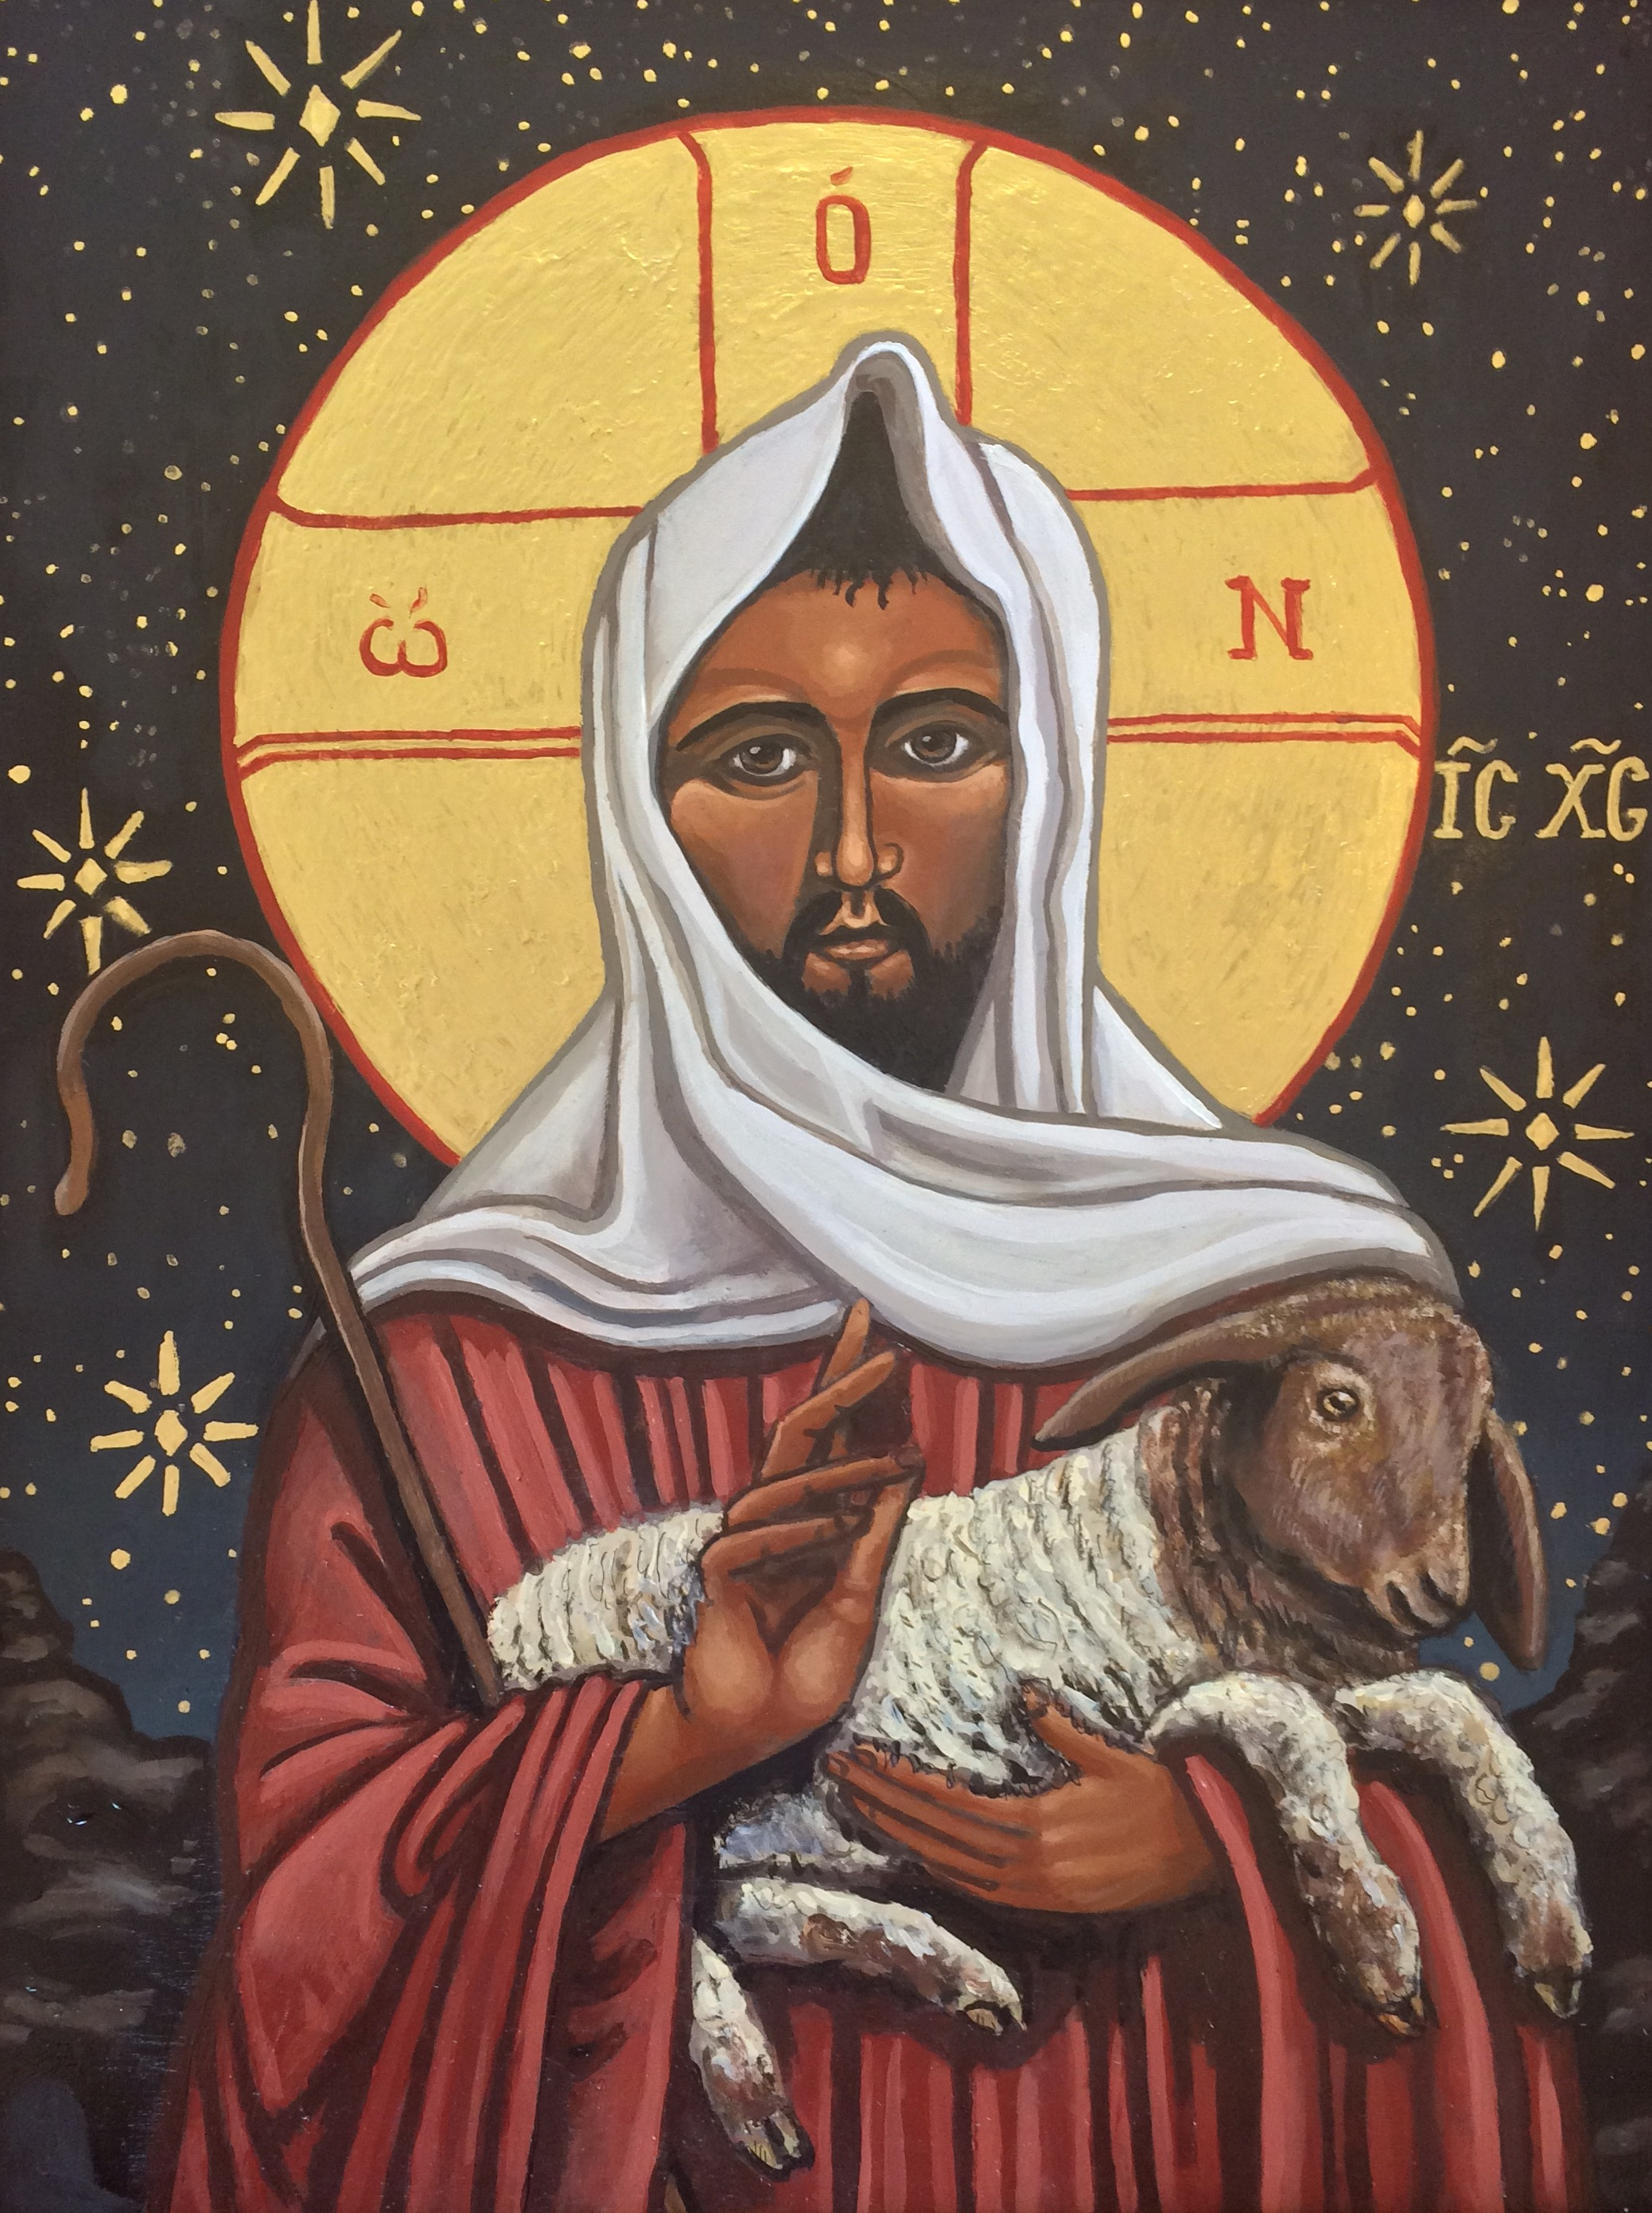
The Good Shepherd
Kelly Latimore

Slide 4
O taste and see that the LORD is good; happy are those who take refuge in him.
Psalm 34:8

Slide 5
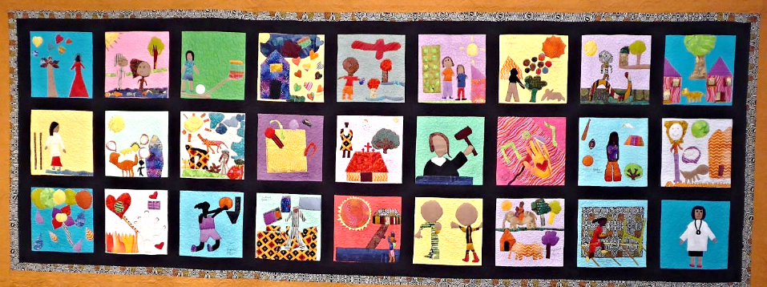
“Girls of Sudan” – The Quilted Conscience Project -- Omaha, Nebraska

Slide 6
See what love the Father has given us, that we should be called children of God...
1 John 3:1a

Slide 7
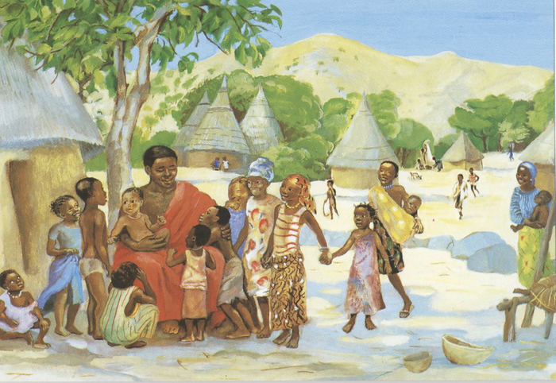
Jesus Welcomes the Children -- JESUS MAFA, Cameroon

Slide 8
When Jesus saw the crowds, he went up the mountain… And he began to speak, and taught them, saying:
Matthew 5:1a, 2

Slide 9
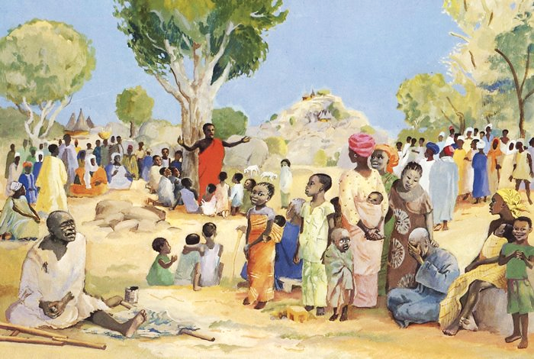
Sermon on the Mount -- JESUS MAFA, Cameroon

Slide 10
"Blessed are the poor in spirit, for theirs is the kingdom of heaven."
Matthew 5:3

Slide 11
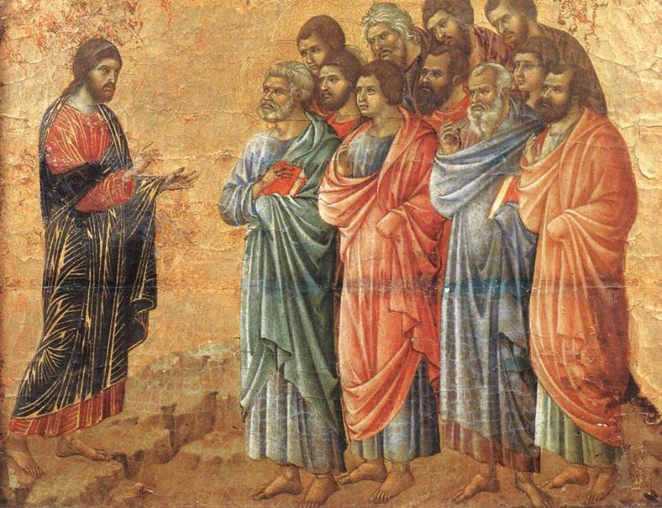
Christ on the Mountain -- Duccio, Museo dell'Opera del Duomo, Siena, Italy

Slide 12
"Blessed are those who mourn, for they will be comforted."
Matthew 5:4

Slide 13
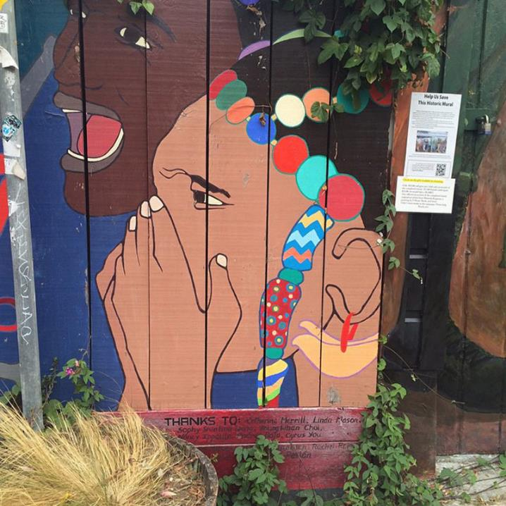
Grief
Mission District
San Francisco, CA

Slide 14
"Blessed are the meek, for they will inherit the earth."
Matthew 5:5

Slide 15
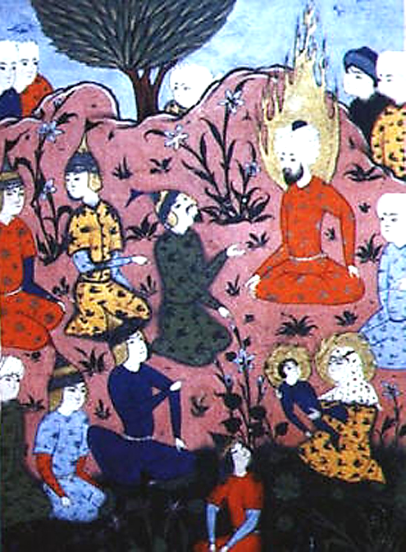
Sermon on the Mount
Undated Persian Miniature

Slide 16
"Blessed are those who hunger and thirst for righteousness, for they will be filled."
Matthew 5:6

Slide 17
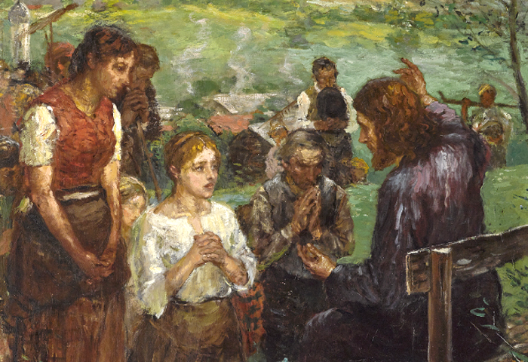
Sermon on the Mount -- Fritz von Uhde, 2nd version

Slide 18
"Blessed are the merciful, for they will receive mercy."
Matthew 5:7

Slide 19
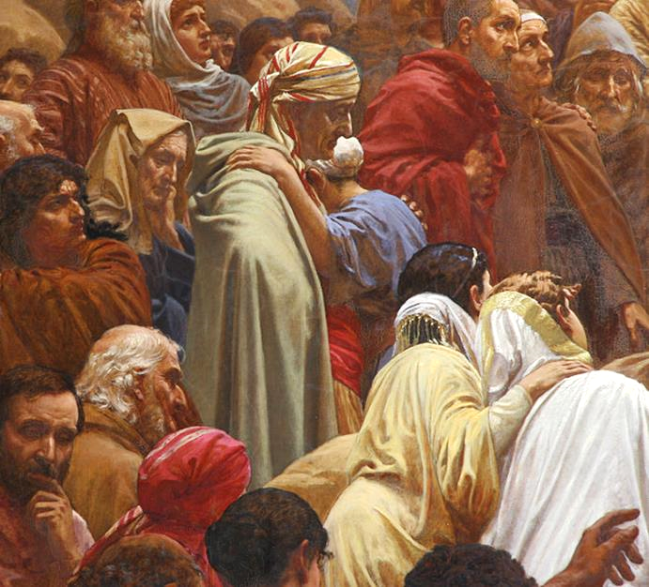
Sermon on the Mount, detail -- Henrik Olrik, Church of St. Matthew, Copenhagen, Denmark

Slide 20
"Blessed are the pure in heart, for they will see God."
Matthew 5:8

Slide 21
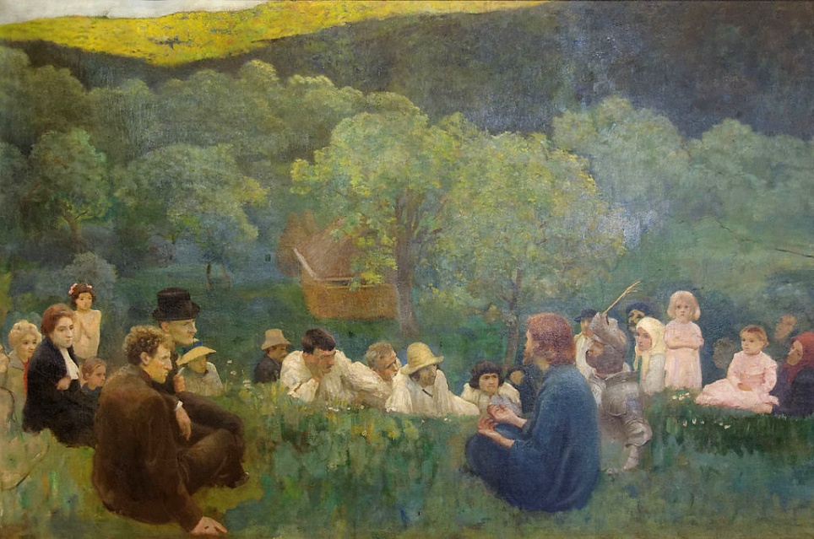
Sermon on the Mountain -- Karoly Ferenczy, Hungarian National Gallery, Budapest, Hungary

Slide 22
"Blessed are the peacemakers, for they will be called children of God."
Matthew 5:9

Slide 23
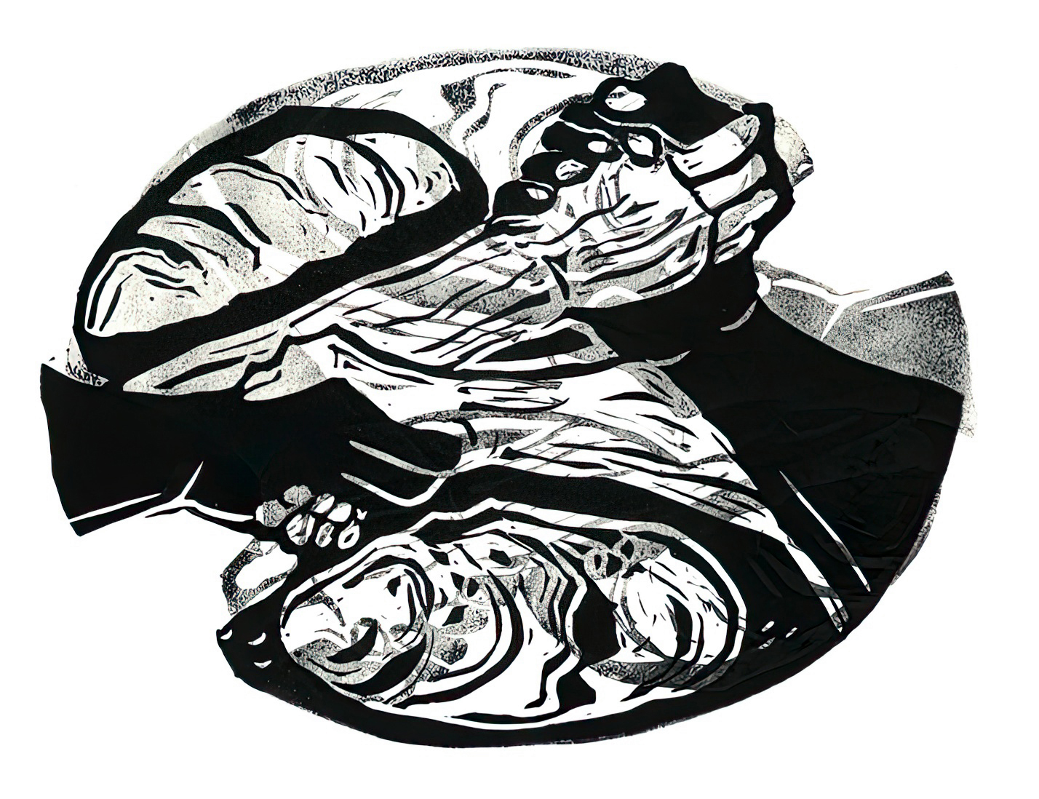
From the Lord's Prayer -- Cara Hochhalter

Slide 24
"Blessed are those who are persecuted for the sake of righteousness, for theirs is the kingdom of heaven."
Matthew 5:10

Slide 25
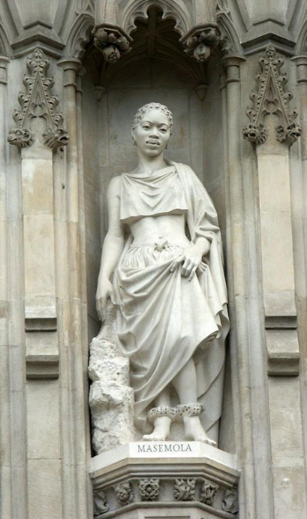
Manche Masemola, Christian Martyr
Westminster Abbey, London, England

Slide 26
Credits
New Revised Standard Version Updated Edition Bible, copyright 2022, Division of Christian Education of the National Council of the Churches of Christ in the United States of America. Used by permission. All rights reserved.
Kelly Latimore Icons, https://kellylatimoreicons.com/
https://www.flickr.com/photos/aliarda/16750603296
http://diglib.library.vanderbilt.edu/act-imagelink.pl?RC=48395
http://diglib.library.vanderbilt.edu/act-imagelink.pl?RC=48284
https://commons.wikimedia.org/wiki/File:Duccio_di_Buoninsegna_-_Appearance_on_the_Mountain_in_Galilee_-_WGA06737.jpg
https://www.flickr.com/photos/shockinglytasty/15117071790
https://commons.wikimedia.org/wiki/File:Jesus-masih-islam.jpg
https://commons.wikimedia.org/wiki/File:Fritz_von_Uhde_Bergpredigt.jpg
http://commons.wikimedia.org/wiki/File:Sankt_Matthaeus_Kirke_Copenhagen_altarpiece_detail3.jpg
https://commons.wikimedia.org/wiki/File:The_Sermon_on_the_Mount_K%C3%A1roly_Ferenczy.jpg
Cara B. Hochhalter - The artist has granted permission for the non-commercial use of this image with attribution.
https://commons.wikimedia.org/wiki/File:WestminsterAbbey-Martyrs.jpg - Jean-Christophe Benoist
Additional descriptions can be found at the Art in the Christian Tradition image library, a service of the Vanderbilt Divinity Library, http://diglib.library.vanderbilt.edu/. All images available via Creative Commons 3.0 License.

