Slide 1
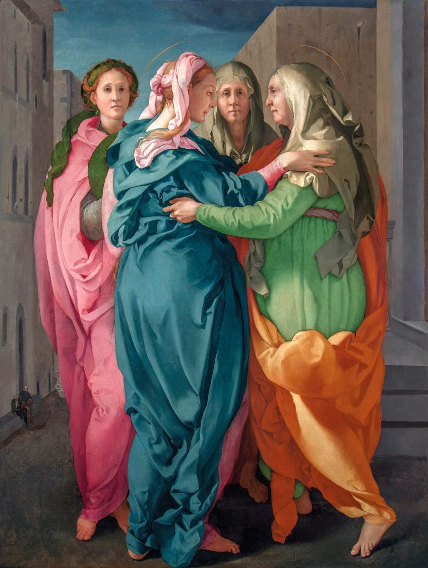
Advent Daily Prayer for Reflection
Week 4
Revised Common Lectionary Year C
The Prayers that follow are written by the RCL specifically for the Advent Lectionary scripture texts:
Micah 5:2-5a • Luke 1:46b-55 or Psalm 80:1-7 • Hebrews 10:5-10 • Luke 1:39-45, (46-55)
Image information may be found at the end.

Slide 2

O God of Elizabeth and Mary,
you visited your servants with news of the world's redemption
in the coming of the Savior.
Fourth Sunday of Advent, Year C
Micah 5:2-5a • Luke 1:46b-55 or Psalm 80:1-7 • Hebrews 10:5-10 • Luke 1:39-45, (46-55)

Slide 3
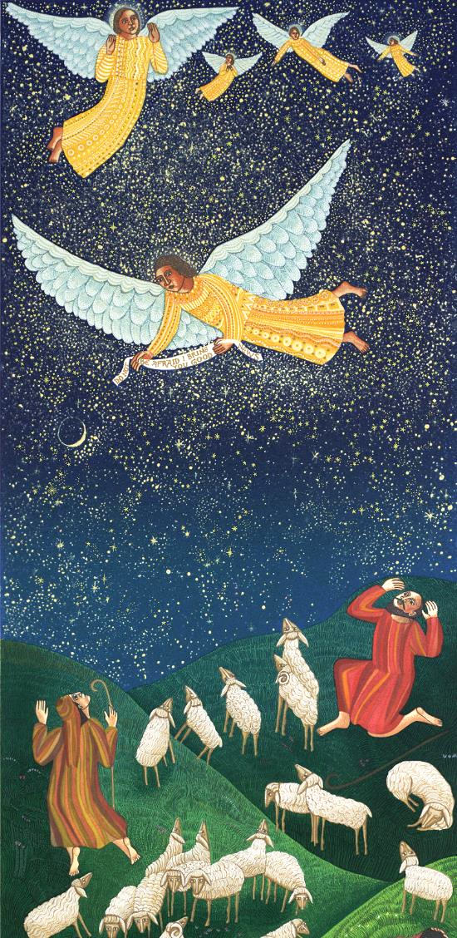
Make our hearts leap with joy,
and fill our mouths with songs of praise,
that we may announce glad tidings of peace,
and welcome the Christ in our midst.
Fourth Monday of Advent, Year C
Micah 5:2-5a • Luke 1:46b-55 or Psalm 80:1-7 • Hebrews 10:5-10 • Luke 1:39-45, (46-55)

Slide 4
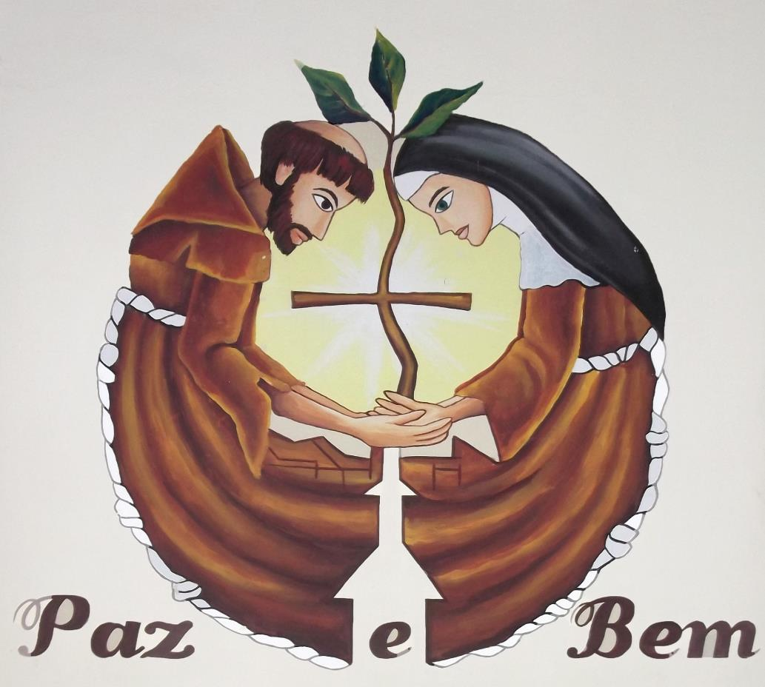
Brothers and sisters,
as we joyfully await the glorious coming of the Christ,
let us pray for the needs of the church, our community, and the world.
Fourth Tuesday of Advent, Year C
Micah 5:2-5a • Luke 1:46b-55 or Psalm 80:1-7 • Hebrews 10:5-10 • Luke 1:39-45, (46-55)

Slide 5
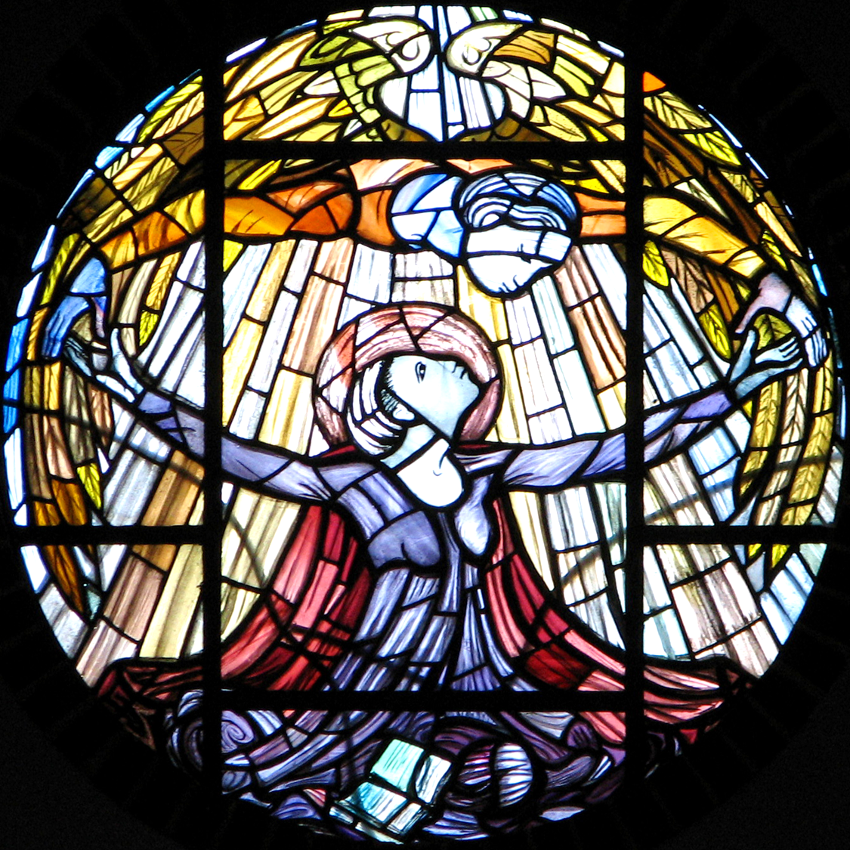
God of promise,
you have given us a sign of your love
through the gift of Jesus Christ, our Savior,
who was promised from ages past.
Fourth Wednesday of Advent, Year C
Micah 5:2-5a • Luke 1:46b-55 or Psalm 80:1-7 • Hebrews 10:5-10 • Luke 1:39-45, (46-55)

Slide 6
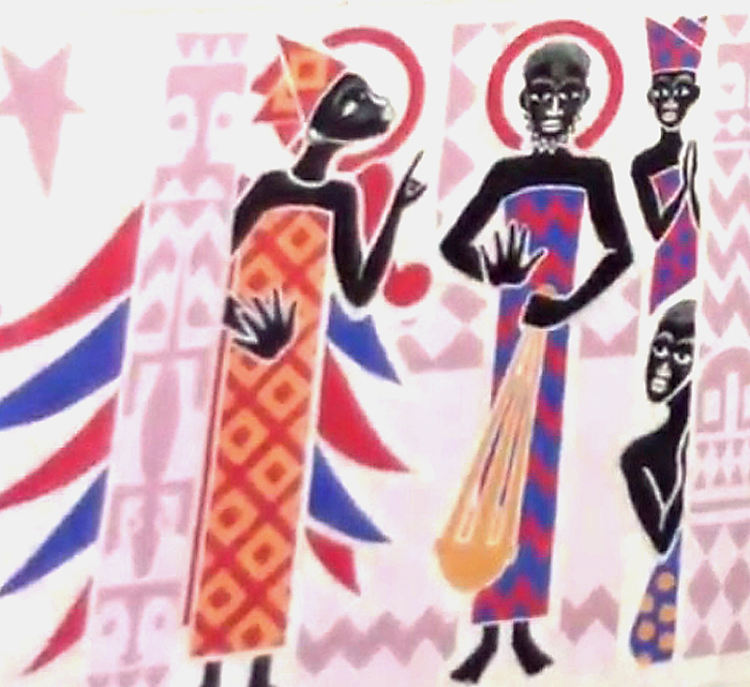
We believe as Joseph did
the message of your presence
whispered by an angel,
and offer our prayers for your world,
confident of your care and mercy for all creation.
Fourth Thursday of Advent, Year C
Micah 5:2-5a • Luke 1:46b-55 or Psalm 80:1-7 • Hebrews 10:5-10 • Luke 1:39-45, (46-55)

Slide 7
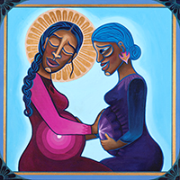
O Shepherd of Israel,
you gently support the one who is with child
and call forth the Lamb who dances in the womb.
Fourth Friday of Advent, Year C
Micah 5:2-5a • Luke 1:46b-55 or Psalm 80:1-7 • Hebrews 10:5-10 • Luke 1:39-45, (46-55)

Slide 8
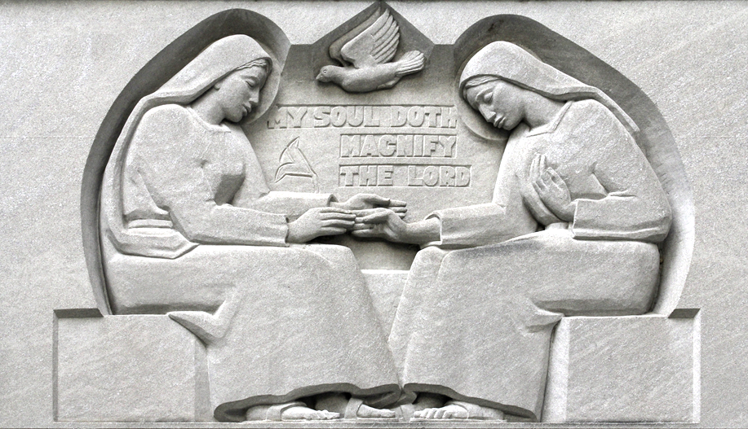
Stir our hearts to recognize Christ's coming,
as Elizabeth recognized his presence
in Mary's radiant obedience to your desire,
and open our souls to receive the one
who came to love your flock.
Fourth Saturday of Advent, Year C
Micah 5:2-5a • Luke 1:46b-55 or Psalm 80:1-7 • Hebrews 10:5-10 Luke 1:39-45, (46-55)

Slide 9
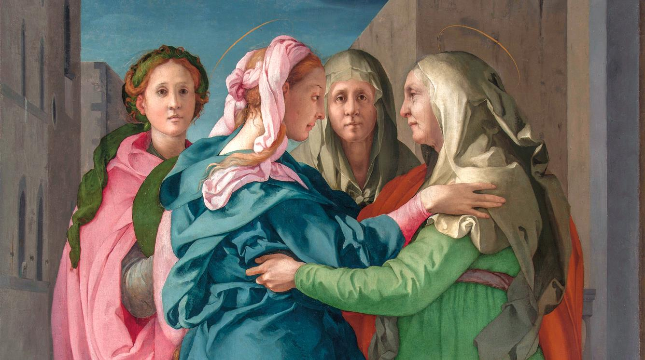
Prayers are reproduced from Revised Common Lectionary Prayers, copyright © 2002 Consultation on Common Texts. Augsburg Fortress. Used by permission. Art image descriptions can be found at the Art in the Christian Tradition image library, a service of the Vanderbilt Divinity Library, http://diglib.library.vanderbilt.edu/. All images available via Creative Commons 3.0 License.
Visitation, by Jacopo da Pontormo -- https://commons.wikimedia.org/wiki/File:Pontormo-visitation-after-restorationRGB.jpg
Visitation, by Father George Saget -- https://commons.wikimedia.org/wiki/File:KeurMoussaAutel.jpg
Shepherds, by John August Swanson -- www.JohnAugustSwanson.com - copyright 1985 by John August Swanson
Francis and Clare, Monastery of the Poor Clares, Caninde, Brazil -- https://commons.wikimedia.org/wiki/File:Holy_Sacrament_Monastery,_Canind%C3%A9,_Brazil_(Poor_Clares)_031.JPG
The Annunciation, Our Lady of Pity, Swaffham -- https://www.flickr.com/photos/paullew/2052404610/
An Angel Appears to Joseph, by Father George Saget -- www.robertharding.com
Mary and Elizabeth, by Lauren Wright Pittman -- http://www.lewpstudio.com - copyright by Lauren Wright Pittman
The Magnificat, Baltimore Cathedral -- https://www.flickr.com/photos/paullew/23612984750

