Slide 1
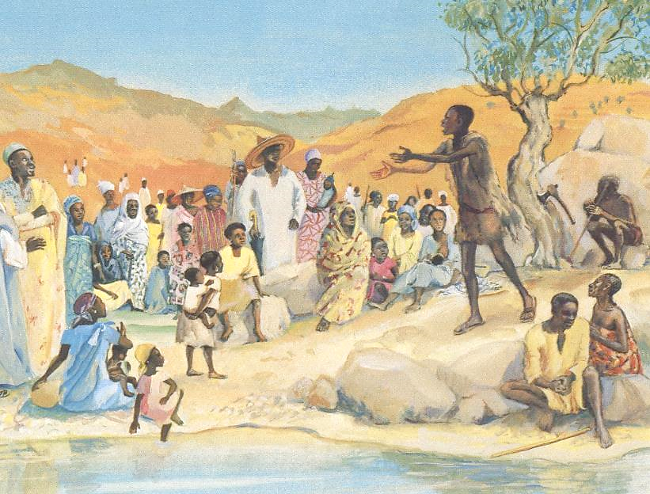
Advent Daily Prayer for Reflection
Week 3
Revised Common Lectionary Year C
The Prayers that follow are written by the RCL specifically for the Advent Lectionary scripture texts:
Zephaniah 3:14-20 • Isaiah 12:2-6 Philippians 4:4-7 • Luke 3:7-18
Image information may be found at the end.

Slide 2
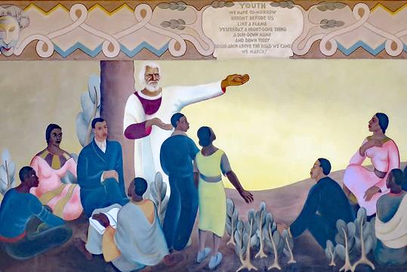
God of hope,
you call us home from the exile of selfish oppression
to the freedom of justice,
the balm of healing,
and the joy of sharing.
Third Sunday of Advent, Year C
Zephaniah 3:14-20 • Isaiah 12:2-6 Philippians 4:4-7 • Luke 3:7-18

Slide 3
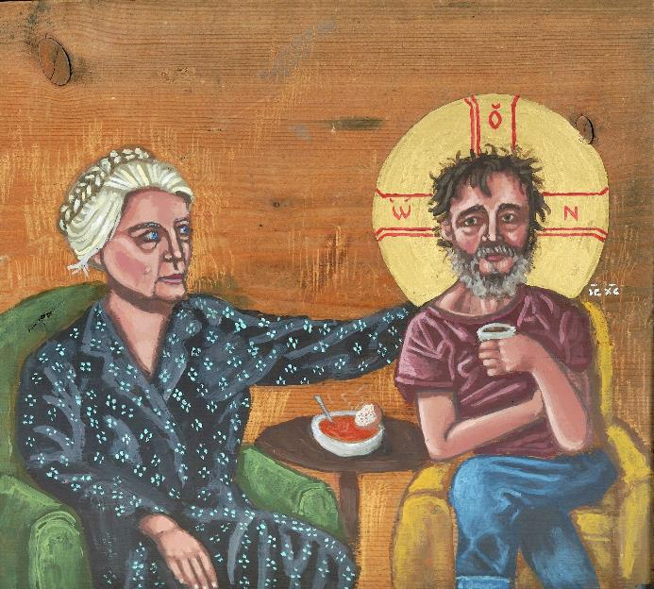
Make us strong to join you in your holy work,
as friends of strangers and victims,
companions of those whom others shun,
and as the happiness of those whose hearts are broken.
Third Monday of Advent, Year C
Zephaniah 3:14-20 • Isaiah 12:2-6 Philippians 4:4-7 • Luke 3:7-18

Slide 4
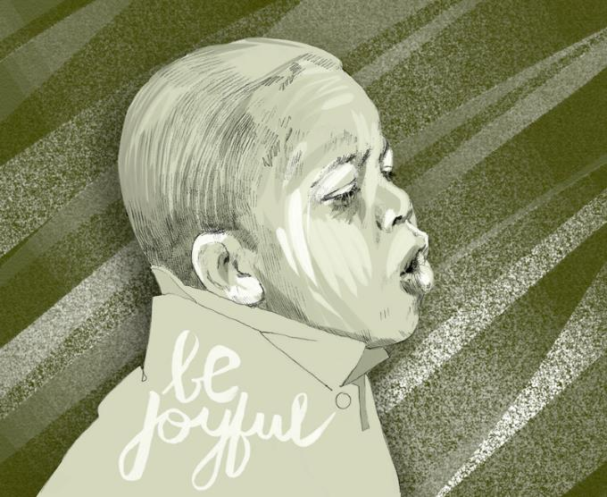
Brothers and sisters,
as we joyfully await the glorious coming of the Christ,
let us pray for the needs of the church, our community, and the world.
Third Tuesday of Advent, Year C
Zephaniah 3:14-20 • Isaiah 12:2-6 Philippians 4:4-7 • Luke 3:7-18

Slide 5
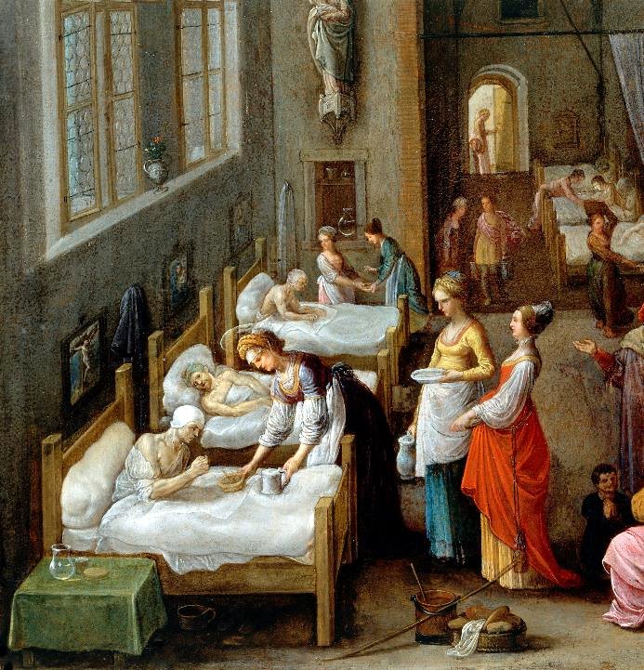
God of joy and exultation,
you strengthen what is weak;
you enrich the poor
and give hope to those who live in fear.
Third Wednesday of Advent, Year C
Zephaniah 3:14-20 • Isaiah 12:2-6 Philippians 4:4-7 • Luke 3:7-18

Slide 6
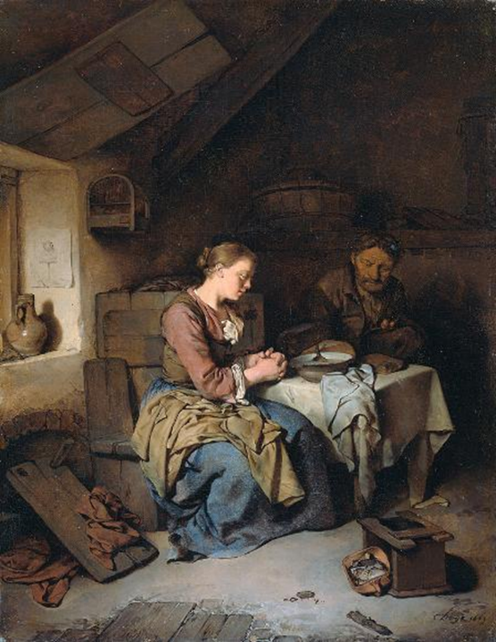
Look upon our needs this day.
Make us grateful for the good news of salvation
and keep us faithful in your service
until the coming of our Lord Jesus Christ.
Third Thursday of Advent, Year C
Zephaniah 3:14-20 • Isaiah 12:2-6 Philippians 4:4-7 • Luke 3:7-18

Slide 7
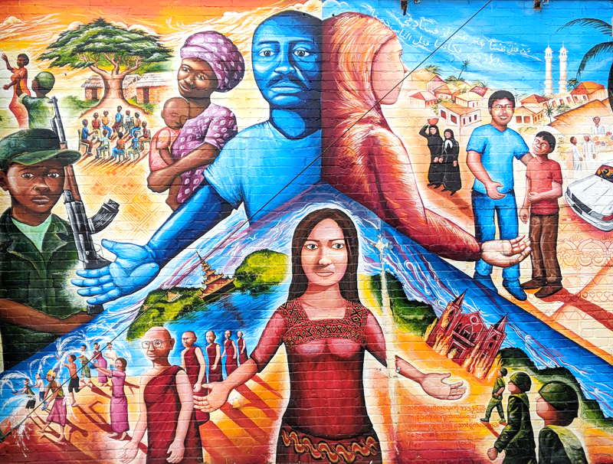
O God of the exiles and the lost,
you promise restoration and wholeness
through the power of Jesus Christ.
Give us faith to live joyfully…
Third Friday of Advent, Year C
Zephaniah 3:14-20 • Isaiah 12:2-6 Philippians 4:4-7 • Luke 3:7-18

Slide 8
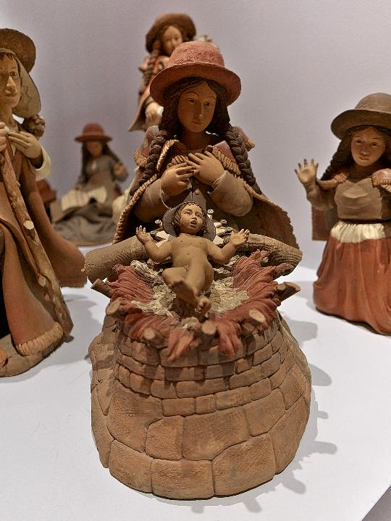
…sustained by your promises
as we eagerly await the day when they will be fulfilled
for all the world to see,
through the coming of your Son, Jesus Christ.
Third Saturday of Advent, Year C
Zephaniah 3:14-20 • Isaiah 12:2-6 Philippians 4:4-7 • Luke 3:7-18

Slide 9
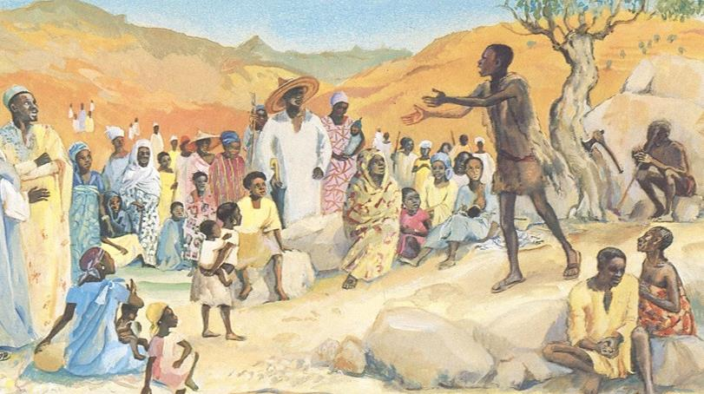

Prayers are reproduced from Revised Common Lectionary Prayers, copyright © 2002 Consultation on Common Texts. Augsburg Fortress. Used by permission. Art image descriptions can be found at the Art in the Christian Tradition image library, a service of the Vanderbilt Divinity Library, http://diglib.library.vanderbilt.edu/. All images available via Creative Commons 3.0 License.
John the Baptist Preaching, by JESUS MAFA -- https://www.librairie-emmanuel.fr/contact
Frederick Douglass Inspiring the Youth, by Cletus Alexander -- Source: https://commons.wikimedia.org/wiki/File:'Douglass_Inspiring_the_Youth_of_the_Negro_Race'_by_Cletus_Alexander_and_Bruno_Peiser,_1933.JPG
Dorothy Day with Homeless Christ, by Kelly Latimore -- https://kellylatimoreicons.com/contact/
Be Joyful, by Susan Murtaugh -- https://www.flickr.com/photos/suzi54241/26338596572
Elizabeth of Hungary Visiting a Hospital, by Adam Elsheimer -- https://commons.wikimedia.org/wiki/File:St_Elizabeth_visiting_a_hospital._Wellcome_V0017201.jpg
Saying Grace, by Cornelis Bega -- http://commons.wikimedia.org/wiki/File:BegaPrayer.jpg
Global Refugee Mural, by Joel Bergner -- Creative Commons Attribution ShareAlike - CC-BY-SA-3.0
Birth of the Christ Child, by Victor and Richard Chavez -- https://commons.wikimedia.org/wiki/File:Bel%C3%A9n_(V%C3%ADctor_y_Richard_Chaves,_Per%C3%BA).jpg

