Slide 1
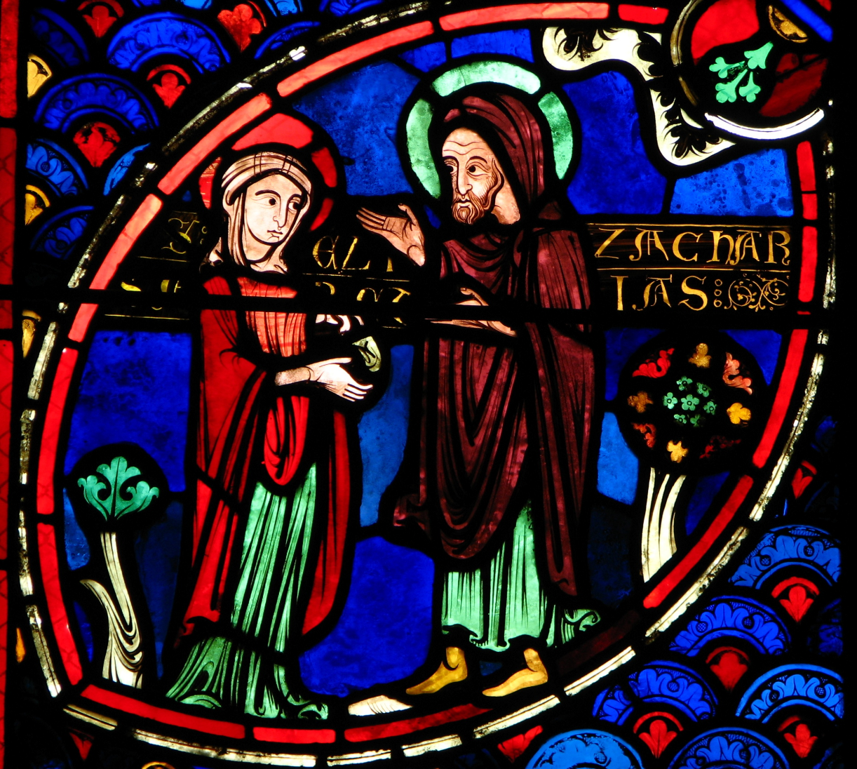
Advent Daily Prayer for Reflection
Week 2
Revised Common Lectionary Year C
The Prayers that follow are written by the RCL specifically for the Advent Lectionary scripture texts:
Baruch 5:1-9 or Malachi 3:1-4
Luke 1:68-79 • Philippians 1:3-11
Luke 3:1-6
Image information may be found at the end.

Slide 2
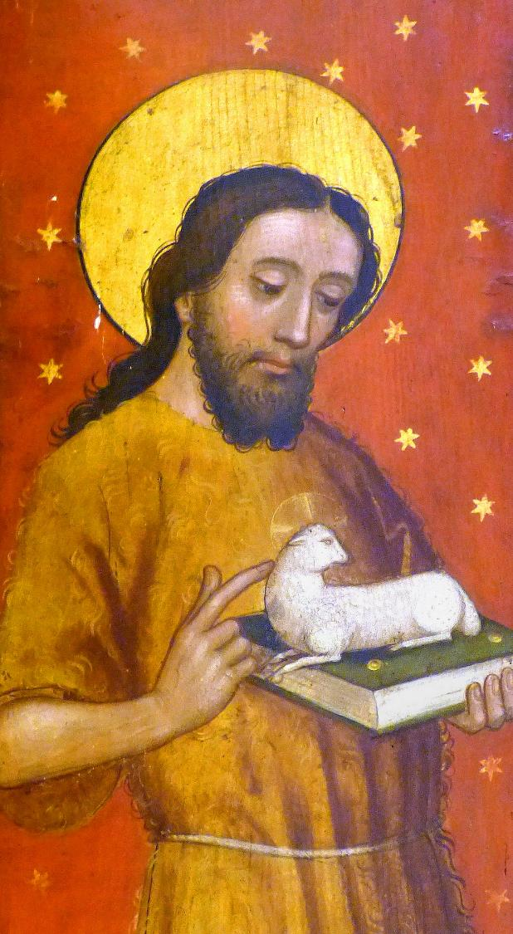
God of timeless grace,
you fill us with joyful expectation.
Make us ready for the message that prepares the way…
Second Sunday of Advent, Year C
Baruch 5:1-9 or Malachi 3:1-4
Luke 1:68-79 • Philippians 1:3-11 • Luke 3:1-6

Slide 3
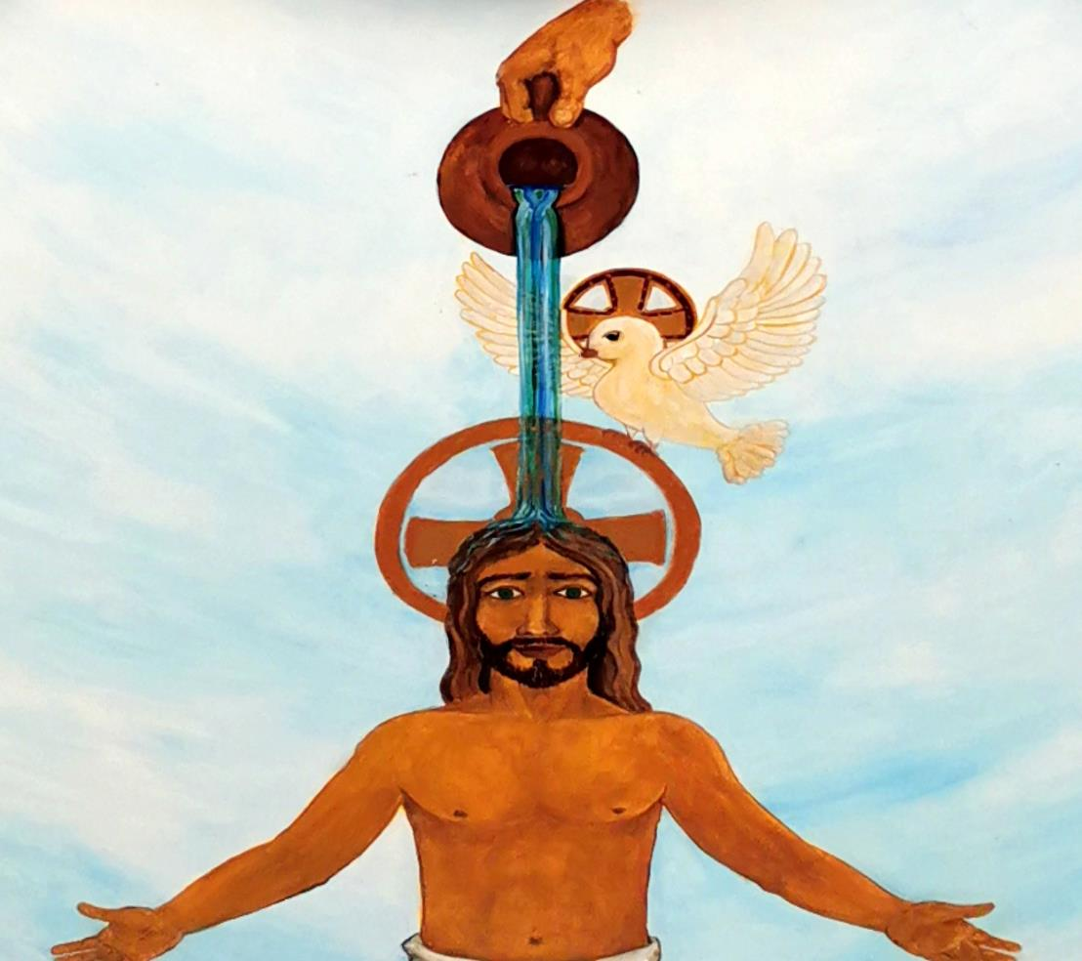
…that with uprightness of heart and holy joy
we may eagerly await the kingdom of your Son, Jesus Christ,
who reigns with you and the Holy Spirit, now and for ever.
Second Monday of Advent, Year C
Baruch 5:1-9 or Malachi 3:1-4
Luke 1:68-79 • Philippians 1:3-11 • Luke 3:1-6

Slide 4
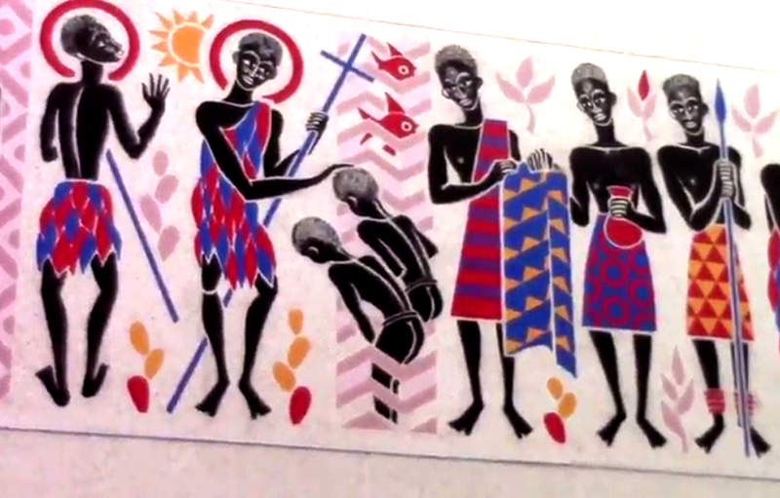
God of hope,
you raised up John the baptizer
as a herald who calls us to conversion.
We joyfully await the glorious coming of Christ.
Second Tuesday of Advent, Year C
Baruch 5:1-9 or Malachi 3:1-4
Luke 1:68-79 • Philippians 1:3-11 • Luke 3:1-6

Slide 5
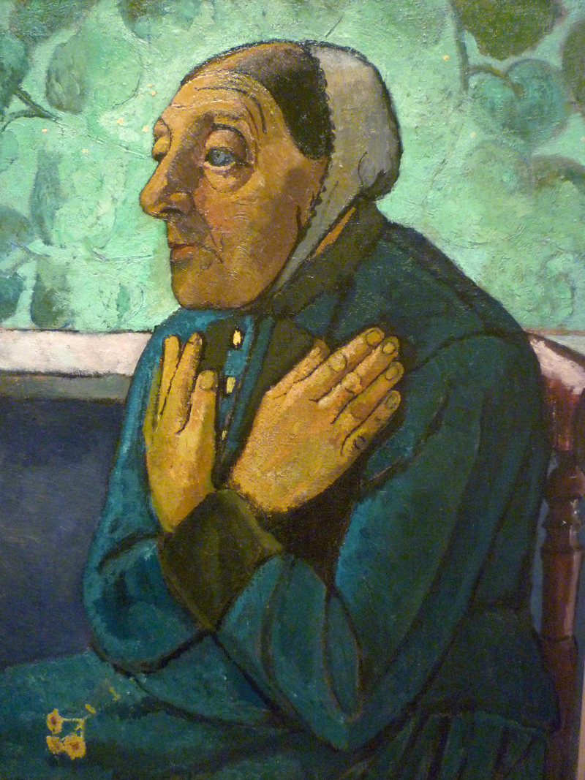
We pray to you for the needs of the church and the world. Hear our humble prayer.
Second Wednesday of Advent, Year C
Baruch 5:1-9 or Malachi 3:1-4
Luke 1:68-79 • Philippians 1:3-11 • Luke 3:1-6

Slide 6
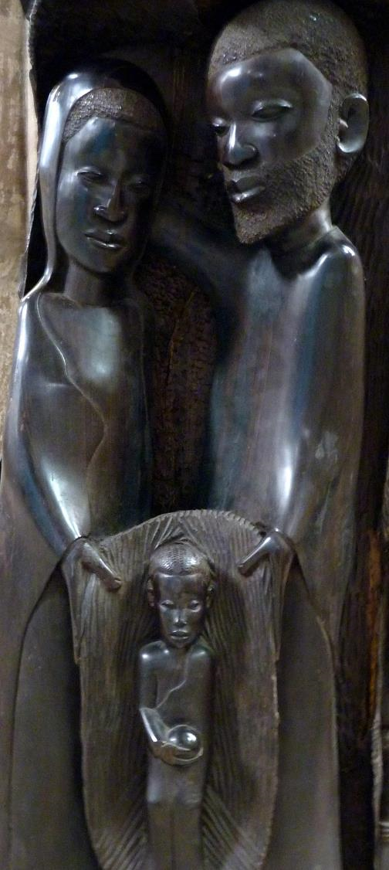
Give voice to your presence among us
until the day of the coming of your Son, Jesus Christ,
who lives and reigns for ever and ever.
Second Thursday of Advent, Year C
Baruch 5:1-9 or Malachi 3:1-4
Luke 1:68-79 • Philippians 1:3-11 Luke 3:1-6

Slide 7
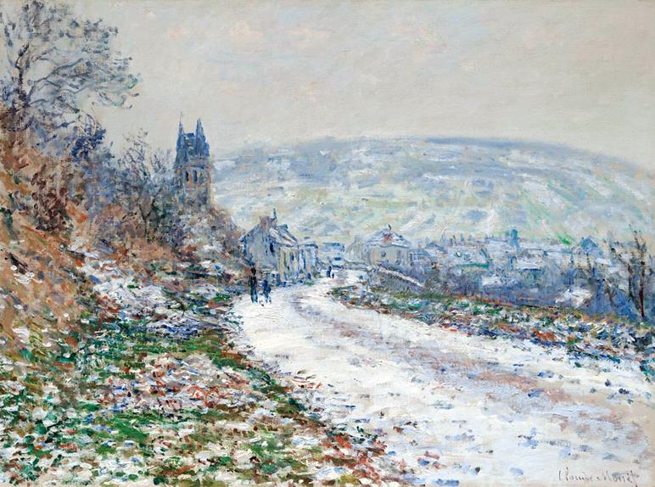
Out of the embrace of mercy and righteousness,
you have brought forth joy and dignity for your people.
Remember now your ancient promise:
make straight the paths that lead to you…
Second Friday of Advent, Year C
Baruch 5:1-9 or Malachi 3:1-4
Luke 1:68-79 • Philippians 1:3-11 • Luke 3:1-6

Slide 8
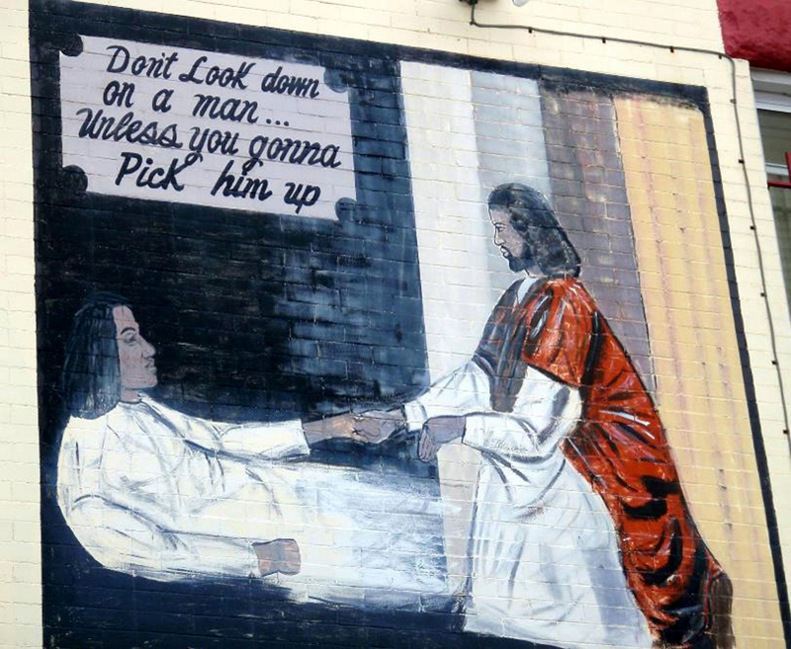
…and smooth the rough ways,
that in our day
we might bring forth your compassion
for all humanity. Amen.
Second Saturday of Advent, Year C
Baruch 5:1-9 or Malachi 3:1-4 • Luke 1:68-79 Philippians 1:3-11 • Luke 3:1-6

Slide 9
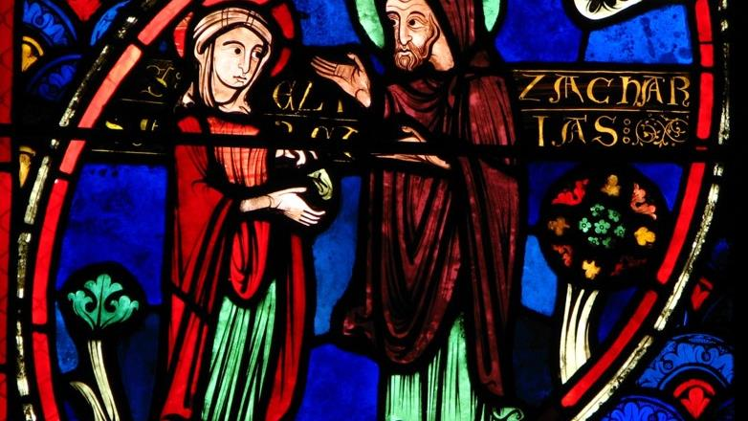

Prayers are reproduced from Revised Common Lectionary Prayers, copyright © 2002 Consultation on Common Texts. Augsburg Fortress. Used by permission. Art image descriptions can be found at the Art in the Christian Tradition image library, a service of the Vanderbilt Divinity Library, http://diglib.library.vanderbilt.edu/. All images available via Creative Commons 3.0 License.
Elizabeth and Zechariah, Bourges Cathedral -- http://www.flickr.com/photos/pelegrino/1356007875/
John the Baptist, Church of St. John and St. Martin, Schwabach, Germany -- https://commons.wikimedia.org/wiki/File:Schwabach_Stadtkirche_-_Katharinenaltar_Fl%C3%BCgel_4a.jpg
Holy Trinity, by Zoltán Joó -- https://commons.wikimedia.org/wiki/File:Coffered_ceiling_by_Zolt%C3%A1n_Jo%C3%B3,_Holy_Spirit_Church,_2019_Veresegyh%C3%A1z.jpg
John the Baptist, by Father Georges Saget -- www.robertharding.com
Woman Praying, by Paula Modersohn-Becker -- https://commons.wikimedia.org/wiki/File:Paula_Modersohn-Becker_-_Old_Peasant_Woman_(c1905).jpg
African Nativity, St. Sebaldus, Nuremberg -- https://www.flickr.com/photos/damiavos/14859315278
Entrance to the Village of Vétheuil in Winter, by Claude Monet -- https://commons.wikimedia.org/wiki/File:Monet_-_Entrance_to_the_Village_of_V%C3%A9theuil_in_Winter,_1879.jpg
Jesus Lends a Helping Hand, mural, Washington, DC -- https://www.flickr.com/photos/daquellamanera/3994554964

