Slide 1
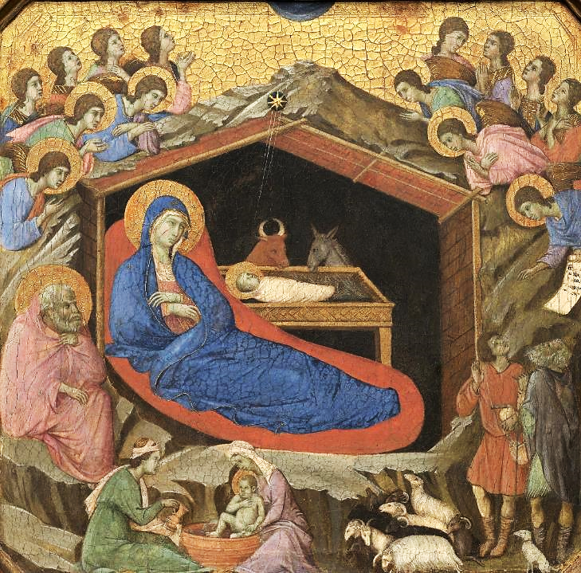
Advent Daily Prayer for Reflection
Week 1
Revised Common Lectionary Year C
The Prayers that follow are written by the RCL specifically for the Advent Lectionary scripture texts:
Jeremiah 33:14-16 • Psalm 25:1-10
1 Thessalonians 3:9-13 • Luke 21:25-36
Image information may be found at the end.

Slide 2
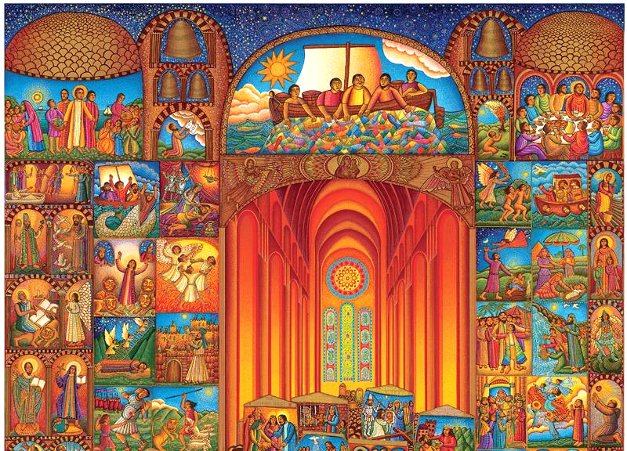
God of justice and peace,
from the heavens you rain down mercy and kindness,
that all on earth may stand in awe and wonder
before your marvelous deeds.
First Sunday of Advent, Year C
Jeremiah 33:14-16 • Psalm 25:1-10 • 1 Thessalonians 3:9-13 • Luke 21:25-36

Slide 3
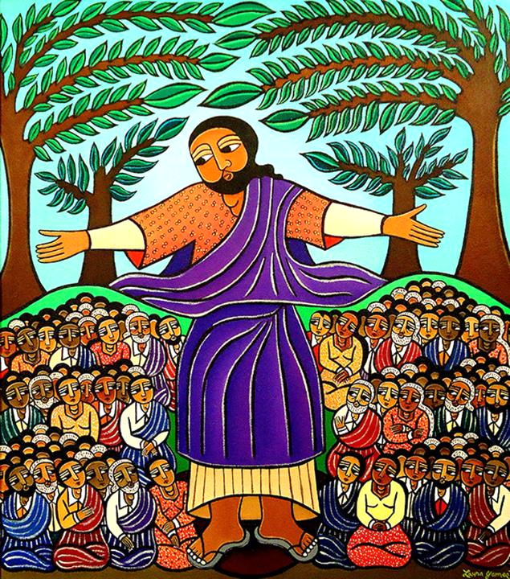
Raise our heads in expectation,
that we may yearn for the coming day of the Lord
and stand without blame before your Son, Jesus Christ,
who lives and reigns for ever and ever. Amen.
First Monday of Advent, Year C
Jeremiah 33:14-16 • Psalm 25:1-10 • 1 Thessalonians 3:9-13 • Luke 21:25-36

Slide 4
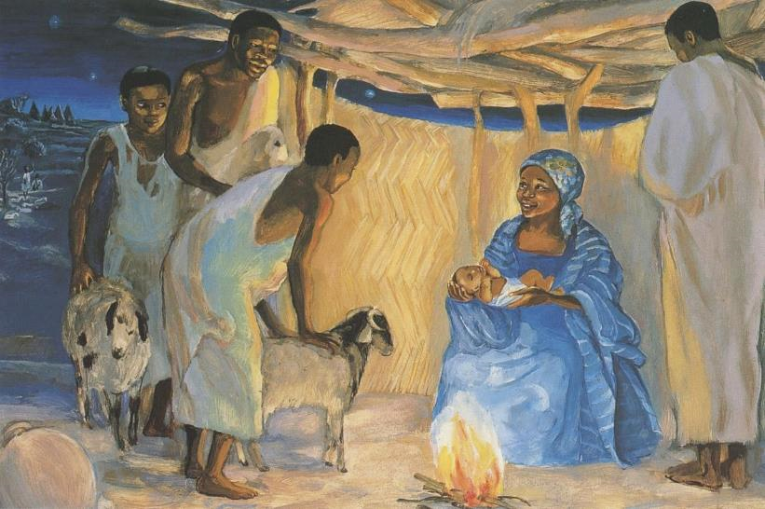
We seek the mighty God in the most unlikely places
as a child in a stable, and in an empty tomb. May God hear these prayers,
which come from the unlikely corners of our lives.
First Tuesday of Advent, Year C
Jeremiah 33:14-16 • Psalm 25:1-10 • 1 Thessalonians 3:9-13 • Luke 21:25-36

Slide 5
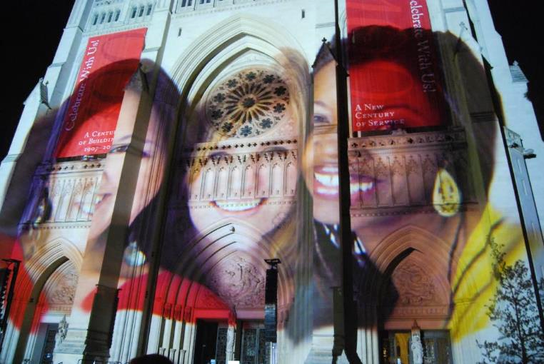
Give us ears to hear, O God,
and eyes to watch, that we may know your presence in our midst during this holy season of joy
as we anticipate the coming of Jesus Christ.
First Wednesday of Advent, Year C
Jeremiah 33:14-16 • Psalm 25:1-10 • 1 Thessalonians 3:9-13 • Luke 21:25-36

Slide 6
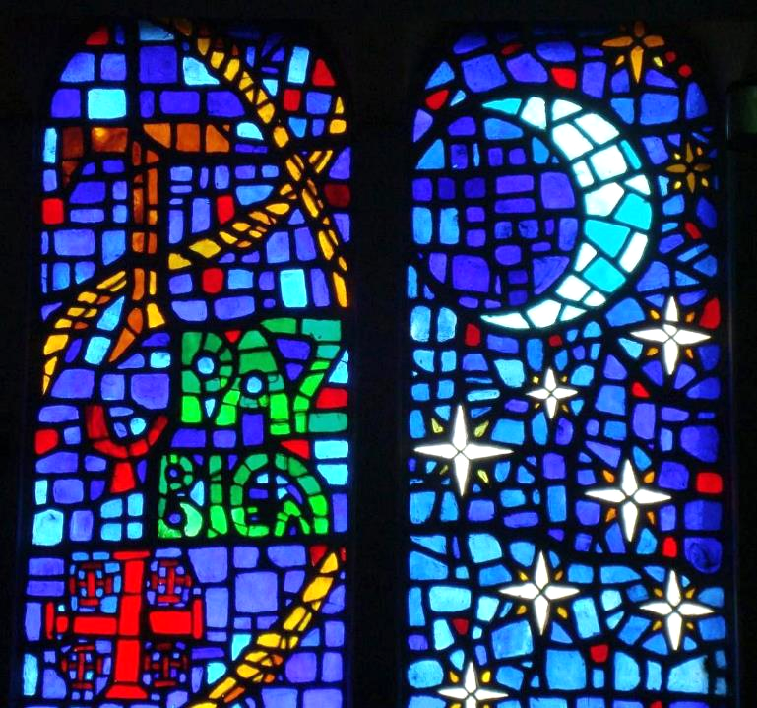
O God of all the prophets,
you herald the coming of the Son of Man
by wondrous signs in the heavens and on the earth.
First Thursday of Advent, Year C
Jeremiah 33:14-16 • Psalm 25:1-10 • 1 Thessalonians 3:9-13 • Luke 21:25-36

Slide 7
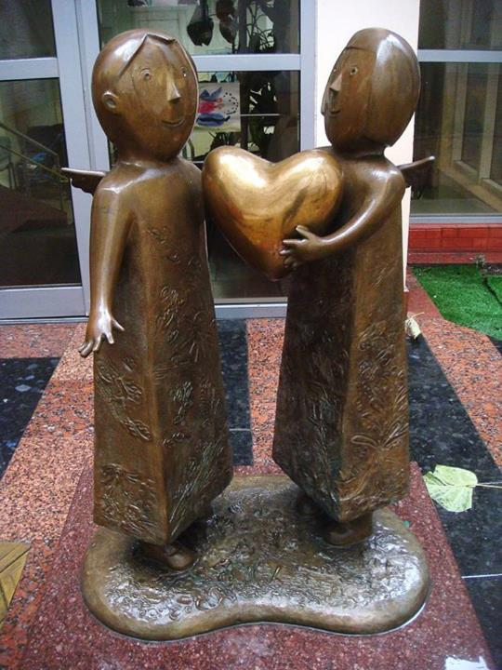
Guard our hearts from despair…
First Friday of Advent, Year C
Jeremiah 33:14-16 • Psalm 25:1-10 • 1 Thessalonians 3:9-13 • Luke 21:25-36

Slide 8
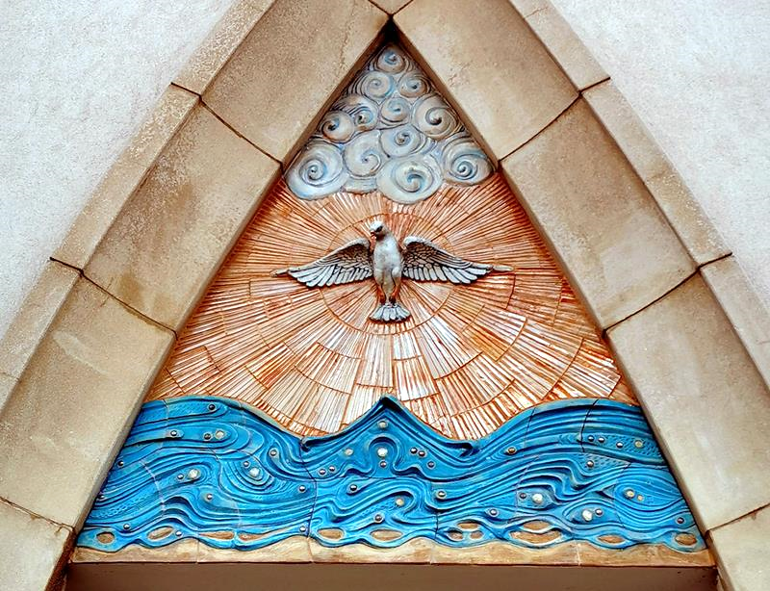
…so that we,
in the company of the faithful
and by the power of your Holy Spirit,
may be found ready to raise our heads
at the coming near of our redemption,
the day of Jesus Christ. Amen.
First Saturday of Advent, Year C
Jeremiah 33:14-16 • Psalm 25:1-10 • 1 Thessalonians 3:9-13 • Luke 21:25-36

Slide 9
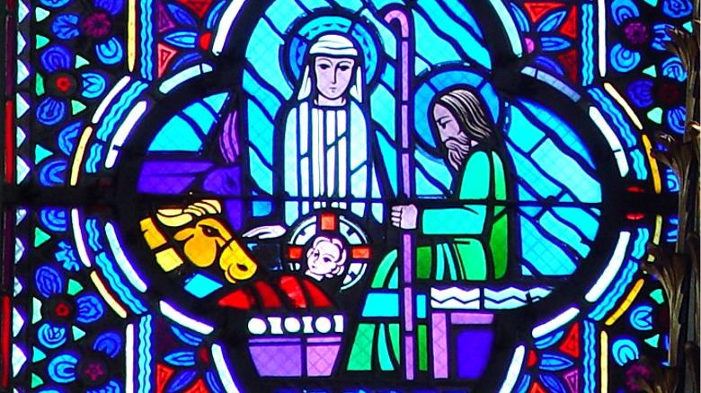
Prayers are reproduced from Revised Common Lectionary Prayers, copyright © 2002 Consultation on Common Texts. Augsburg Fortress. Used by permission. Art image descriptions can be found at the Art in the Christian Tradition image library, a service of the Vanderbilt Divinity Library, http://diglib.library.vanderbilt.edu/. All images available via Creative Commons 3.0 License.
Nativity, by Duccio -- https://commons.wikimedia.org/wiki/File:Duccio_di_Buoninsegna_058.jpg
Procession, by John August Swanson -- www.JohnAugustSwanson.com - copyright 2007 by John August Swanson
Sermon on the Mount, by Laura James -- https://www.laurajamesart.com/collections/religious/
Birth of Jesus with the Shepherds, by JESUS MAFA -- http://www.librairie-emmanuel.fr
Ligthing to Unite, by Gerry Hofstetter -- https://www.flickr.com/photos/johnsonderman/2482318736
Paz y Bien, Parish of the Holy Kings, Mexico City -- https://commons.wikimedia.org/wiki/File:Saints_Kings_Church,_3000_R%C3%ADo_Consulado_Avenue,_Venustiano_Carranza,_Federal_District,_Mexico06_-_Paz_y_bien.jpg
Heart of the World, by Mikhail Reva -- https://commons.wikimedia.org/wiki/File:Children_sculpture_by_Mikhail_Reva.jpg
Coming of the Holy Spirit,by Eva Kun -- https://commons.wikimedia.org/wiki/File:VeresegyhazaSzentlelekFotoTalerTamas8.jpg

