Slide 1
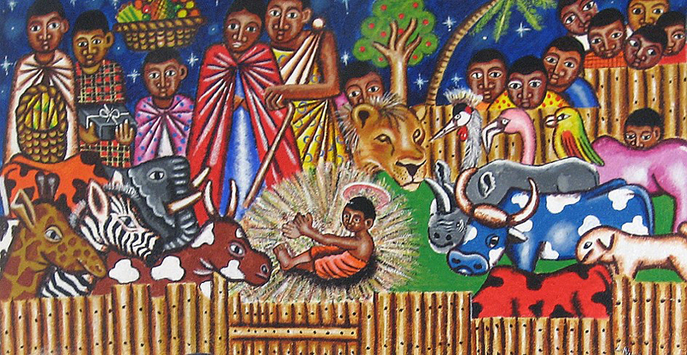
Advent Daily Prayer for Reflection
Week 3
Revised Common Lectionary Year B
The Prayers that follow are written by the RCL specifically for the Advent Lectionary scripture texts:
Isaiah 61:1-4, 8-11 • Psalm 126 or Luke 1:46b-55 • 1 Thessalonians 5:16-24 • John 1:6-8, 19-28
Image information may be found at the end.

Slide 2
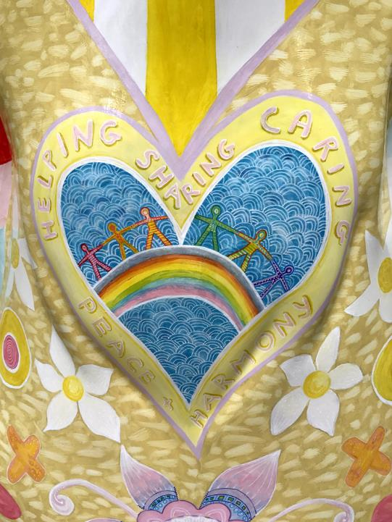
God of hope,
you call us home from the exile of selfish oppression
to the freedom of justice,
the balm of healing,
and the joy of sharing.
Third Sunday of Advent, Year B

Slide 3
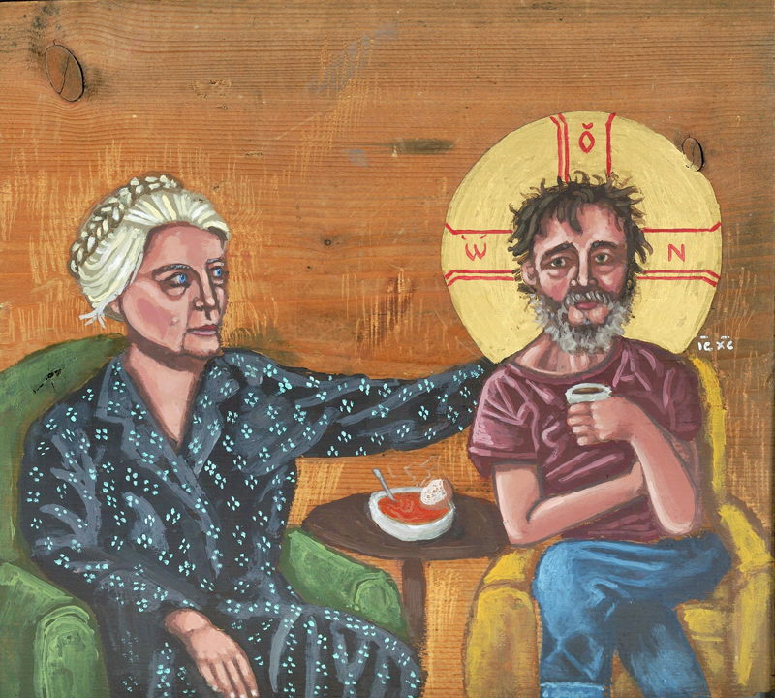
Make us strong to join you in your holy work,
as friends of strangers and victims,
companions of those whom others shun…
Third Monday of Advent, Year B

Slide 4
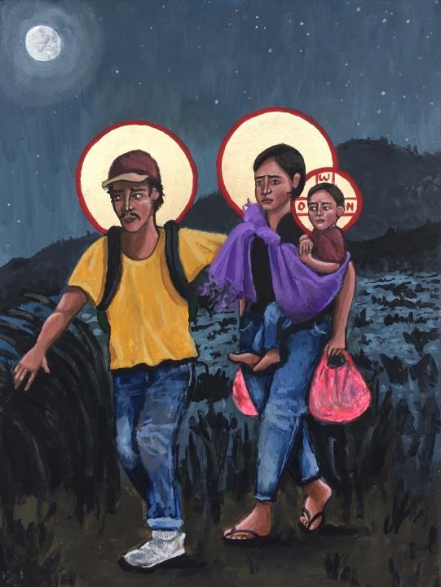
God of joy and exultation,
you strengthen what is weak;
you enrich the poor
and give hope to those who live in fear.
Third Tuesday of Advent, Year B

Slide 5
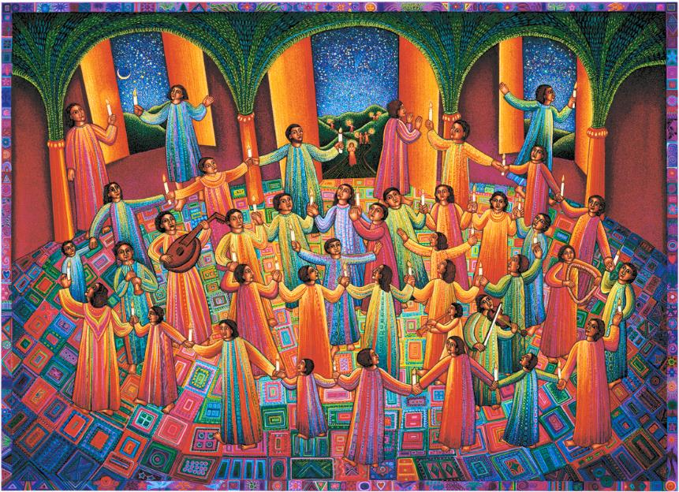
God of joy…look upon our needs this day.
Make us grateful for the good news of salvation
and keep us faithful in your service
until the coming of our Lord Jesus Christ,
who lives for ever and ever.
Third Wednesday of Advent, Year B

Slide 6
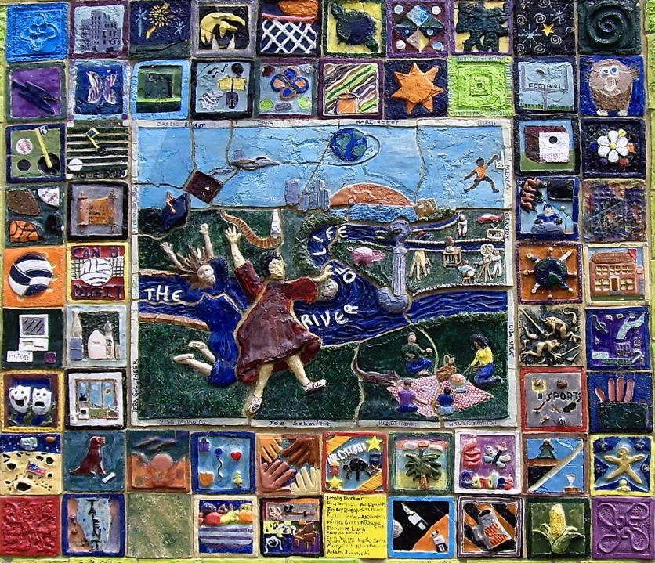
Merciful God of peace,
your work, spoken by the prophets,
restores your people's life and hope.
Third Thursday of Advent, Year B

Slide 7
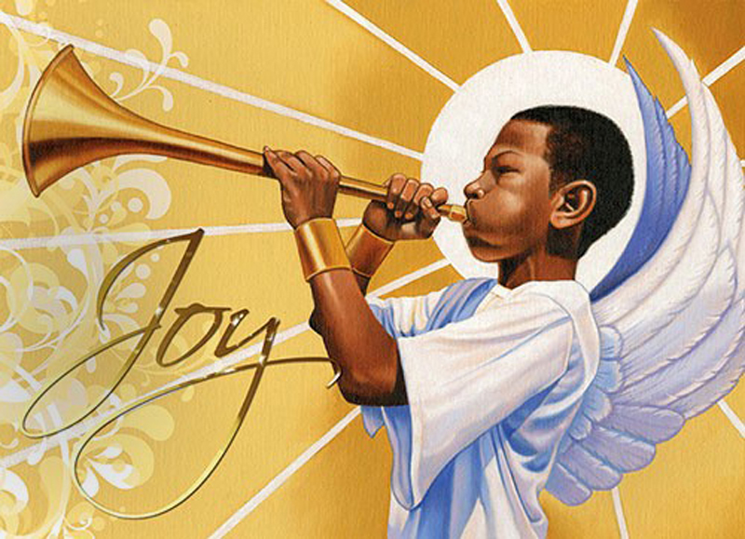
Fill our hearts with the joy of your saving grace,
that we may hold fast to your great goodness
and in our lives proclaim your justice in all the world.
Third Friday of Advent, Year B

Slide 8
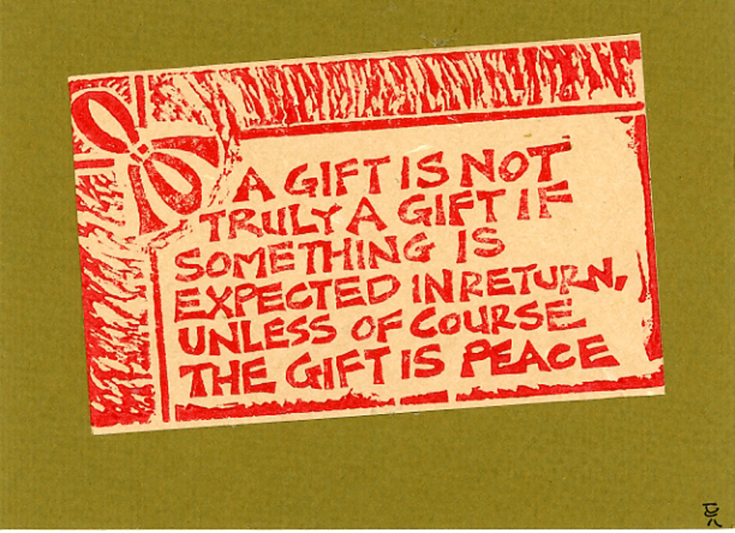
Light of life, you came in flesh …
and gave us power to be your children.
Grant us faith, O Christ, to see your presence among us,
so that all of creation may sing new songs of gladness
and walk in the way of peace.
Third Saturday of Advent, Year B

Slide 9
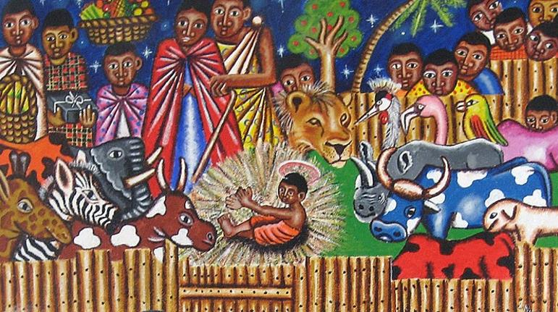
Prayers are reproduced from Revised Common Lectionary Prayers, copyright © 2002 Consultation on Common Texts. Augsburg Fortress. Used by permission. Art image descriptions can be found at the Art in the Christian Tradition image library, a service of the Vanderbilt Divinity Library, http://diglib.library.vanderbilt.edu/. All images available via Creative Commons 3.0 License.
Nativity, Kenyan Artist -- https://www.flickr.com/photos/genvessel/537858093
Helping, Sharing, Caring, Harmony, Peace, Karen Roe-- https://www.flickr.com/photos/karen_roe/36068574913/ - Karen Roe
Dorothy Day with Homeless Christ, Kelly Latimore -- https://kellylatimoreicons.com/contact/
Refugees, Sagrada Familia, Kelly Latimore -- https://kellylatimoreicons.com/contact/
Celebration, John August Swanson -- www.JohnAugustSwanson.com - copyright 1997 by John August Swanson
River of Life -- https://www.flickr.com/photos/22711505@N05/5818969367
Joy to the World, Democratic Republic of Congo -- https://www.flickr.com/photos/babasteve/31844535845/
Christmas Card Hand Print -- http://www.flickr.com/photos/yardsale/76188544/

