Slide 1
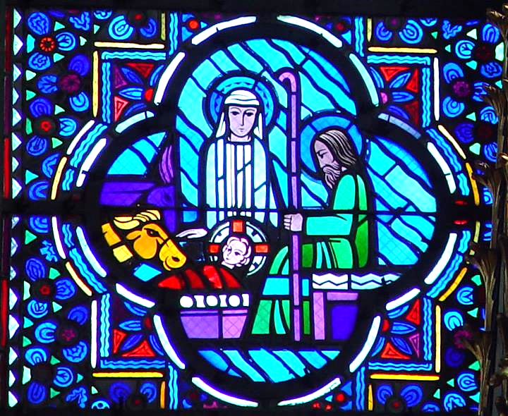
Advent Daily Prayer for Reflection
Week 1
Revised Common Lectionary Year B
First Week
The Prayers that follow are written by the RCL specifically for the Advent Lectionary scripture texts:
Isaiah 64:1-9 • Psalm 80:1-7, 17-19
1 Corinthians 1:3-9 • Mark 13:24-37
Image information may be found at the end.

Slide 2
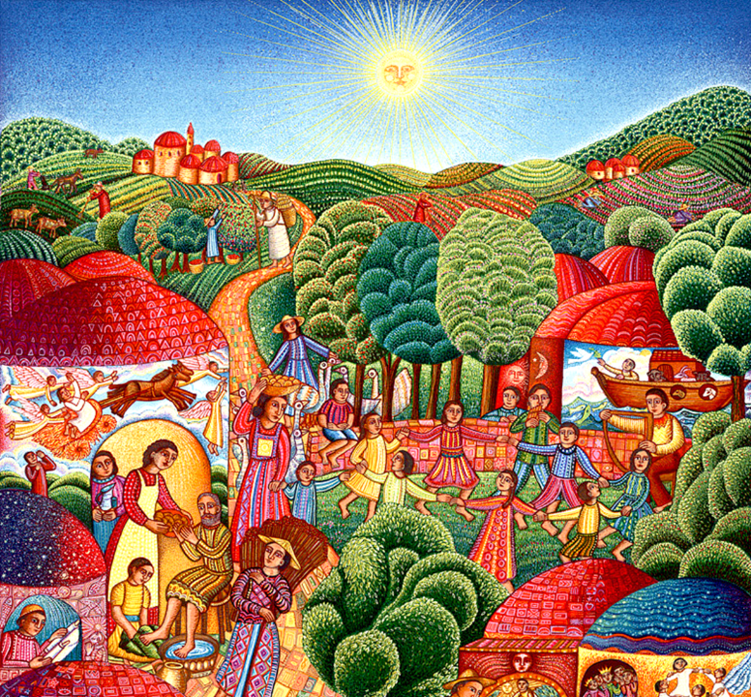
God of justice and peace,
from the heavens you rain down mercy and kindness,
that all on earth may stand in awe and wonder
before your marvelous deeds.
First Sunday of Advent, Year B
add scripture links

Slide 3
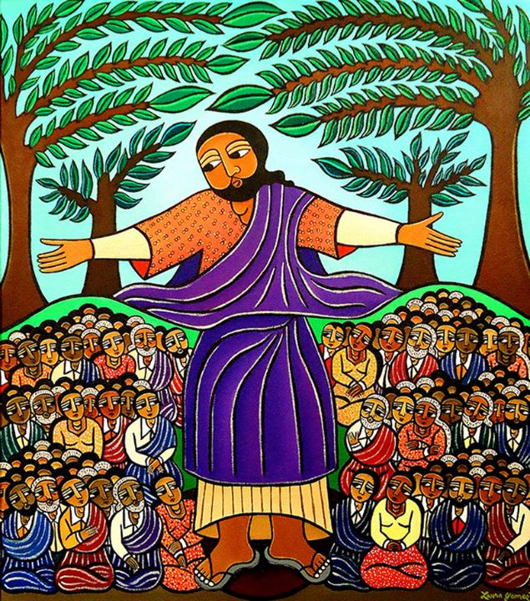
Raise our heads in expectation,
that we may yearn for the coming day of the Lord
and stand without blame before your Son, Jesus Christ,
who lives and reigns for ever and ever. Amen.
First Monday of Advent, Year B

Slide 4
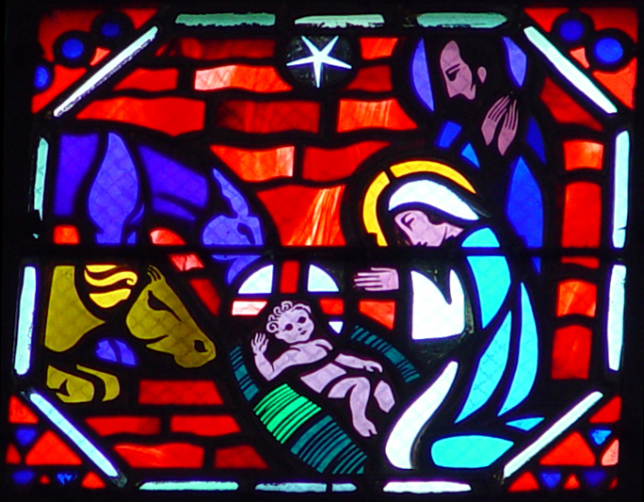
We seek the mighty God in the most unlikely places
as a child in a stable, and in an empty tomb. May God hear these prayers,
which come from the unlikely corners of our lives.
First Tuesday of Advent, Year B

Slide 5
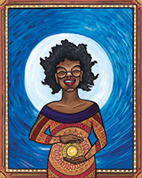
Give us ears to hear, O God,
and eyes to watch, that we may know your presence in our midst during this holy season of joy
as we anticipate the coming of Jesus Christ.
First Wednesday of Advent, Year B

Slide 6
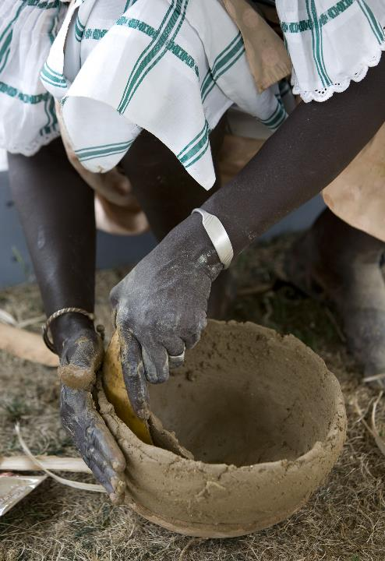
Creator of the world,
you are the potter, we are the clay,
and you form us in your image.
First Thursday of Advent, Year B

Slide 7
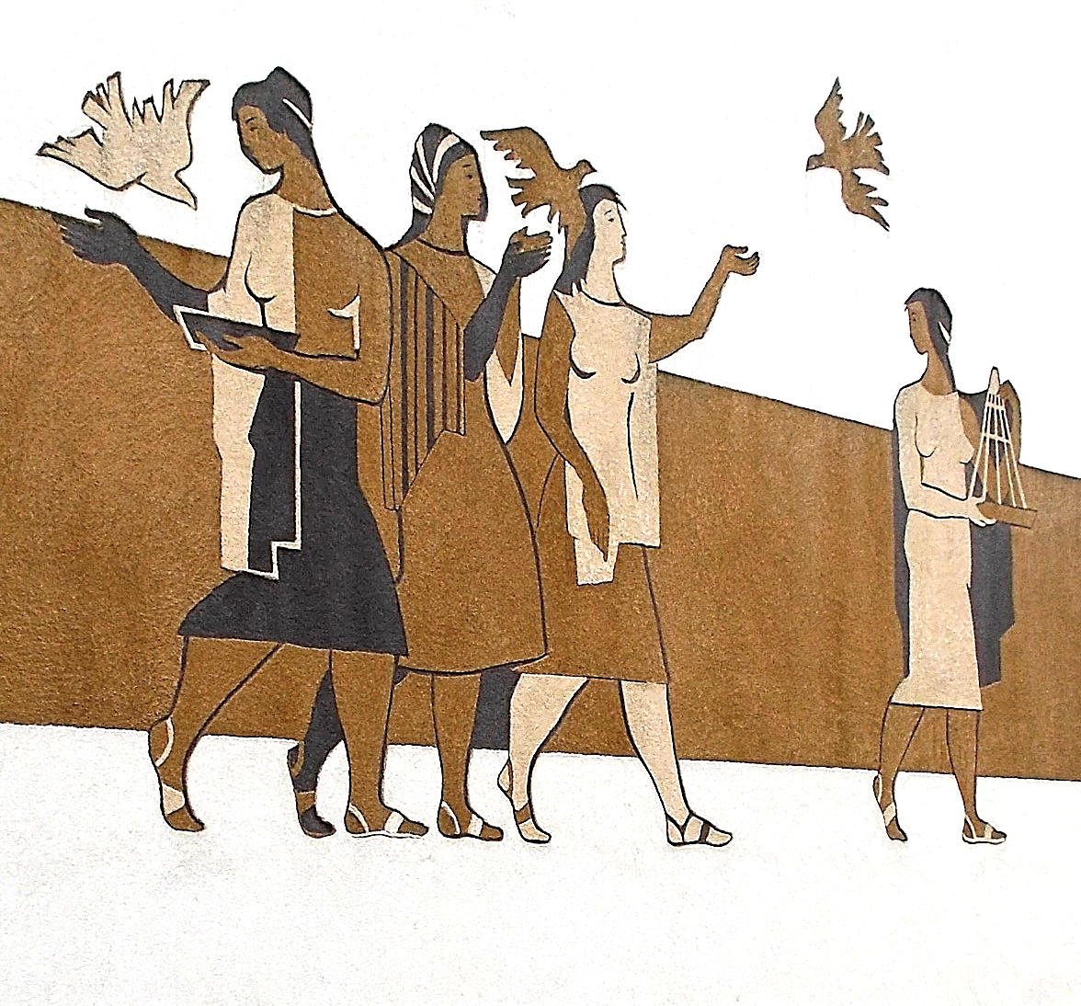
Shape our spirits
by Christ's transforming power,
that as one people
we may live out your compassion and justice,
whole and sound in the realm of your peace. Amen.
First Friday of Advent, Year B

Slide 8
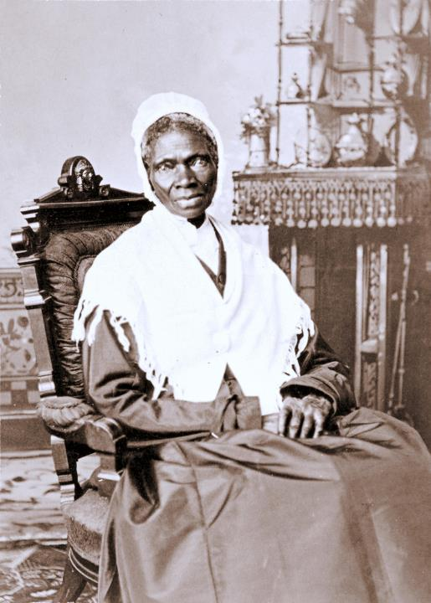
Open our eyes to Christ's presence in the shadows of our world,
so that we, like him, may become beacons of your justice,
and defenders of all for whom there is no room.
First Saturday of Advent, Year B

Slide 9
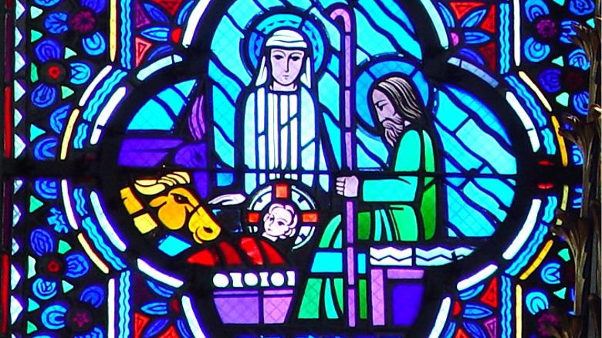
Prayers are reproduced from Revised Common Lectionary Prayers, copyright © 2002 Consultation on Common Texts. Augsburg Fortress. Used by permission. Art image descriptions can be found at the Art in the Christian Tradition image library, a service of the Vanderbilt Divinity Library, http://diglib.library.vanderbilt.edu/. All images available via Creative Commons 3.0 License.
Nativity, by Jacques Le Breton and Jean Gaudin -- http://diglib.library.vanderbilt.edu/act-imagelink.pl?RC=29379
A Visit, by John August Swanson -- www.JohnAugustSwanson.com - copyright 1995 by John August Swanson
Sermon on the Mount, by Laura James -- https://www.laurajamesart.com/collections/religious/
Christ is Born, by Jacques Le Breton and Jean Gaudin -- http://diglib.library.vanderbilt.edu/act-imagelink.pl?RC=51556
Mary’s Song, by Lauren Wright Pittman -- http://www.lewpstudio.com - copyright by Lauren Wright Pittman
Making Pots -- https://commons.wikimedia.org/wiki/File:Description-_A_woman_potter_from_Senegal_hand_shapes_a_pot_in_the_Roots_of_Virginia_Culture_program_at_the_2007_Smithsonian_Folklife_Festival_on_the_National_Mall,_Washington,_D.C._(2553825128).jpg
Peace, by Andrea Michnay -- https://commons.wikimedia.org/wiki/File:L%C3%A1nyok,_madarakkal_(Michnay_Andrea),_2018_Oroszl%C3%A1ny.jpg
Sojourner Truth -- https://commons.wikimedia.org/wiki/File:Sojourner_truth_c1870.jpg

