Slide 1
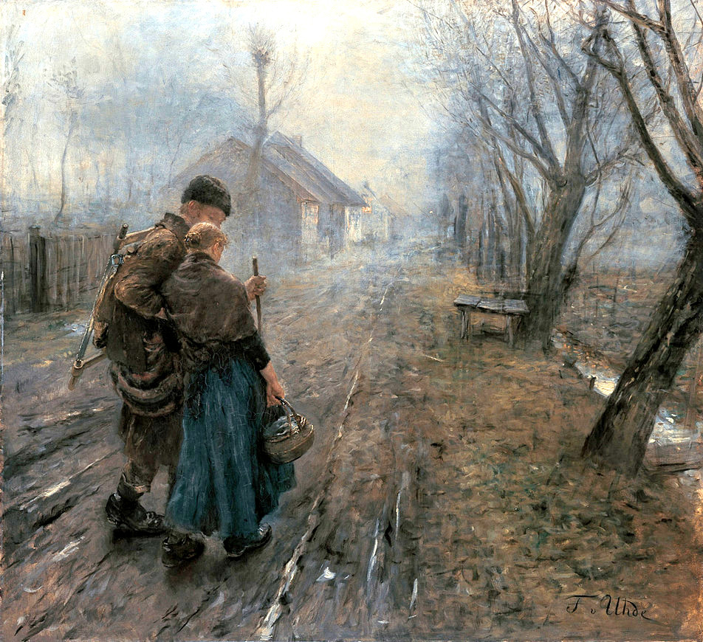
Advent Daily Prayer for Reflection
Week 4
Revised Common Lectionary Year A
The Prayers that follow are written by the RCL specifically for the Advent Lectionary scripture texts:
Isaiah 7:10-16 • Psalm 80:1-7, 17-19
Romans 1:1-7 • Matthew 1:18-25
Image information may be found at the end.

Slide 2
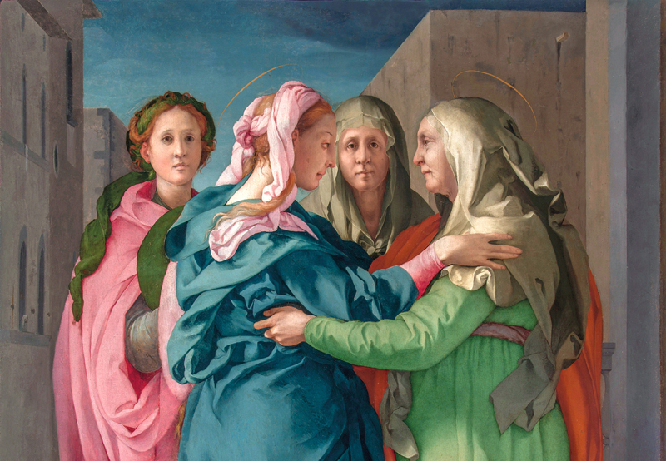
O God of Elizabeth and Mary,
you visited your servants with news of the world's redemption
in the coming of the Savior.
Fourth Sunday of Advent, Year A
Isaiah 7:10-16 • Psalm 80:1-7, 17-19
Romans 1:1-7 • Matthew 1:18-25

Slide 3
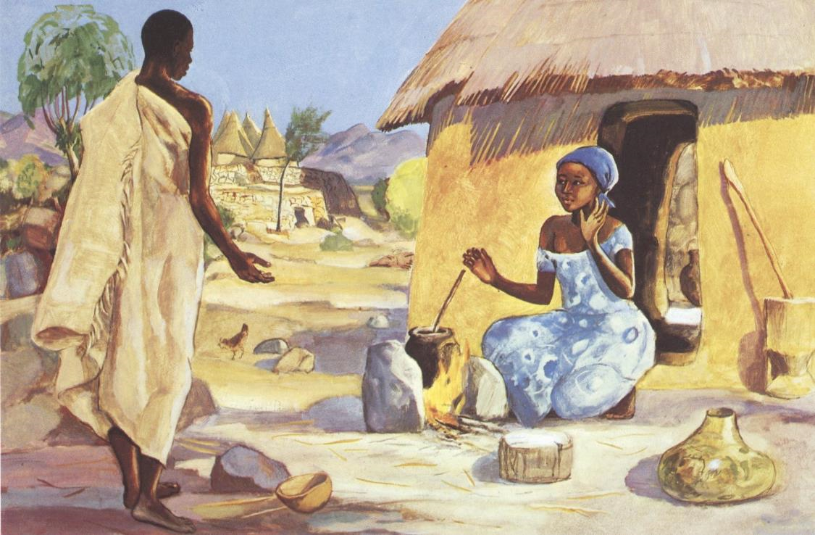
Make our hearts leap with joy,
and fill our mouths with songs of praise,
that we may announce glad tidings of peace,
and welcome the Christ in our midst.
Fourth Monday of Advent, Year A
Isaiah 7:10-16 • Psalm 80:1-7, 17-19
Romans 1:1-7 • Matthew 1:18-25

Slide 4
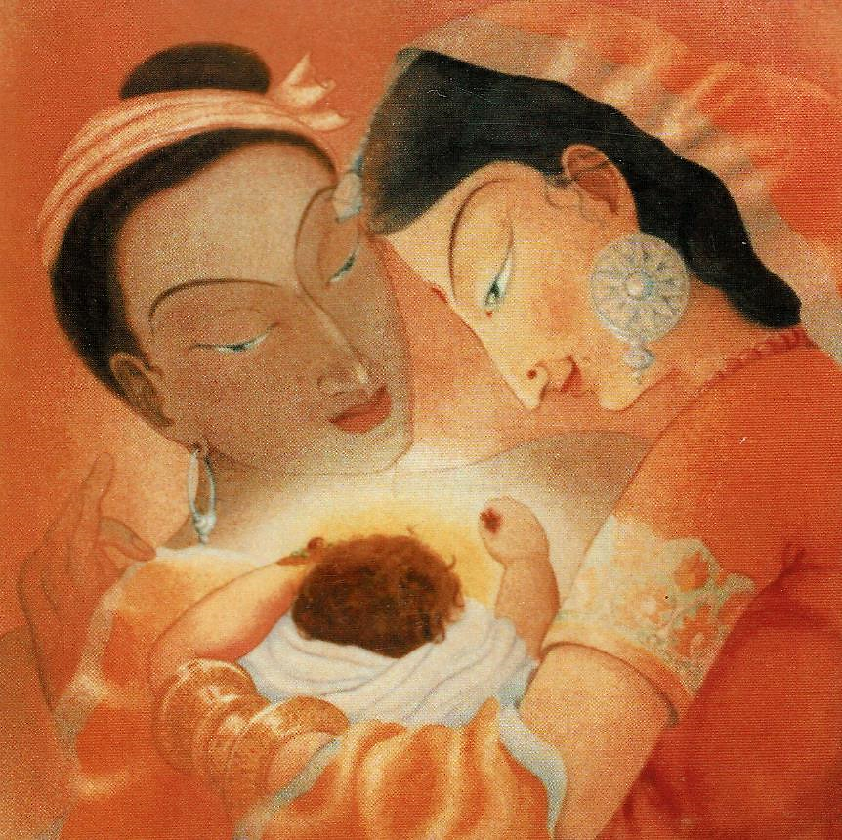
Brothers and sisters,
as we joyfully await the glorious coming of the Christ,
let us pray for the needs of the church, our community, and the world.
Fourth Tuesday of Advent, Year A
Isaiah 7:10-16 • Psalm 80:1-7, 17-19
Romans 1:1-7 • Matthew 1:18-25

Slide 5
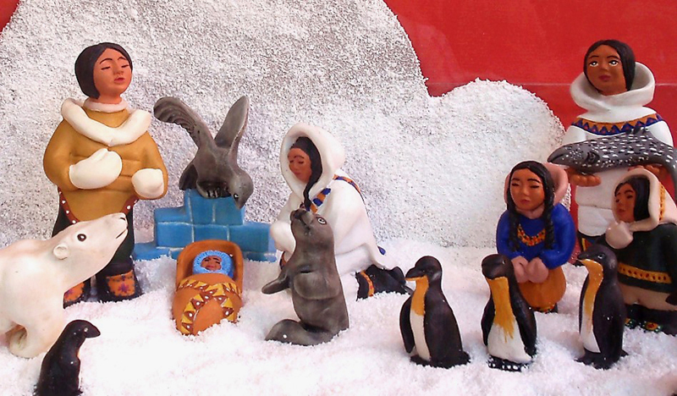
God of promise,
you have given us a sign of your love
through the gift of Jesus Christ, our Savior,
who was promised from ages past.
Fourth Wednesday of Advent, Year A
Isaiah 7:10-16 • Psalm 80:1-7, 17-19
Romans 1:1-7 • Matthew 1:18-25

Slide 6
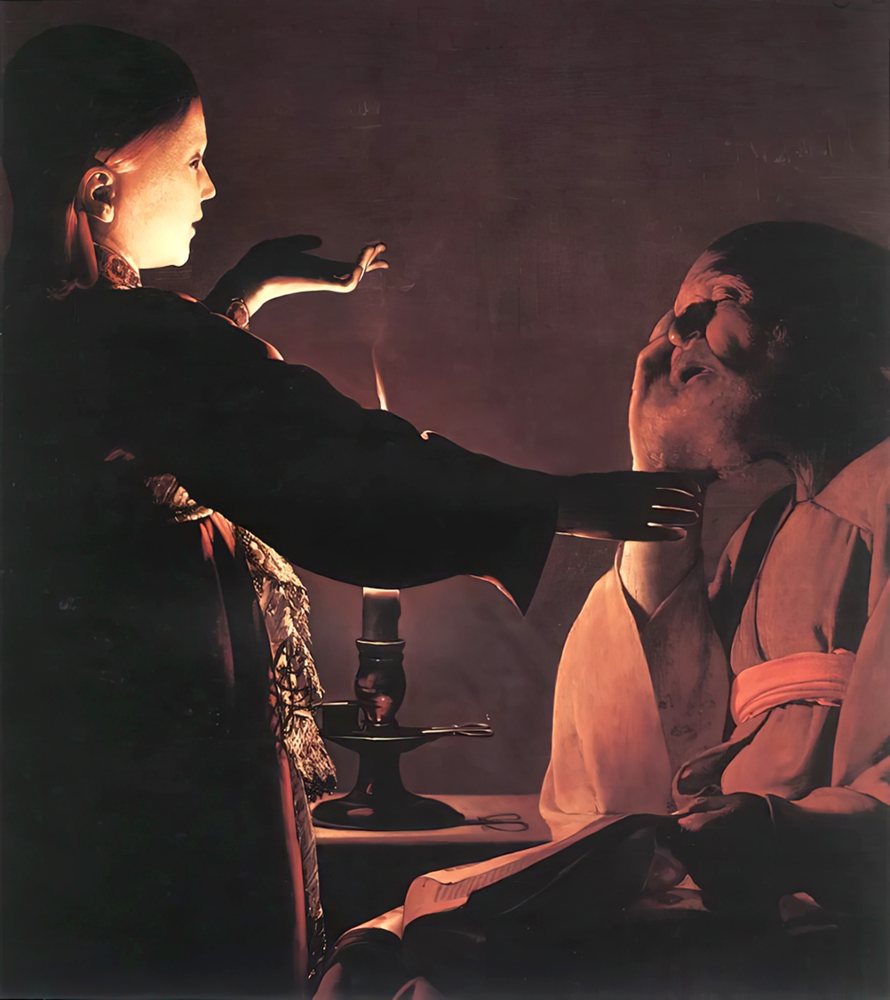
We believe as Joseph did
the message of your presence
whispered by an angel,
and offer our prayers for your world,
confident of your care and mercy for all creation.
Fourth Saturday of Advent, Year A
Isaiah 7:10-16 • Psalm 80:1-7, 17-19
Romans 1:1-7 • Matthew 1:18-25

Slide 7
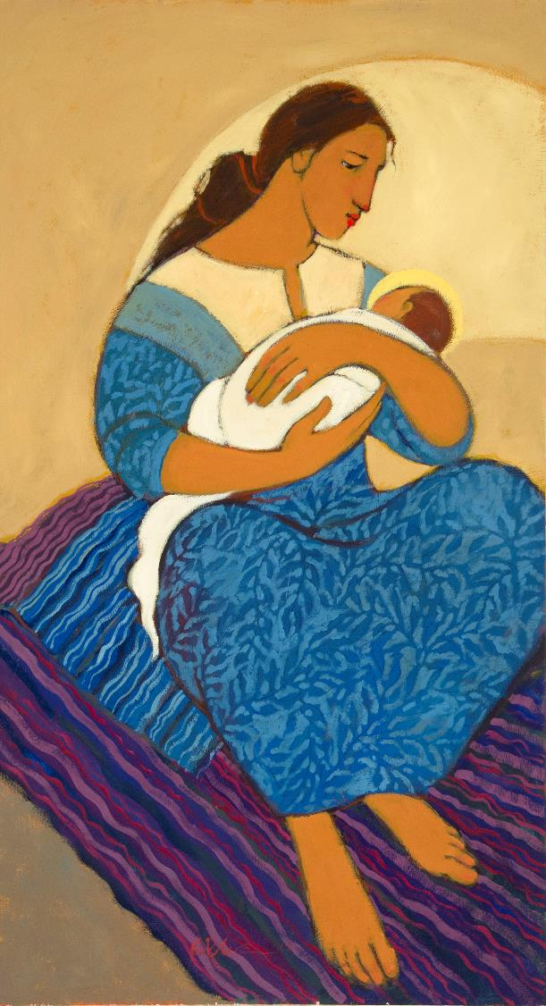
Shepherd of Israel,
may Jesus, Emmanuel and son of Mary,
be more than just a dream in our hearts.
Fourth Thursday of Advent, Year A
Isaiah 7:10-16 • Psalm 80:1-7, 17-19
Romans 1:1-7 • Matthew 1:18-25

Slide 8
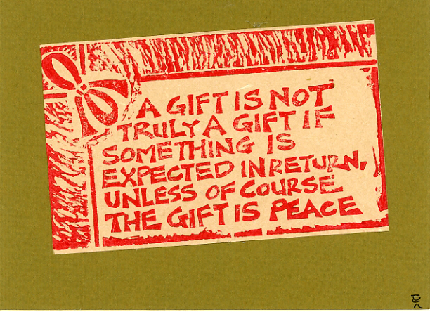
With the apostles, prophets, and saints,
save us, restore us,
and lead us in the way of grace and peace,
that we may bear your promise into the world. Amen.
Fourth Friday of Advent, Year A
Isaiah 7:10-16 • Psalm 80:1-7, 17-19
Romans 1:1-7 • Matthew 1:18-25

Slide 9
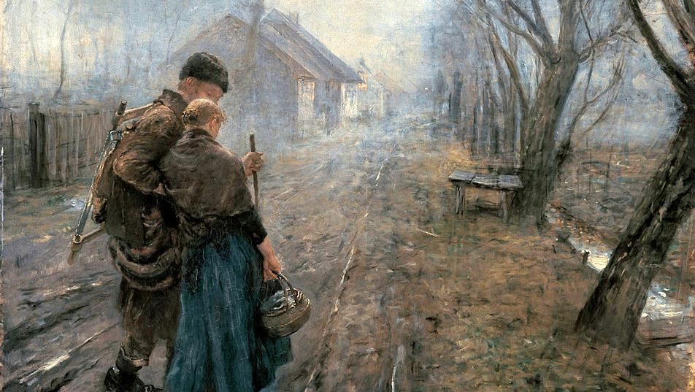
Prayers are reproduced from Revised Common Lectionary Prayers, copyright © 2002 Consultation on Common Texts. Augsburg Fortress. Used by permission. Art image descriptions can be found at the Art in the Christian Tradition image library, a service of the Vanderbilt Divinity Library, http://diglib.library.vanderbilt.edu/. All images available via Creative Commons 3.0 License.
Difficult Journey, Fritz von Uhde. https://commons.wikimedia.org/wiki/File:Fritz_v_Uhde_Schwerer_Gang_(1).jpg
Visitation, Jacopo da Pontormo. https://commons.wikimedia.org/wiki/File:Pontormo-visitation-after-restorationRGB.jpg
Annunciation, JESUS MAFA, Cameroon. http://www.librairie-emmanuel.fr (contact page: https://www.librairie-emmanuel.fr/contact)
Holy Family in Saffron, Frank Wesley. Estate of Frank Wesley, http://www.frankwesleyart.com/main_page.htm
Inuit Nativity. https://www.flickr.com/photos/azuaje/5321600328
Mary and Baby Jesus, Kathleen Peterson. https://www.kathleenpetersonart.com
Angel Visiting Joseph in a Dream, George de La Tour. https://commons.wikimedia.org/wiki/File:Georges_de_La_Tour_022.jpg
"A Gift Is Not Truly a Gift…", Linoleum print. http://www.flickr.com/photos/yardsale/76188544/

