Slide 1
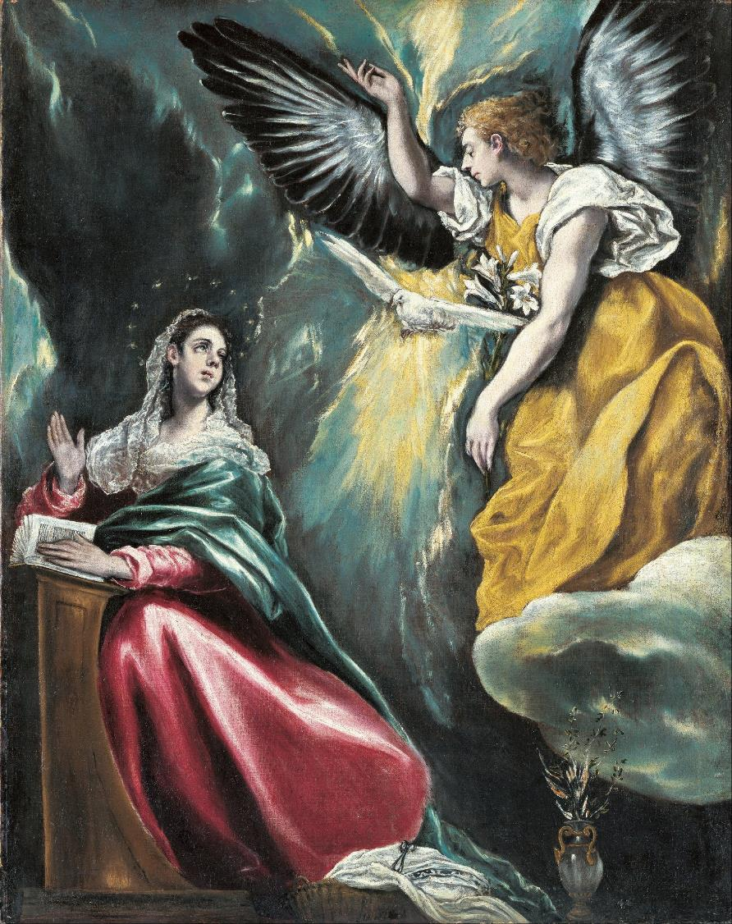
Advent Daily Prayer for Reflection
Week 3
Revised Common Lectionary Year A
The Prayers that follow are written by the RCL specifically for the Advent Lectionary scripture texts:
Isaiah 35:1-10 • Psalm 146:5-10 or Luke 1:46b-55
James 5:7-10 • Matthew 11:2-11
Image information may be found at the end.

Slide 2
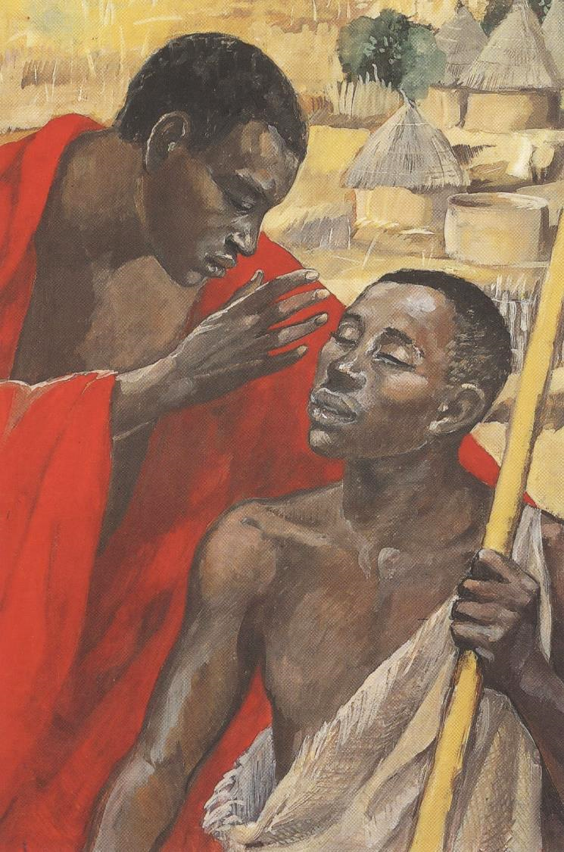
God of hope,
you call us home from the exile of selfish oppression
to the freedom of justice,
the balm of healing,
and the joy of sharing.
Third Sunday of Advent, Year A
Isaiah 35:1-10 • Psalm 146:5-10 or Luke 1:46b-55
James 5:7-10 • Matthew 11:2-11

Slide 3
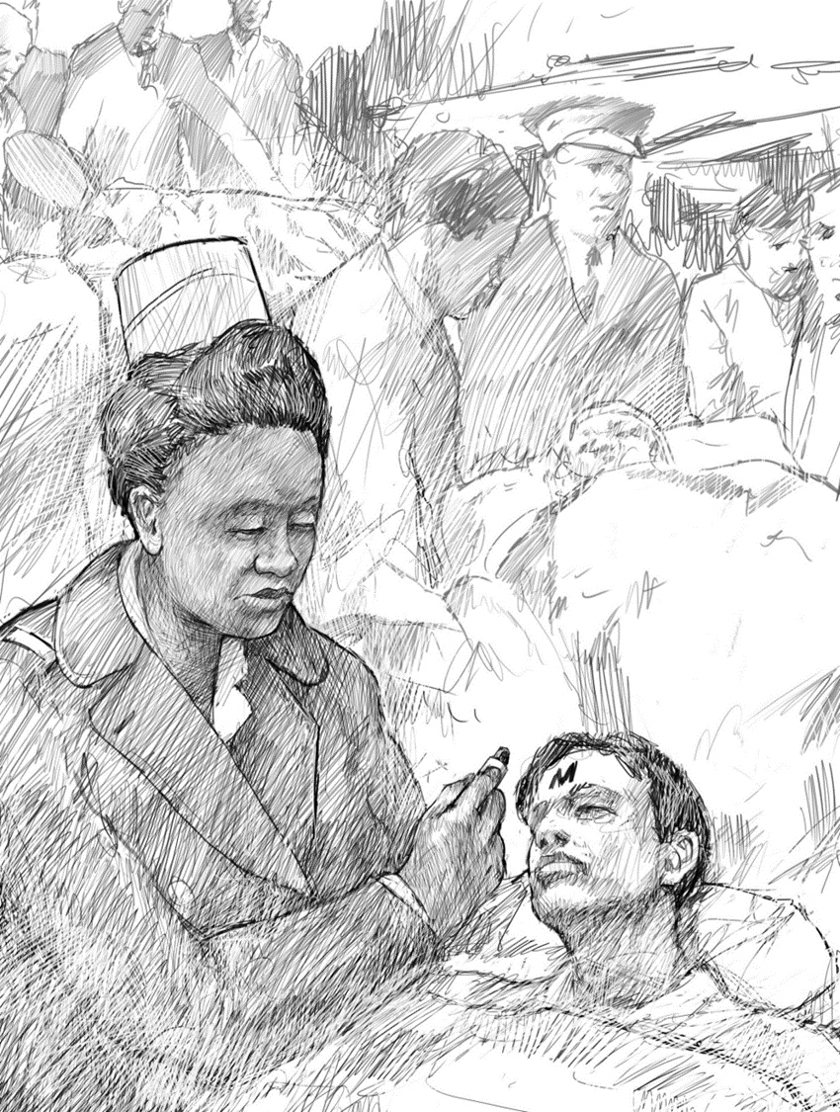
Make us strong to join you in your holy work,
as friends of strangers and victims,
companions of those whom others shun,
and as the happiness of those whose hearts are broken.
Third Monday of Advent, Year A
Isaiah 35:1-10 • Psalm 146:5-10 or Luke 1:46b-55
James 5:7-10 • Matthew 11:2-11

Slide 4
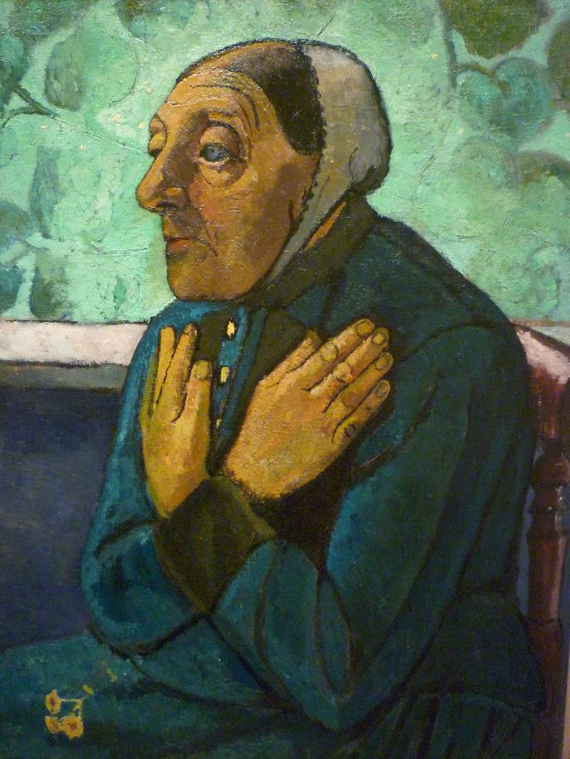
Brothers and sisters,
as we joyfully await the glorious coming of the Christ,
let us pray for the needs of the church, our community, and the world.
Third Tuesday of Advent, Year A
Isaiah 35:1-10 • Psalm 146:5-10 or Luke 1:46b-55
James 5:7-10 • Matthew 11:2-11

Slide 5
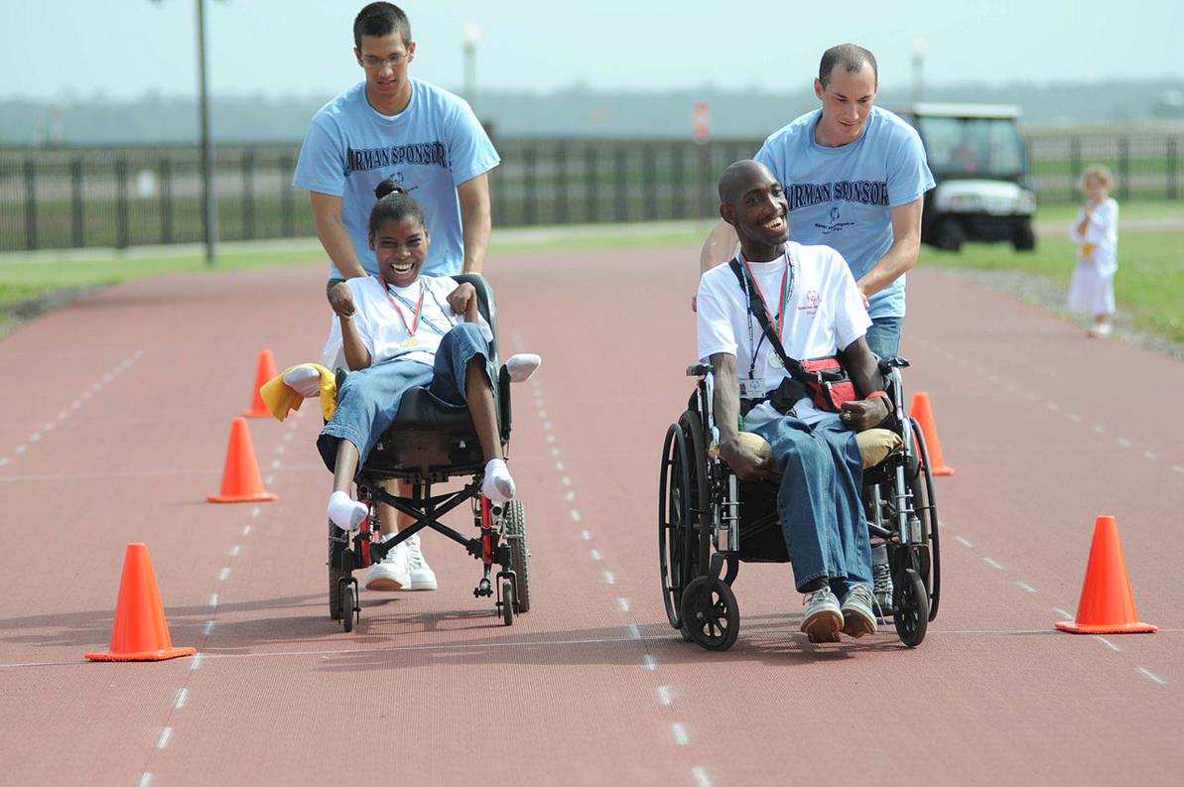
God of joy and exultation,
you strengthen what is weak;
you enrich the poor
and give hope to those who live in fear.
Third Wednesday of Advent, Year A
Isaiah 35:1-10 • Psalm 146:5-10 or Luke 1:46b-55
James 5:7-10 • Matthew 11:2-11

Slide 6
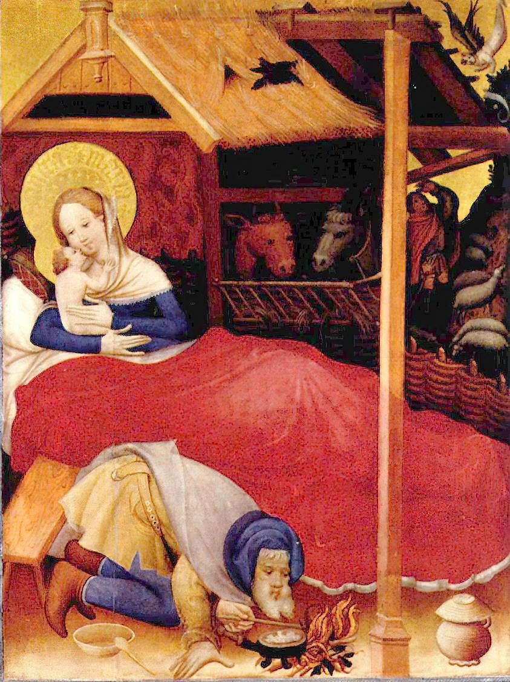
Look upon our needs this day.
Make us grateful for the good news of salvation
and keep us faithful in your service
until the coming of our Lord Jesus Christ.
Third Thursday of Advent, Year A
Isaiah 35:1-10 • Psalm 146:5-10 or Luke 1:46b-55
James 5:7-10 • Matthew 11:2-11

Slide 7
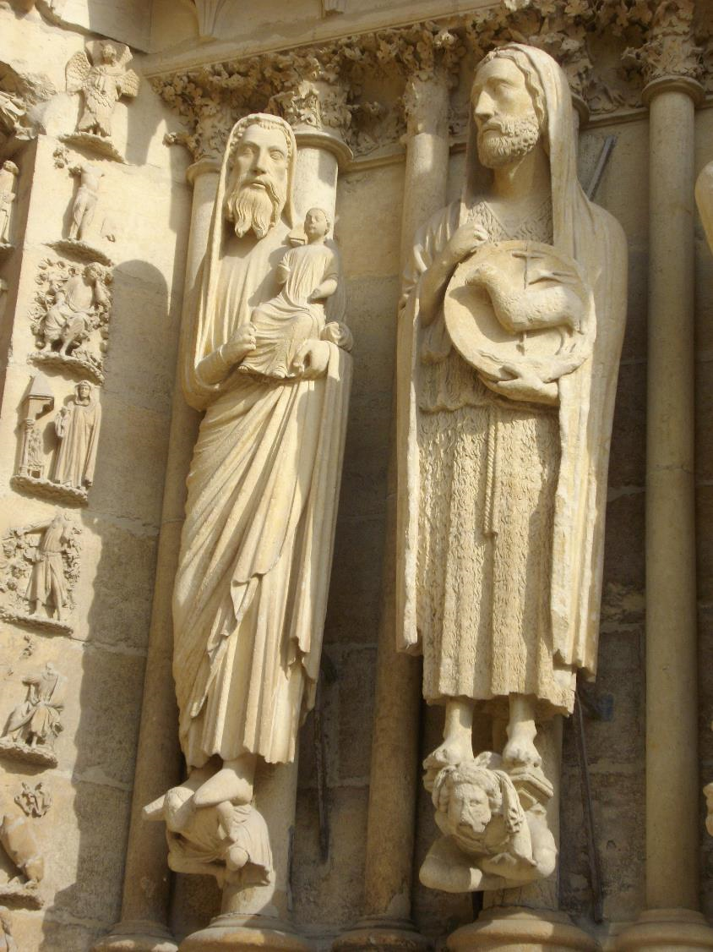
O God of Isaiah and John the Baptist,
through all such faithful ones
you proclaim the unfolding of future joy
and renewed life.
Third Friday of Advent, Year A
Isaiah 35:1-10 • Psalm 146:5-10 or Luke 1:46b-55
James 5:7-10 • Matthew 11:2-11

Slide 8
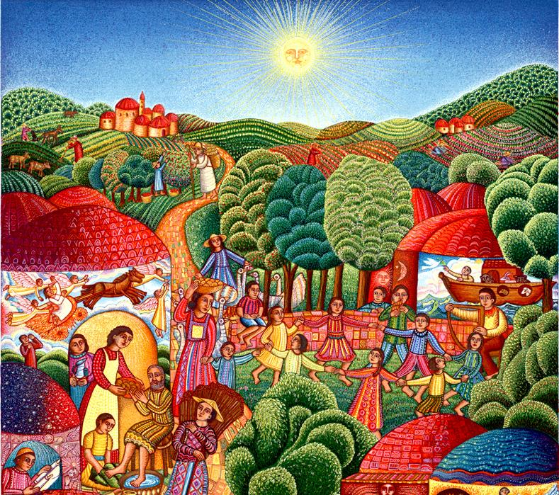
Strengthen our hearts to believe your advent promise
that one day we will walk in the holy way of Christ,
where sorrow and sighing will be no more
and the journey of God's people will be joy. Amen.
Third Saturday of Advent, Year A
Isaiah 35:1-10 • Psalm 146:5-10 or Luke 1:46b-55
James 5:7-10 • Matthew 11:2-11

Slide 9
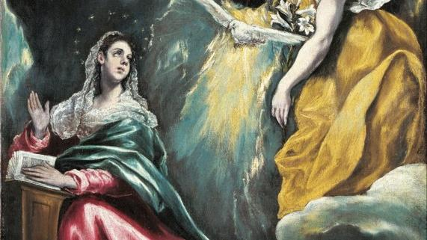

Prayers are reproduced from Revised Common Lectionary Prayers, copyright © 2002 Consultation on Common Texts. Augsburg Fortress. Used by permission. Art image descriptions can be found at the Art in the Christian Tradition image library, a service of the Vanderbilt Divinity Library, http://diglib.library.vanderbilt.edu/. All images available via Creative Commons 3.0 License.
The Annunciation, El Greco. https://commons.wikimedia.org/wiki/File:El_GRECO_(Domenikos_Theotokopoulos)_-_Annunciation_-_Google_Art_Project.jpg
Jesus Cures the Man Born Blind, JESUS MAFA. http://www.librairie-emmanuel.fr (contact page: https://www.librairie-emmanuel.fr/contact)
Abbie Sweetwine Treating the Injured, Air Force Medical Service. https://commons.wikimedia.org/wiki/File:Drawing_of_Abbie_Sweetwine_treating_injured.jpg
Old Peasant Woman, Paula Modersohn-Becker. https://commons.wikimedia.org/wiki/File:Paula_Modersohn-Becker_-_Old_Peasant_Woman_(c1905).jpg
Mississippi Special Olympics Assisted Race, U. S. Air Force. https://commons.wikimedia.org/wiki/File:U.S._Air_Force_Airman_Basic_Tyler_Hewitt,_left,_pushes_Veronica_Nickelson_and_Airman_1st_Class_Adam_Trochesset_pushes_Roderick_Smith_while_competing_in_the_25-meter_assisted_wheelchair_race_at_the_2010_100515-F-BD983-009.jpg
Nativity, Conrad von Soest. https://commons.wikimedia.org/wiki/File:Conrad_von_Soest_003.jpg
Isaiah and John the Baptist, Reims Cathedral. https://commons.wikimedia.org/wiki/File:Cath%C3%A9drale_ND_de_Reims_-_fa%C3%A7ade_ouest_(15).JPG
A Visit, John August Swanson. Estate of John August Swanson, https://www.johnaugustswanson.com/

