Slide 1
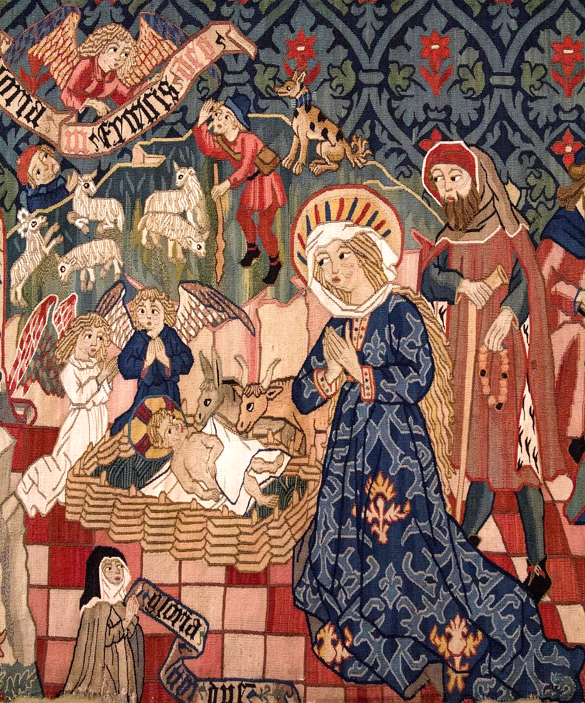
Advent Daily Prayer for Reflection
Week 2
Revised Common Lectionary Year A
The Prayers that follow are written by the RCL specifically for the Advent Lectionary scripture texts:
Isaiah 11:1-10 • Psalm 72:1-7, 18-19
Romans 15:4-13 • Matthew 3:1-12
Image information may be found at the end.

Slide 2
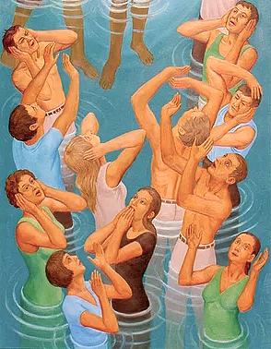
God of timeless grace,
you fill us with joyful expectation.
Make us ready for the message that prepares the way…
Second Sunday of Advent, Year A
Isaiah 11:1-10 • Psalm 72:1-7, 18-19
Romans 15:4-13 • Matthew 3:1-12

Slide 3
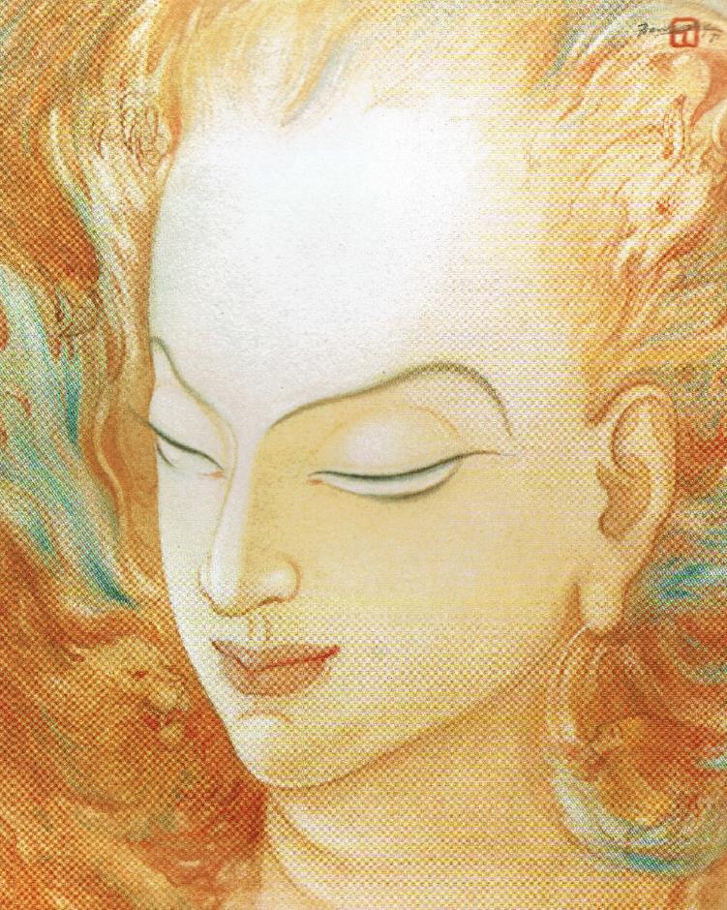
…that with uprightness of heart and holy joy
we may eagerly await the kingdom of your Son, Jesus Christ,
who reigns with you and the Holy Spirit, now and for ever.
Second Monday of Advent, Year A
Isaiah 11:1-10 • Psalm 72:1-7, 18-19
Romans 15:4-13 • Matthew 3:1-12

Slide 4
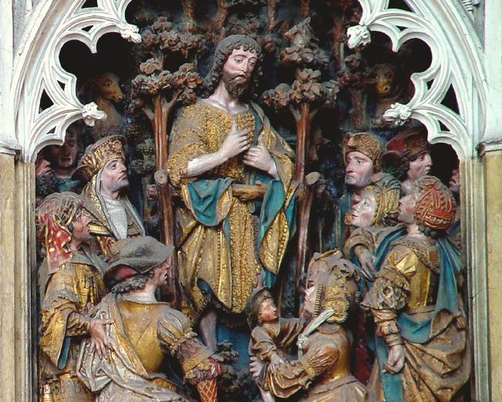
God of hope,
you raised up John the baptizer
as a herald who calls us to conversion.
We joyfully await the glorious coming of Christ.
Second Tuesday of Advent, Year A
Isaiah 11:1-10 • Psalm 72:1-7, 18-19
Romans 15:4-13 • Matthew 3:1-12

Slide 5
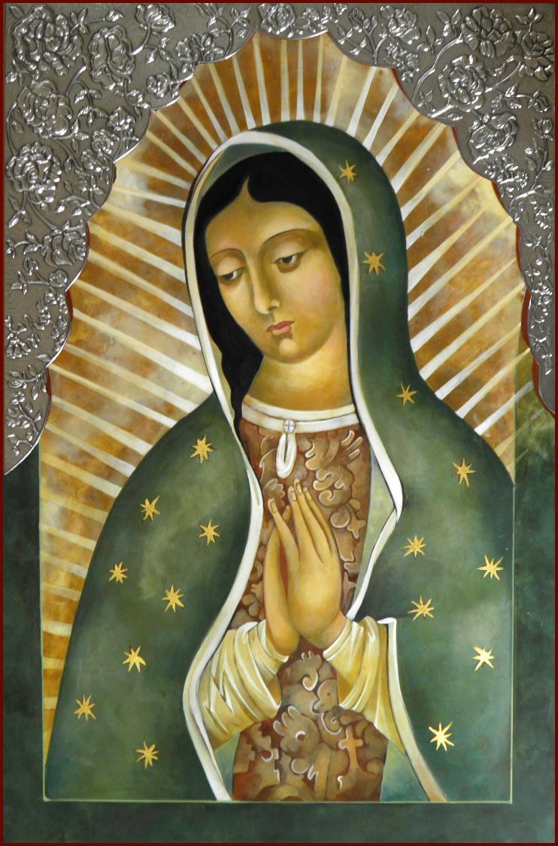
We pray to you for the needs of the church and the world. Hear our humble prayer.
Second Wednesday of Advent, Year A
Isaiah 11:1-10 • Psalm 72:1-7, 18-19
Romans 15:4-13 • Matthew 3:1-12

Slide 6
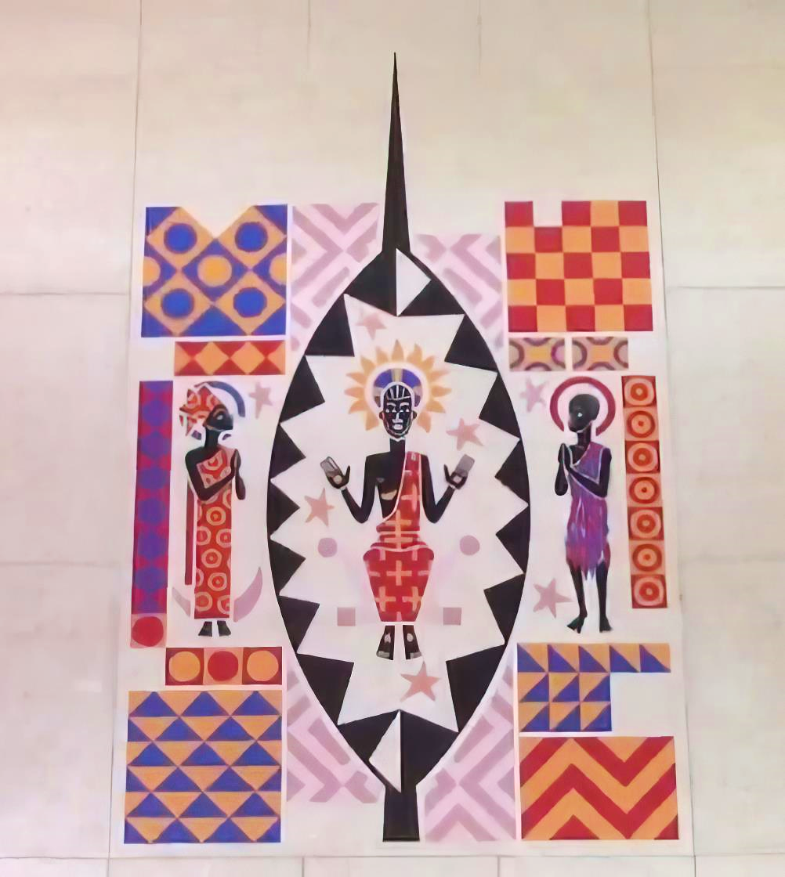
Give voice to your presence among us
until the day of the coming of your Son, Jesus Christ,
who lives and reigns for ever and ever.
Second Thursday of Advent, Year A
Isaiah 11:1-10 • Psalm 72:1-7, 18-19
Romans 15:4-13 • Matthew 3:1-12

Slide 7
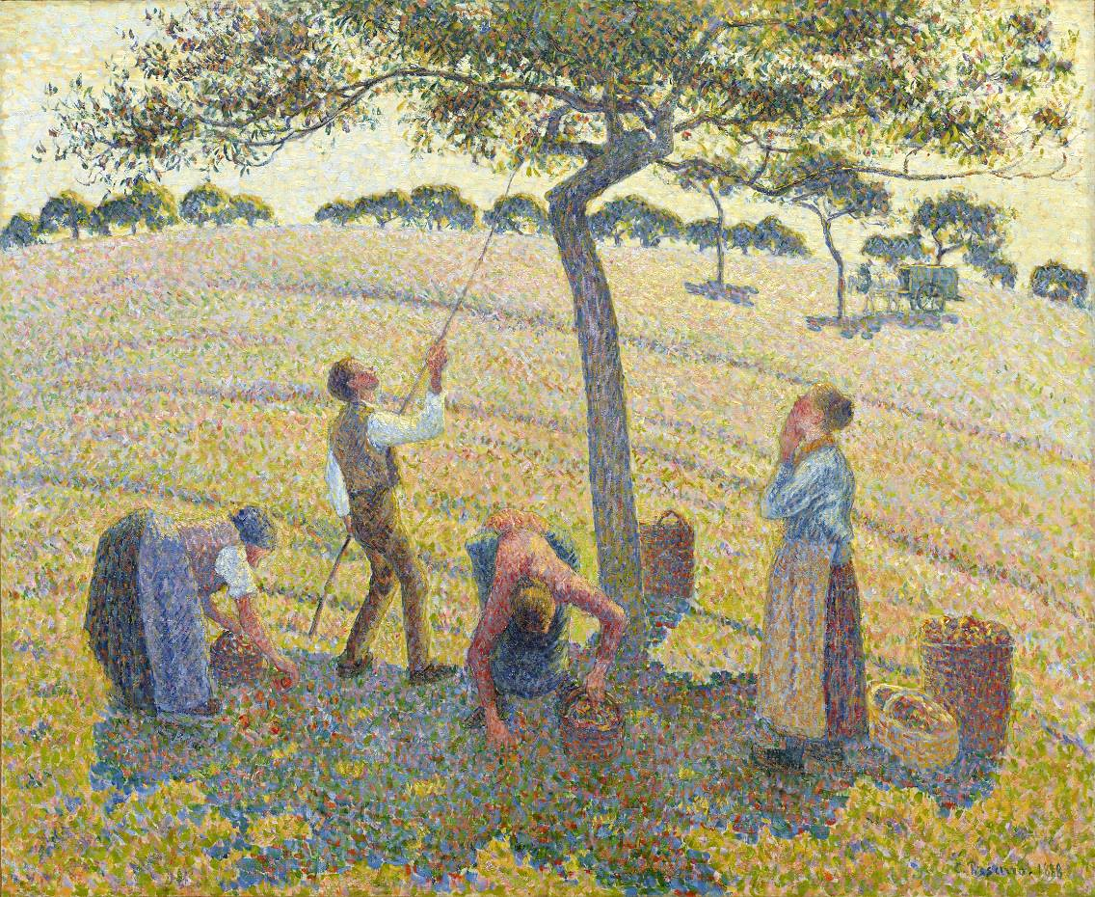
Laboring God,
with axe and winnowing fork
you clear a holy space
where hurt and destruction have no place,
and a little child holds sway.
Second Friday of Advent, Year A
Isaiah 11:1-10 • Psalm 72:1-7, 18-19
Romans 15:4-13 • Matthew 3:1-12

Slide 8
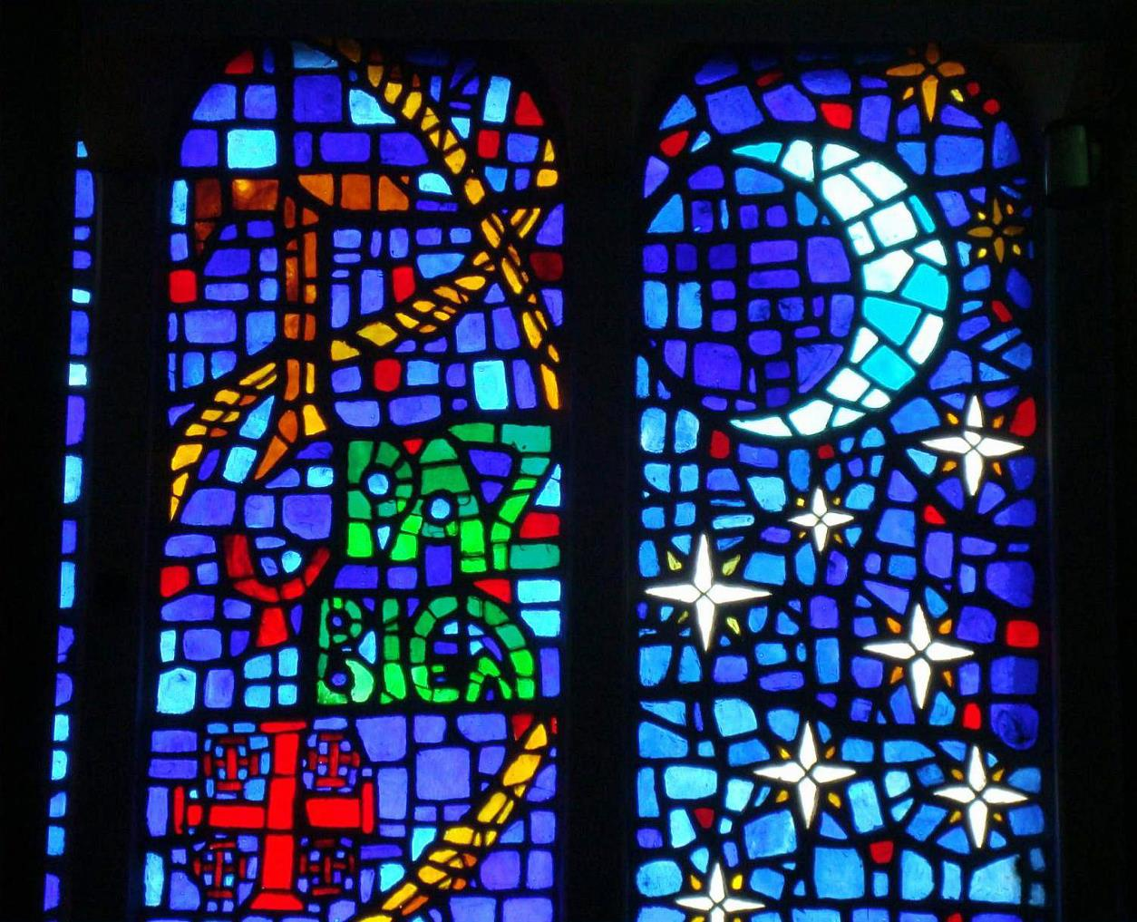
Clear our lives of hatred and despair,
sow seeds of joy and peace,
that shoots of hope may spring forth
and we may live in harmony
with one another. Amen.
Second Saturday of Advent, Year A
Isaiah 11:1-10 • Psalm 72:1-7, 18-19
Romans 15:4-13 • Matthew 3:1-12

Slide 9
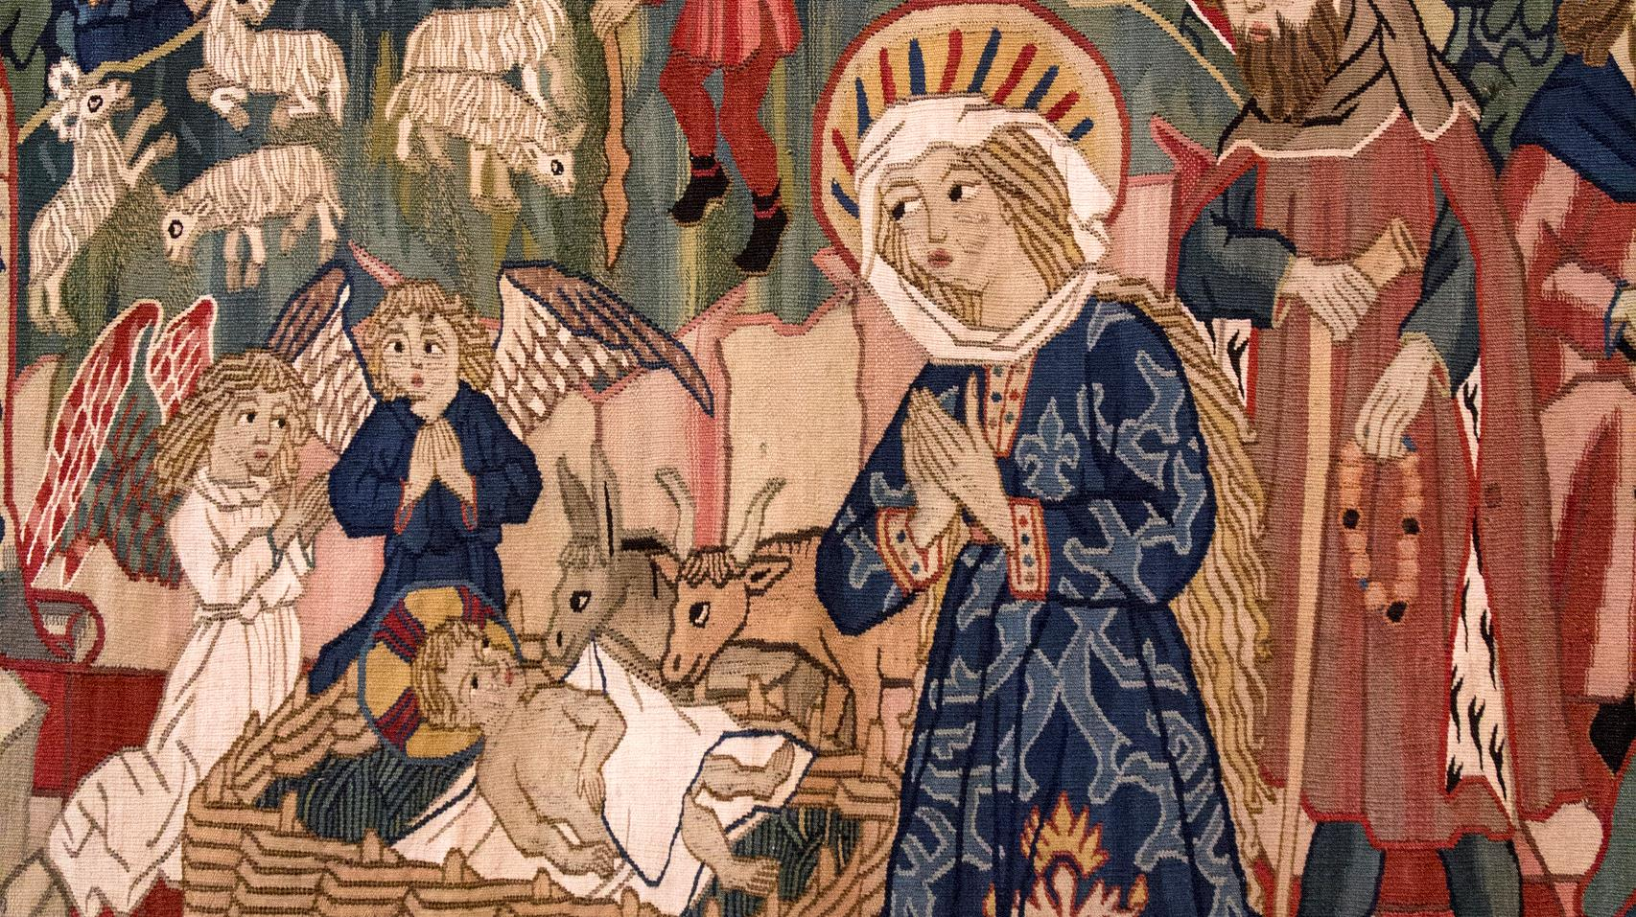
Prayers are reproduced from Revised Common Lectionary Prayers, copyright © 2002 Consultation on Common Texts. Augsburg Fortress. Used by permission. Art image descriptions can be found at the Art in the Christian Tradition image library, a service of the Vanderbilt Divinity Library, http://diglib.library.vanderbilt.edu/. All images available via Creative Commons 3.0 License.
Christ is Born, Swiss Dominican nun from medieval period. https://www.flickr.com/photos/paullew/8305678703 - Fr Lawrence Lew, O.P.
Baptism of Christ, Peter Koenig. Peter Winfried (Canisius) Koenig, https://www.pwkoenig.co.uk/
Holy Spirit, Frank Wesley. Estate of Frank Wesley, http://www.frankwesleyart.com/main_page.htm
John the Baptist, early 16th century polychrome carving, Amiens. https://diglib.library.vanderbilt.edu/act-imagelink.pl?RC=29350
Virgin of Guadalupe, Mary Jane Miller. https://www.millericons.com/
Christ in Glory, Father Saget, Keur Moussa Abbey. Robert Harding Photographers, https://www.robertharding.com/
Apple Harvest at Eragny, Camille Pissaro. https://commons.wikimedia.org/wiki/File:Apple_Harvest_by_Camille_Pissarro.jpg
Paz y Bien (Peace and All Good), Parish of the Holy Kings, Mexico City. https://commons.wikimedia.org/wiki/File:Saints_Kings_Church,_3000_R%C3%ADo_Consulado_Avenue,_Venustiano_Carranza,_Federal_District,_Mexico06_-_Paz_y_bien.jpg

