Slide 1
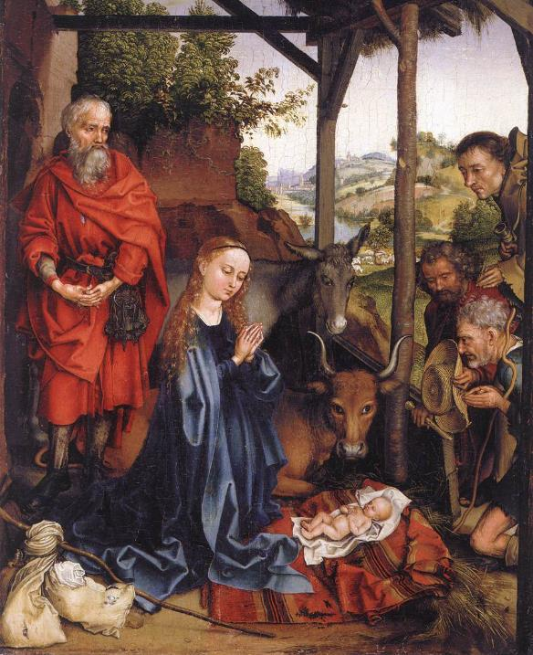
Advent Daily Prayer for Reflection
Week 1
Revised Common Lectionary Year A
The Prayers that follow are written by the RCL specifically for the Advent Lectionary scripture texts:
Isaiah 2:1-5 • Psalm 122
Romans 13:11-14 • Matthew 24:36-44
Image information may be found at the end.

Slide 2
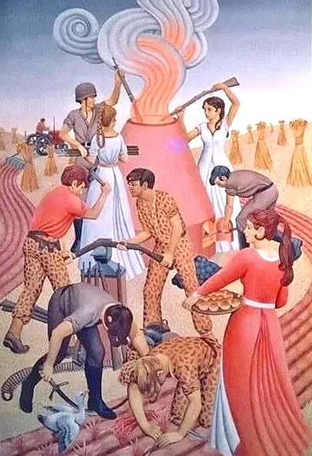
First Sunday of Advent, Year A
God of justice and peace,
from the heavens you rain down mercy and kindness,
that all on earth may stand in awe and wonder
before your marvelous deeds.
Isaiah 2:1-5 • Psalm 122
Romans 13:11-14
Matthew 24:36-44

Slide 3
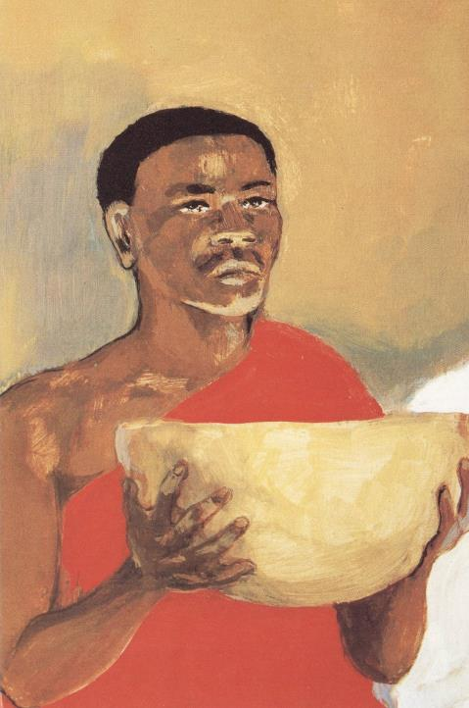
First Monday of Advent, Year A
Raise our heads in expectation,
that we may yearn for the coming day of the Lord
and stand without blame before your Son, Jesus Christ,
who lives and reigns for ever and ever. Amen.
Isaiah 2:1-5 • Psalm 122
Romans 13:11-14 • Matthew 24:36-44

Slide 4
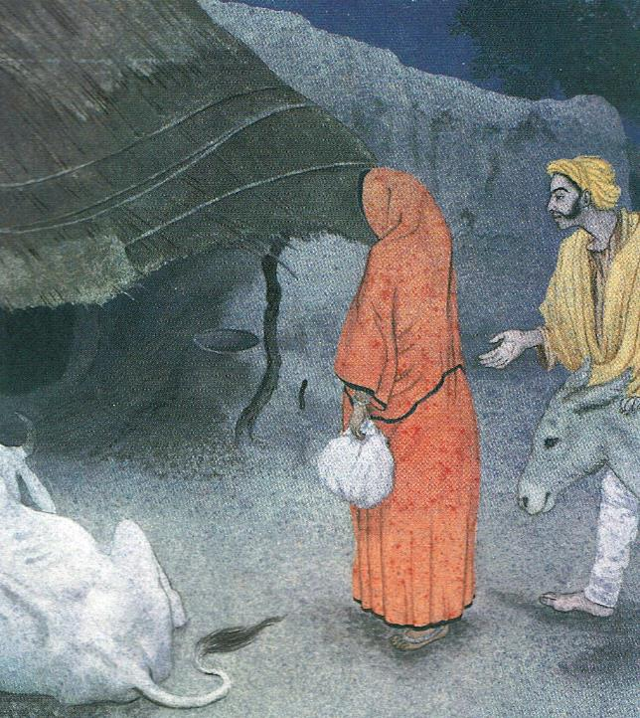
First Tuesday of Advent, Year A
We seek the mighty God in the most unlikely places
as a child in a stable, and in an empty tomb. May God hear these prayers,
which come from the unlikely corners of our lives.
Isaiah 2:1-5 • Psalm 122
Romans 13:11-14
Matthew 24:36-44

Slide 5
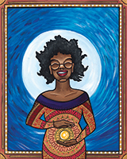
First Wednesday of Advent, Year A
Give us ears to hear, O God,
and eyes to watch, that we may know your presence in our midst during this holy season of joy
as we anticipate the coming of Jesus Christ.
Isaiah 2:1-5 • Psalm 122
Romans 13:11-14 • Matthew 24:36-44

Slide 6
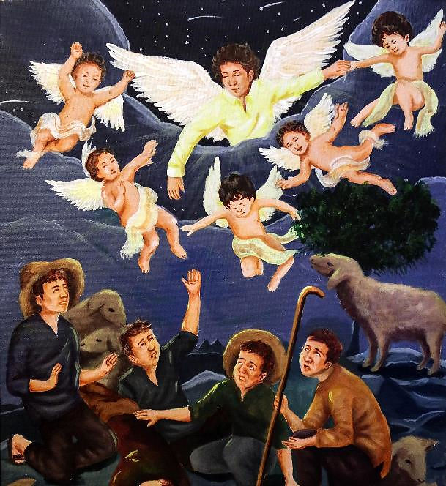
First Thursday of Advent, Year A
Unexpected God,
your advent alarms us.
Isaiah 2:1-5 • Psalm 122
Romans 13:11-14
Matthew 24:36-44

Slide 7
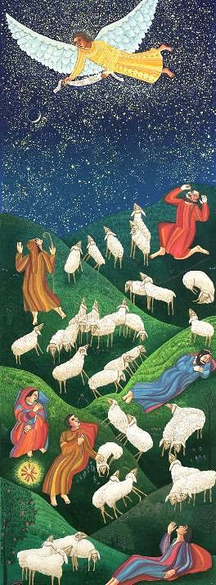
First Friday of Advent, Year A
Wake us from drowsy worship,
from the sleep that neglects love,
and the sedative of misdirected frenzy.
Isaiah 2:1-5 • Psalm 122
Romans 13:11-14
Matthew 24:36-44

Slide 8
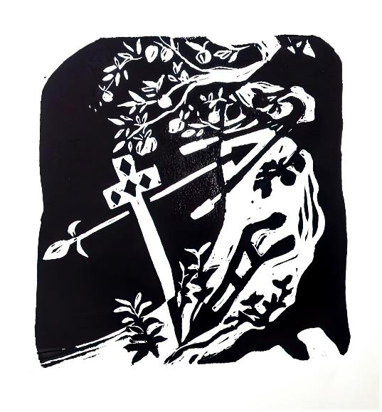
First Saturday of Advent, Year A
Awaken us now to your coming,
and bend our angers into your peace. Amen.
Isaiah 2:1-5 • Psalm 122
Romans 13:11-14
Matthew 24:36-44

Slide 9
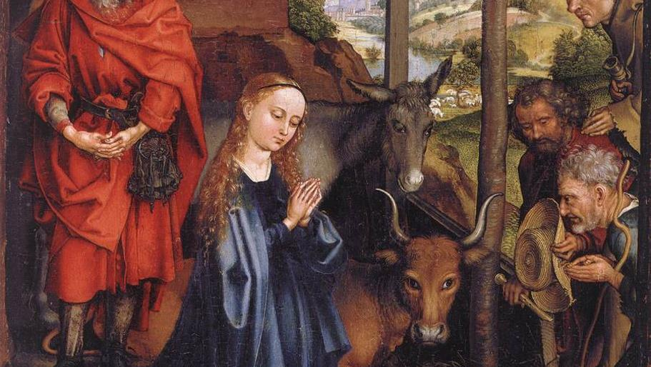
Prayers are reproduced from Revised Common Lectionary Prayers, copyright © 2002 Consultation on Common Texts. Augsburg Fortress. Used by permission. Art image descriptions can be found at the Art in the Christian Tradition image library, a service of the Vanderbilt Divinity Library, http://diglib.library.vanderbilt.edu/. All images available via Creative Commons 3.0 License.
Adoration of the Shepherds, Martin Schongauer,. https://commons.wikimedia.org/wiki/File:Martin_Schongauer_-_Nativity_-_WGA21041.jpg
Swords Into Plowshares, Peter Koenig. Peter Winfried (Canisius) Koenig, https://www.pwkoenig.co.uk/
Lord's Supper, Jesus MAFA. http://www.librairie-emmanuel.fr (contact page: https://www.librairie-emmanuel.fr/contact)
The Only Room, Frank Wesley. Estate of Frank Wesley, http://www.frankwesleyart.com/main_page.htm
Mary's Song, Lauren Wright Pittman. Lauren Wright Pittman, http://www.lewpstudio.com/
Annunciation to the Shepherds. https://www.flickr.com/photos/paullew/31817765076 - Fr Lawrence Lew, O.P.
Shepherds, John August Swanson. Estate of John August Swanson, https://www.johnaugustswanson.com/
Swords Into Plowshares, Cara B. Hochhalter. The artist must be contacted for other uses.

