Slide 1
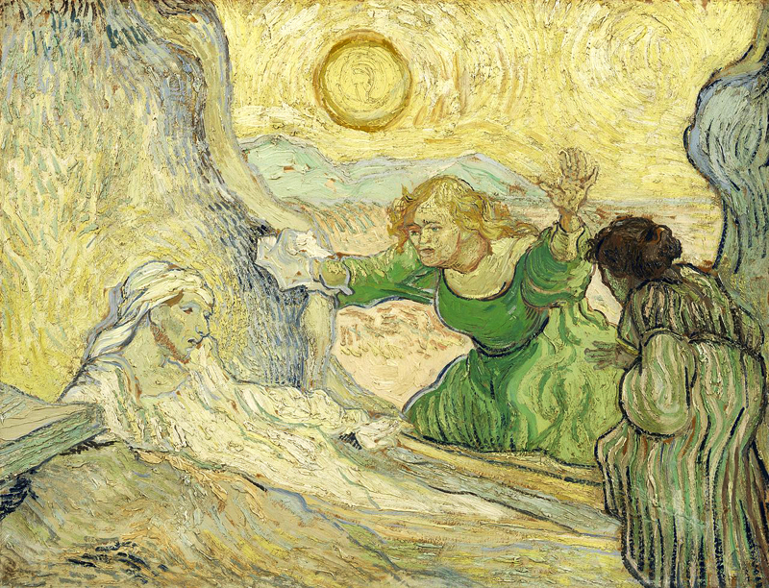
Lenten Daily Prayer for Reflection
Week 5
Revised Common Lectionary Year A
The Prayers that follow are written by the RCL specifically for the
Lectionary scripture texts:
Ezekiel 37:1-14 • Psalm 130
Romans 8:6-11 • John 11:1-45
Image information may be found at the end.

Slide 2
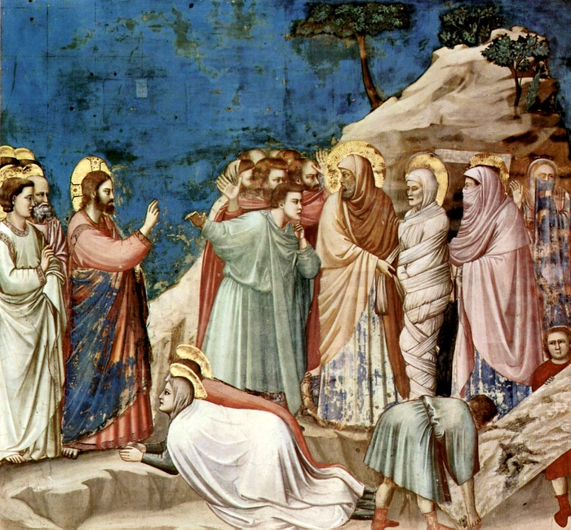
Fifth Sunday of Lent, Year A
God of the living…we pass from the shadow of death
to the light of the resurrection.
Remain with us and give us hope.
Ezekiel 37:1-14 • Psalm 130
Romans 8:6-11 • John 11:1-45

Slide 3
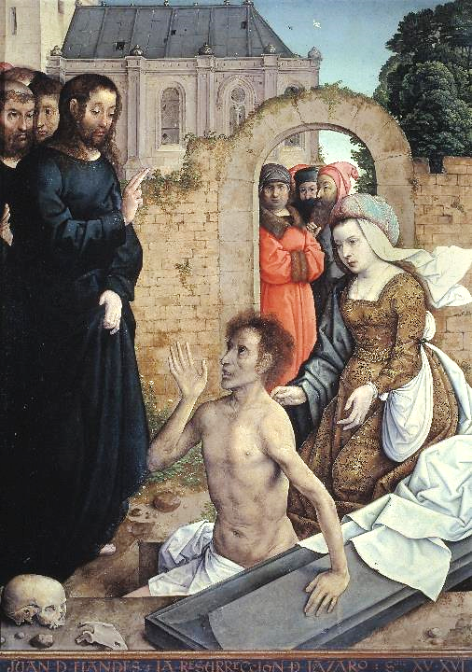
Fifth Monday of Lent, Year A
Help us as we take up your invitation to prayer and simplicity,
that the discipline of these forty days
may sharpen our hunger for the feast of your holy friendship.
Ezekiel 37:1-14 • Psalm 130
Romans 8:6-11 • John 11:1-45

Slide 4
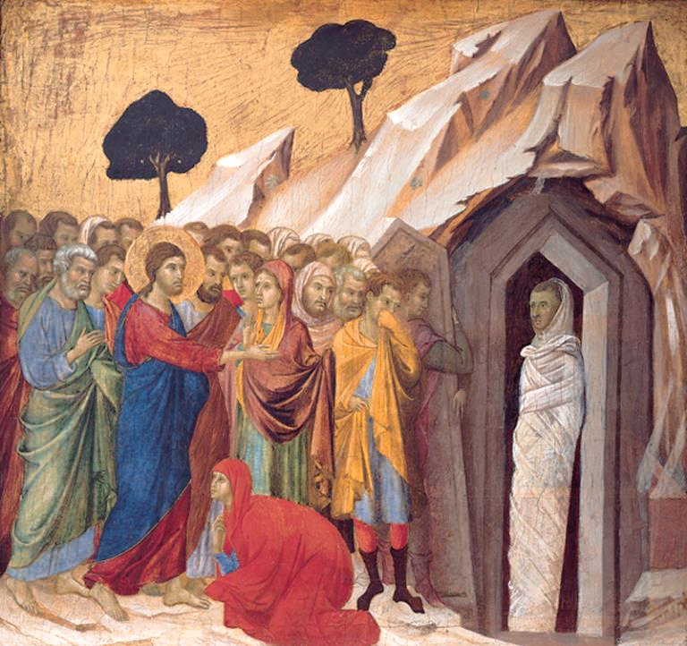
Fifth Tuesday of Lent, Year A
God of compassion,
you know our faults and yet you promised to forgive.
Keep us in your presence and give us your wisdom.
Ezekiel 37:1-14 • Psalm 130
Romans 8:6-11 • John 11:1-45

Slide 5
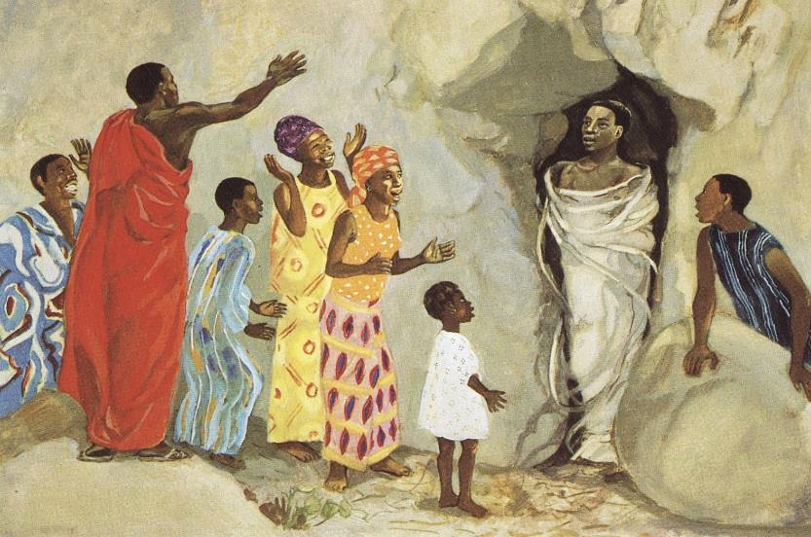
Fifth Wednesday of Lent, Year A
Open our hearts to gladness,
call dry bones to dance,
and restore to us the joy of your salvation.
Ezekiel 37:1-14 • Psalm 130
Romans 8:6-11 • John 11:1-45

Slide 6
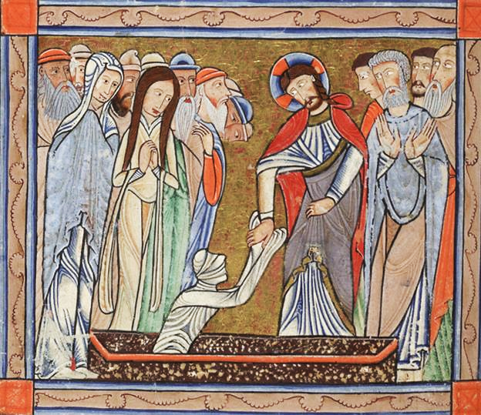
Fifth Thursday of Lent, Year A
God of all consolation and compassion,
your Son comforted the grieving sisters, Martha and Mary.
Ezekiel 37:1-14 • Psalm 130
Romans 8:6-11 • John 11:1-45

Slide 7
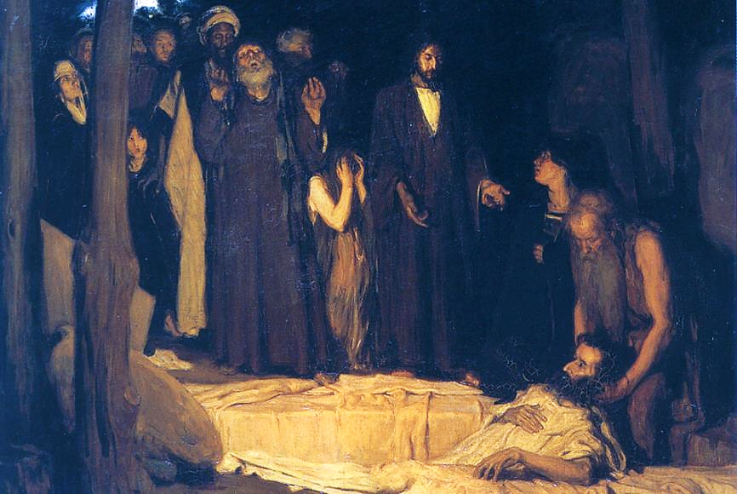
Fifth Friday of Lent, Year A
Your breath alone brings life
to dry bones and weary souls.
Ezekiel 37:1-14 • Psalm 130
Romans 8:6-11 • John 11:1-45

Slide 8
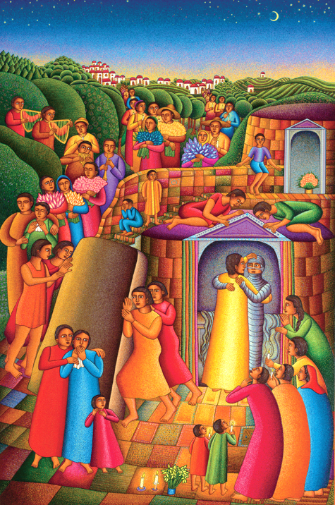
Fifth Saturday of Lent, Year A
Pour out your Spirit upon us,
that we may face despair and death
with the hope of resurrection
and faith in the One
who called Lazarus forth from the grave. Amen.
Ezekiel 37:1-14 • Psalm 130
Romans 8:6-11 • John 11:1-45

Slide 9
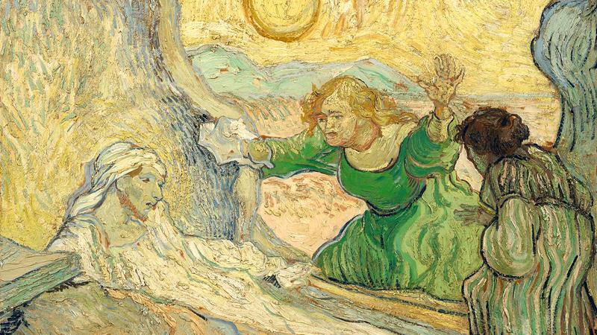
Prayers are reproduced from Revised Common Lectionary Prayers, copyright © 2002 Consultation on Common Texts. Augsburg Fortress. Used by permission. Art image descriptions can be found at the Art in the Christian Tradition image library, a service of the Vanderbilt Divinity Library, http://diglib.library.vanderbilt.edu/. All images available via Creative Commons 3.0 License.
Raising of Lazarus, Vincent van Gogh -- https://commons.wikimedia.org/wiki/File:De_opwekking_van_Lazarus_(naar_Rembrandt)_-_s0169V1962_-_Van_Gogh_Museum.jpg
The Raising of Lazarus, Giotto -- https://commons.wikimedia.org/wiki/File:Giotto_di_Bondone_021.jpg
Resurrection of Lazarus, Juan de Flandes -- https://commons.wikimedia.org/wiki/File:Juan_de_Flandes_001.jpg
Raising of Lazarus, Duccio -- https://commons.wikimedia.org/wiki/File:%27The_Raising_of_Lazarus%27,_tempera_and_gold_on_panel_by_Duccio_di_Buoninsegna,_1310%E2%80%9311,_Kimbell_Art_Museum.jpg
Raising of Lazarus, JESUS MAFA -- https://www.editions-emmanuel.com/contact/
Raising of Lazarus, Master of the Hunterian Psalter -- http://special.lib.gla.ac.uk/images/psalter/H229_0011vwf.jpg
Resurrection of Lazarus, Henry Ossawa Tanner -- https://commons.m.wikimedia.org/wiki/File:Henry_Ossawa_Tanner,_Resurrection_of_Lazarus.jpg
Take Away the Stone – John August Swanson -- Estate of John August Swanson, https://www.johnaugustswanson.com/

