Slide 1
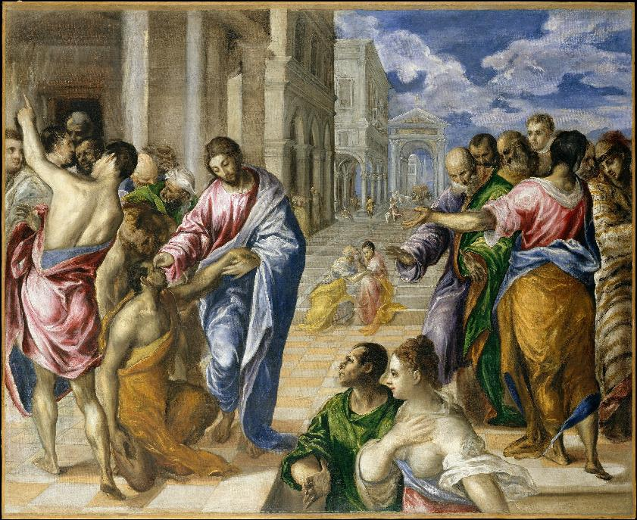
Lenten Daily Prayer for Reflection
Week 4
Revised Common Lectionary Year A
The Prayers that follow are written by the RCL specifically for the
Lectionary scripture texts:
1 Samuel 16:1-13 • Psalm 23
Ephesians 5:8-14 • John 9:1-41
Image information may be found at the end.

Slide 2
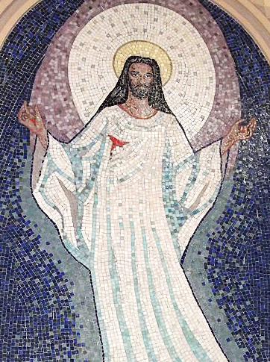
Fourth Sunday of Lent, Year A
God of the covenant,
in the glory of the cross
your Son embraced the power of death
and broke its hold over your people.
In this time of repentance,
draw all people to yourself.
1 Samuel 16:1-13 • Psalm 23
Ephesians 5:8-14 • John 9:1-41

Slide 3
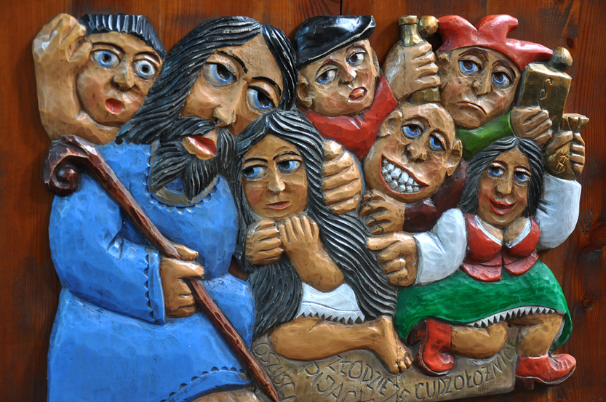
Fourth Monday of Lent, Year A
You open your arms to accept us
even before we turn to meet your welcome; you invite us to forgiveness even before our hearts are softened to repentance.
1 Samuel 16:1-13 • Psalm 23
Ephesians 5:8-14 • John 9:1-41

Slide 4
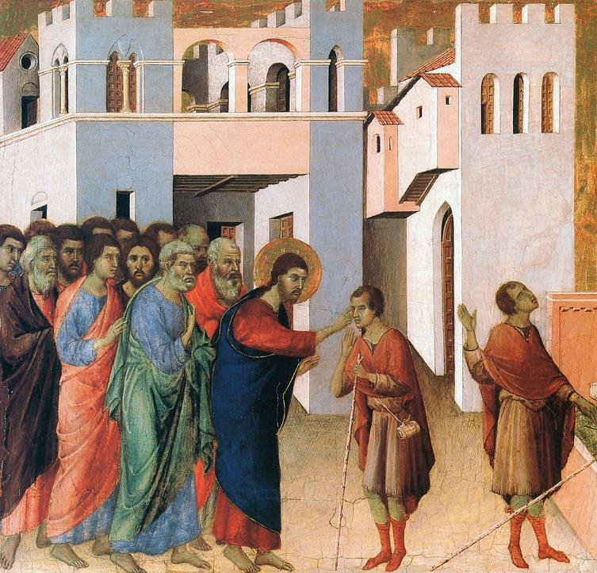
Fourth Tuesday of Lent, Year A
Through Christ you make us a new creation, O God,
for with him we pass from sin to the new life of grace.
1 Samuel 16:1-13 • Psalm 23
Ephesians 5:8-14 • John 9:1-41

Slide 5
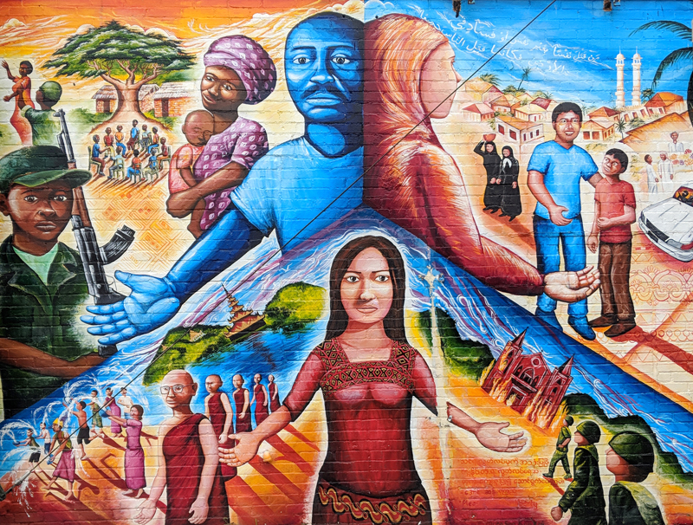
Fourth Wednesday of Lent, Year A
Accept our prayers in the warm embrace of your compassion,
and welcome all people to the festive banquet of your table.
1 Samuel 16:1-13 • Psalm 23
Ephesians 5:8-14 • John 9:1-41

Slide 6
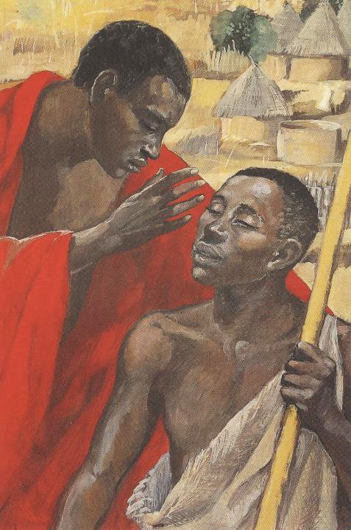
Fourth Thursday of Lent, Year A
Discerner of hearts,
you look beneath our outward appearance
and see your image in each of us.
1 Samuel 16:1-13 • Psalm 23
Ephesians 5:8-14 • John 9:1-41

Slide 7
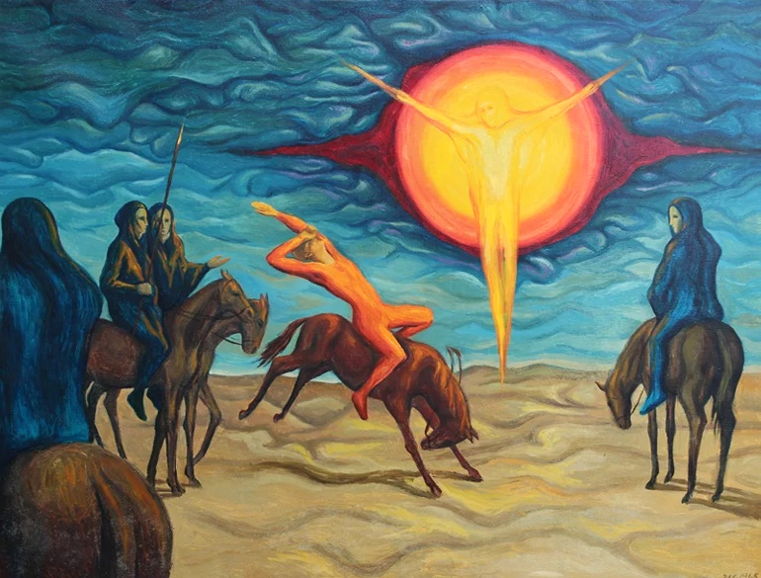
Fourth Friday of Lent, Year A
Banish in us the blindness
that prevents us from recognizing truth…
1 Samuel 16:1-13 • Psalm 23
Ephesians 5:8-14 • John 9:1-41

Slide 8
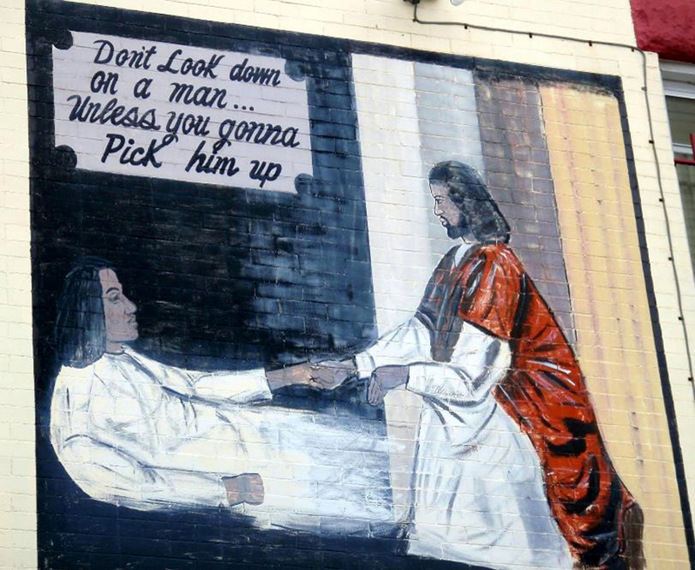
Fourth Saturday of Lent, Year A
…so we may see the world through your eyes
and with the compassion of Jesus Christ who redeems us. Amen.
1 Samuel 16:1-13 • Psalm 23
Ephesians 5:8-14 • John 9:1-41

Slide 9
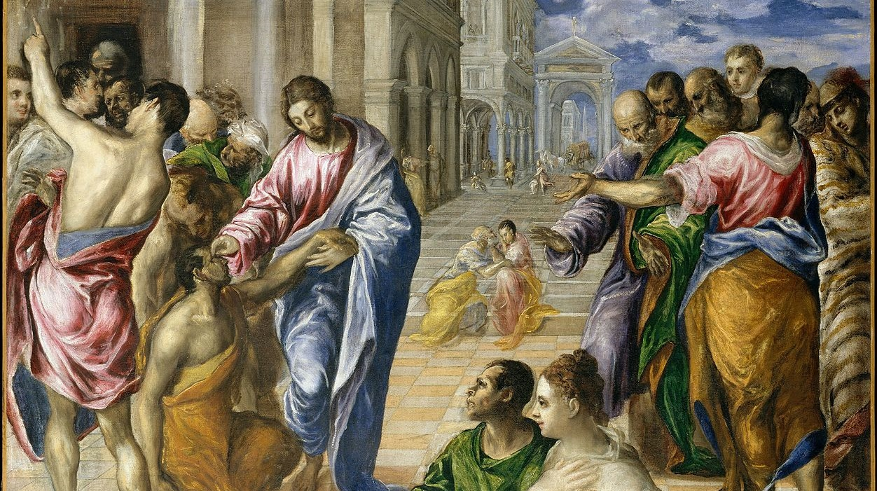
Prayers are reproduced from Revised Common Lectionary Prayers, copyright © 2002 Consultation on Common Texts. Augsburg Fortress. Used by permission. Art image descriptions can be found at the Art in the Christian Tradition image library, a service of the Vanderbilt Divinity Library, http://diglib.library.vanderbilt.edu/. All images available via Creative Commons 3.0 License.
Christ Healing the Blind, El Greco -- https://commons.wikimedia.org/wiki/File:Christ_Healing_the_Blind_MET_DT407.jpg
Resurrection, Anonymous, Brazil -- https://commons.wikimedia.org/wiki/File:0000_Mosaics_of_Resurrection_of_Christ.JPG
Jesus and Mary of Bethany, Anonymous Polish -- http://www.flickr.com/photos/feargal/5096168563/ - CC BY-NC-ND 2.0s https://commons.wikimedia.org/wiki/File:The_return_of_the_prodigal_son,_Elena_Murariu.jpg
Healing of the Man Born Blind, Duccio -- https://commons.wikimedia.org/wiki/File:Duccio_di_Buoninsegna_037.jpg
Global Refugee Mural, Joel Bergner -- https://joelartista.com/about/ - Artist must be contacted for permission.
Jesus Cures the Man Born Blind, JESUS MAFA -- http://www.librairie-emmanuel.fr (contact page: https://www.librairie-emmanuel.fr/contact)
Conversion of Paul, Peter Koenig -- Peter Winfried (Canisius) Koenig, https://www.pwkoenig.co.uk/
Jesus Lends a Helping Hand, Anonymous, Washington, DC -- https://www.flickr.com/photos/daquellamanera/3994554964

