Slide 1
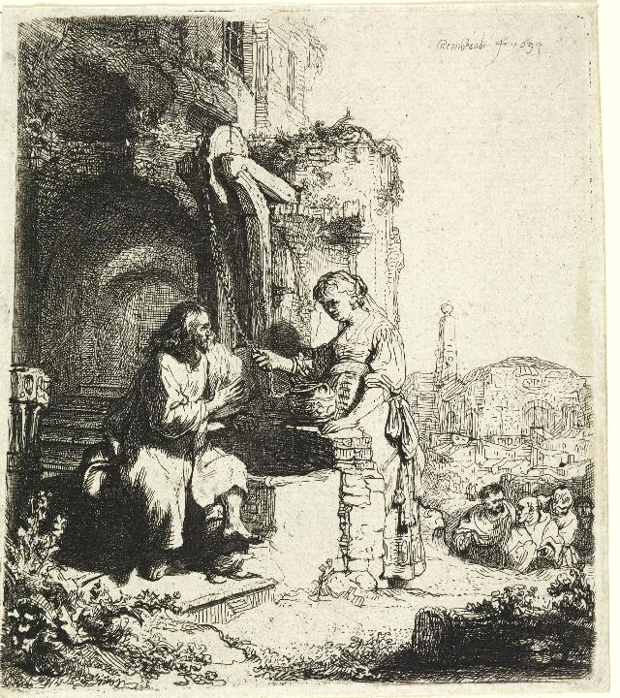
Lenten Daily Prayer for Reflection
Week 3
Revised Common Lectionary Year A
The Prayers that follow are written by the RCL specifically for the
Lectionary scripture texts:
Exodus 17:1-7 • Psalm 95
Romans 5:1-11 • John 4:5-42
Image information may be found at the end.

Slide 2
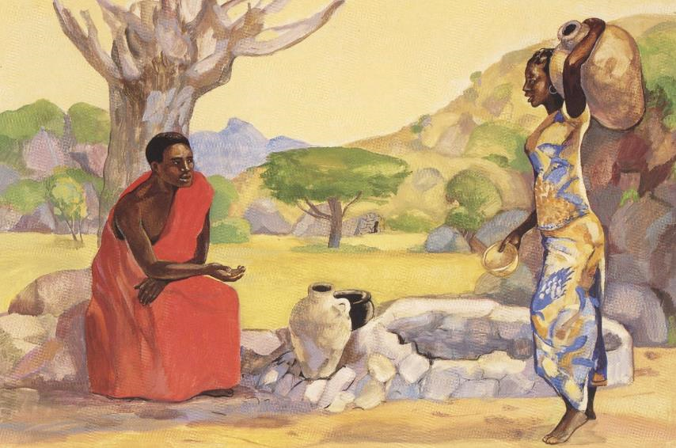
Third Sunday of Lent, Year A
God of the living, help us as we take up your invitation to prayer and simplicity,
that the discipline of these forty days
may whet our thirst for the living water you offer
through Jesus Christ.
Exodus 17:1-7 • Psalm 95
Romans 5:1-11 • John 4:5-42

Slide 3
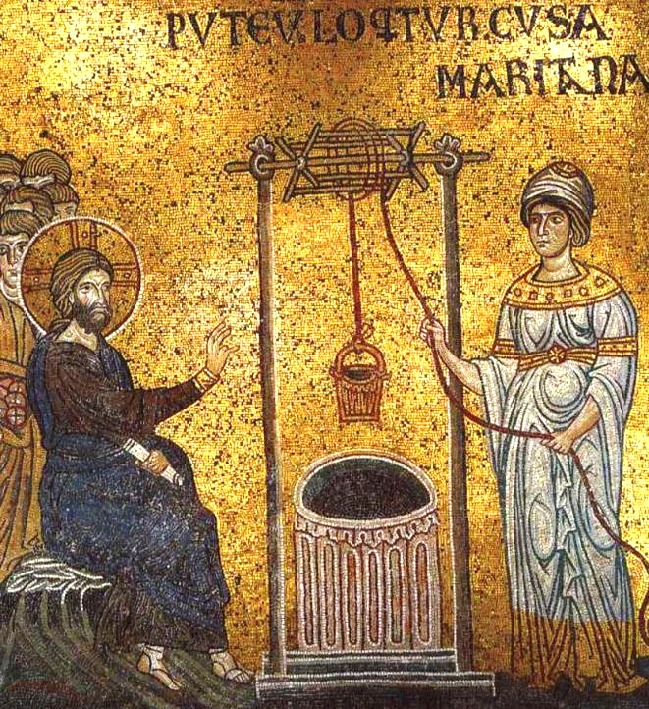
Third Monday of Lent, Year A
Shape us and transform us by your grace,
that we may grow in wisdom and in confidence,
never faltering until we have done all that you desire
to bring your realm of shalom to fulfillment.
Exodus 17:1-7 • Psalm 95
Romans 5:1-11 • John 4:5-42

Slide 4
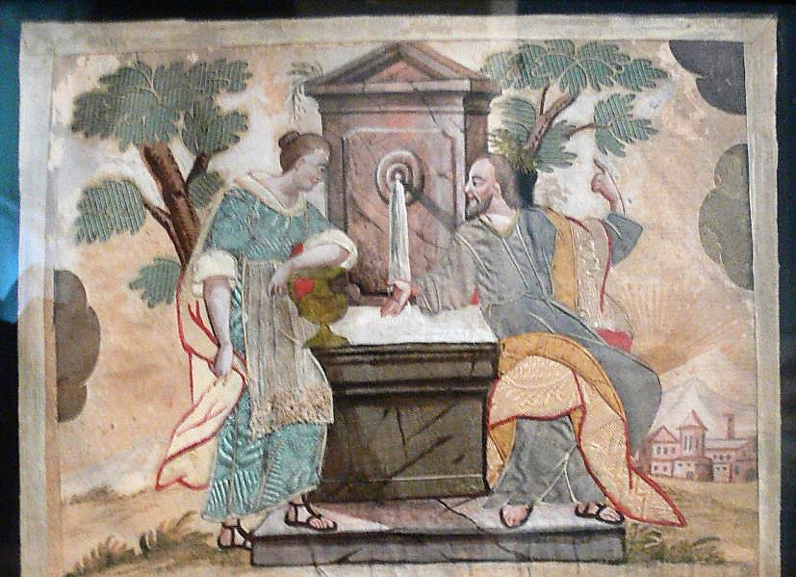
Third Tuesday of Lent, Year A
Pour your love into our hearts,
that, overflowing with joy,
we may freely share the blessings of your realm
and faithfully proclaim the good news of Christ.
Exodus 17:1-7 • Psalm 95
Romans 5:1-11 • John 4:5-42

Slide 5
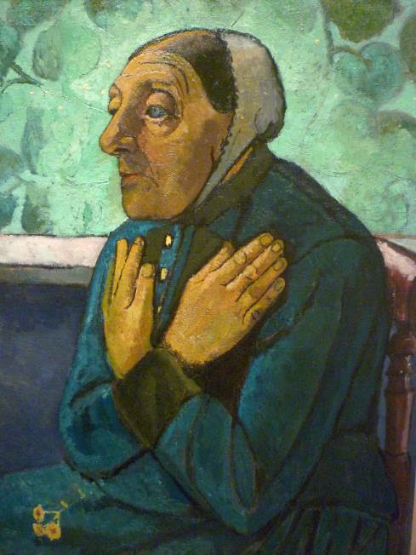
Third Wednesday of Lent, Year A
Faithful God of love,
we gather the needs of ourselves and others,
and offer them to you in faith and love,
seeking to be strengthened to meet them.
Exodus 17:1-7 • Psalm 95
Romans 5:1-11 • John 4:5-42

Slide 6
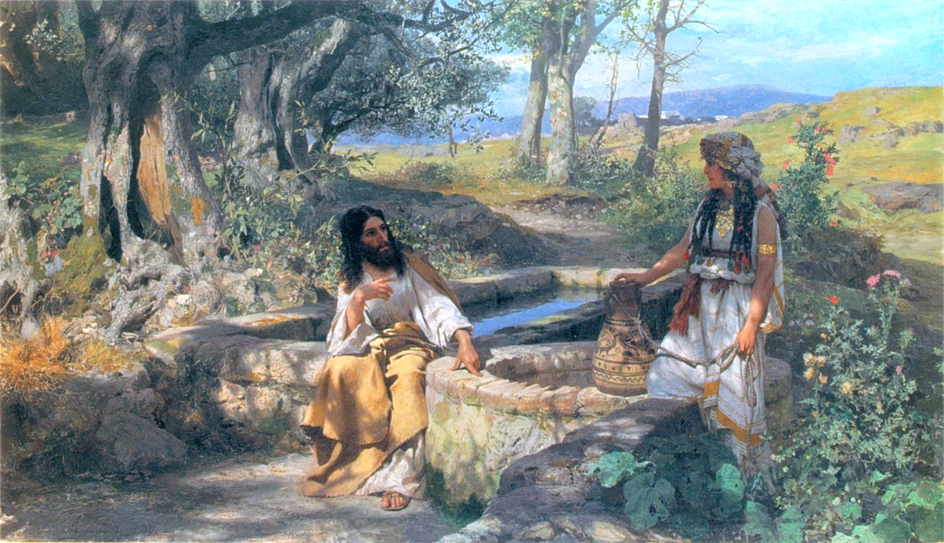
Third Thursday of Lent, Year A
Enduring Presence,
goal and guide,
you go before and await our coming.
Exodus 17:1-7 • Psalm 95
Romans 5:1-11 • John 4:5-42

Slide 7
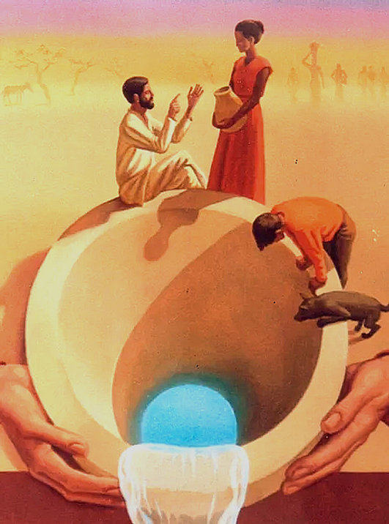
Third Friday of Lent, Year A
Only our thirst compels us
beyond complaint to conversation,
beyond rejection to relationship.
Exodus 17:1-7 • Psalm 95
Romans 5:1-11 • John 4:5-42

Slide 8
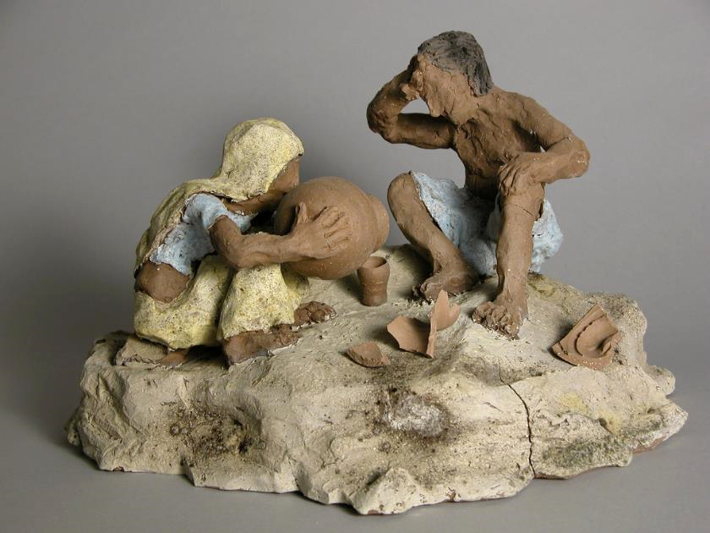
Third Saturday of Lent, Year A
Pour your love into our hearts,
that, refreshed and renewed,
we may invite others to the living water
given to us in Jesus Christ our Lord. Amen.
Exodus 17:1-7 • Psalm 95
Romans 5:1-11 • John 4:5-42

Slide 9
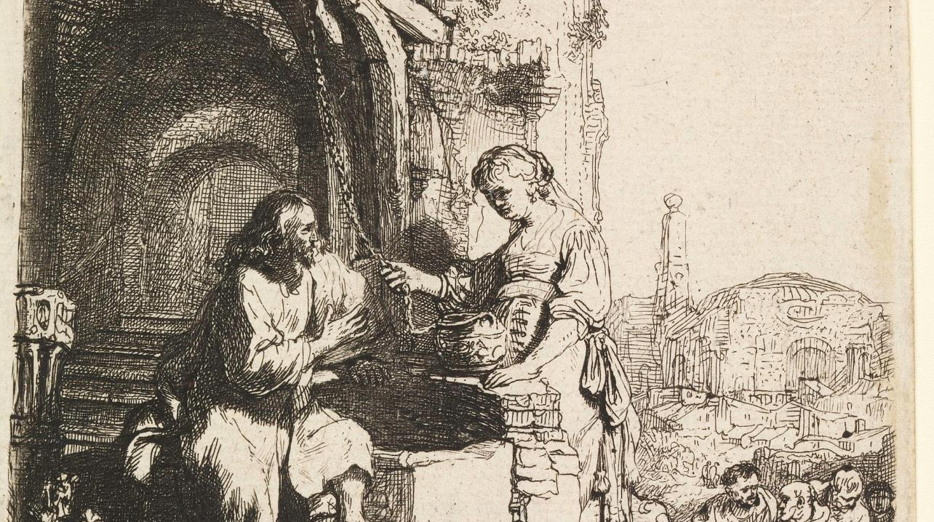
Prayers are reproduced from Revised Common Lectionary Prayers, copyright © 2002 Consultation on Common Texts. Augsburg Fortress. Used by permission. Art image descriptions can be found at the Art in the Christian Tradition image library, a service of the Vanderbilt Divinity Library, http://diglib.library.vanderbilt.edu/. All images available via Creative Commons 3.0 License.
Christ and the Woman of Samaria, Rembrandt -- https://commons.wikimedia.org/wiki/File:Print,_Christ_and_the_Woman_of_Samaria_Among_Ruins,_1634_(CH_18612697).jpg
Jesus and the Samaritan Woman, JESUS MAFA -- http://www.librairie-emmanuel.fr (contact page: https://www.librairie-emmanuel.fr/contact)
Christ and the Samaritan Woman, Cathedral of Monreale, Sicily -- http://commons.wikimedia.org/wiki/File:Christ_an%D0%B2_Samaritan_woman_(Monreale).jpg
Christ at the Well, Peter Koenig -- https://www.pwkoenig.co.uk/
Christ and the Samaritan Woman, 18th century German needlework -- http://commons.wikimedia.org/wiki/File:Applikationsbild_aus_Gotteszell.jpg
Old Peasant Woman, Paula Modersohn-Becker -- https://commons.wikimedia.org/wiki/File:Paula_Modersohn-Becker_-_Old_Peasant_Woman_(c1905).jpg
Christ and the Samaritan Woman, Henryk Siemiradzki -- http://commons.wikimedia.org/wiki/File:Siemiradzki-Chrystus_i_Samarytanka.jpg
Christ at the Well, Peter Koenig -- Peter Winfried (Canisius) Koenig, https://www.pwkoenig.co.uk/
Christ and the Samaritan Woman, Austin D. Miller -- http://www.flickr.com/photos/two_r_better/158783308/

