Slide 1
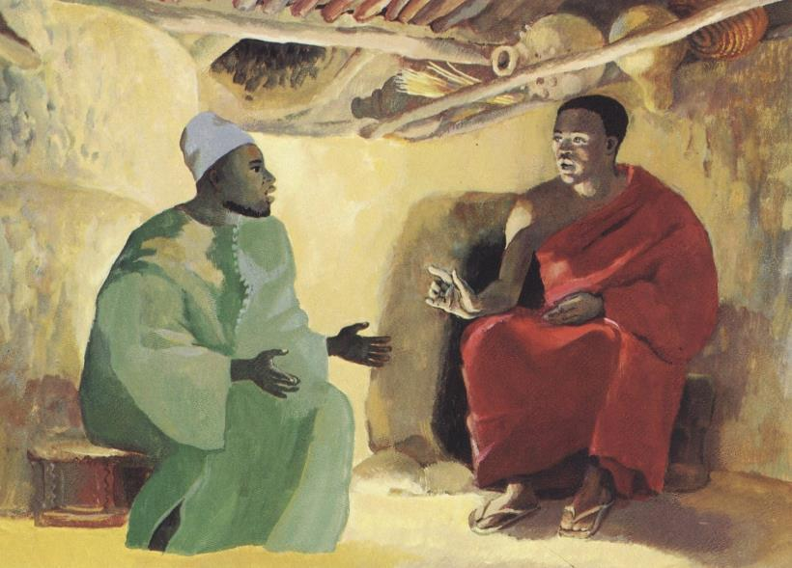
Lenten Daily Prayer for Reflection
Week 2
Revised Common Lectionary Year A
The Prayers that follow are written by the RCL specifically for the
Lectionary scripture texts:
Genesis 12:1-4a • Psalm 121
Romans 4:1-5, 13-17
John 3:1-17 or Matthew 17:1-9
Image information may be found at the end.

Slide 2
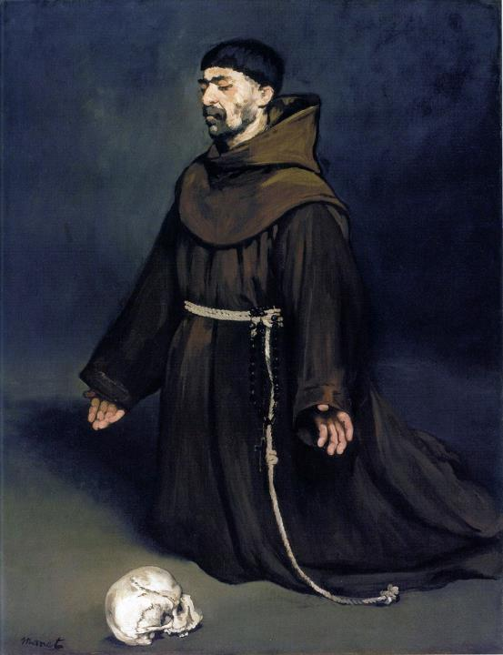
Second Sunday in Lent, Year A
God of the covenant,
help us as we take up your invitation to prayer and simplicity,
that the discipline of these forty days
may sharpen our hunger for the feast of your holy friendship.
Genesis 12:1-4a • Psalm 121
Romans 4:1-5, 13-17
John 3:1-17 or Matthew 17:1-9

Slide 3
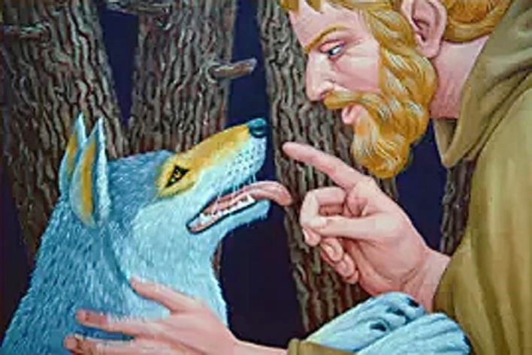
Second Monday in Lent, Year A
God of the covenant,
you call us to be fruitful servants within creation,
and to offer our lives
as the foundation of your realm.
Genesis 12:1-4a • Psalm 121
Romans 4:1-5, 13-17
John 3:1-17 or Matthew 17:1-9

Slide 4
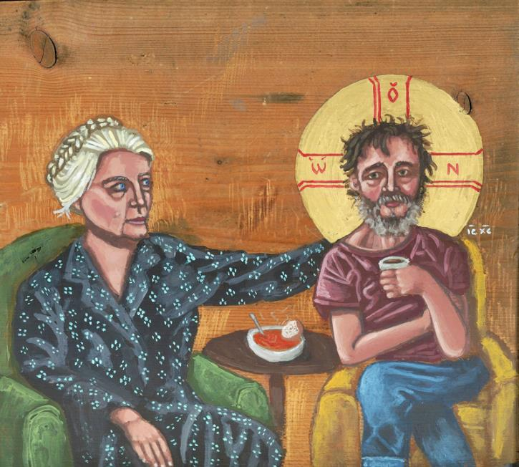
Second Tuesday in Lent, Year A
Grant, O God, that the prayers we offer
may be your channel for new and abundant life
not only hoped for,
but worked for,
through faithful word and deed.
Genesis 12:1-4a • Psalm 121
Romans 4:1-5, 13-17
John 3:1-17 or Matthew 17:1-9

Slide 5
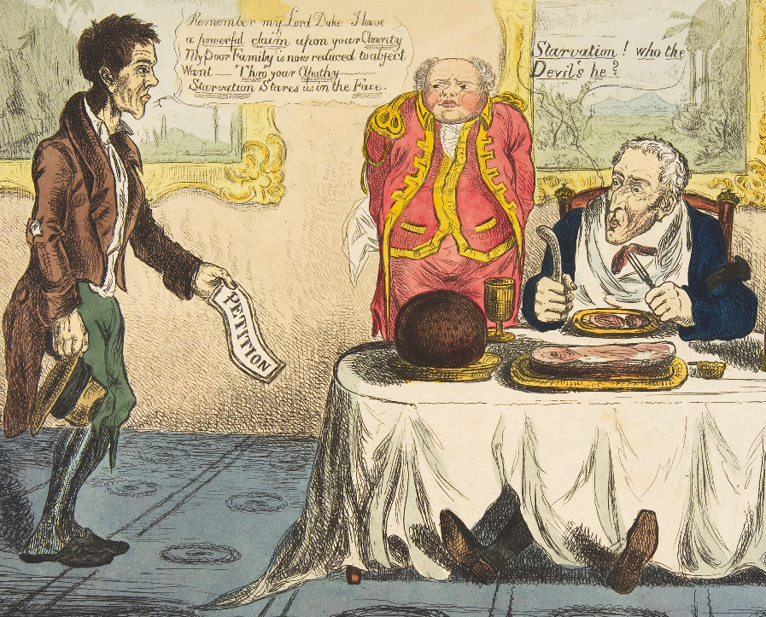
Second Wednesday in Lent, Year A
God of amazing compassion,
lover of wayward peoples…
Genesis 12:1-4a • Psalm 121
Romans 4:1-5, 13-17
John 3:1-17 or Matthew 17:1-9

Slide 6
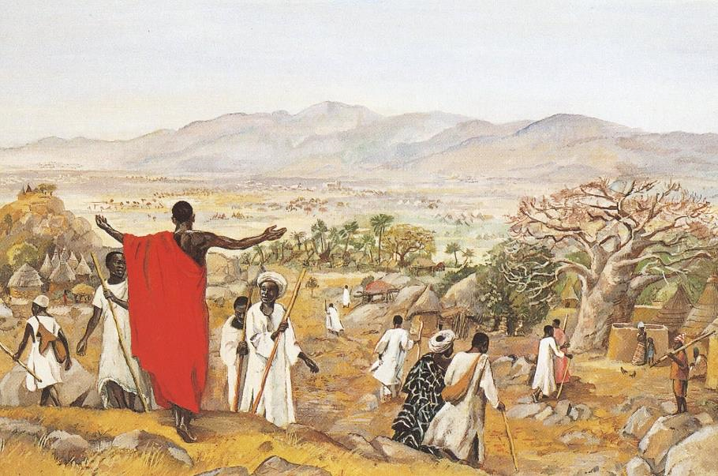
Second Thursday in Lent, Year A
…you bring to birth a pilgrim people,
and call us to be a blessing for ourselves and all the world.
Genesis 12:1-4a • Psalm 121
Romans 4:1-5, 13-17
John 3:1-17 or Matthew 17:1-9

Slide 7
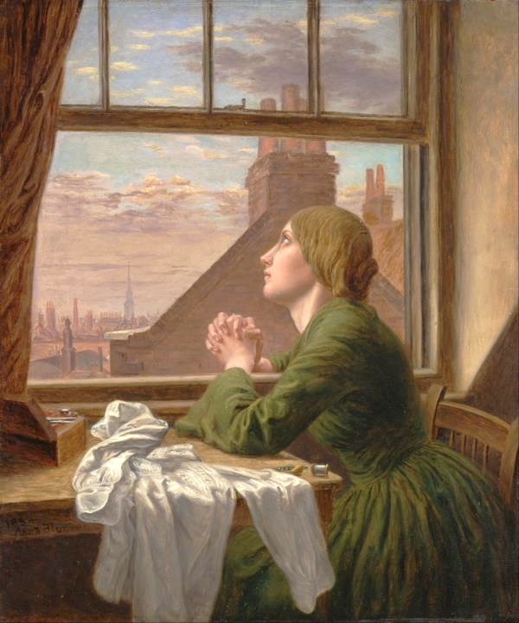
Second Friday in Lent, Year A
We lay before you the desires of our hearts,
that we may be transformed by their fulfillment.
Genesis 12:1-4a • Psalm 121
Romans 4:1-5, 13-17
John 3:1-17 or Matthew 17:1-9

Slide 8
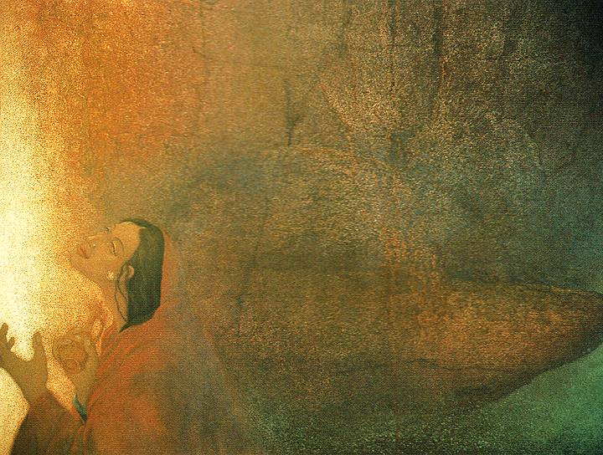
Second Saturday in Lent, Year A
We pray for grace to take your generous gift
and step with courage on this holy path, confident in the radiant life that is your plan for us,
made known and given in Jesus Christ our Lord. Amen.
Genesis 12:1-4a • Psalm 121
Romans 4:1-5, 13-17
John 3:1-17 or Matthew 17:1-9

Slide 9
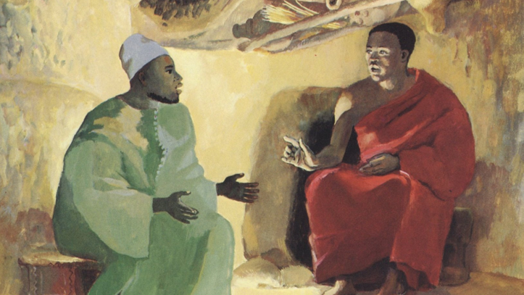
Prayers are reproduced from Revised Common Lectionary Prayers, copyright © 2002 Consultation on Common Texts. Augsburg Fortress. Used by permission. Art image descriptions can be found at the Art in the Christian Tradition image library, a service of the Vanderbilt Divinity Library, http://diglib.library.vanderbilt.edu/. All images available via Creative Commons 3.0 License.
Nicodemus, JESUS MAFA -- http://www.librairie-emmanuel.fr (contact page: https://www.librairie-emmanuel.fr/contact)
A Monk in Prayer, Eduard Manet -- https://commons.wikimedia.org/wiki/File:%C3%89douard_Manet_-_Un_moine_en_pri%C3%A8re.jpg
St. Francis of Assisi with Wolfe, Peter Koenig -- Peter Winfried (Canisius) Koenig, https://www.pwkoenig.co.uk/
Dorothy Day with Homeless Christ, Kelly Latimore Icons -- Kelly Latimore Icons, https://kellylatimoreicons.com/
Lazarus and the Rich Man, Anonymous -- https://commons.wikimedia.org/wiki/File:Lazarus_and_the_Rich_Man_MET_DP818354.jpg
The Mission to the World, JESUS MAFA -- http://www.librairie-emmanuel.fr (contact page: https://www.librairie-emmanuel.fr/contact)
For Only One Short Hour – The Seamstress, Anna Blunden -- https://commons.wikimedia.org/wiki/File:Anna_Blunden_-_%22For_Only_One_Short_Hour%22_-_Google_Art_Project.jpg
Altar of God, Frank Wesley -- Estate of Frank Wesley, http://www.frankwesleyart.com/main_page.htm

