Slide 1
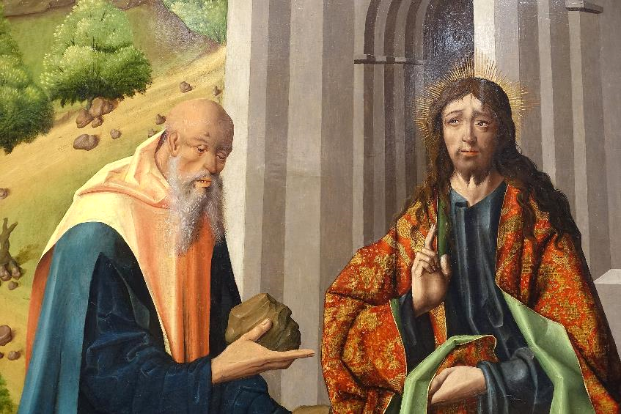
Lenten Daily Prayer for Reflection
Week 1
Revised Common Lectionary Year A
The Prayers that follow are written by the RCL specifically for the
Lectionary scripture texts:
Genesis 2:15-17; 3:1-7 • Psalm 32
Romans 5:12-19 • Matthew 4:1-11
Image information may be found at the end.

Slide 2
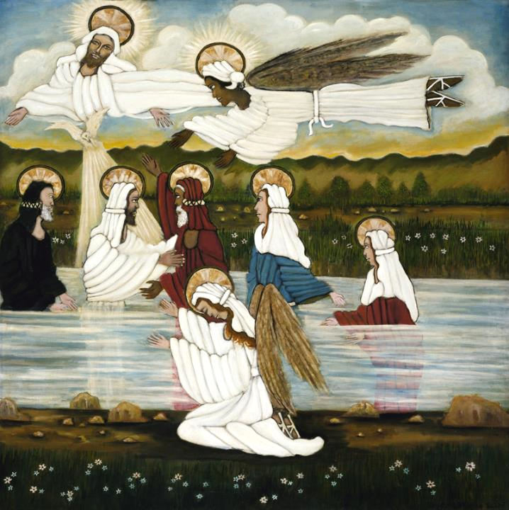
First Sunday in Lent, Year A
God of wilderness and water,
your Son was baptized and tempted as we are. Guide us through this season,
that we may not avoid struggle,
but open ourselves to blessing, through the cleansing depths of repentance
and the heaven-rending words of the Spirit.
Genesis 2:15-17; 3:1-7 • Psalm 32
Romans 5:12-19 • Matthew 4:1-11

Slide 3
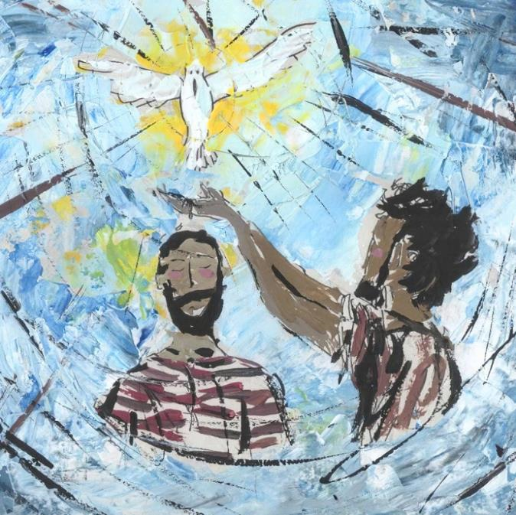
First Monday in Lent, Year A
Help us as we take up your invitation to prayer and simplicity,
that the discipline of these forty days
may sharpen our hunger for the feast of your holy friendship,
and whet our thirst for the living water you offer
through Jesus Christ.
Genesis 2:15-17; 3:1-7 • Psalm 32
Romans 5:12-19 • Matthew 4:1-11

Slide 4
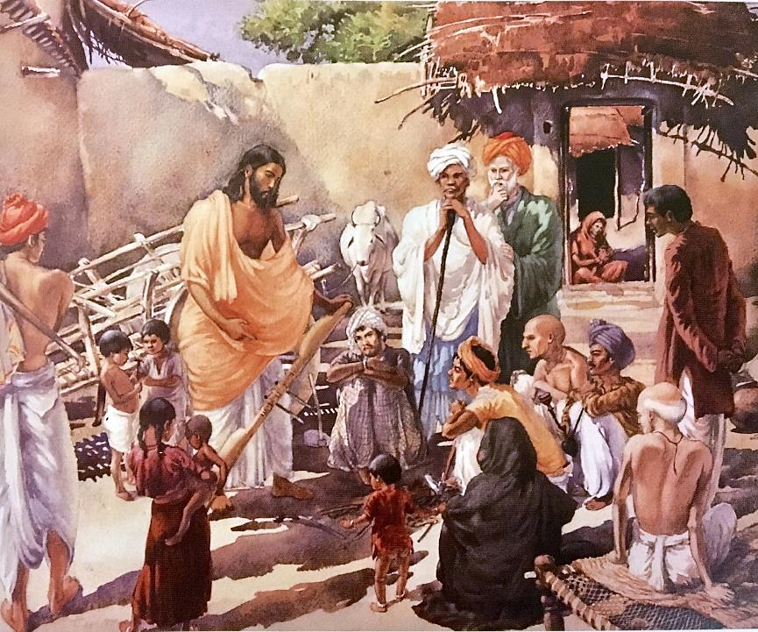
First Tuesday in Lent, Year A
Beloved friends, in this season of repentance and healing,
we accept God's invitation to be ever-mindful of the needs of others,
offering our prayers on behalf of God's community in the church and the world.
Genesis 2:15-17; 3:1-7 • Psalm 32
Romans 5:12-19 • Matthew 4:1-11

Slide 5
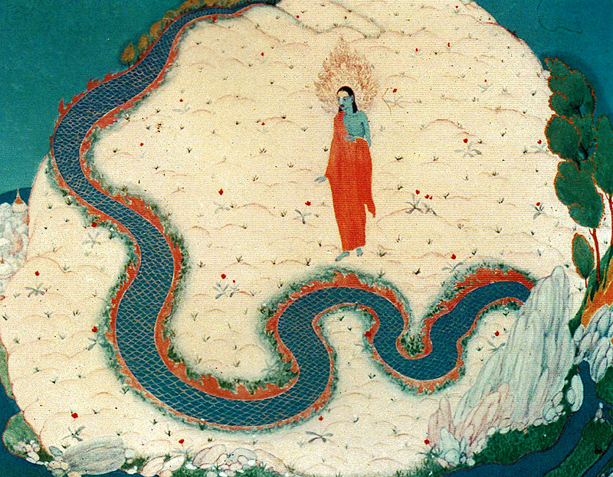
First Wednesday in Lent, Year A
Fill us with your strength
to resist the seductions of our foolish desires
and the tempter's vain delights,
that we may walk in obedience and righteousness,
rejoicing in you with an upright heart.
Genesis 2:15-17; 3:1-7 • Psalm 32
Romans 5:12-19 • Matthew 4:1-11

Slide 6
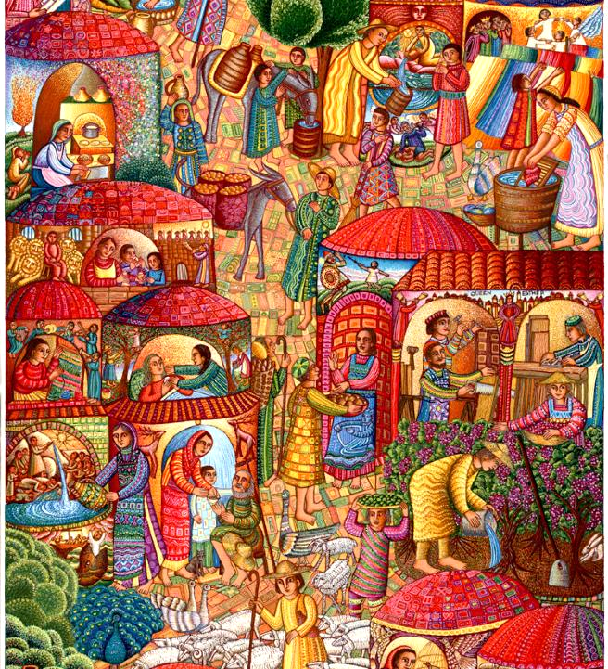
First Thursday in Lent, Year A
In this time of repentance,
draw all people to yourself…
Genesis 2:15-17; 3:1-7 • Psalm 32
Romans 5:12-19 • Matthew 4:1-11

Slide 7
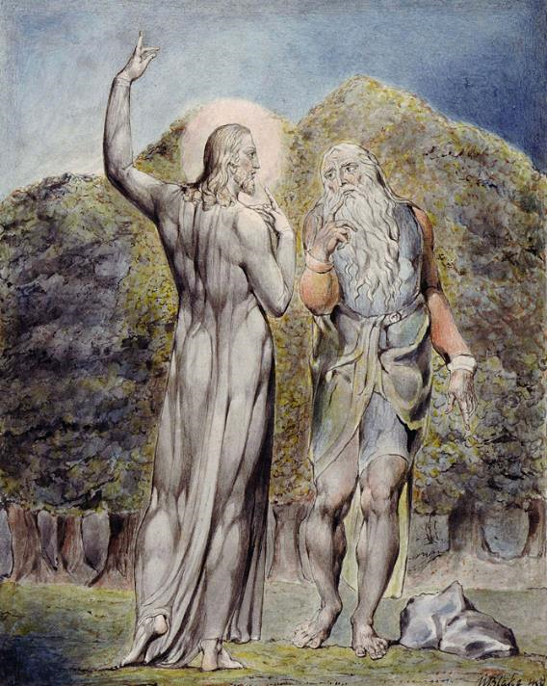
First Friday in Lent, Year A
God of mercy,
your word was the sure defense of Jesus in his time of testing.
Genesis 2:15-17; 3:1-7 • Psalm 32
Romans 5:12-19 • Matthew 4:1-11

Slide 8
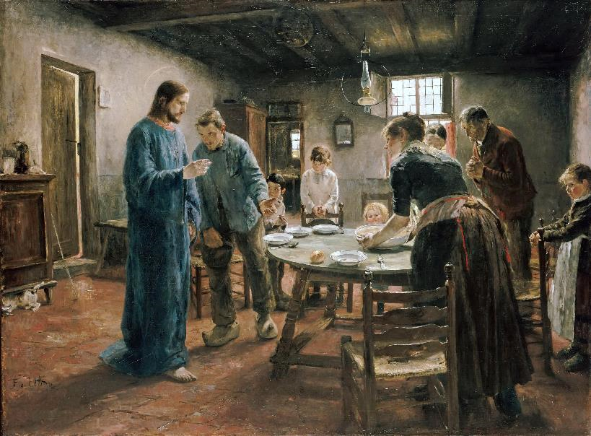
First Saturday in Lent, Year A
Minister to us in the wilderness of our temptation, that we who have been set free from sin by Christ may serve you well into life everlasting.
Amen.
Genesis 2:15-17; 3:1-7 • Psalm 32
Romans 5:12-19 • Matthew 4:1-11

Slide 9
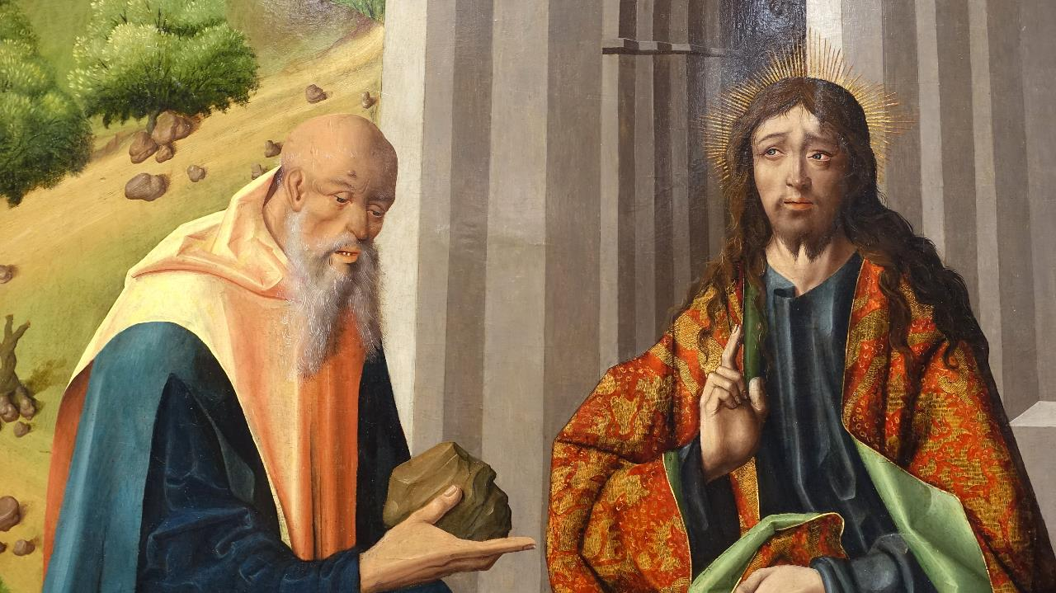
Prayers are reproduced from Revised Common Lectionary Prayers, copyright © 2002 Consultation on Common Texts. Augsburg Fortress. Used by permission. Art image descriptions can be found at the Art in the Christian Tradition image library, a service of the Vanderbilt Divinity Library, http://diglib.library.vanderbilt.edu/. All images available via Creative Commons 3.0 License.
Temptation of Christ – Maestro Bartolomé, https://commons.wikimedia.org/wiki/File:The_Temptations_of_Christ_by_Maestro_Bartolom%C3%A9_and_workshop,_detail,_after_1493,_oil_on_panel_-_University_of_Arizona_Museum_of_Art_-_University_of_Arizona_-_Tucson,_AZ_-_DSC08333.jpg
Baptism of Jesus -- Lorenzo Scott, https://americanart.si.edu/artwork/baptism-jesus-33953
Baptism of Christ -- Liz Valente, https://www.instagram.com/donalizvalente/
Jai Christ -- Frank Wesley, Estate of Frank Wesley, http://www.frankwesleyart.com/main_page.htm
Temptations -- Frank Wesley, Estate of Frank Wesley, http://www.frankwesleyart.com/main_page.htm
A Visit -- John August Swanson, Estate of John August Swanson, https://www.johnaugustswanson.com/
The First Temptation -- William Blake, https://commons.wikimedia.org/wiki/File:ParadiseRBlake2.jpg
Mealtime Prayer -- Fritz von Uhde, https://commons.wikimedia.org/wiki/File:The_Mealtime_Prayer_-_Fritz_von_Uhde_-_Google_Cultural_Institute.jpg

