Slide 1
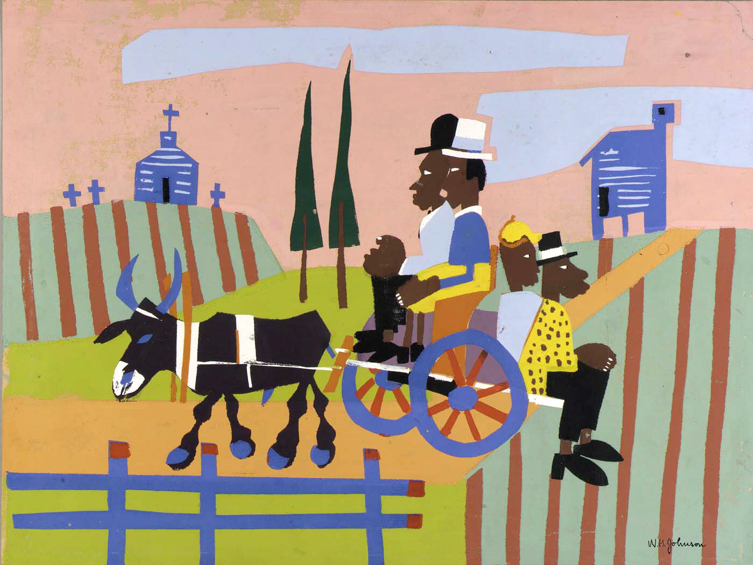
Lenten Daily Prayer for Reflection
Ash Wednesday
Revised Common Lectionary Year A
The Prayers that follow are written by the RCL specifically for the
Lectionary scripture texts:
Joel 2:1-2, 12-17 or Isaiah 58:1-12
Psalm 51:1-17
2 Corinthians 5:20b-6:10
Matthew 6:1-6, 16-21
Image information may be found at the end.

Slide 2
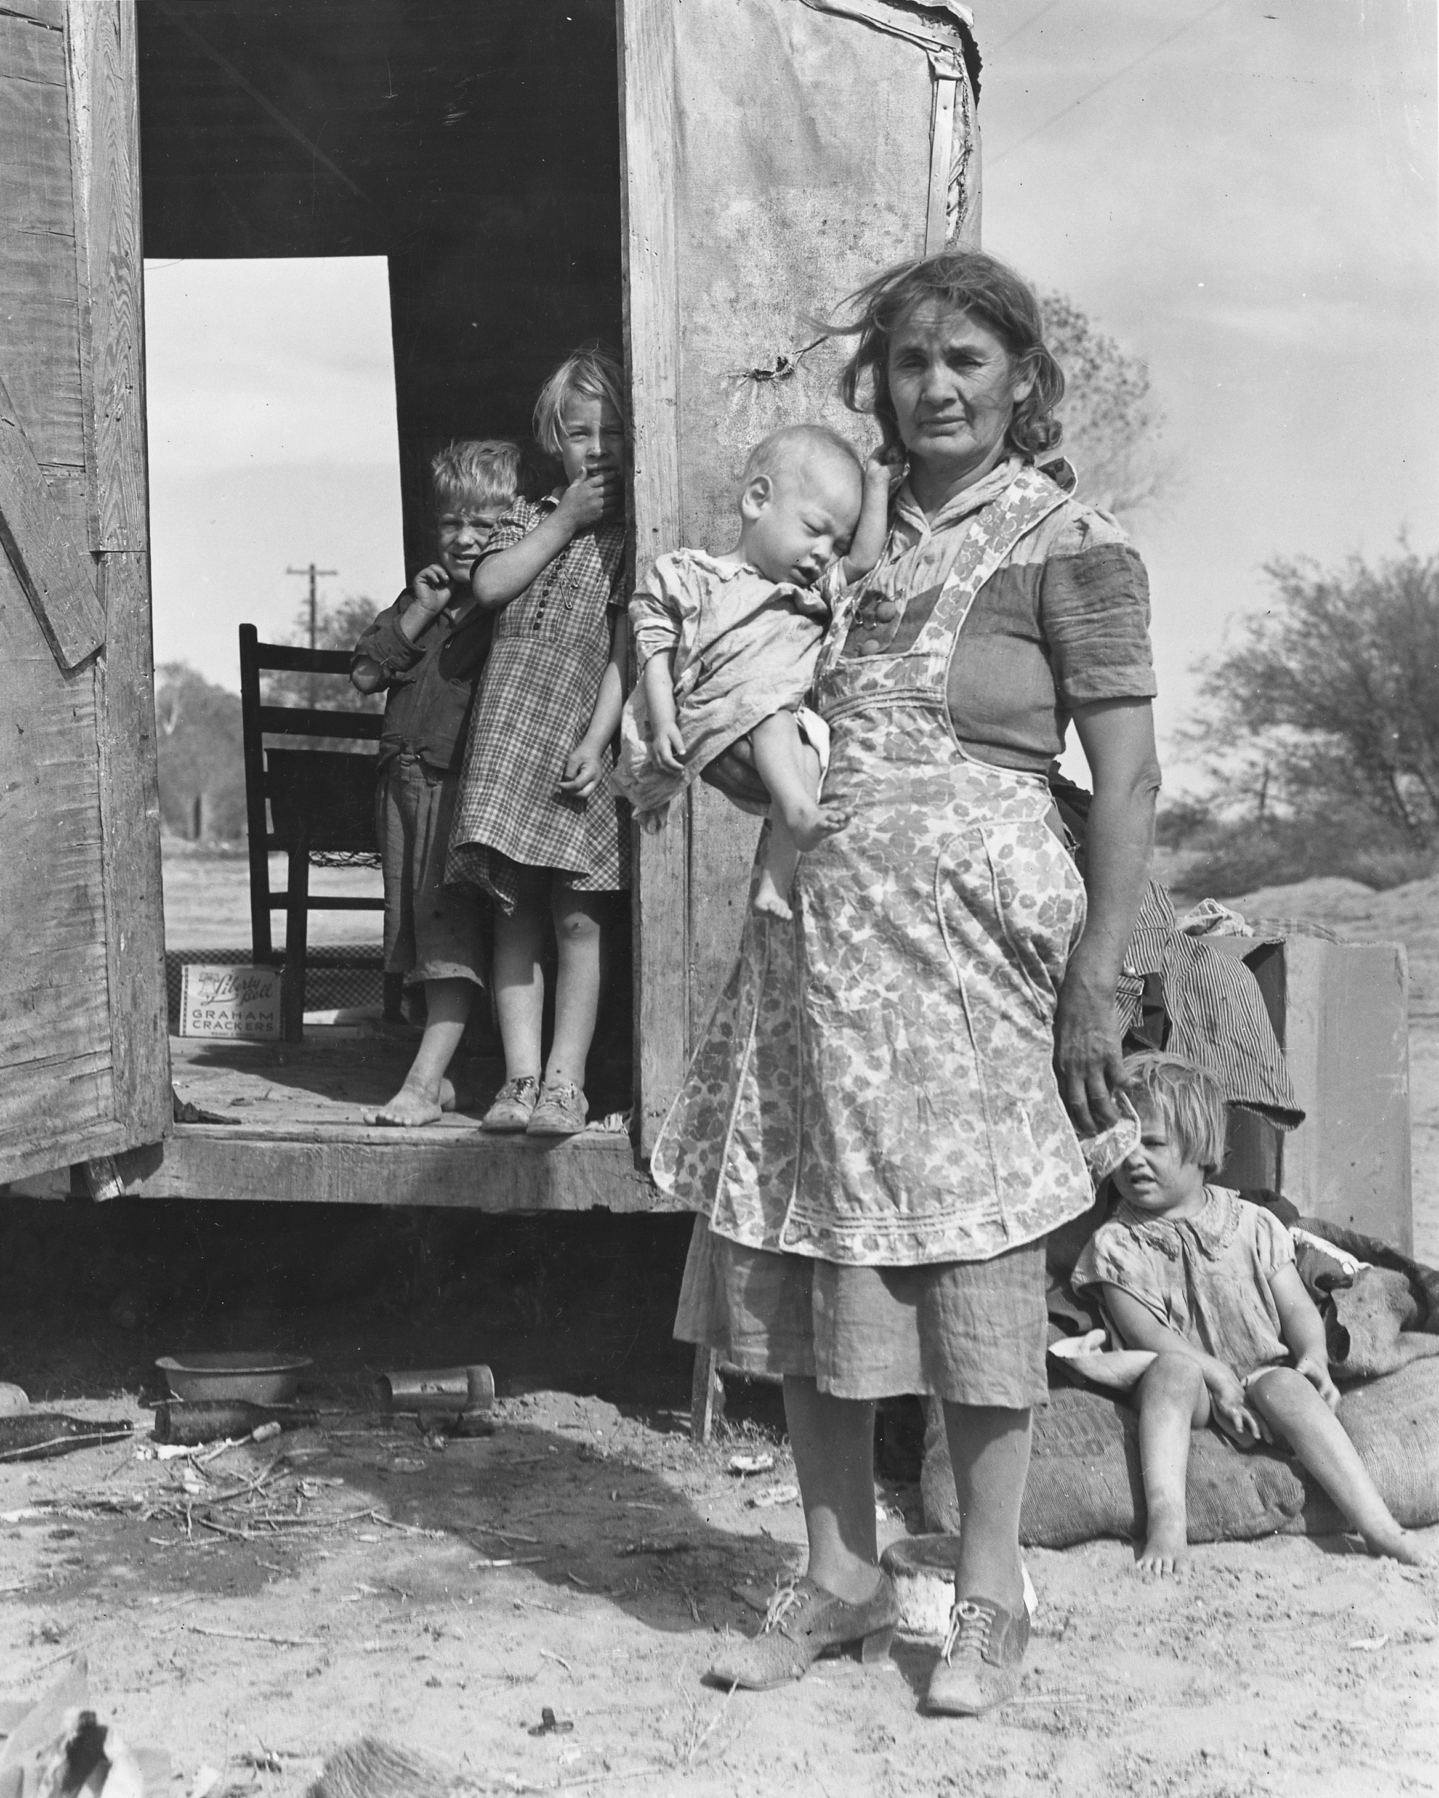
Ash Wednesday, Year A
Righteous God,
in humility and repentance
we bring our failures in caring, helping, and loving,
we bring the pain we have caused other,
we bring the injustice in society of which we are a part,
to the transforming power of your grace.
Joel 2:1-2, 12-17 or Isaiah 58:1-12
Psalm 51:1-17
2 Corinthians 5:20b-6:10
Matthew 6:1-6, 16-21

Slide 3
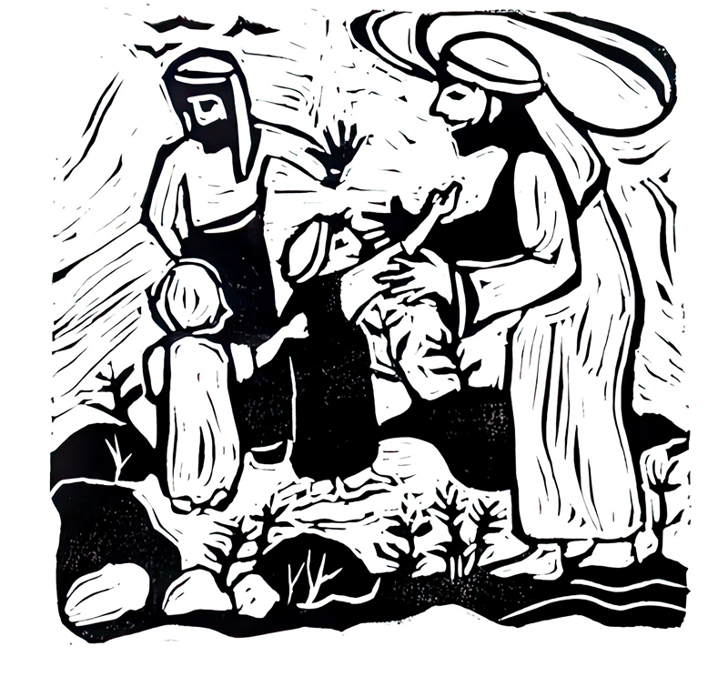
Thursday after Ash Wednesday, Year A
Grant us the courage to accept the healing you offer
and to turn again toward the sunrise of your reign,
that we may walk with you in the promise of peace
you have willed for all the children of the earth,
and have made known to us in Christ Jesus. Amen.
Joel 2:1-2, 12-17 or Isaiah 58:1-12
Psalm 51:1-17
2 Corinthians 5:20b-6:10
Matthew 6:1-6, 16-21

Slide 4
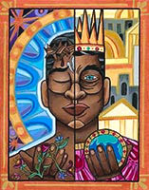
Friday after Ash Wednesday, Year A
O God, you delight … in a humble and contrite heart.
Overturn our love of worldly possessions
and fix our hearts more firmly on you,
that, having nothing,
we may yet possess everything,
a treasure stored up for us in heaven.
Joel 2:1-2, 12-17 or Isaiah 58:1-12
Psalm 51:1-17
2 Corinthians 5:20b-6:10
Matthew 6:1-6, 16-21

Slide 5
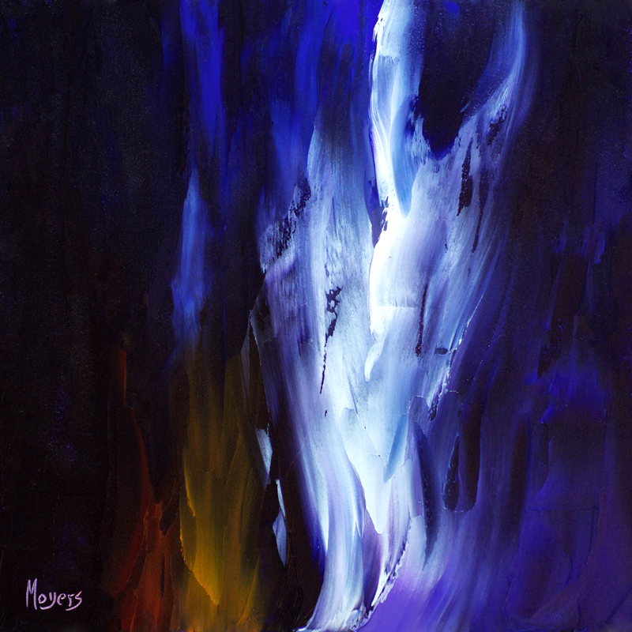
Saturday after Ash Wednesday, Year A
Look with mercy on our contrite hearts … and create a new and right spirit in us,
that we may declare your praise
and offer an acceptable sacrifice in these Lenten days;
through Christ Jesus, who bore our sins on the cross.
Joel 2:1-2, 12-17 or Isaiah 58:1-12
Psalm 51:1-17
2 Corinthians 5:20b-6:10
Matthew 6:1-6, 16-21

Slide 6
Prayers are reproduced from Revised Common Lectionary Prayers, copyright © 2002 Consultation on Common Texts. Augsburg Fortress. Used by permission. Art image descriptions can be found at the Art in the Christian Tradition image library, a service of the Vanderbilt Divinity Library, http://diglib.library.vanderbilt.edu/. All images available via Creative Commons 3.0 License
Going to Church, William H. Johnson -- https://commons.wikimedia.org/wiki/File:Going_to_Church,_by_William_H._Johnson.jpg
Children in a Democracy, Dorothea Lange -- http://commons.wikimedia.org/wiki/File:On_Arizona_Highway_87,_south_of_Chandler._Maricopa_County,_Arizona._Children_in_a_democracy._A_migra_._._._-_NARA_-_522527.jpg
Welcoming the Children, Cara B. Hochhalter. The artist has granted permission for the non-commercial use of this image with attribution. The artist must be contacted for other uses. See: https://diglib.library.vanderbilt.edu/act-imagelink.pl?RC=59289
A Choice, Lauren Wright Pittman -- http://www.lewpstudio.com/
Prayer, Mike Moyers -- https://www.mikemoyersfineart.com/

