Slide 1
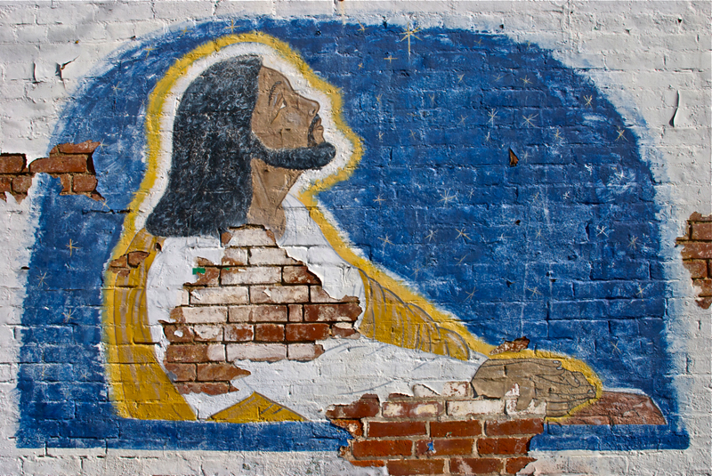
Lenten Daily Prayer for Reflection
Week 5
Revised Common Lectionary Year B
The Prayers that follow are written by the RCL specifically for the
Lectionary scripture texts:
Jeremiah 31:31-34
Psalm 51:1-2 or Psalm 119:9-16
Hebrews 5:5-10 • John 12:20-33
Image information may be found at the end.

Slide 2
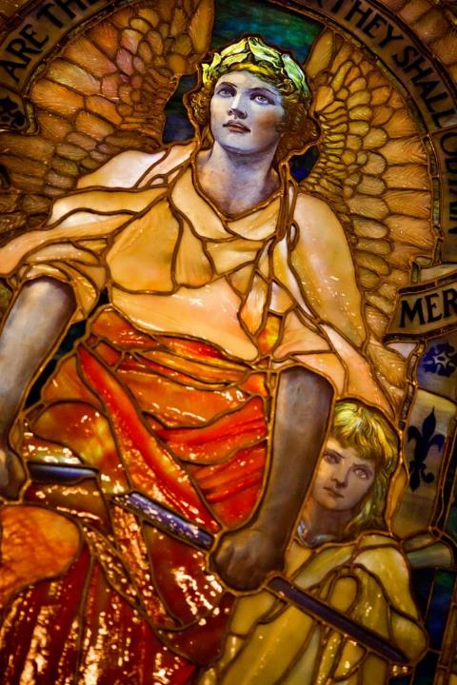
Fifth Sunday of Lent, Year B
God of justice, your word is light and truth. Let your face shine on us to restore us, that we may walk in your way, seeking justice and doing good.
Jeremiah 31:31-34
Psalm 51:1-2 or Psalm 119:9-16
Hebrews 5:5-10 • John 12:20-33

Slide 3
Fifth Monday of Lent, Year B
Divine Judge, you framed the earth with love and mercy and declared it good; yet we, desiring to justify ourselves, judge others harshly, without knowledge or understanding.
Jeremiah 31:31-34
Psalm 51:1-2 or Psalm 119:9-16
Hebrews 5:5-10 • John 12:20-33

Slide 4
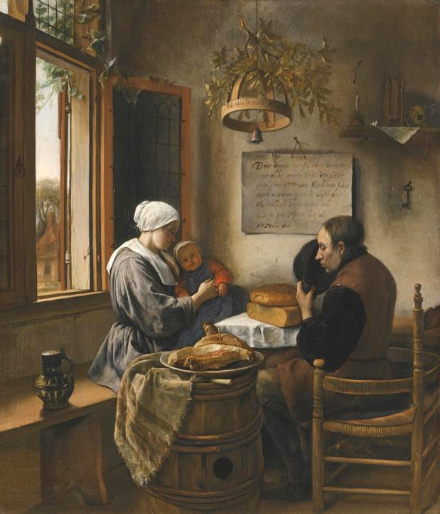
Fifth Tuesday of Lent, Year B
Keep us faithful in prayer that we may be filled with the knowledge of your will, and not ignore or pass by another's need, but plumb the depths of love in showing mercy.
Jeremiah 31:31-34
Psalm 51:1-2 or Psalm 119:9-16
Hebrews 5:5-10 • John 12:20-33

Slide 5
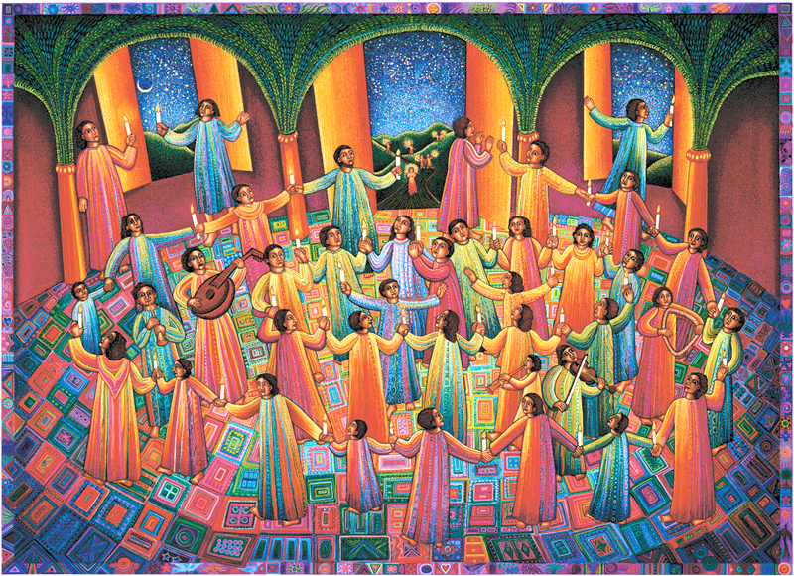
Fifth Wednesday of Lent, Year B
God of compassion, you know our faults and yet you promised to forgive. Keep us in your presence and give us your wisdom.
Open our hearts to gladness, call dry bones to dance, and restore to us the joy of your salvation.
Jeremiah 31:31-34
Psalm 51:1-2 or Psalm 119:9-16
Hebrews 5:5-10 • John 12:20-33

Slide 6
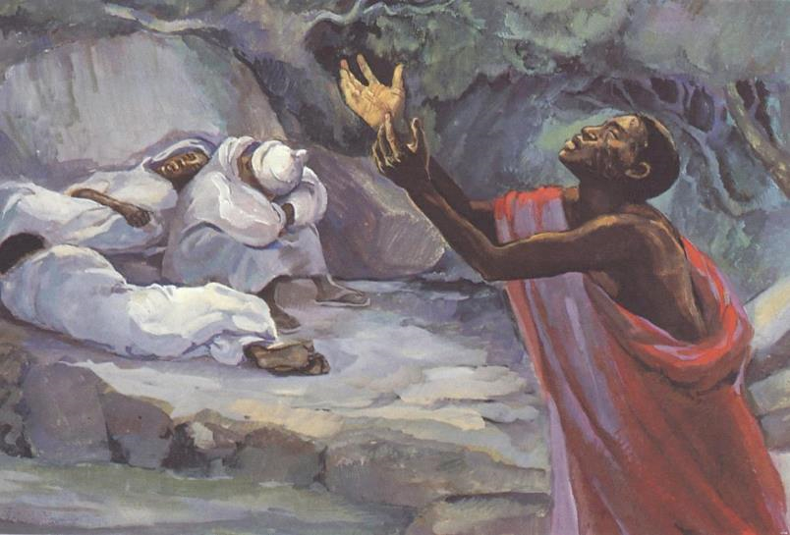
Fifth Thursday of Lent, Year B
Sisters and brothers, as Jesus, in the days before his passion, offered prayers and supplications with loud cries and tears, let us pray for those who suffer, those who are in need, and those who seek reconciliation.
Jeremiah 31:31-34
Psalm 51:1-2 or Psalm 119:9-16
Hebrews 5:5-10 • John 12:20-33

Slide 7
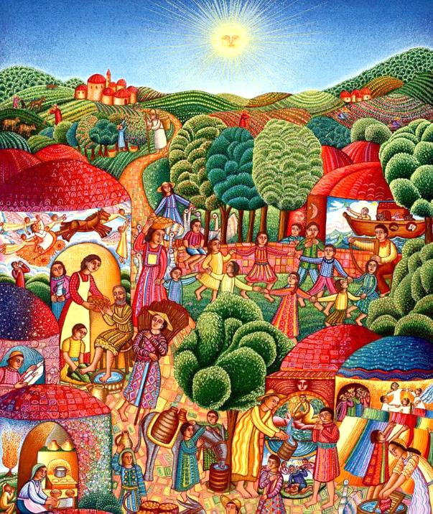
Fifth Friday of Lent, Year B
God of suffering and glory, in Jesus Christ you reveal the way of life through the path of obedience. Inscribe your law in our hearts, that in life we may not stray from you, but may be your people.
Jeremiah 31:31-34
Psalm 51:1-2 or Psalm 119:9-16
Hebrews 5:5-10 • John 12:20-33

Slide 8
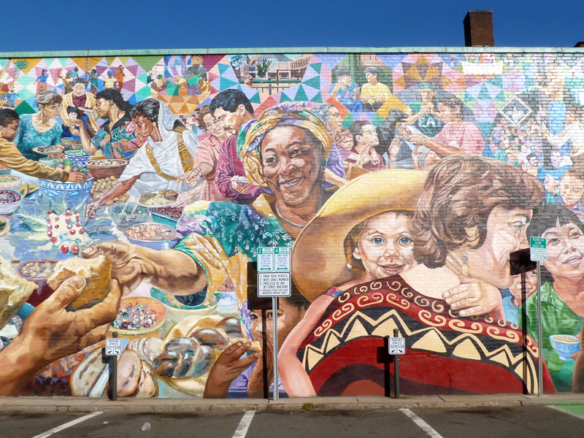
Fifth Saturday of Lent, Year B
Through our Lord Jesus who has fulfilled the law in every way, grant that we may love you with heart, soul, strength, and mind, and our neighbor as ourselves. Amen.
Jeremiah 31:31-34
Psalm 51:1-2 or Psalm 119:9-16
Hebrews 5:5-10 • John 12:20-33

Slide 9
Prayers are reproduced from Revised Common Lectionary Prayers, copyright © 2002 Consultation on Common Texts. Augsburg Fortress. Used by permission. Art image descriptions can be found at the Art in the Christian Tradition image library, a service of the Vanderbilt Divinity Library, http://diglib.library.vanderbilt.edu/. All images available via Creative Commons 3.0 License.
Jesus Praying, Unidentified KY Muralist -- https://www.flickr.com/photos/talesoftaromeet/6867087845 - DL Duncan
Blessed Art the Merciful, Louis Comfort Tiffany -- https://www.flickr.com/photos/thomashawk/5391897874/ - Thomas Hawk
Skyspace, Love Oak Meeting House, James Turrell -- http://www.flickr.com/photos/21804434@N02/5394865139
Prayer Before the Meal, Jan Steen -- https://commons.wikimedia.org/wiki/File:Jan_Steen_-_The_Prayer_Before_the_Meal,_1660.jpg
Celebration, John August Swanson -- www.JohnAugustSwanson.com - copyright 1997 by John August Swanson
Christ on Gethsemane, JESUS MAFA -- https://www.librairie-emmanuel.fr/contact
The Visitor, John august Swanson -- www.JohnAugustSwanson.com - copyright 1995 by John August Swanson
The Potluck, David Fichter -- https://www.flickr.com/photos/zenmama/9595059022/ - Lorianne DiSabato

