Slide 1
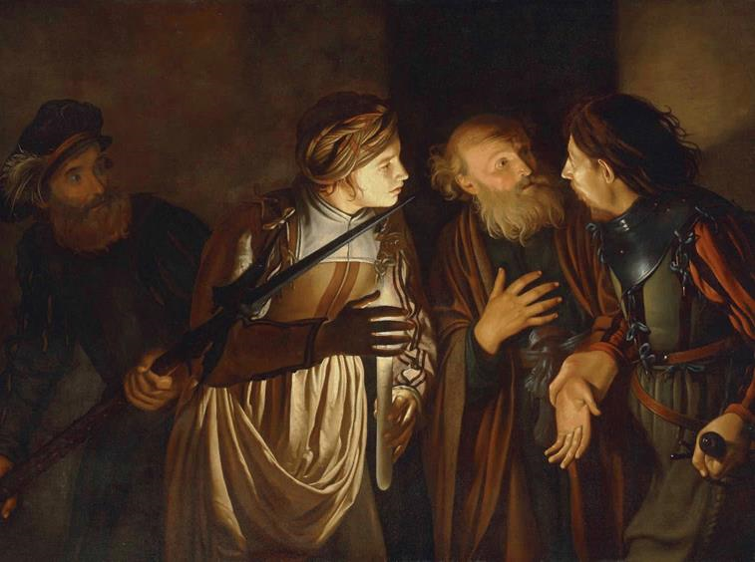
Daily Prayer for Reflection
Palm/Passion Sunday
with Holy Week
Revised Common Lectionary Year B
Prayers are written by the RCL specifically for the Palm/Passion Sunday
and Holy Week scripture texts.
Psalm 118:1-2, 19-29 • Mark 11:1-11
or John 12:12-16
Isaiah 50:4-9a • Psalm 31:9-16
Philippians 2:5-11
Mark 14:1-15:47 or Mark 15:1-39, (40-47)
Image information may be found at the end.

Slide 2
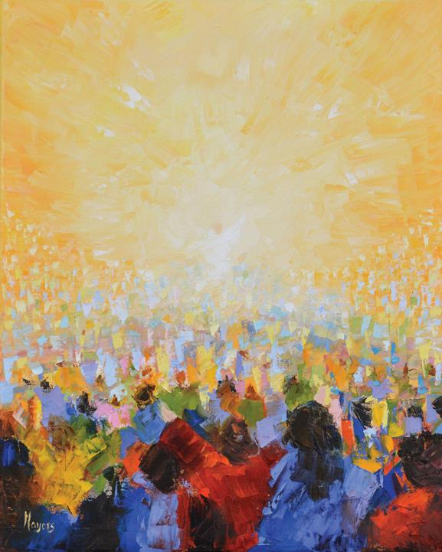
Palm/Passion Sunday, Year B
Sovereign God, you have established your rule over the human heart, not by force but by the servant example of Jesus Christ. Move us by your Spirit to join the joyful procession of those who confess Christ Jesus with their tongues and praise him with their lives.
Psalm 118:1-2, 19-29
Mark 11:1-11 or John 12:12-16

Slide 3
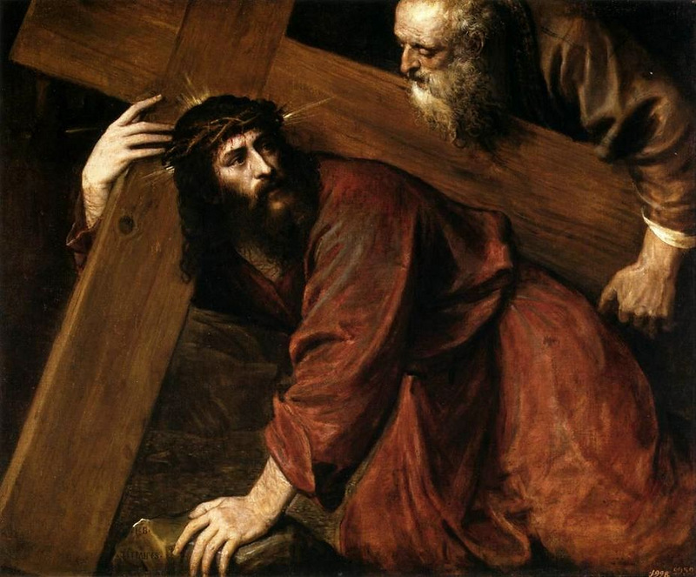
Monday of Holy Week, Year B
God of steadfast love, we see your holy purpose in the tender compassion of Jesus, who calls us into new and living friendship with you. May we, who take shelter in the shadow of your wings, be filled with the grace of his tender caring; may we, who stumble in selfish darkness, see your glory in the light of his self-giving.
Isaiah 42:1-9 • Psalm 36:5-11 • Hebrews 9:11-15 • John 12:1-11

Slide 4
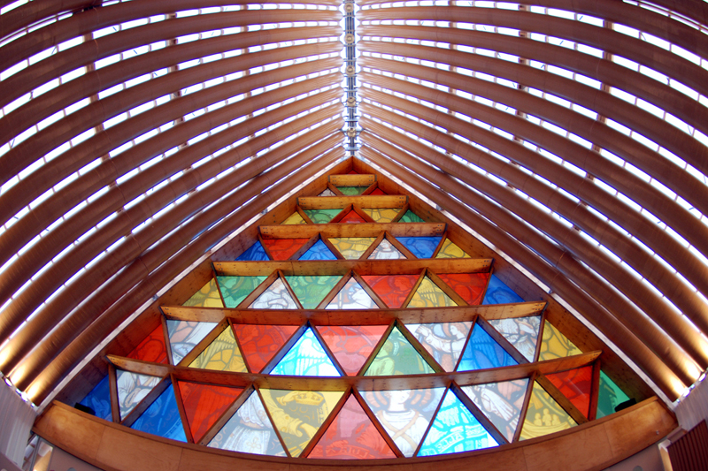
Tuesday of Holy Week, Year B
Holy and immortal God, from earliest times you have named us and called us into discipleship. Teach us to follow the One whose light scatters the darkness of our world, that we may walk as children of the light.
Isaiah 49:1-7 • Psalm 71:1-14
1 Corinthians 1:18-31 • John 12:20-36

Slide 5
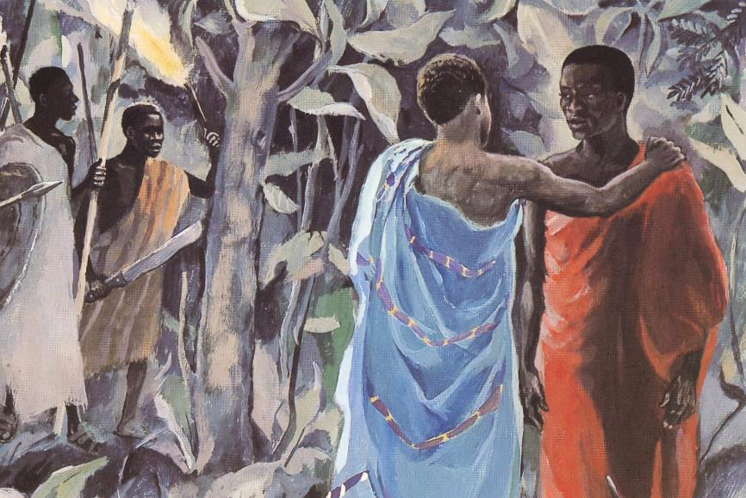
Wednesday of Holy Week, Year B
Troubled God, in every generation you call your people to contend against the brutality of sin and betrayal. Keep us steadfast even in our fear and uncertainty, that we may follow where Jesus has led the way.
Isaiah 50:4-9a • Psalm 70
Hebrews 12:1-3 • John 13:21-32

Slide 6
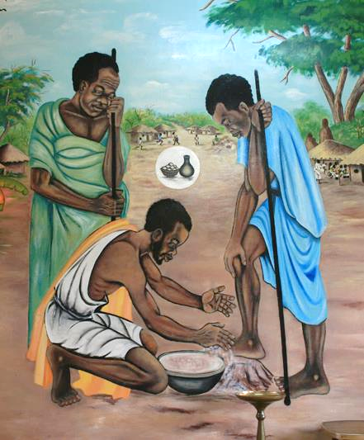
Maundy Thursday, Year B
Eternal God, in the sharing of a meal your son established a new covenant for all people, and in the washing of feet he showed us the dignity of service. Grant that by the power of your Holy Spirit these signs of our life in faith may speak again to our hearts, feed our spirits, and refresh our bodies.
Exodus 12:1-4, (5-10), 11-14 • Psalm 116:1-2, 12-19
1 Corinthians 11:23-26 • John 13:1-17, 31b-35

Slide 7
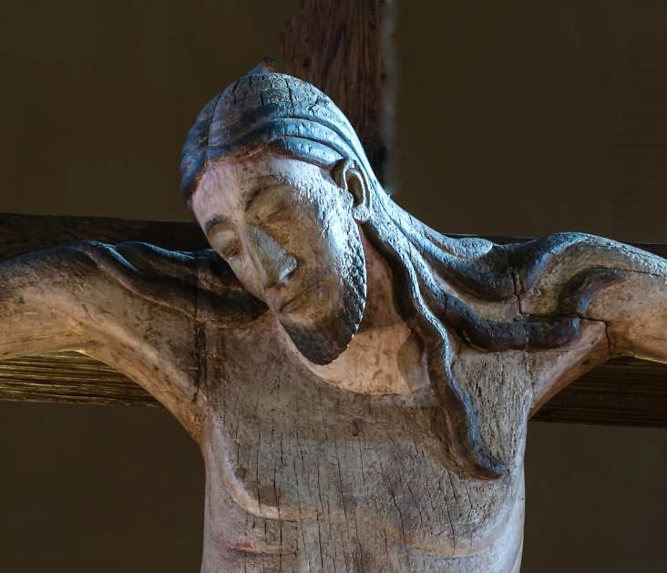
Good Friday, Year B
Grieving God, on the cross your Son embraced death even as he had embraced life: faithfully and with good courage. Grant that we who have been born out of his wounded side may hold fast to our faith in him exalted and may find mercy in all times of need.
Isaiah 52:13-53:12 • Psalm 22 • Hebrews 10:16-25
or Hebrews 4:14-16; 5:7-9 • John 18:1-19:42

Slide 8
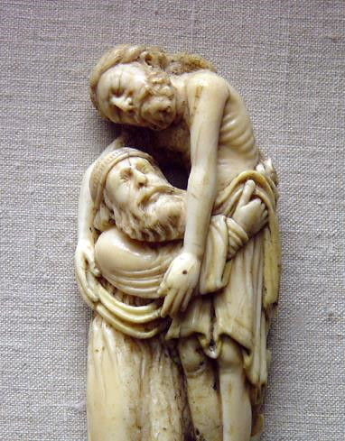
Holy Saturday, Year B
Christ our God, your love is poured out in death for our sakes. Hold us in your embrace as we wait for Easter's dawn. Comfort us with the promise that no power on earth, not even death itself, can separate us from your love; and strengthen us to wait until you are revealed to us in all your risen glory.
Job 14:1-14 or Lamentations 3:1-9, 19-24
Psalm 31:1-4, 15-16 • 1 Peter 4:1-8
Matthew 27:57-66 or John 19:38-42

Slide 9
Prayers are reproduced from Revised Common Lectionary Prayers, copyright © 2002 Consultation on Common Texts. Augsburg Fortress. Used by permission. Art image descriptions can be found at the Art in the Christian Tradition image library, a service of the Vanderbilt Divinity Library, http://diglib.library.vanderbilt.edu/. All images available via Creative Commons 3.0 License.
Peter's Denial, Adam de Coster -- https://commons.wikimedia.org/wiki/File:Adam_de_Coster_-_The_Denial_of_Saint_Peter.jpg
Hallelujah, Mike Moyers -- https://www.mikemoyersfineart.com/
Simon the Cyrene Assists Jesus, Titian -- http://commons.wikimedia.org/wiki/File:Titian_-_Christ_Carrying_the_Cross_-_WGA22830.jpg
Cardboard Cathedral, Shigeru Ban -- http://www.flickr.com/photos/geoftheref/9477818560
Kiss of Judas, JESUS MAFA -- https://www.librairie-emmanuel.fr/contact
Christ Washing Peter's Feet, Unidentified Zambian muralist -- http://www.flickr.com/photos/toddhiestand/2628057856/
Crucifixion, Seckau Basilica -- https://commons.wikimedia.org/wiki/File:Abtei_Seckau_Basilika_Kreuzigungsgruppe_Kruzifix_01.jpg
Descent from the Cross, 13th c. ivory -- http://diglib.library.vanderbilt.edu/act-imagelink.pl?RC=31721

