Slide 1
THIRD SUNDAY OF EASTER
Year C
Acts 9:1-6, (7-20) • Psalm 30 • Revelation 5:11-14
John 21:1-19

Slide 2
He fell to the ground and heard a voice saying to him, "Saul, Saul, why do you persecute me?" He asked, "Who are you, Lord?" The reply came, "I am Jesus, whom you are persecuting."
Acts 9:4-5

Slide 3
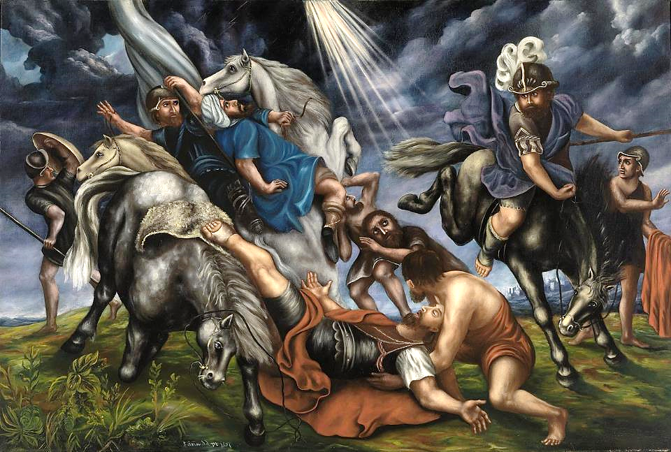
Conversion of Saul -- Simeon Griswold, Smithsonian Museum of American Art, Washington, DC

Slide 4
You have turned my mourning into dancing; you have taken off my sackcloth and clothed me with joy …
Psalm 30:11

Slide 5
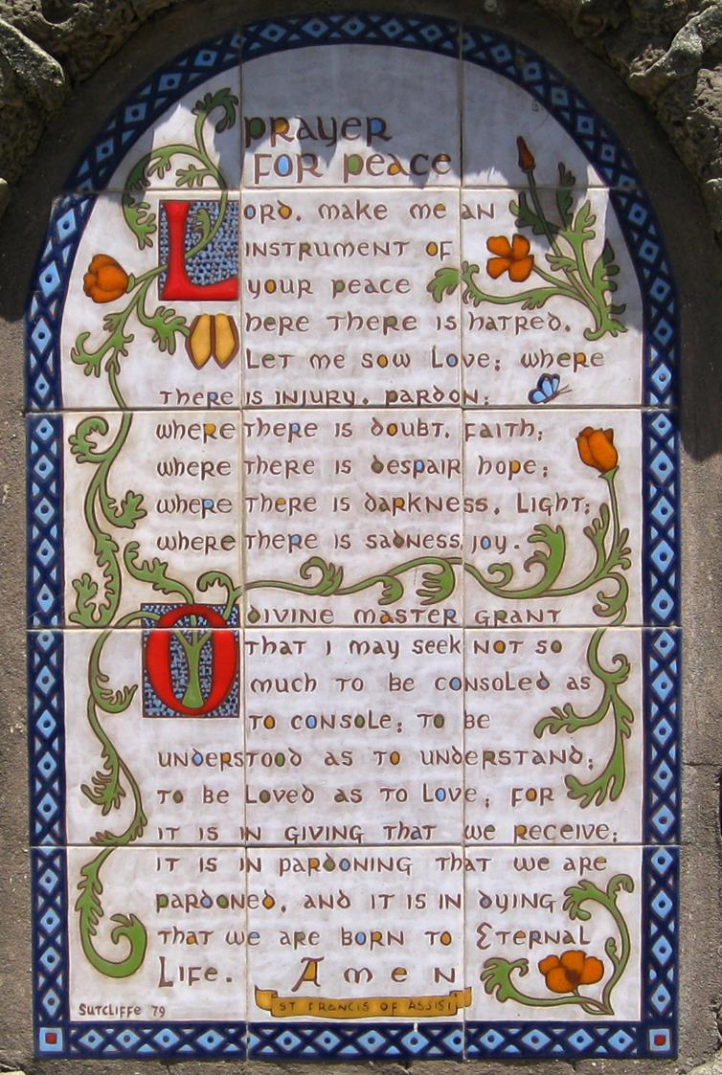
Prayer for Peace
Judy Sutcliffe
Monastery of Poor Clares
Santa Barbara, CA

Slide 6
Then I heard every creature in heaven and on earth … singing,
"To the one seated on the throne and to the Lamb be blessing and honor and glory and might forever and ever!"
Revelation 5:13ac

Slide 7
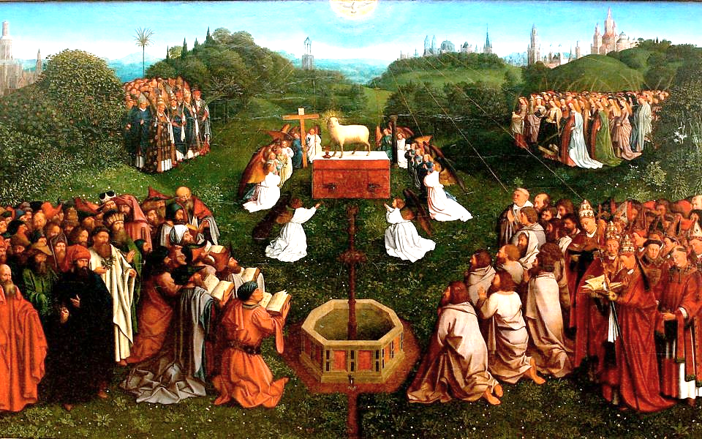
Behold the Lamb, Ghent Altarpiece -- Jan van Eyck, Saint Bavo Cathedral, Ghent, Belgium

Slide 8
Simon Peter said to them, "I am going fishing." They said to him, "We will go with you." They went out and got into the boat, but … they caught nothing.
John 21:3

Slide 9
Just after daybreak, Jesus stood on the beach; but the disciples did not know that it was Jesus.
John 21:4

Slide 10
Jesus said to them … "Cast the net to the right side of the boat" … So they cast it … they were not able to haul it in because there were so many fish.
John 21:5a, 6bc

Slide 11
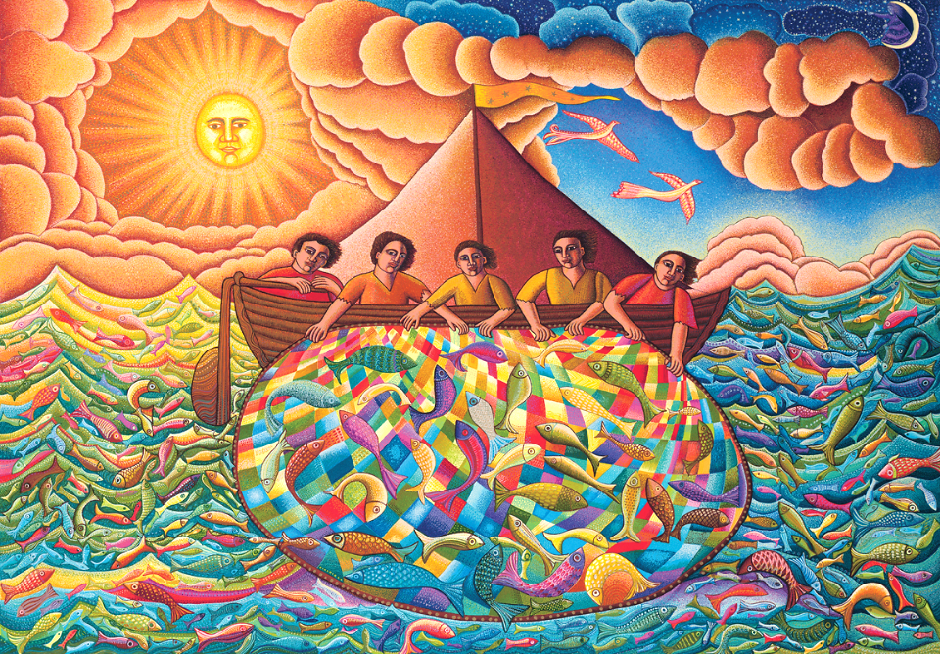
The Great Catch -- John August Swanson, serigraph, 1993

Slide 12
That disciple whom Jesus loved said to Peter, "It is the Lord!" When Simon Peter heard that it was the Lord … he … jumped into the sea.
John 21:7a, c

Slide 13
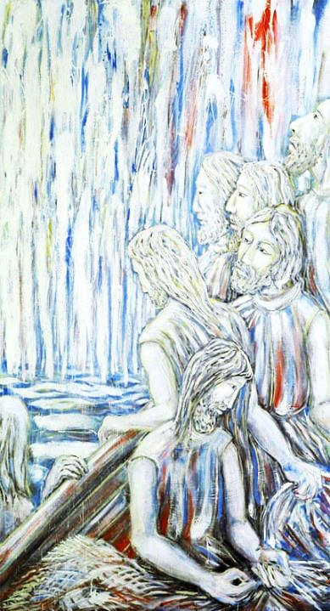
Christ Appears to the Disciples at the Sea of Tiberias
Jacek Rossakiewicz, 1990

Slide 14
But the other disciples came in the boat, dragging the net full of fish, for they were not far from the land …
John 21:8a

Slide 15
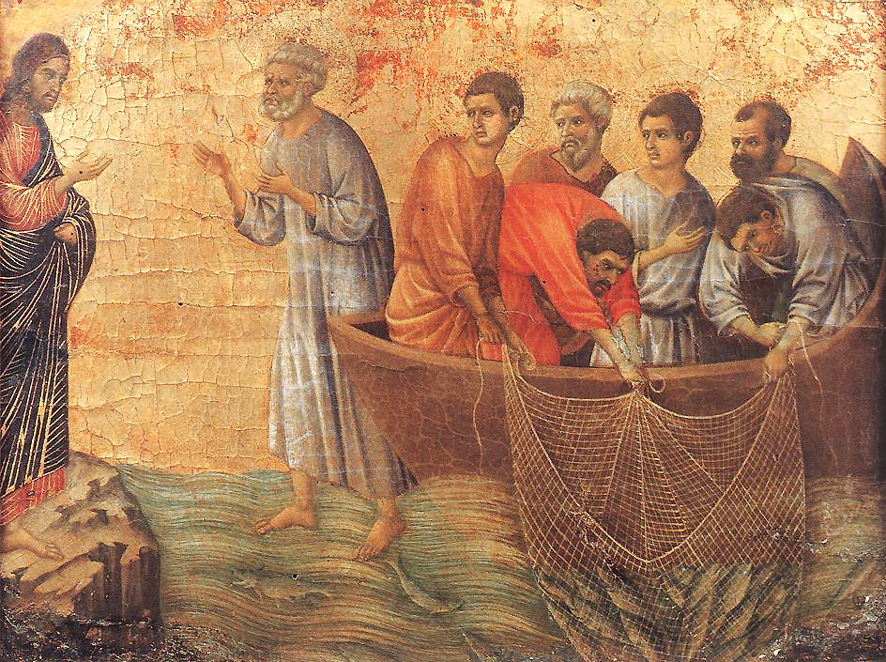
Appearance on Lake Tiberias -- Duccio, Museo dell'Opera del Duomo, Siena, Italy

Slide 16
When they had gone ashore, they saw a charcoal fire there, with fish on it, and bread. Jesus said to them, "Come and have breakfast."
John 21:9, 12a

Slide 17
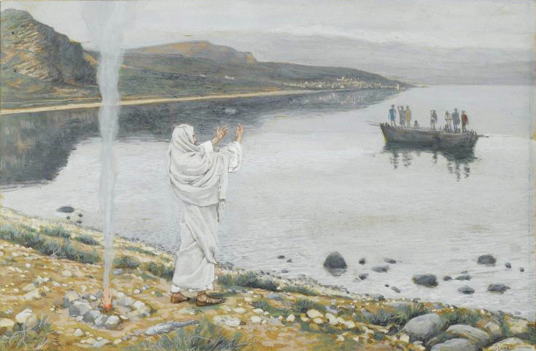
Christ Appears on the Shore of Lake Tiberias -- James Tissot, Brooklyn Museum of Art, New York, NY

Slide 18
Jesus came and took the bread and gave it to them, and did the same with the fish.
John 21:13

Slide 19
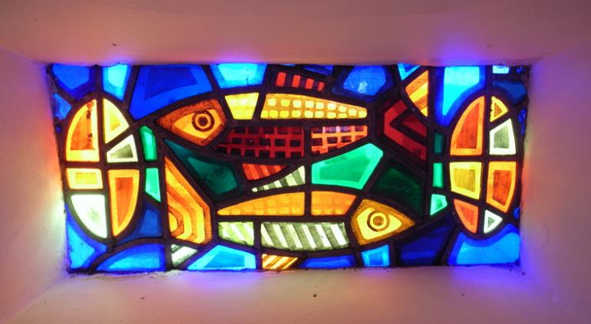
Loaves and Fish -- Helen Moloney, Church of St. Michael, Creeslough, Ireland

Slide 20
Jesus said …"Simon son of John, do you love me?" He said to him, "Yes, Lord; you know that I love you." Jesus said to him, "Tend my sheep."
John 21:15b, 16b

Slide 21
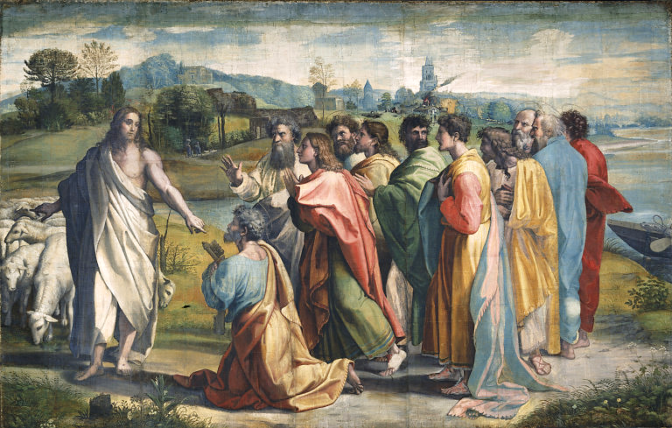
Christ's Charge to Peter to Feed his Sheep -- Raphael, Victoria and Albert Museum, London

Slide 22
Credits
New Revised Standard Version Bible, copyright 1989, Division of Christian Education of the National Council of the Churches of Christ in the United States of America. Used by permission. All rights reserved.
https://commons.wikimedia.org/wiki/File:The_Conversion_of_Saul_SAAM-1974.131_1.jpg
https://commons.wikimedia.org/wiki/File:Prayer_for_Peace_-_Flickr_-_brewbooks.jpg
https://commons.wikimedia.org/wiki/File:Genter_altar,_lamb_adoration_-_Jan_van_Eyck.jpg
www.JohnAugustSwanson.com - copyright 1993 by John August Swanson
https://commons.wikimedia.org/wiki/File:Rossakiewicz_Tyberiada.jpg
https://commons.wikimedia.org/wiki/File:Duccio_di_Buoninsegna_-_Appearance_on_Lake_Tiberias_-_WGA06736.jpg
https://commons.wikimedia.org/wiki/File:Brooklyn_Museum_-_Christ_Appears_on_the_Shore_of_Lake_Tiberias_(Apparition_du_Christ_sur_les_bords_du_lac_de_Tib%C3%A9riade)_-_James_Tissot.jpg
https://www.flickr.com/photos/stevecadman/4935677083
https://commons.wikimedia.org/wiki/File:V%26A_-_Raphael,_Christ%27s_Charge_to_Peter_(1515).jpg
Additional descriptions can be found at the Art in the Christian Tradition image library, a service of the Vanderbilt Divinity Library, http://diglib.library.vanderbilt.edu/. All images available via Creative Commons 3.0 License.

