Slide 1
SIXTH SUNDAY OF EASTER
Year C
Acts 16:9-15 • Psalm 67 • Revelation 21:10, 22-22:5 • John 14:23-29 or John 5:1-9

Slide 2
A certain woman named Lydia, a worshiper of God, was listening to us; she was from the city of Thyatira and a dealer in purple cloth.
Acts 16:14a

Slide 3
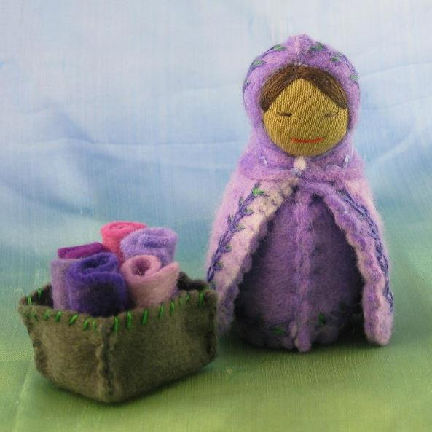
Lydia with Purple Cloth
Alkelda Crafts

Slide 4
The Lord opened her heart to listen eagerly to what was said by Paul.
Acts 16:14b

Slide 5
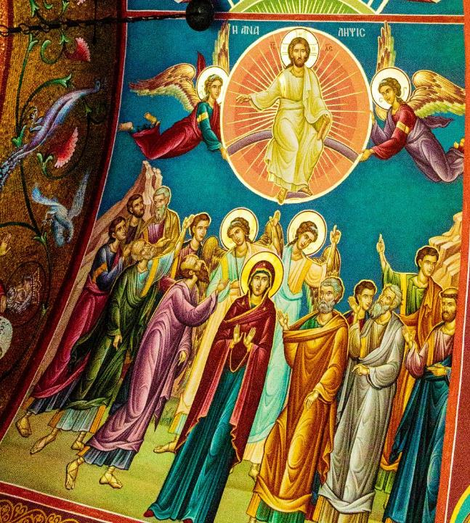
Lydia with Paul
Greek Orthodox Church of Lydia
Thyatira, Macedonia

Slide 6
When she and her household were baptized, she urged us, saying, "If you have judged me to be faithful to the Lord …
Acts 16:15a

Slide 7
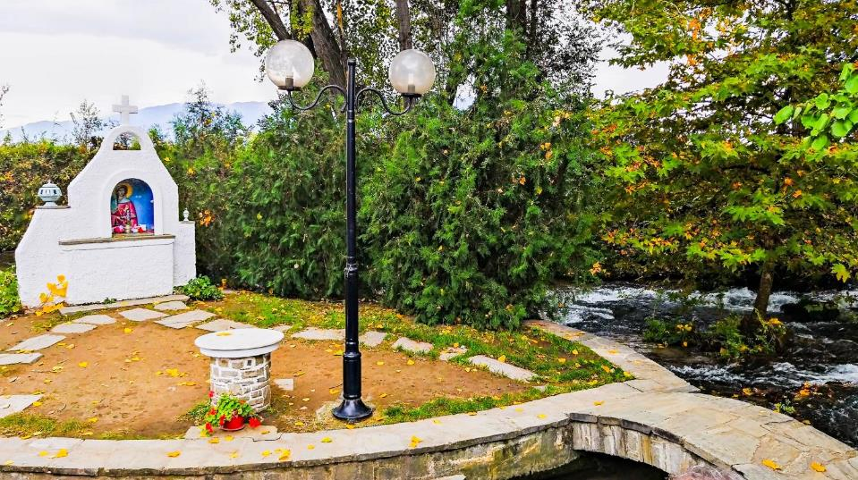
Altar commemorating Lydia's Baptism -- Thyatira, Macedonia

Slide 8
come and stay at my home."
And she prevailed upon us.
Acts 16:15b

Slide 9
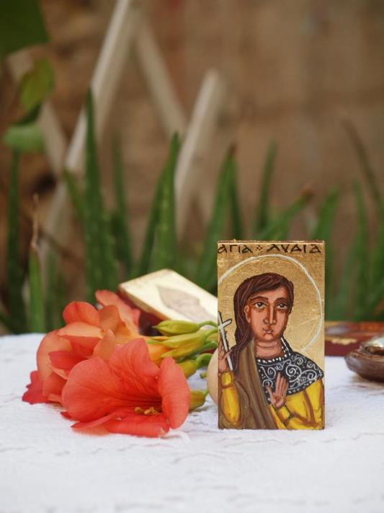
Religious Miniature of Lydia of Thyatira
Angelica Byzantine Art

Slide 10
Let the nations be glad and sing for joy, for you judge the peoples with equity and guide the nations upon earth.
Psalm 67:4

Slide 11
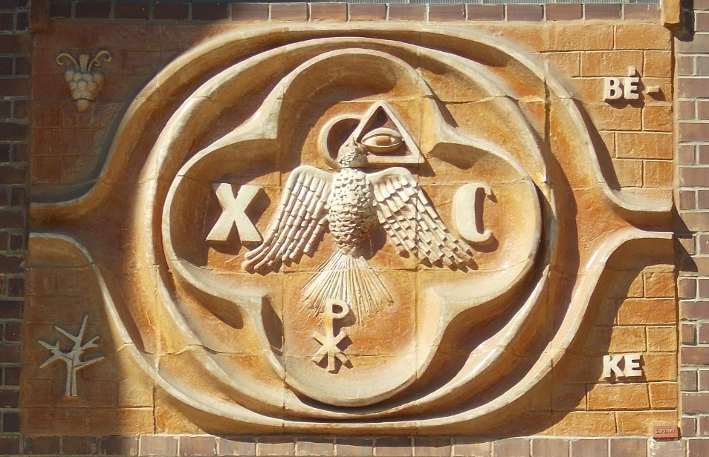
Symbol of Peace with Eye of Providence -- Sacred Heart Church, Komarom, Hungary

Slide 12
On either side of the river is the tree of life … and the leaves of the tree are for the healing of the nations.
Revelation 22:2bd

Slide 13
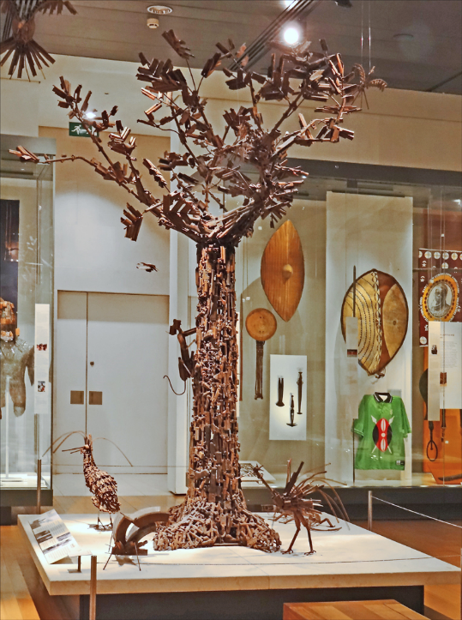
Tree of Life,
made from decommissioned weapons, Maputo, Mozambique
British Museum, London

Slide 14
Peace I leave with you; my peace I give to you … Do not let your hearts be troubled, and do not let them be afraid.
John 14:27ac

Slide 15
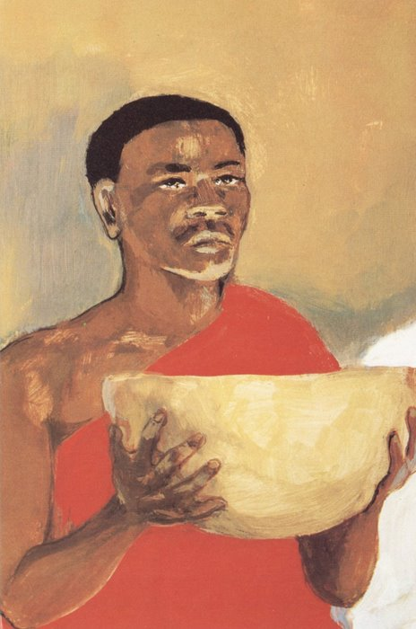
Jesus Christ at the Lord's Supper, detail
JESUS MAFA, Cameroon

Slide 16
Now in Jerusalem … there is a pool, called in Hebrew Beth-zatha … which has five porticoes. In these lay many invalids--blind, lame, and paralyzed.
John 5:2ac, 3

Slide 17
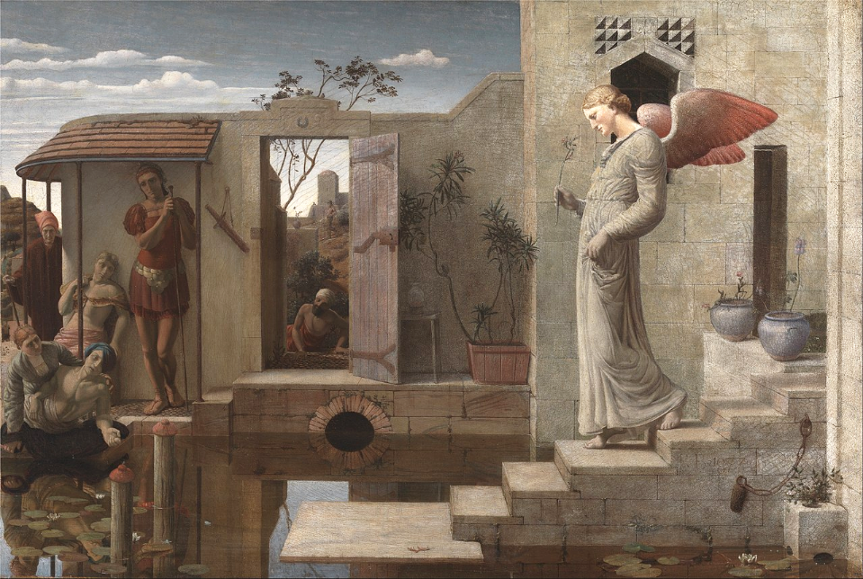
The Pool of Bethesda -- Robert Bateman, Yale Center for British Art, New Haven, CT

Slide 18
One man was there who had been ill for thirty-eight years. When Jesus saw him lying there … he said to him, "Do you want to be made well?"
John 5:5-6ac

Slide 19
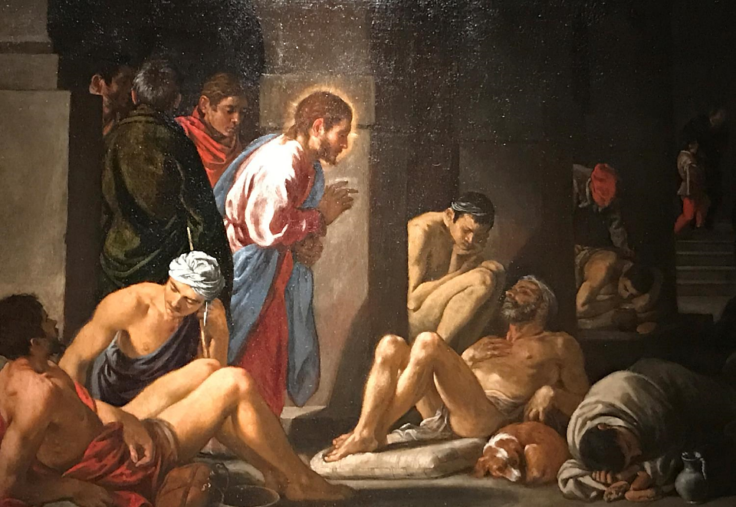

Slide 20
The sick man answered him, "Sir, I have no one to put me into the pool when the water is stirred up; and while I am making my way, someone else steps down ahead of me."
John 5:7

Slide 21
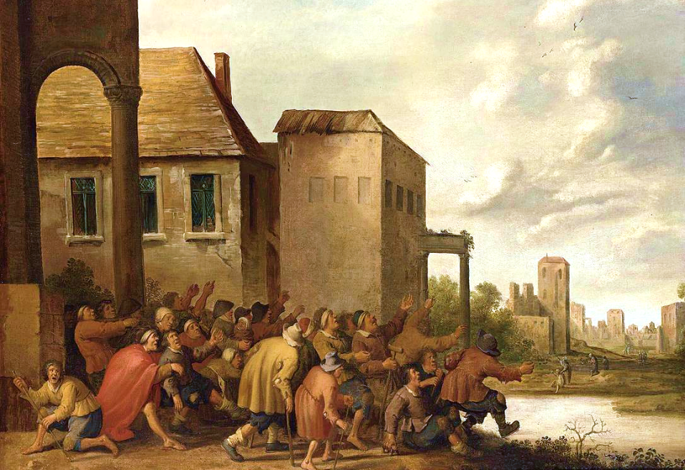
The Pool of Bethesda -- Joost Cornelisz Droochsloot, 1645

Slide 22
Jesus said to him, "Stand up,
take your mat and walk."
John 5:8

Slide 23
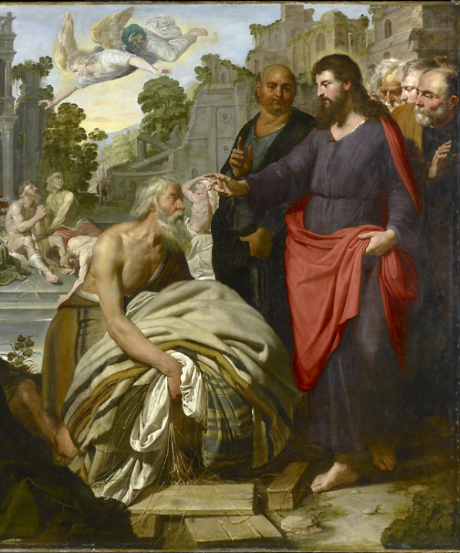
Christ at the Pool of Bethesda
Artus Wolffort
Art Gallery of Ontatio
Toronto, Canada

Slide 24
At once the man was made well, and he took up his mat and began to walk. Now that day was a sabbath.
John 5:9

Slide 25
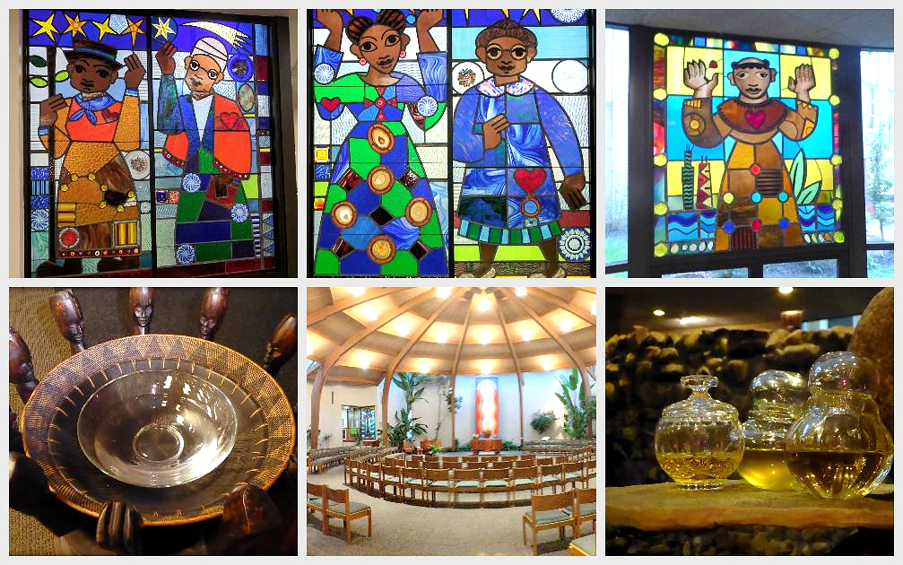
St. Benedict African Catholic Church -- Chicago, IL

Slide 26
Credits
New Revised Standard Version Bible, copyright 1989, Division of Christian Education of the National Council of the Churches of Christ in the United States of America. Used by permission. All rights reserved.
https://www.flickr.com/photos/alkelda/8347293119 - Alkelda
https://www.flickr.com/photos/captspaulding/38314688816/ - CaptSpalding
https://www.flickr.com/photos/captspaulding/24499073678/ - CaptSpalding
https://www.flickr.com/photos/erifragiadaki/14962284898/ - Eri Fragiadaki
https://commons.wikimedia.org/wiki/File:Sacred_Heart_church,_Peace._-_Szent_L%C3%A1szl%C3%B3_Street,_Kom%C3%A1rom,_Hungary.jpg – Globetrotter19
https://www.flickr.com/photos/dalbera/8721976885 -Jean-Pierre Dalbéra
http://diglib.library.vanderbilt.edu/act-imagelink.pl?RC=48298
https://commons.wikimedia.org/wiki/File:Robert_Bateman_-_The_Pool_of_Bethesda_-_Google_Art_Project.jpg
https://commons.wikimedia.org/wiki/File:Pedro_Orrente_-_Christ_Healing_the_Sick_at_the_Pool_of_Bethesda_-_KHM_Vienna.jpg
https://commons.wikimedia.org/wiki/File:Joost_Cornelisz._Droochsloot_-_The_Pool_of_Bethesda_-_WGA6681.jpg
https://commons.wikimedia.org/wiki/File:Artus_Wolffort_-_Christ_at_the_Pool_of_Bethesda_(Ontario).jpg
https://commons.wikimedia.org/wiki/File:Paolo_Veronese_-_Healing_of_the_Lame_Man_at_the_Pool_of_Bethesda_-_WGA24794.jpg
https://www.flickr.com/photos/yooperann/37485577690
Additional descriptions can be found at the Art in the Christian Tradition image library, a service of the Vanderbilt Divinity Library, http://diglib.library.vanderbilt.edu/. All images available via Creative Commons 3.0 License.

