Slide 1
Third Sunday after Pentecost
Year C
2 Kings 2:1-2, 6-14 and Psalm 77:1-2, 11-20 • 1 Kings 19:15-16, 19-21 and Psalm 16 • Galatians 5:1, 13-25 • Luke 9:51-62

Slide 2
As they continued walking and talking, a chariot of fire and horses of fire separated the two of them, and Elijah ascended in a whirlwind into heaven.
2 Kings 2:11

Slide 3
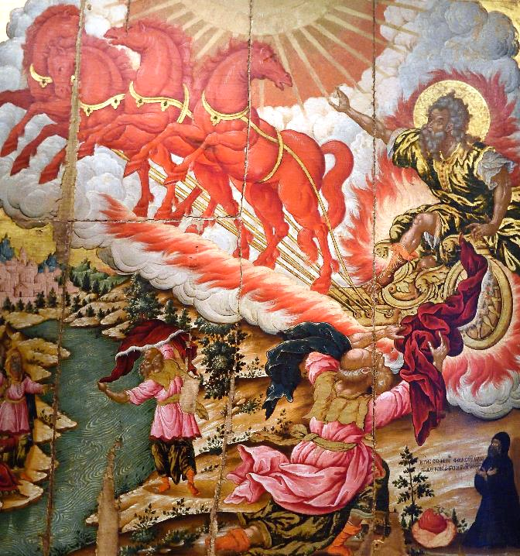
Elijah and Elisha
Theodore Poulakis
Byzantine Museum
Athens, Greece

Slide 4
He picked up the mantle of Elijah that had fallen … and struck the water … the water was parted … and Elisha went over.
2 Kings 2:13a, 14bd

Slide 5
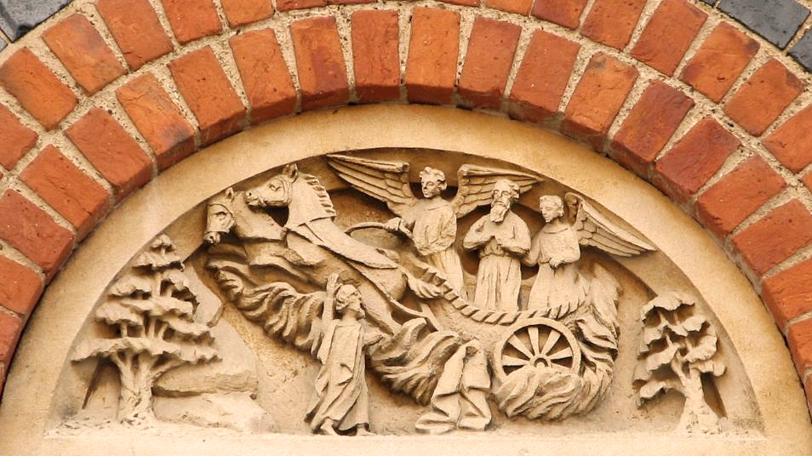
Elijah and Elisha -- Tympanum of Home on Walton Well Road, Oxford, England

Slide 6
Your way was through the sea, your path, through the mighty waters; yet your footprints were unseen.
Psalm 77:19

Slide 7
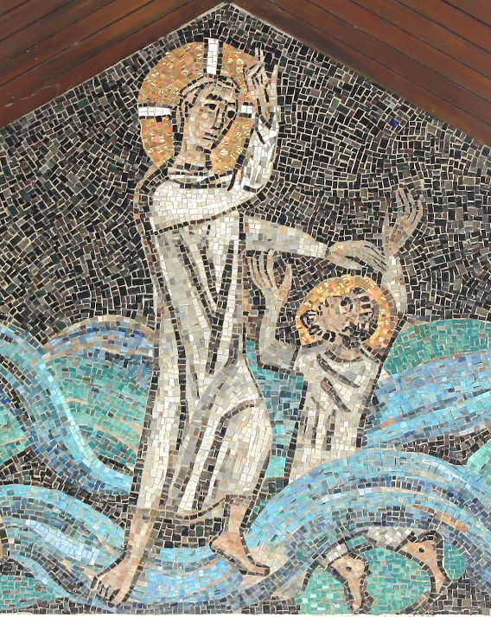
Christ Walks on WaterS
Church of St. Peter
Hamburg, Germany

Slide 8
Elisha … left the oxen, ran after Elijah, and said, "Let me kiss my father and my mother, and then I will follow you."
1 Kings 19:19b, 20a

Slide 9
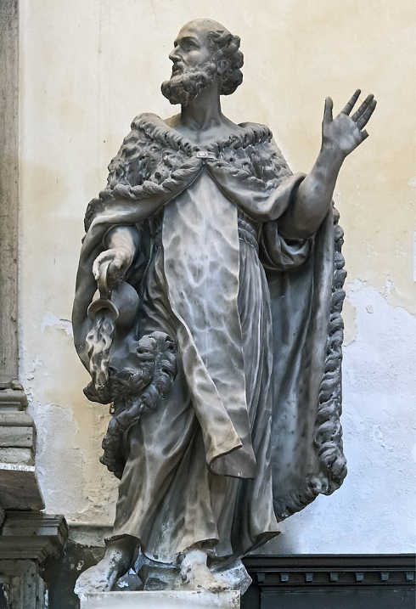
The Prophet Elisha
Tommaso Rues
Santa Maria dei Carmini
Venice, Italy

Slide 10
You show me the path of life.
In your presence there is fullness of joy …
Psalm 16:11a

Slide 11
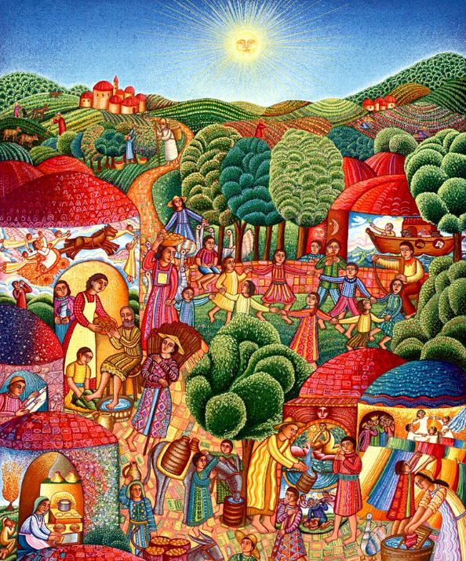
A Visit
John August Swanson
Serigraph, 1995

Slide 12
For the whole law is summed up in a single commandment, "You shall love your neighbor as yourself."
Galatians 5:14

Slide 13
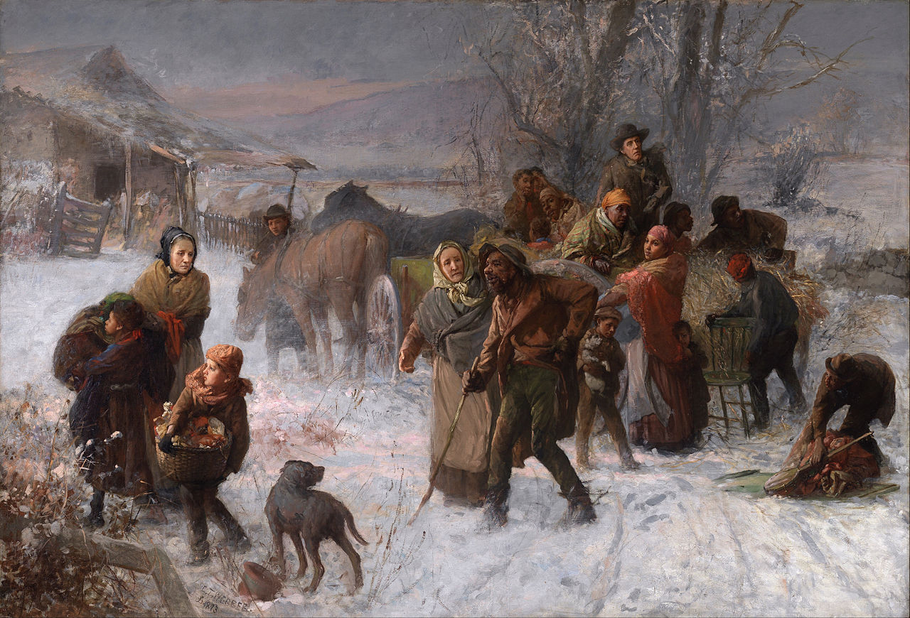
Underground Railroad -- Charles Webber, Cincinnati Art Museum, Cincinnati, OH

Slide 14
… the fruit of the Spirit is love, joy, peace, patience, kindness, generosity, faithfulness, gentleness, and self-control.
Galatians 5:22b-23a

Slide 15
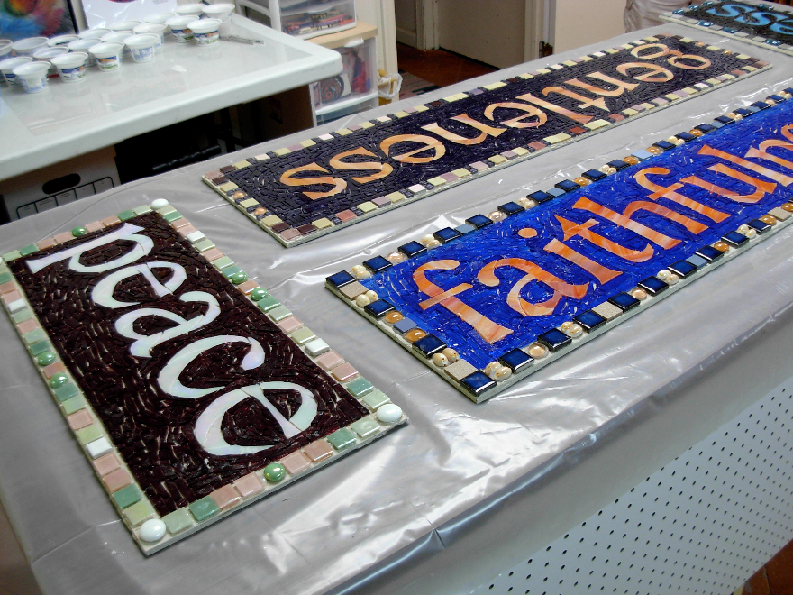
Ready to grout – Fruit of the Spirit mosaic commission -- Suzanne Halstead

Slide 16
… live by the Spirit,
… be guided by the Spirit.
Galatians 5:25bd

Slide 17
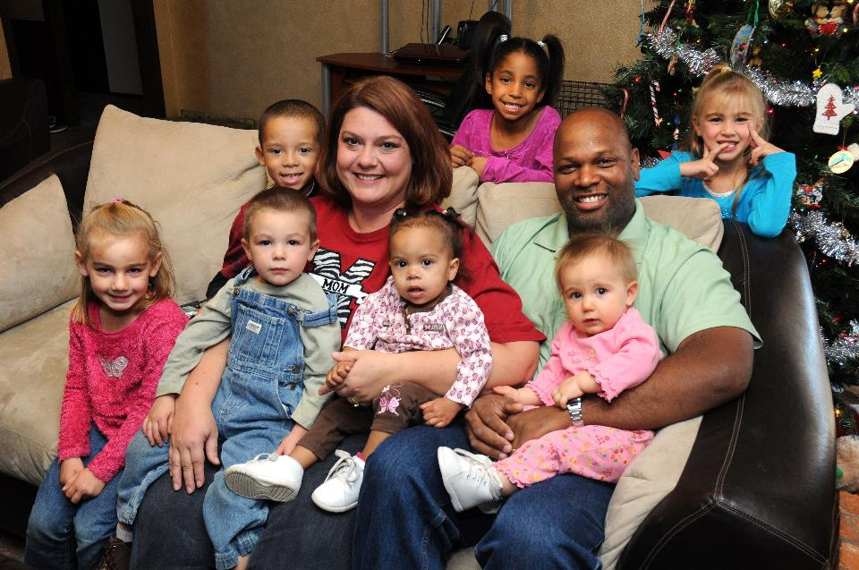
The Holt Family, Oklahoma Adoptive Parents of the Year, Tinker Air Force Base, OK

Slide 18
As they were going along the road, someone said to him, "I will follow you wherever you go."
Luke 9:57

Slide 19
And Jesus said to him, "Foxes have holes, and birds of the air have nests; but the Son of Man has nowhere to lay his head."
Luke 9:58

Slide 20
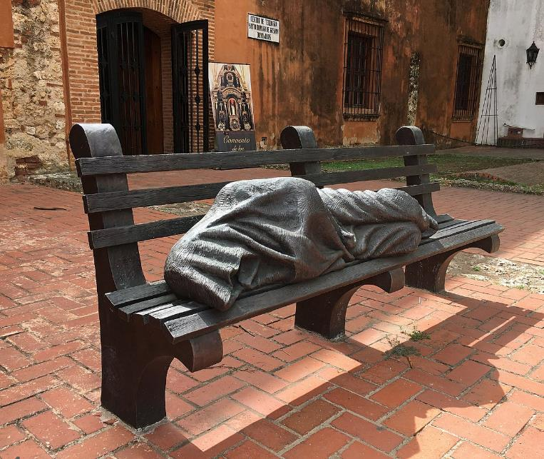
Homeless Jesus -- Timothy Smaltz, Convent Ciudad Colonial, Santo Domingo, Dominican Republic

Slide 21
To another he said, "Follow me." But he said, "Lord, first let me go and bury my father."
Luke 9:59

Slide 22
But Jesus said to him, "Let the dead bury their own dead; but as for you, go and proclaim the kingdom of God."
Luke 9:60

Slide 23
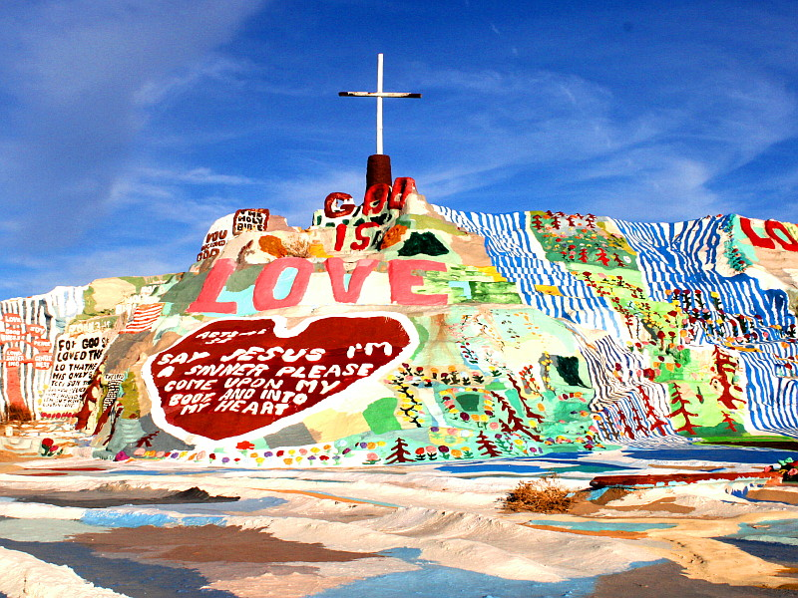
Salvation Mountain -- Leonard Knight, Imperial County, CA

Slide 24
Another said, "I will follow you, Lord; but let me first say farewell to those at my home."
Luke 9:61

Slide 25
Jesus said to him, "No one who puts a hand to the plow and looks back is fit for the kingdom of God."
Luke 9:62

Slide 26
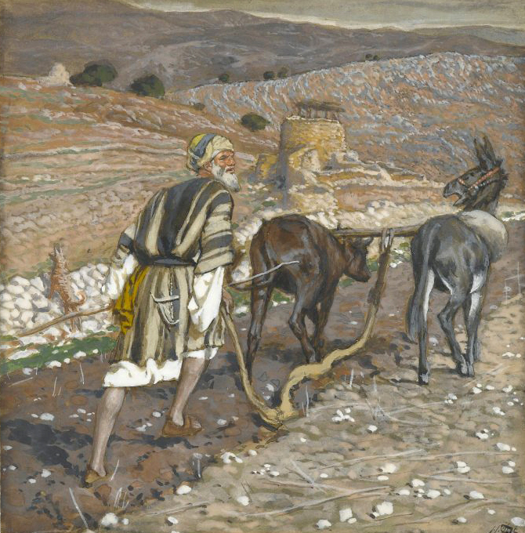
Looking Back – the Man at the Plow
James Tissot
Brooklyn Museum
New York, NY

Slide 27
Credits
New Revised Standard Version Bible, copyright 1989, Division of Christian Education of the National Council of the Churches of Christ in the United States of America. Used by permission. All rights reserved.
https://www.flickr.com/photos/36217981@N02/15796999284/
https://www.flickr.com/photos/paullew/431550496/
https://commons.wikimedia.org/wiki/File:Spgb_tympanon.jpg
https://commons.wikimedia.org/wiki/File:Santa_Maria_dei_Carmini_(Venice)_-_Chapel_of_St._Anthony_of_Padua_-_Elisha_by_Tommaso_Rues.jpg
https://commons.wikimedia.org/wiki/File:Charles_T._Webber_-_The_Underground_Railroad_-_Google_Art_Project.jpg
https://www.flickr.com/photos/nutmegdesigns/6077059476 - Margaret Almon
https://www.tinker.af.mil/News/Features/Display/Article/388803 via Flickr, David Faytinger
https://commons.wikimedia.org/wiki/File:Homeless_Jesus_CCSD_07_2018_9749.jpg – Mariordo
https://www.flickr.com/photos/caveman_92223/3160573307
https://commons.wikimedia.org/wiki/File:Brooklyn_Museum_-_The_Man_at_the_Plough_(L%27homme_%C3%A0_la_charrue)_-_James_Tissot_-_overall.jpg
Additional descriptions can be found at the Art in the Christian Tradition image library, a service of the Vanderbilt Divinity Library, http://diglib.library.vanderbilt.edu/. All images available via Creative Commons 3.0 License.

