Slide 1
Twentieth Sunday after Pentecost
Year C
Joel 2:23-32 and Psalm 65 • Sirach 35:12-17 or Jeremiah 14:7-10, 19-22 and Psalm 84:1-7 • 2 Timothy 4:6-8, 16-18 • Luke 18:9-14

Slide 2
… be glad and rejoice in the LORD your God; for he has given the early rain for your vindication, he has poured down for you abundant rain …
Joel 2:23b

Slide 3
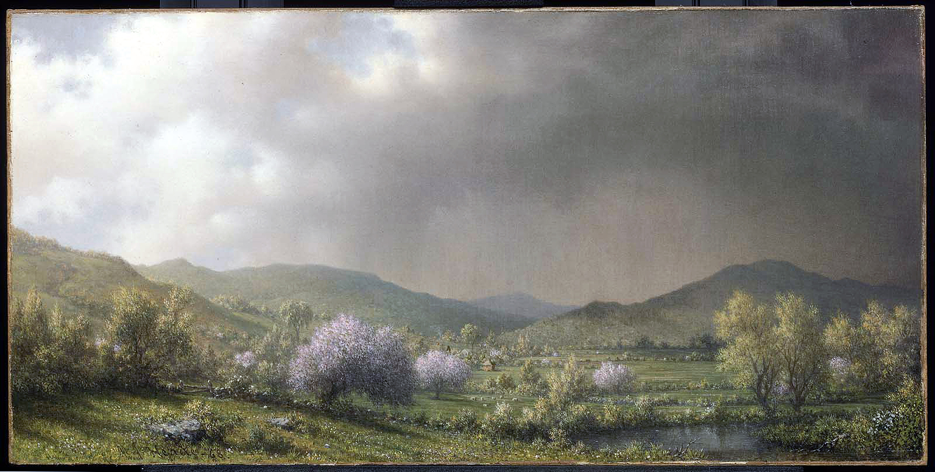
April Showers -- Martin Heade, Museum of Fine Arts, Boston, MA

Slide 4
You visit the earth and water it,
you greatly enrich it;
the river of God is full of water;
Psalm 65:9

Slide 5
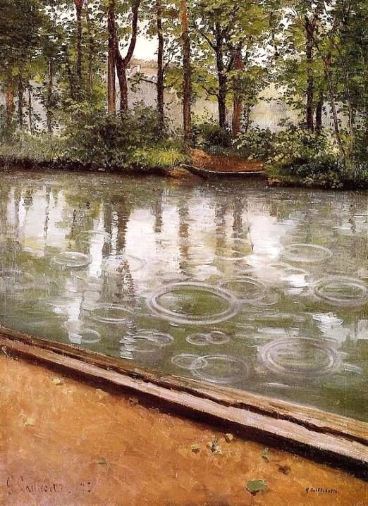
The Effect of Rain, Yerres River
Gustave Caillebotte
Indiana Art Museum
Bloomington, IN

Slide 6
We look for peace, but find no good; for a time of healing, but there is terror instead. We acknowledge our wickedness, O LORD …
Jeremiah 14:19c, 20a

Slide 7
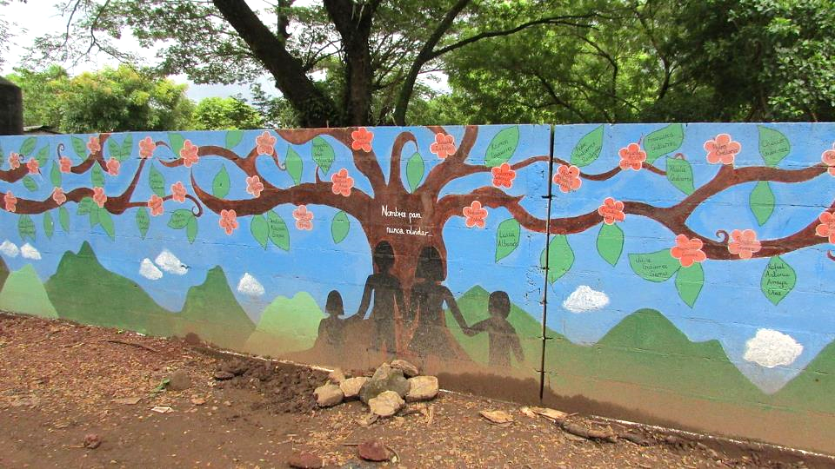
Tribute to the Lost Community Members from the Civil War -- Nuevo Gualcho, El Salvador

Slide 8
How lovely is your dwelling place, O LORD of hosts! … Even the sparrow finds a home, and the swallow a nest for herself, where she may lay her young …
Psalm 84:1, 3a

Slide 9
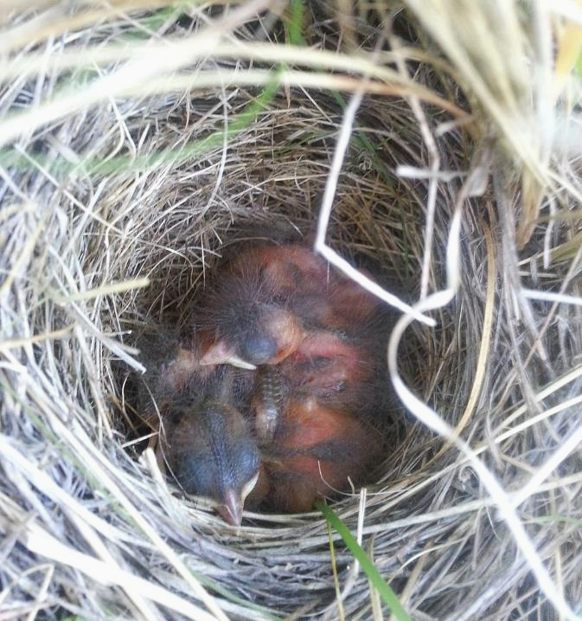
Savannah Sparrow Nestlings
Nest Monitoring Project of Sensitive Birds
Alberta, CA

Slide 10
I have fought the good fight,
I have finished the race,
I have kept the faith.
2 Timothy 4:7

Slide 11
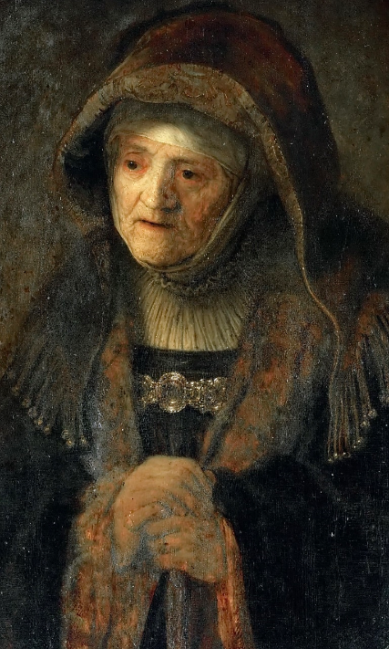
The Prophetess Anna, or, The Artist's Mother
Rembrandt, Kunsthistorisches Museum, Vienna, Austria

Slide 12
He also told this parable to some who … were righteous and regarded others with contempt:
Luke 18:9ac

Slide 13
"Two men went up to the temple to pray, one a Pharisee and the other a tax collector.
Luke 18:10

Slide 14
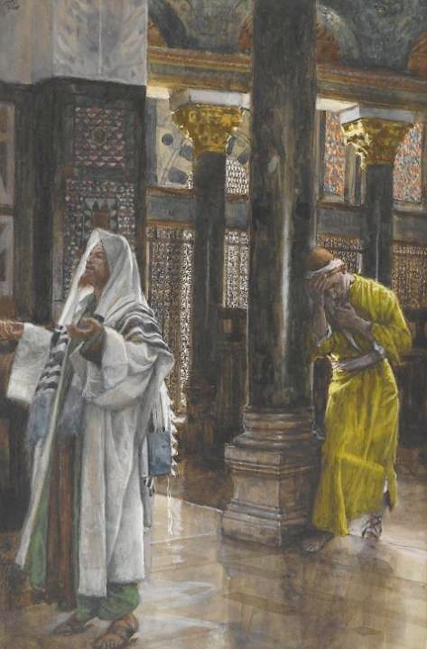
The Pharisee and the Tax Collector
James Tissot
Brooklyn Museum
Brooklyn, NY

Slide 15
The Pharisee, standing by himself, was praying thus, 'God, I thank you that I am not like other people: thieves, rogues, adulterers, or even like this tax collector.
Luke 18:11

Slide 16
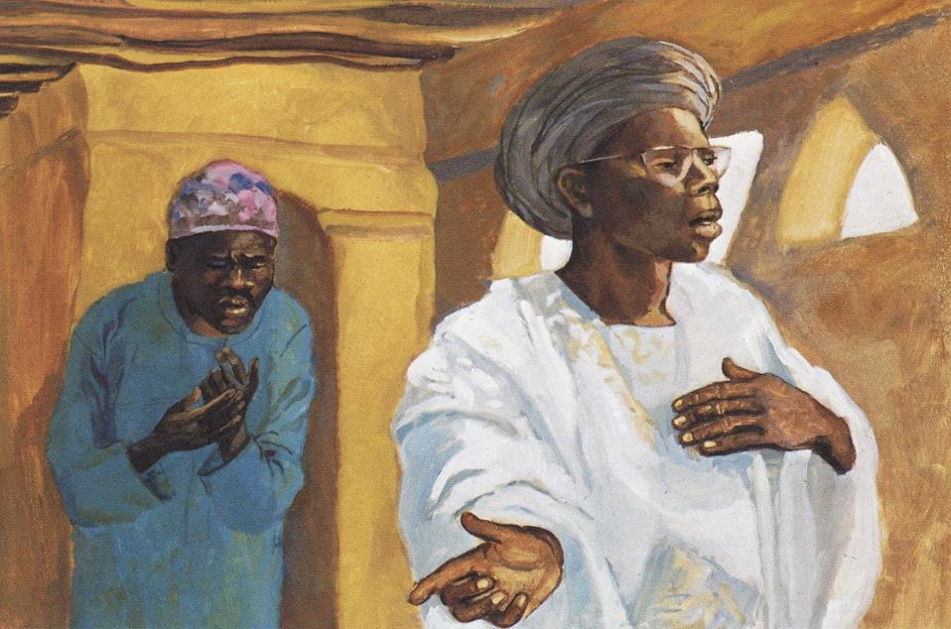
The Pharisee and the Tax Collector -- JESUS MAFA, Cameroon

Slide 17
I fast twice a week; I give a tenth of all my income.'
Luke 18:12

Slide 18
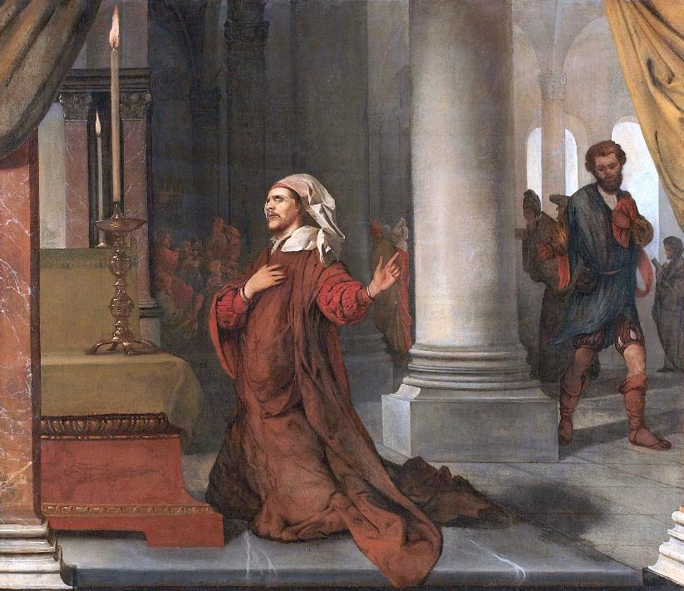
The Pharisee and the Tax Collector
Barent Fabritius RijksmuseumAmsterdam, Netherlands

Slide 19
But the tax collector, standing far off, would not even look up to heaven, but was beating his breast and saying, 'God, be merciful to me, a sinner!'
Luke 18:13

Slide 20
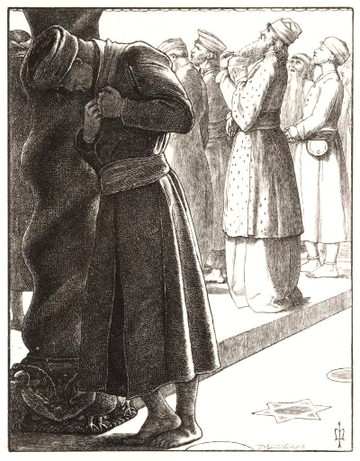
The Pharisee and the Publican
John Everitt Millais
Tate Britain
London, England

Slide 21
I tell you, this man went down to his home justified rather than the other; for all who exalt themselves will be humbled, but all who humble themselves will be exalted."
Luke 18:14

Slide 22
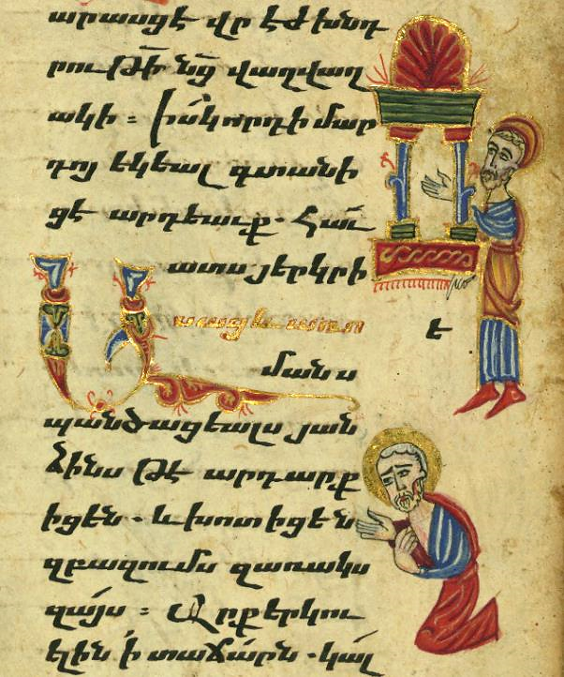
The Pharisee and the Tax Collector
Aristakes
Armenia, 1475
Walters Art Museum
Baltimore, MD

Slide 23
Credits
New Revised Standard Version Bible, copyright 1989, Division of Christian Education of the National Council of the Churches of Christ in the United States of America. Used by permission. All rights reserved.
https://commons.wikimedia.org/wiki/File:Martin_Johnson_Heade_-_April_Showers_-_47.1173_-_Museum_of_Fine_Arts.jpg
http://commons.wikimedia.org/wiki/File:G._Caillebotte_-_L%27Yerres,_pluie.jpg
https://commons.wikimedia.org/wiki/File:War_memorial_mural_-_Nuevo_Gualcho,_El_Salvador.JPG – Amelia Hunt
https://commons.wikimedia.org/wiki/File:Savannah_Sparrow,_Passerculus_sandwichensis,_nestlings_baby_birds,_in_nest_AB_Canada_(1).jpg
https://commons.wikimedia.org/wiki/File:Rembrandt_Harmensz._van_Rijn_085b.jpg
https://commons.wikimedia.org/wiki/File:Tissot_The_Pharisee_and_the_publican_Brooklyn.jpg
http://diglib.library.vanderbilt.edu/act-imagelink.pl?RC=48268
https://commons.wikimedia.org/wiki/File:De_Farizee%C3%ABr_en_de_tollenaar_Rijksmuseum_SK-A-2959.jpeg
http://commons.wikimedia.org/wiki/File:MillaisThe_Pharisee_and_the_publican_Tate.jpg
https://commons.wikimedia.org/wiki/File:Gospel_Book,_Publican_and_the_Pharisee,_Walters_Manuscript_W.540,_fol._179r.jpg
Additional descriptions can be found at the Art in the Christian Tradition image library, a service of the Vanderbilt Divinity Library, http://diglib.library.vanderbilt.edu/. All images available via Creative Commons 3.0 License.

