Slide 1
Tenth Sunday after Pentecost
Year C
Isaiah 5:1-7 and Psalm 80:1-2, 8-19 • Jeremiah 23:23-29 and Psalm 82 • Hebrews 11:29-12:2 • Luke 12:49-56

Slide 2
You brought a vine out of Egypt … and planted it. You cleared the ground for it; it took deep root and filled the land.
Psalm 80:8ac, 9

Slide 3
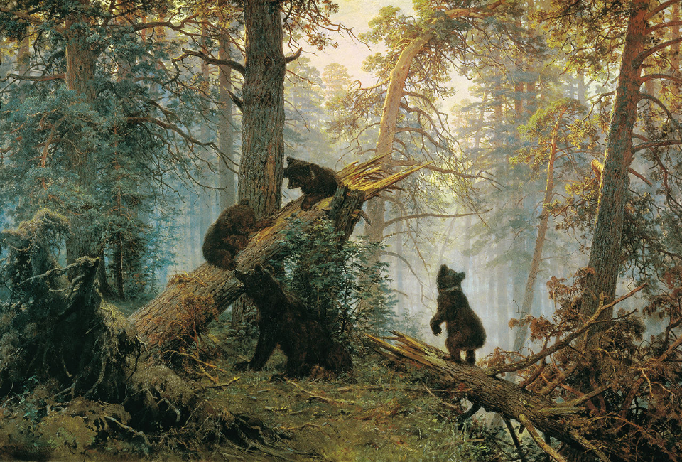
Morning in a Pine Forest -- Ivan Shishkin, Tretyakov Gallery, Moscow, Russia

Slide 4
The mountains were covered with its shade, the mighty cedars with its branches;
Psalm 80:10

Slide 5
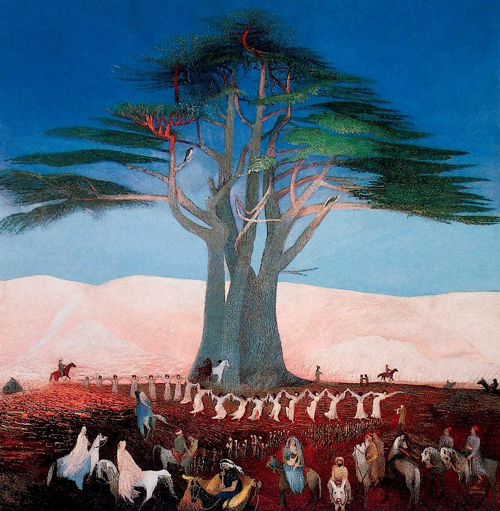
Pilgrimage to the Cedars of Lebanon
T. Csontváry Kosztka
Hungarian National Gallery
Budapest, Hungary

Slide 6
it sent out its branches to the sea, and its shoots to the River.
Psalm 80:11

Slide 7
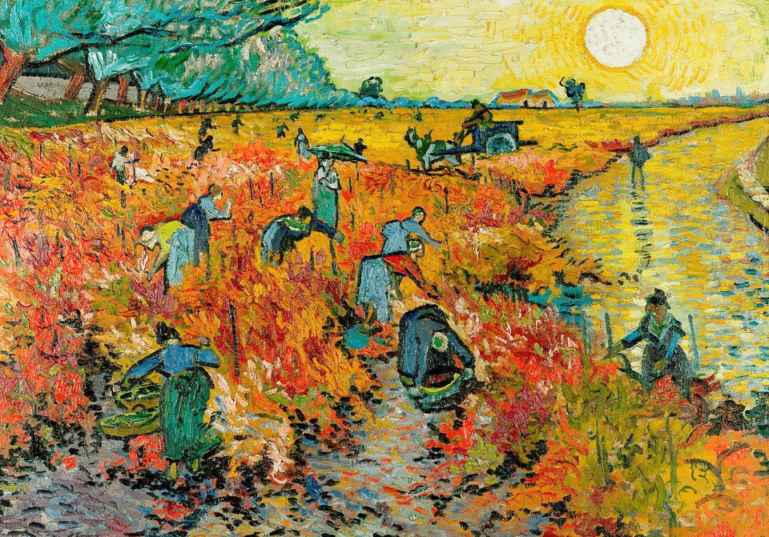
Red Vineyard -- Vincent van Gogh, Pushkin Museum of Fine Arts, Moscow, Russia

Slide 8
For the vineyard of the LORD of hosts is the house of Israel, and the people of Judah are his pleasant planting; he expected justice, but saw bloodshed; righteousness, but heard a cry!
Isaiah 5:7

Slide 9
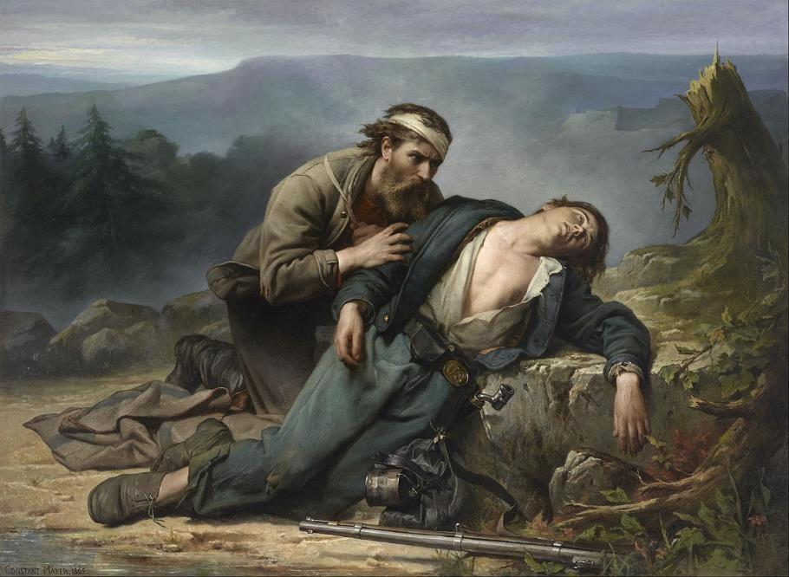
Recognition: North and South -- Constant Mayer, Museum of Fine Arts, Houston, TX

Slide 10
Who can hide in secret places so that I cannot see them, says the LORD. Do I not fill heaven and earth?
Jeremiah 23:24a

Slide 11
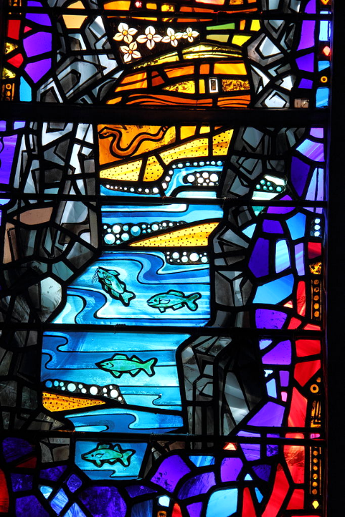
Beauty of Creation
Washington National Cathedral
Washington, DC

Slide 12
Give justice to the weak and the orphan; maintain the right of the lowly and the destitute.
Psalm 82:3

Slide 13
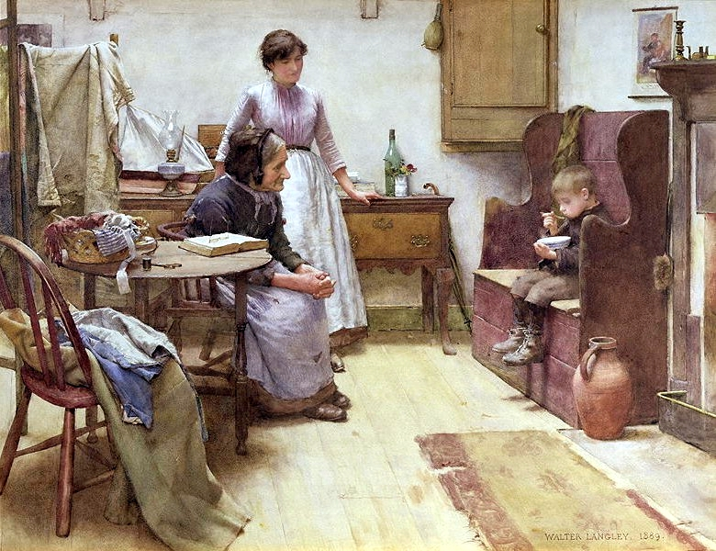
The Waif -- Walter Langley

Slide 14
By faith Rahab the prostitute did not perish with those who were disobedient, because she had received the spies in peace.
Hebrews 11:31

Slide 15
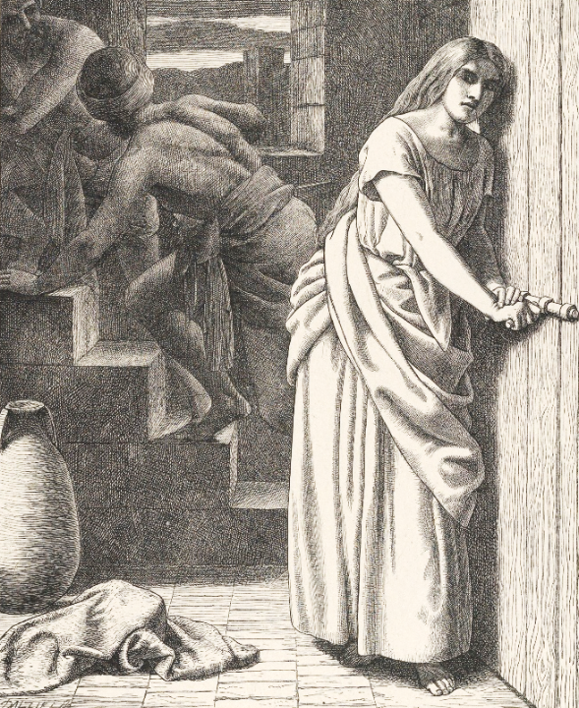
Rahab and the Spies
Camden Press
Metropolitan Museum of Art
New York, NY

Slide 16
… since we are surrounded by so great a cloud of witnesses … let us run with perseverance the race that is set before us,
Hebrews 12:1ac

Slide 17
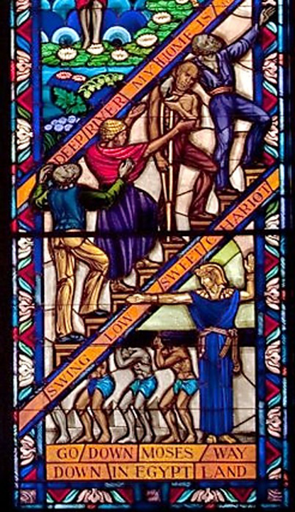
Singing Windows, detail
University Chapel
Tuskegee University
Tuskegee, AL

Slide 18
looking to Jesus the pioneer … who … endured the cross, disregarding its shame, and has taken his seat at the right hand of the throne of God.
Hebrews 12:2ac

Slide 19
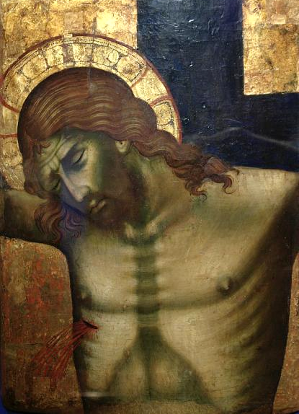
Christ on the Cross
Paolo Veneziano
National Museum
Krakow, Poland

Slide 20
"I came to bring fire to the earth, and how I wish it were already kindled!
Luke 12:49

Slide 21
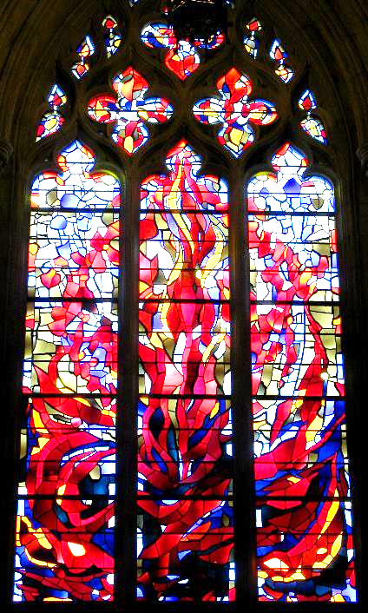
Fire
Washington National Cathedral
Washington, DC

Slide 22
I have a baptism with which to be baptized, and what stress I am under until it is completed!"
Luke 12:50

Slide 23
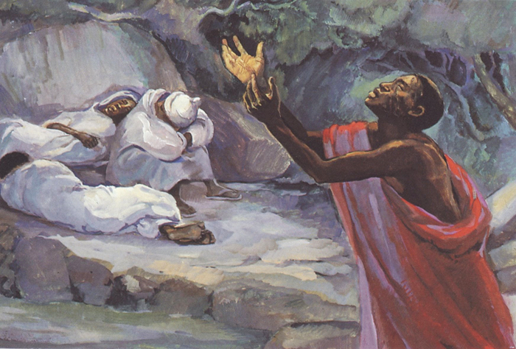
Gethsemane -- JESUS MAFA, Cameroon

Slide 24
Credits
New Revised Standard Version Bible, copyright 1989, Division of Christian Education of the National Council of the Churches of Christ in the United States of America. Used by permission. All rights reserved.
https://commons.wikimedia.org/wiki/File:Clerestory_window_-_South_Nave_Bay_D_-_National_Cathedral_-_DC.JPG
https://commons.wikimedia.org/wiki/File:Csontv%C3%A1ry_Kosztka,_Tivadar_-_Pilgrimage_to_the_Cedars_of_Lebanon_-_Google_Art_Project.jpg
https://commons.wikimedia.org/wiki/File:Vincent_van_Gogh_-_Red_Vineyard_at_Arles_(1888).jpg
https://commons.wikimedia.org/wiki/File:Constant_Mayer_-_Recognition-_North_and_South_-_Google_Art_Project.jpg
https://commons.wikimedia.org/wiki/File:Stained_glass_window_Washington_National_Cathedral_2012_06.JPG – Caroline Lena Becker
https://www.flickr.com/photos/cdevers/4602805654/
https://commons.wikimedia.org/wiki/File:Walter_Langley_-_The_Waif_1889.jpg
https://commons.wikimedia.org/wiki/File:Rahab_and_the_Spies_(Dalziels%27_Bible_Gallery)_MET_DP835647.jpg
https://commons.wikimedia.org/wiki/File:Singing_Windows_stained_glass,_designed_by_J%26R_Lamb,_located_in_the_University_chapel_at_Tuskegee_University,_Tuskegee,_Alabama_LCCN2010637794.tif
https://commons.wikimedia.org/wiki/File:Veneziano_Crucifixion.jpg – BergererSF
http://www.flickr.com/photos/laurapadgett/3375617793/
http://diglib.library.vanderbilt.edu/act-imagelink.pl?RC=48391
Additional descriptions can be found at the Art in the Christian Tradition image library, a service of the Vanderbilt Divinity Library, http://diglib.library.vanderbilt.edu/. All images available via Creative Commons 3.0 License.

