Slide 1
Fifth Sunday after Pentecost
Year C
Amos 7:7-17 and Psalm 82 • Deuteronomy 30:9-14 and Psalm 25:1-10 • Colossians 1:1-14 • Luke 10:25-37

Slide 2
"A man was going down from Jerusalem to Jericho, and fell into the hands of robbers, who stripped him, beat him, and went away, leaving him half dead.
Luke 10:30b

Slide 3
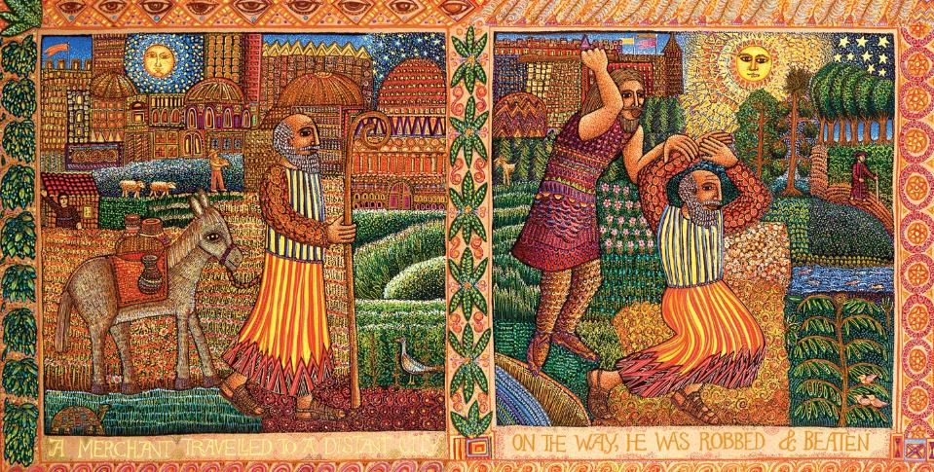
The Good Samaritan, detail -- John August Swanson, serigraph, 2002

Slide 4
Now by chance a priest was going down that road; and when he saw him, he passed by on the other side.
Luke 10:31

Slide 5
So likewise a Levite, when he came to the place and saw him, passed by on the other side.
Luke 10:32

Slide 6
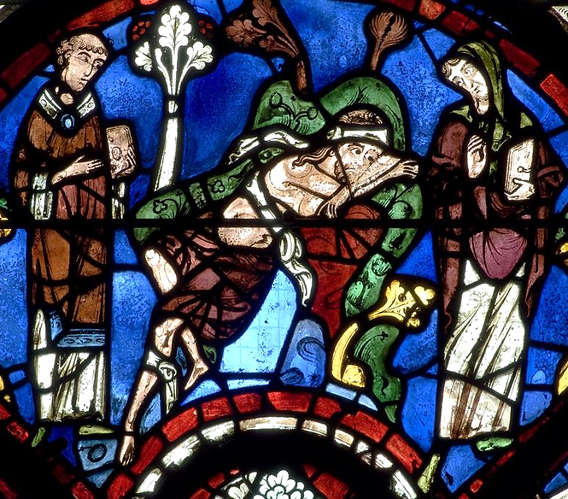
A Priest and a Levite See the Wounded Man and Walk By
Chartres Cathedral, Chartres, France

Slide 7
But a Samaritan while traveling came near him; and when he saw him, he was moved with pity.
Luke 10:33

Slide 8
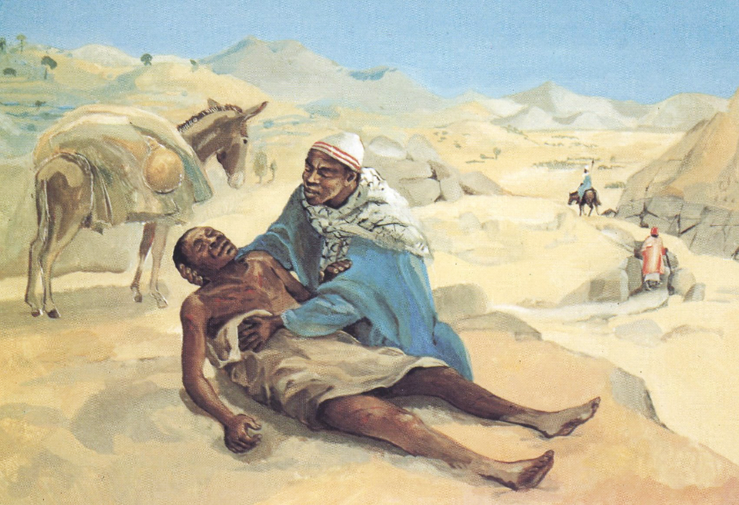
The Good Samaritan -- JESUS MAFA, Cameroon

Slide 9
He went to him and bandaged his wounds, having poured oil and wine on them.
Luke 10:34a

Slide 10
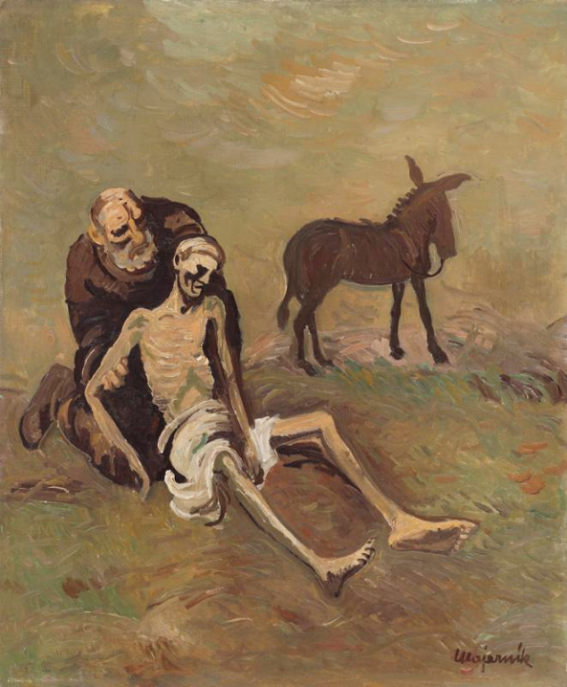
Cyprian Majernik
Slovakia, 1944

Slide 11
Then he put him on his own animal, brought him to an inn, and took care of him.
Luke 10:34b

Slide 12
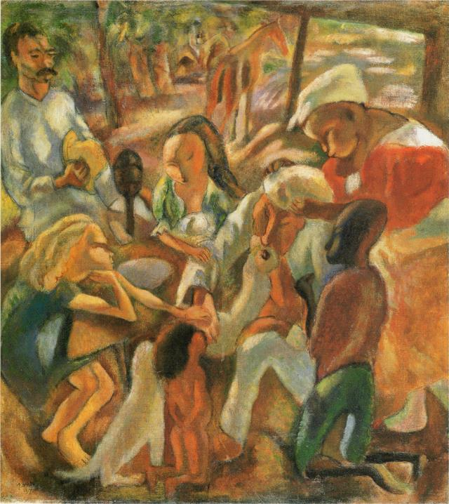
The Good Samaritan
Jules Pascin
Hokkaido Prefectural Museum of Modern Art
Sapporo, Japan

Slide 13
The next day he took out two denarii, gave them to the innkeeper,
Luke 10:35a

Slide 14
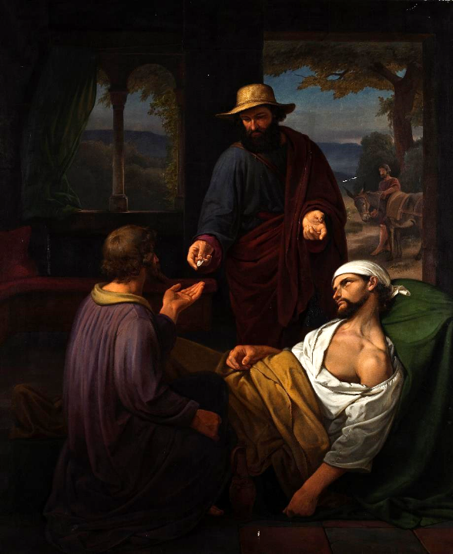
Emil Andersen
The Good Samaritan
Thorvaldsen Museum
Copenhagen, Denmark

Slide 15
and said, 'Take care of him; and when I come back, I will repay you whatever more you spend.'
Luke 10:35b

Slide 16
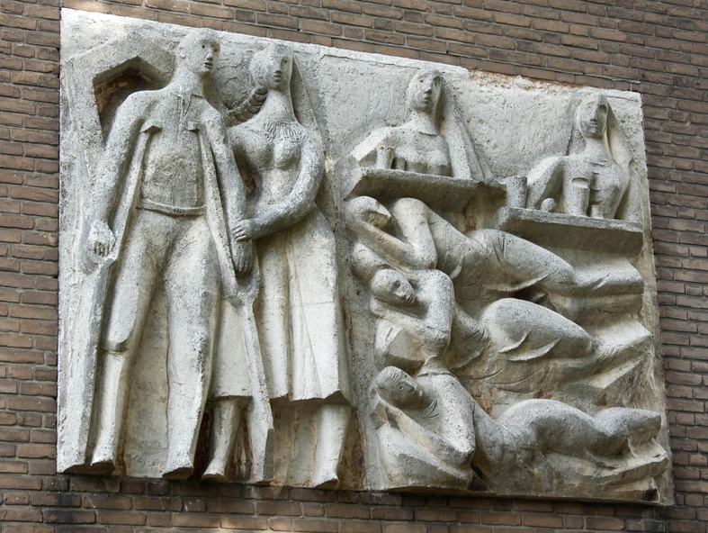
The Good Samaritan Cared for at the Inn -- Charles Eyck, Wageningen, Netherlands

Slide 17
Which of these three, do you think, was a neighbor to the man who fell into the hands of the robbers?"
Luke 10:36

Slide 18
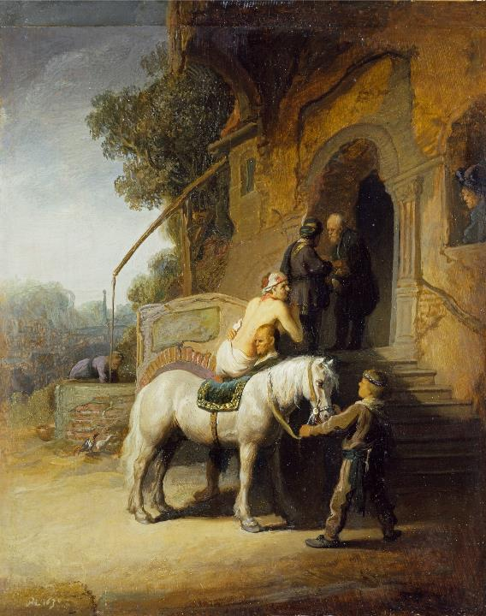
The Good Samaritan
Rembrandt
Wallace Collection
London, England

Slide 19
He said, "The one who showed him mercy." Jesus said to him, "Go and do likewise."
Luke 10:37

Slide 20
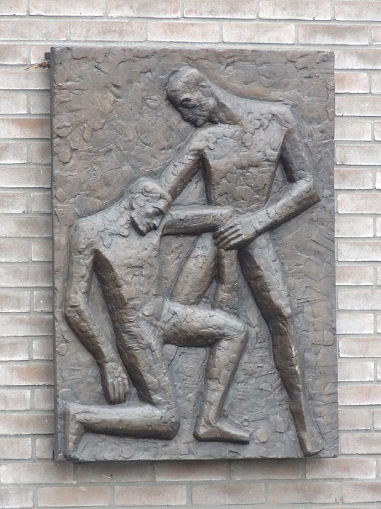
The Good Samaritan
Jan Gierfeld
City church De Bleek
Almelo, Netherlands

Slide 21
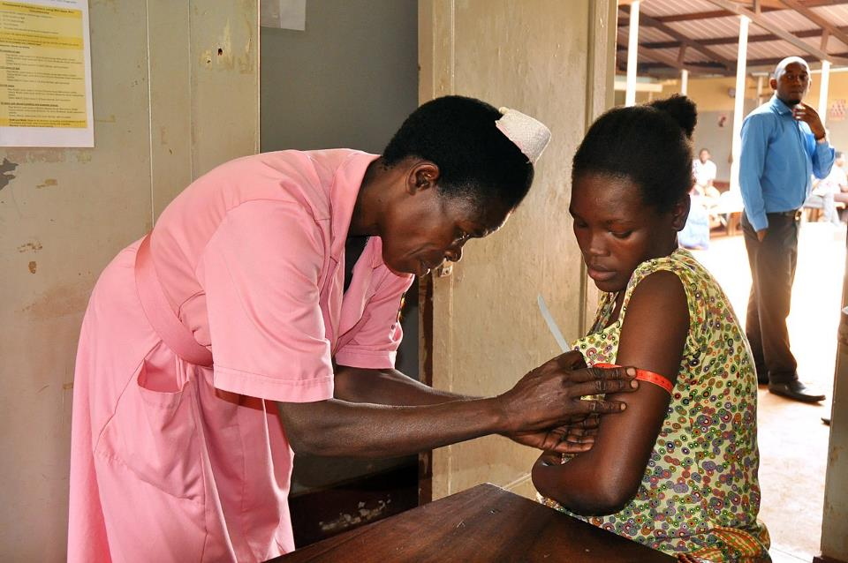
Maternal Health Checkup -- Jinja Regional Referral Hospital, Jinja, Uganda

Slide 22
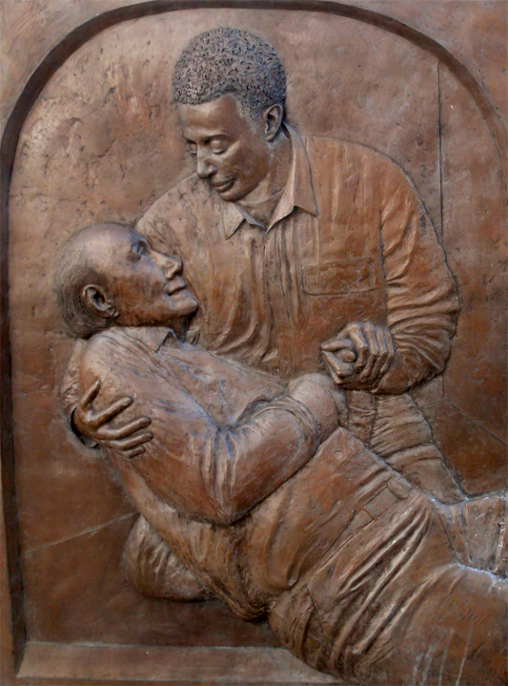
The Good Samaritan Monument
Winston-Salem, NC

Slide 23
Credits
New Revised Standard Version Bible, copyright 1989, Division of Christian Education of the National Council of the Churches of Christ in the United States of America. Used by permission. All rights reserved.
www.JohnAugustSwanson.com - copyright 2002 by John August Swanson
https://commons.wikimedia.org/wiki/File:Chartres_Bay_44_Good_Samaritan_Panel_08.jpg
http://diglib.library.vanderbilt.edu/act-imagelink.pl?RC=48381
https://commons.wikimedia.org/wiki/File:Majernik-Samaritan.jpg
https://commons.wikimedia.org/wiki/File:JulesPascin-1917-The_Good_Samaritan(Persons_in_Cuba).png
https://www.thorvaldsensmuseum.dk/en/collections/work/B195
https://commons.wikimedia.org/wiki/File:Charles_Eyck_-_De_barmhartige_Samaritaan.jpg
https://commons.wikimedia.org/wiki/File:Rembrandt_Harmensz._van_Rijn_033.jpg
https://commons.wikimedia.org/wiki/File:Almelo_-_Reli%C3%ABf_%27De_Barmhartige_Samaritaan%27_van_Jan_Gierveld_op_de_achterzijde_van_stadskerk_De_Bleek_1.jpg
https://commons.wikimedia.org/wiki/File:Uganda_Nutrition_(41809766381).jpg
https://www.flickr.com/photos/daquellamanera/6794762102
Additional descriptions can be found at the Art in the Christian Tradition image library, a service of the Vanderbilt Divinity Library, http://diglib.library.vanderbilt.edu/. All images available via Creative Commons 3.0 License.

