Slide 1
FOURTH SUNDAY AFTER THE EPIPHANY
Year C
Jeremiah 1:4-10 • Psalm 71:1-6 1 Corinthians 13:1-13 • Luke 4:21-30

Slide 2
"Before I formed you in the womb I knew you, and before you were born I consecrated you; I appointed you a prophet to the nations."
Jeremiah 1:5

Slide 3
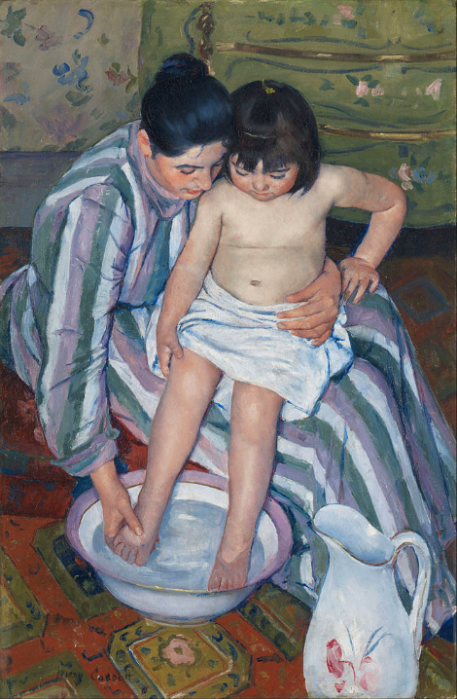
The Child's Bath
Mary Cassatt
Art Institute of Chicago
Chicago, IL

Slide 4
Upon you I have leaned from my birth; it was you who took me from my mother's womb. My praise is continually of you.
Psalm 71:6

Slide 5
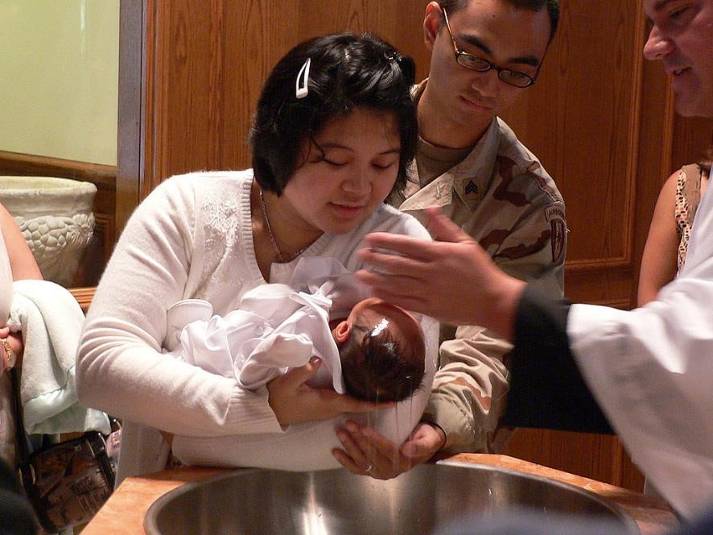
Child Baptism -- Carlo Cabanilla, 2004

Slide 6
If I speak in the tongues of mortals and of angels, but do not have love, I am a noisy gong or a clanging cymbal.
1 Corinthians 13:1

Slide 7
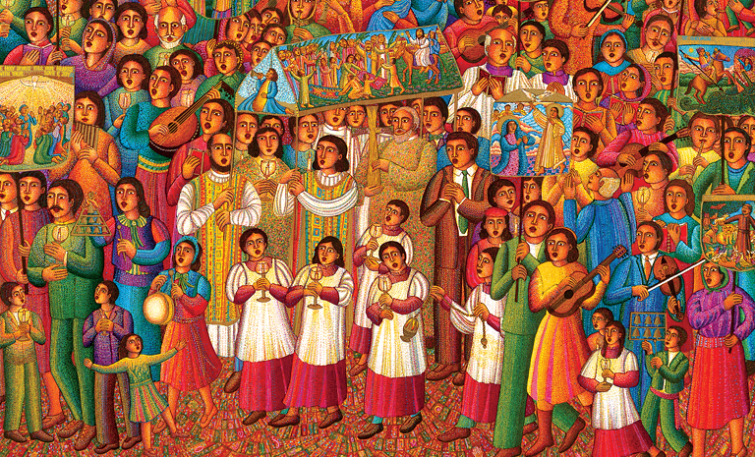
Procession, detail -- John August Swanson, serigraph, 2007

Slide 8
And if I have prophetic powers, and understand all mysteries and all knowledge, and if I have all faith, so as to remove mountains, but do not have love, I am nothing.
1 Corinthians 13:2

Slide 9
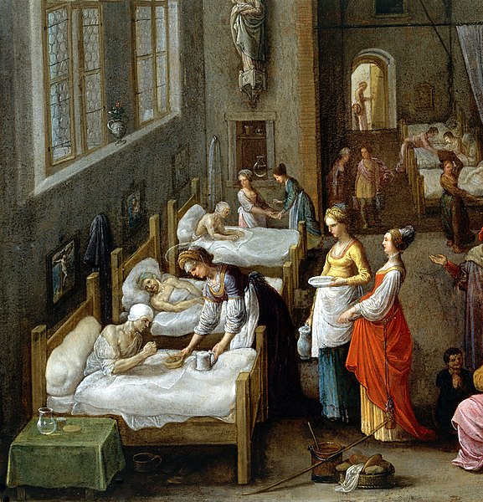
Elizabeth of Hungary Visiting a Hospital
Wellcome Collection
London, UK

Slide 10
If I give away all my possessions, and if I hand over my body so that I may boast, but do not have love, I gain nothing.
1 Corinthians 13:3

Slide 11
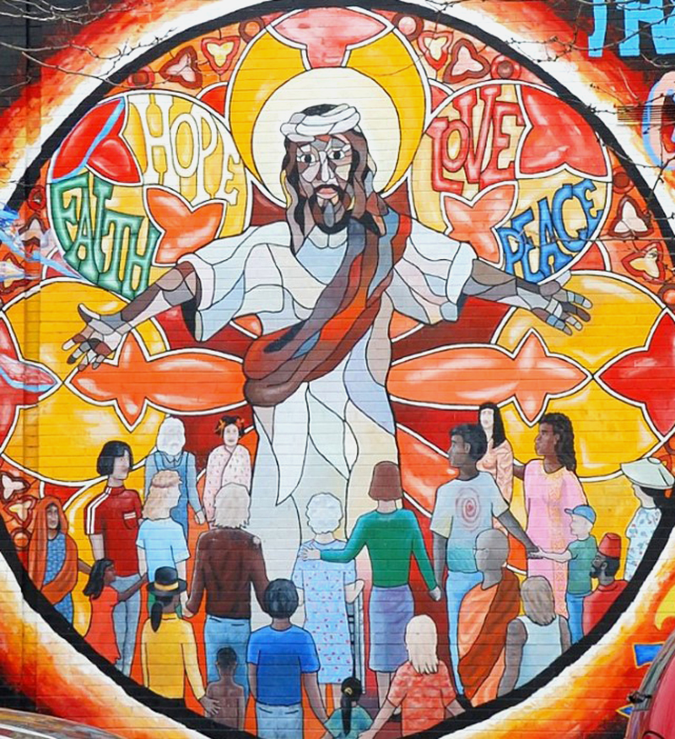
Jesus Mural of Faith, Hope, Love, and Peace
Chicago, IL

Slide 12
Love is patient; love is kind; love is not envious or boastful or arrogant or rude. It does not insist on its own way; it is not irritable or resentful;
1 Corinthians 13:4-5

Slide 13
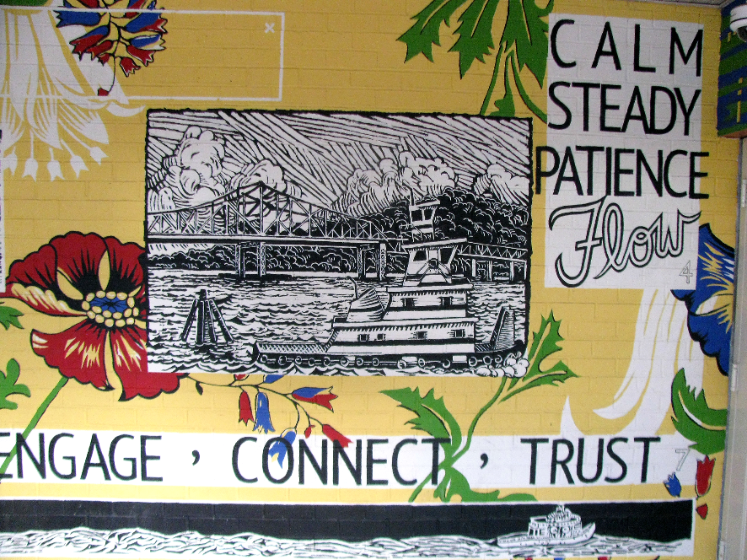
17 Tugs – a Collaborative Mural -- Tarrytown, NY

Slide 14
it does not rejoice in wrongdoing, but rejoices in the truth. It bears all things, believes all things, hopes all things, endures all things.
1 Corinthians 13:6-7

Slide 15
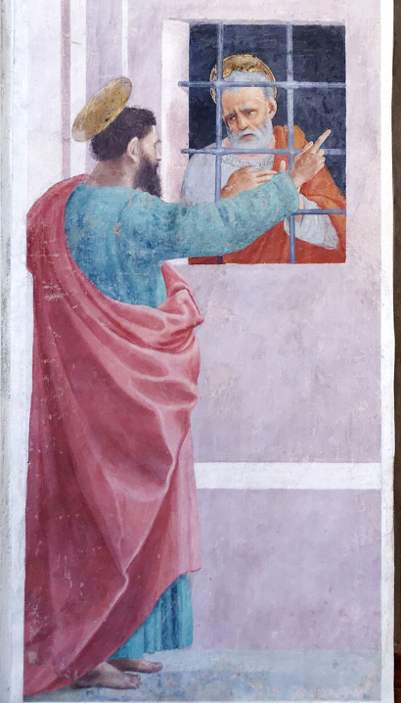
Paul Visiting Peter in Prison
Filippino Lippi
Brancacci Chapel
Florence, Italy

Slide 16
Love never ends. But as for prophecies, they will come to an end; as for tongues, they will cease; as for knowledge, it will come to an end.
1 Corinthians 13:8

Slide 17
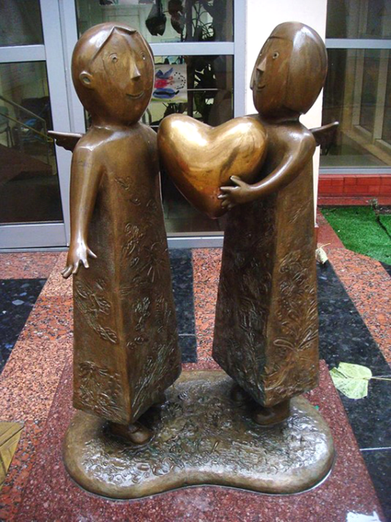
Heart of the World
Mikhail Reva
Odessa Children's Hospital
Odessa, Ukraine

Slide 18
When I was a child, I spoke like a child, I thought like a child, I reasoned like a child; when I became an adult, I put an end to childish ways.
1 Corinthians 13:11

Slide 19
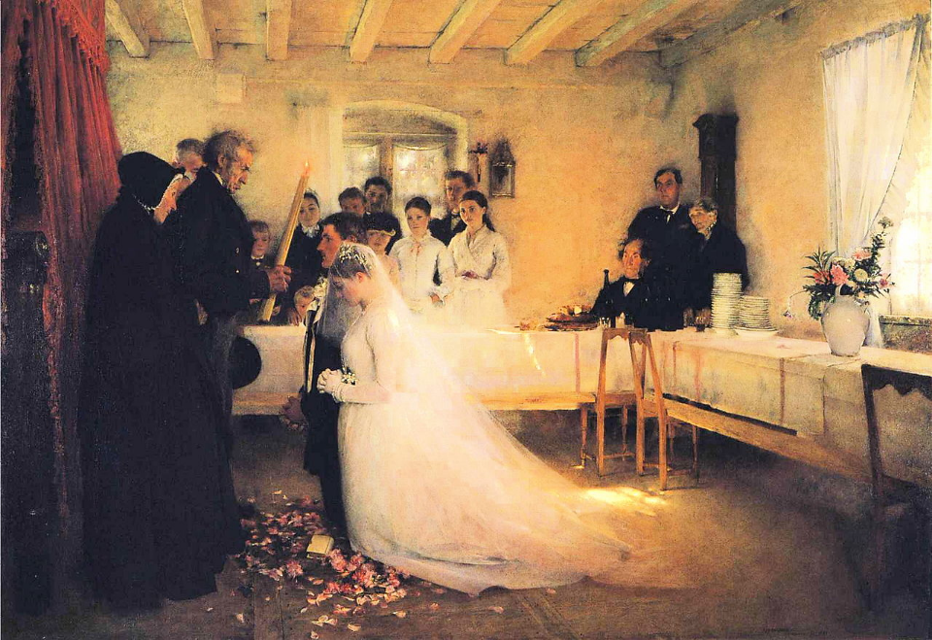
Blessing the Young Couple -- Pascal Dagnan-Bouveret, Pushkin Museum of Fine Arts, Moscow, Russia

Slide 20
For now we see in a mirror, dimly, but then we will see face to face. Now I know only in part; then I will know fully, even as I have been fully known.
1 Corinthians 13:12

Slide 21
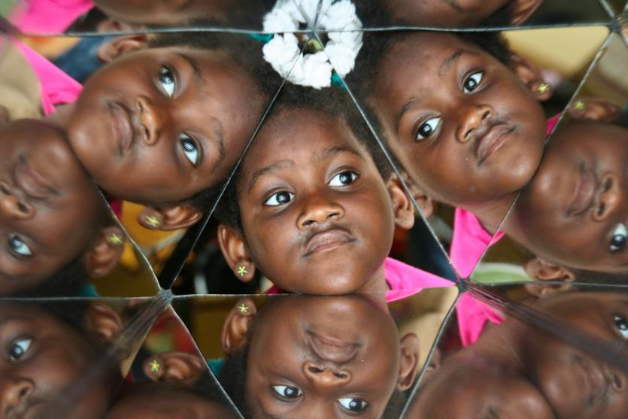
Lourdie Prism Mirror Reflections -- Children's Museum, Grand Rapids, MI

Slide 22
And now faith, hope, and love abide, these three; and the
greatest of these is love.
1 Corinthians 13:13

Slide 23
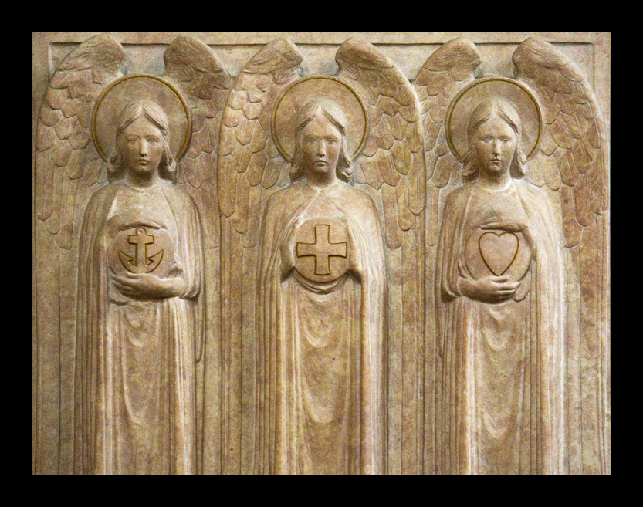
Faith, Hope, and Love -- St. Giles Cathedral, Edinburgh, Scotland

Slide 24
And he said, "Truly I tell you, no prophet is accepted in the prophet's hometown."
Luke 4:24

Slide 25
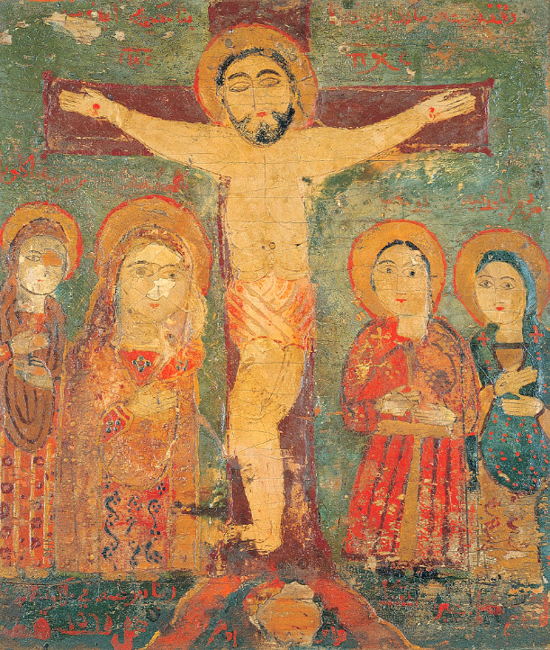
The Crucifixion with Arabic inscriptions
c. 1560
Benaki Museum Athens, Greece

Slide 26
Credits
New Revised Standard Version Bible, copyright 1989, Division of Christian Education of the National Council of the Churches of Christ in the United States of America. Used by permission. All rights reserved.
https://commons.wikimedia.org/wiki/File:Mary_Cassatt_-_The_Child%27s_Bath_-_Google_Art_Project.jpg
https://commons.wikimedia.org/wiki/File:Child_baptism.jpg - Carlo Cabanilla
www.JohnAugustSwanson.com - copyright 2007 by John August Swanson
https://commons.wikimedia.org/wiki/File:St_Elizabeth_visiting_a_hospital._Wellcome_V0017201.jpg
https://www.flickr.com/photos/36847973@N00/3342340183
https://www.flickr.com/photos/edenpictures/10720635735
https://commons.wikimedia.org/wiki/File:St_Paul_Visiting_St_Peter_in_Prison_Filippino_Lippi_Cappella_Brancacci.jpg - Marie-Lan Nguyen
https://commons.wikimedia.org/wiki/File:Children_sculpture_by_Mikhail_Reva.jpg
https://commons.wikimedia.org/wiki/File:Pascal_Dagnan-Bouveret_-_Blessing_of_the_Young_Couple_Before_Marriage.JPG
https://www.flickr.com/photos/stevendepolo/5644831975 - Steven Depolo
http://www.flickr.com/photos/paullew/5709533172/ - Fr Lawrence Lew, O.P.
https://commons.wikimedia.org/wiki/File:The_Crucifixion_-_Google_Art_Project.jpg
Additional descriptions can be found at the Art in the Christian Tradition image library, a service of the Vanderbilt Divinity Library, http://diglib.library.vanderbilt.edu/. All images available via Creative Commons 3.0 License.

