Slide 1
FIRST SUNDAY IN LENT
Year C
Deuteronomy 26:1-11 • Psalm 91:1-2, 9-16 Romans 10:8b-13 • Luke 4:1-13

Slide 2
Then you, together with the Levites and the aliens who reside among you, shall celebrate with all the bounty that the LORD your God has given to you.
Deuteronomy 26:11

Slide 3
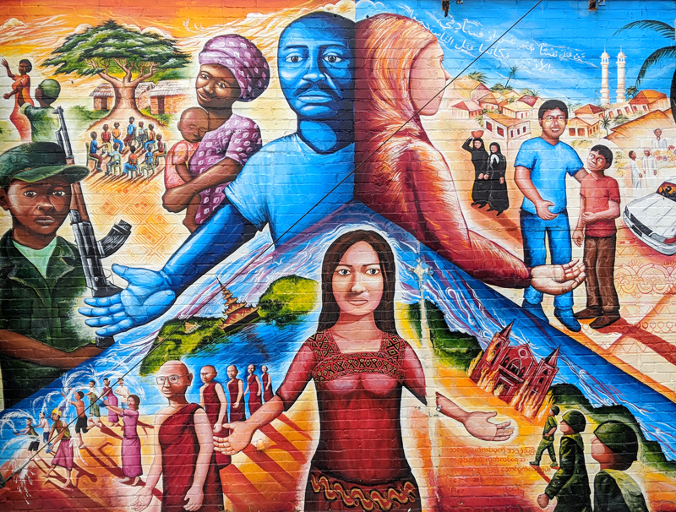
Global Refugee Mural -- Joel Bergner

Slide 4
For he will command his angels … to guard you in all your ways. On their hands they will bear you up, … you will not dash your foot against a stone.
Psalm 91:11ac,12ac

Slide 5
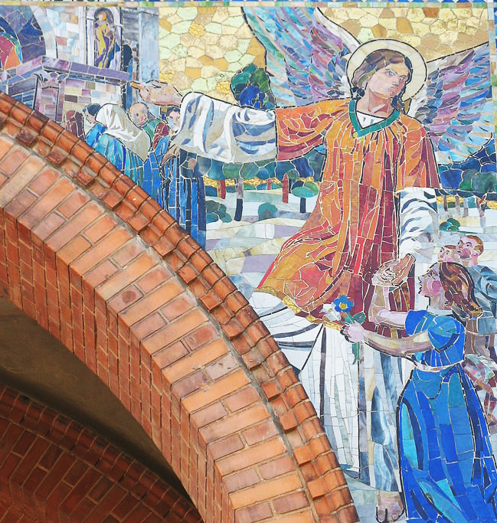
Guardian Angel
Antonskirche
Vienna, Austria

Slide 6
For there is no distinction between Jew and Greek; the same Lord is Lord of all and is generous to all who call on him.
Romans 10:12

Slide 7
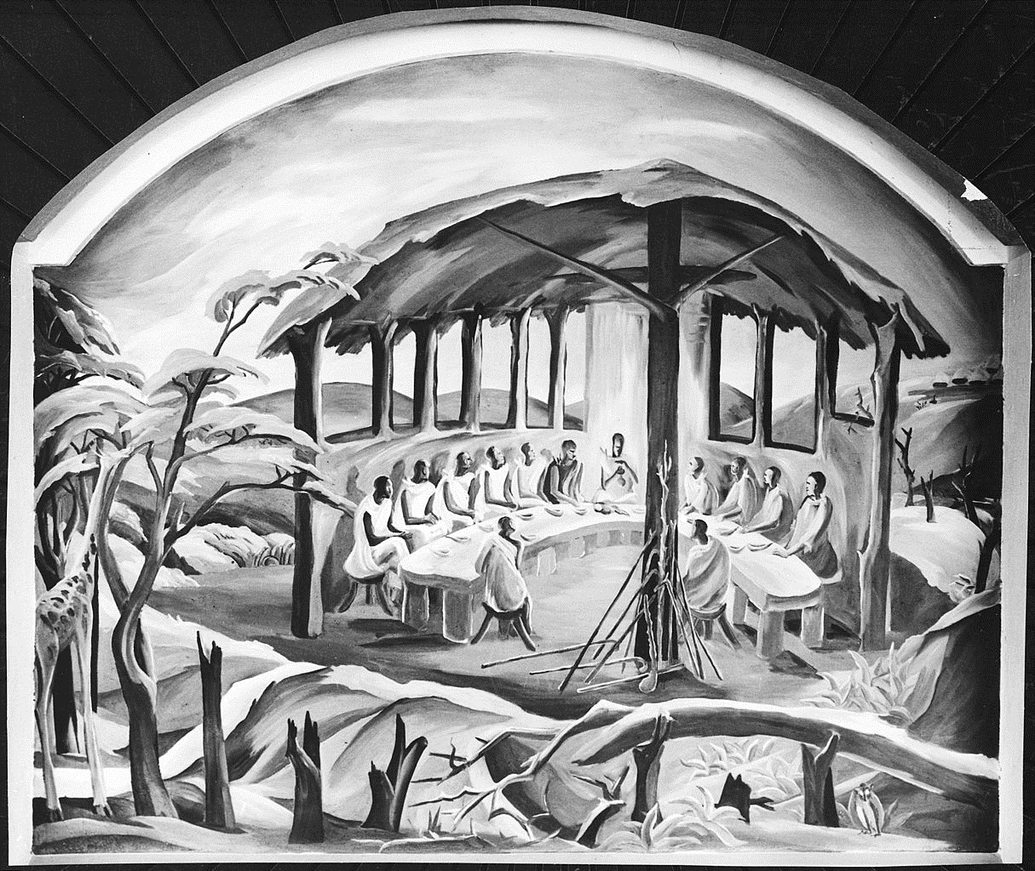
Last Supper
Elimo Njau
Fort Hall Memorial Chapel Kenya

Slide 8
Jesus, full of the Holy Spirit, … was led by the Spirit in the wilderness, where for forty days he was tempted by the devil.
Luke 4:1ac, 2a

Slide 9
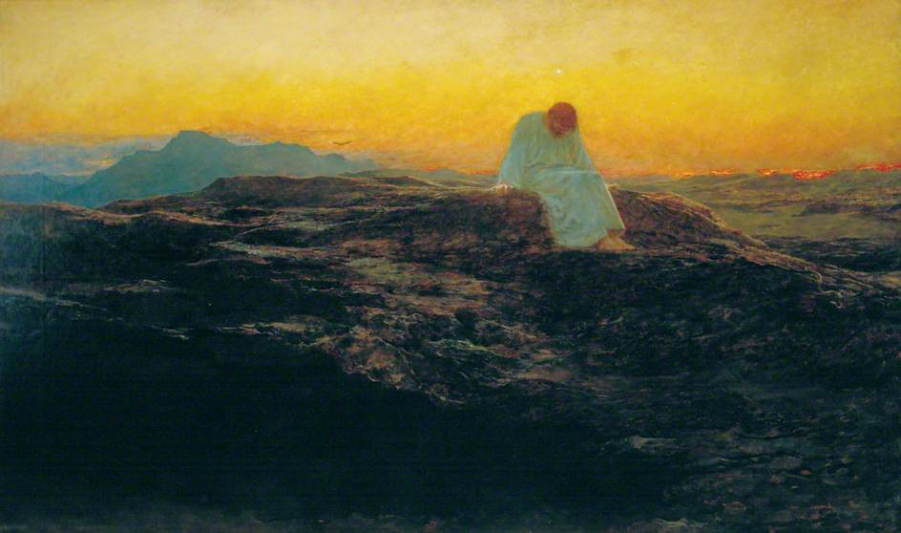
Temptation in the Wilderness -- Briton Riviere, Guildhall Art Gallery, London, England

Slide 10
The devil said to him, "If you are the Son of God, command this stone to become a loaf of bread."
Luke 4:3

Slide 11
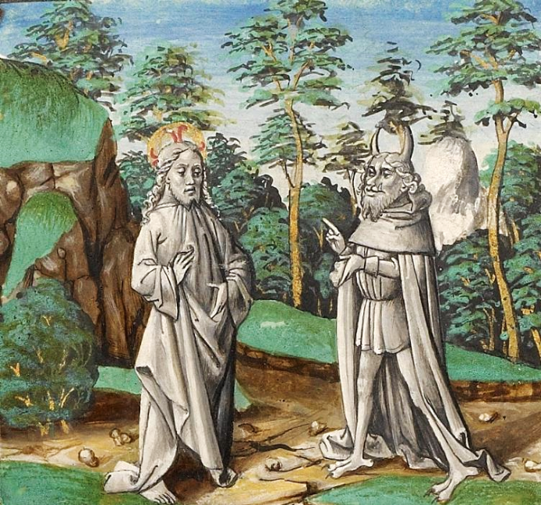
First Temptation of Christ -- Late 15th c. manuscript, Getty Center, Los Angeles, CA

Slide 12
Jesus answered him, "It is written, 'One does not live by bread alone.'"
Luke 4:4

Slide 13
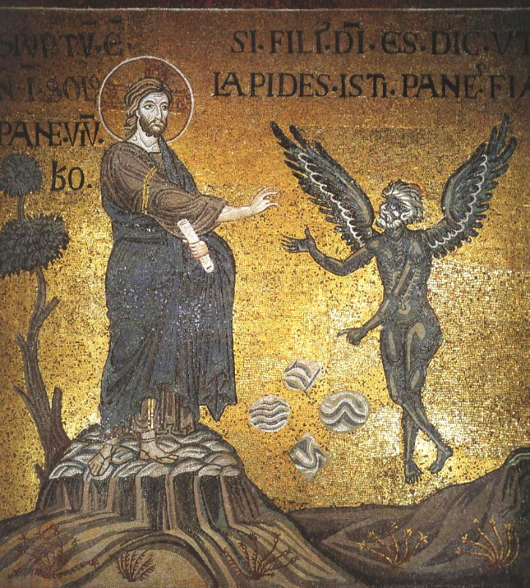
Christ Tempted
Monreale Cathedral
Monreale, Italy

Slide 14
Then the devil led him up and showed him in an instant all the kingdoms of the world … "To you I will give their glory and all this authority;
Luke 4:5, 6b

Slide 15
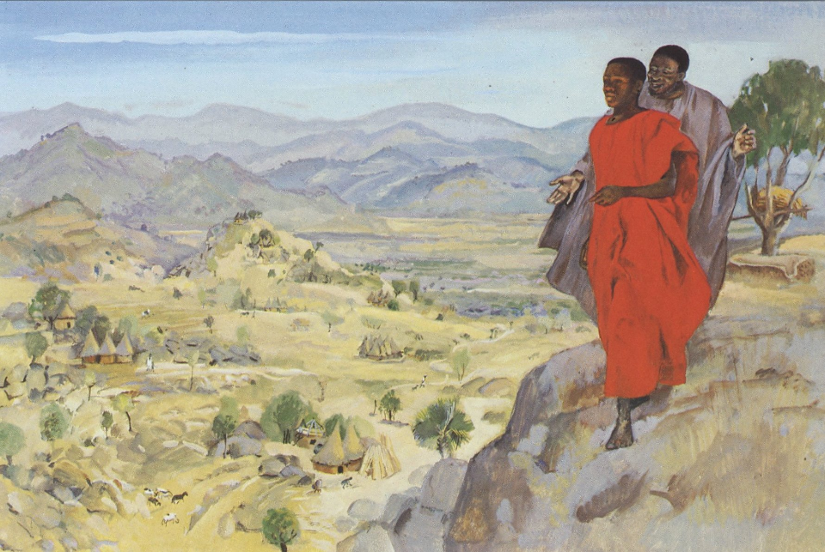
Temptation of Christ -- JESUS MAFA, Cameroon

Slide 16
If you, then, will worship me, it will all be yours." Jesus answered him, "It is written, 'Worship the Lord your God, and serve only him.'"
Luke 4:7-8

Slide 17
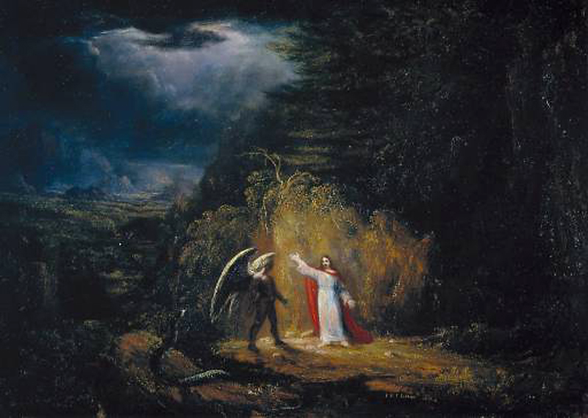
Temptation in the Wilderness -- John St. John Long, Tate Britain, London, England

Slide 18
Then the devil took him to Jerusalem and placed him on the pinnacle of the temple, saying to him, "If you are the Son of God, throw yourself down from here,
Luke 4:9

Slide 19
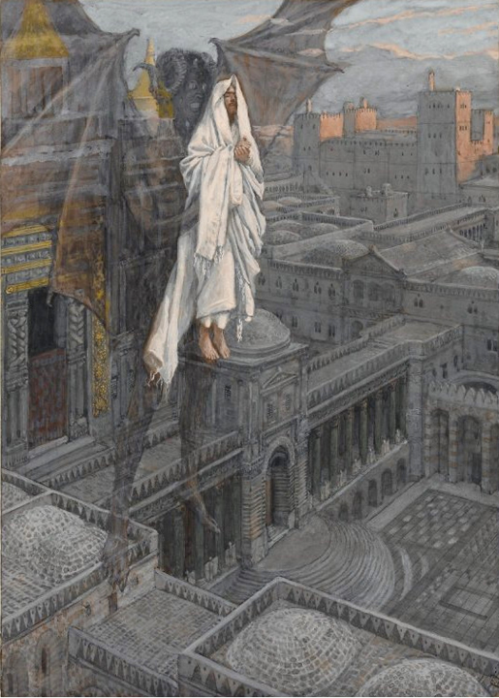
Jesus Carried Up to the Pinnacle of the Temple
James Tissot
Brooklyn Museum
New York, NY

Slide 20
for it is written, 'He will command his angels concerning you, to protect you,' and 'On their hands they will bear you up …'"
Luke 4:10, 11a

Slide 21
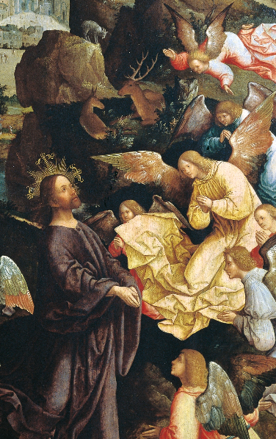
Christ Ministered to by Angels
Jacob Cornelisz van Oostsanen
Suermondt-Ludwig Museum
Aachen, Germany

Slide 22
Jesus answered him, "It is said, 'Do not put the Lord your God to the test.'"
Luke 4:12

Slide 23
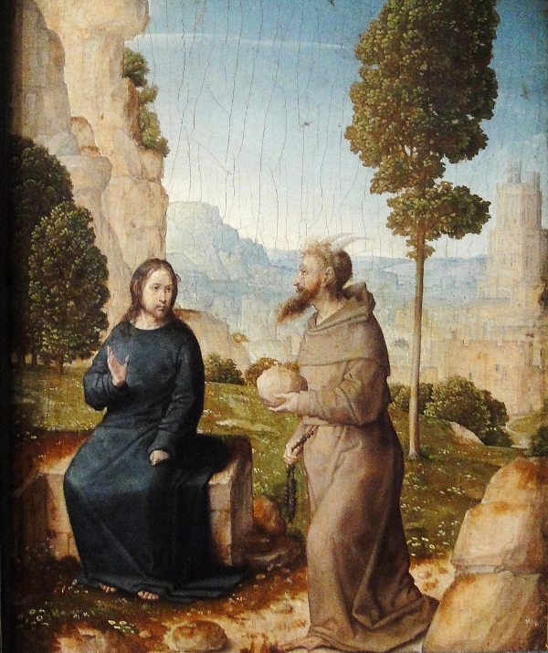
Jesus and the Tempter
Juan de Flandes
National Gallery of Art
Washington, DC

Slide 24
Credits
New Revised Standard Version Bible, copyright 1989, Division of Christian Education of the National Council of the Churches of Christ in the United States of America. Used by permission. All rights reserved.
https://joelartista.com/about/
https://commons.wikimedia.org/wiki/File:Antonsplatz_22.JPG
https://commons.wikimedia.org/wiki/File:%22The_Last_Supper%22_-_NARA_-_558940.jpg
https://commons.wikimedia.org/wiki/File:Briton_Rivi%C3%A8re_-_The_Temptation_in_the_Wilderness.jpg
https://commons.wikimedia.org/wiki/File:The_First_Temptation_of_Christ_-_Google_Art_Project.jpg
https://commons.wikimedia.org/wiki/File:Christ%27s_temptation_(Monreale).jpg – Sibeaster
http://diglib.library.vanderbilt.edu/act-imagelink.pl?RC=48312
http://diglib.library.vanderbilt.edu/act-imagelink.pl?RC=54299
http://commons.wikimedia.org/wiki/File:Brooklyn_Museum_-_Jesus_Carried_up_to_a_Pinnacle_of_the_Temple_(J%C3%A9sus_port%C3%A9_sur_le_pinacle_du_Temple)_-_James_Tissot_-_overall.jpg
https://commons.wikimedia.org/wiki/File:The_temptation_of_Christ,_by_Jacob_Cornelisz_van_Oostsanen.jpg
http://diglib.library.vanderbilt.edu/act-imagelink.pl?RC=54301
Additional descriptions can be found at the Art in the Christian Tradition image library, a service of the Vanderbilt Divinity Library, http://diglib.library.vanderbilt.edu/. All images available via Creative Commons 3.0 License.

