Slide 1
Eighth Sunday after the Epiphany
Year C
Isaiah 55:10-13 • Psalm 92:1-4, 12;15
1 Corinthians 15:51-58 • Luke 6:39-49

Slide 2
You will go out in joy and be led forth in peace; the mountains and hills will burst into song before you, and all the trees of the field will clap their hands.
Isaiah 55:12

Slide 3
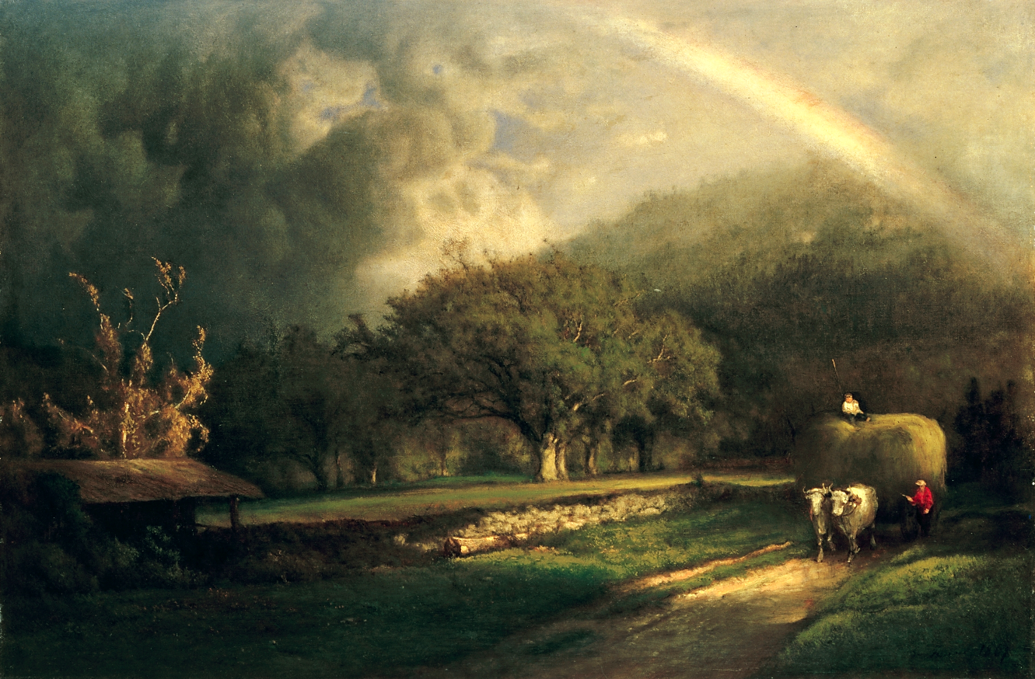
Rainbow in the Berkshire Hills
George Inness, 1869

Slide 4
It is good to praise the LORD and make music to your name, O Most High,
Psalm 92:1

Slide 5
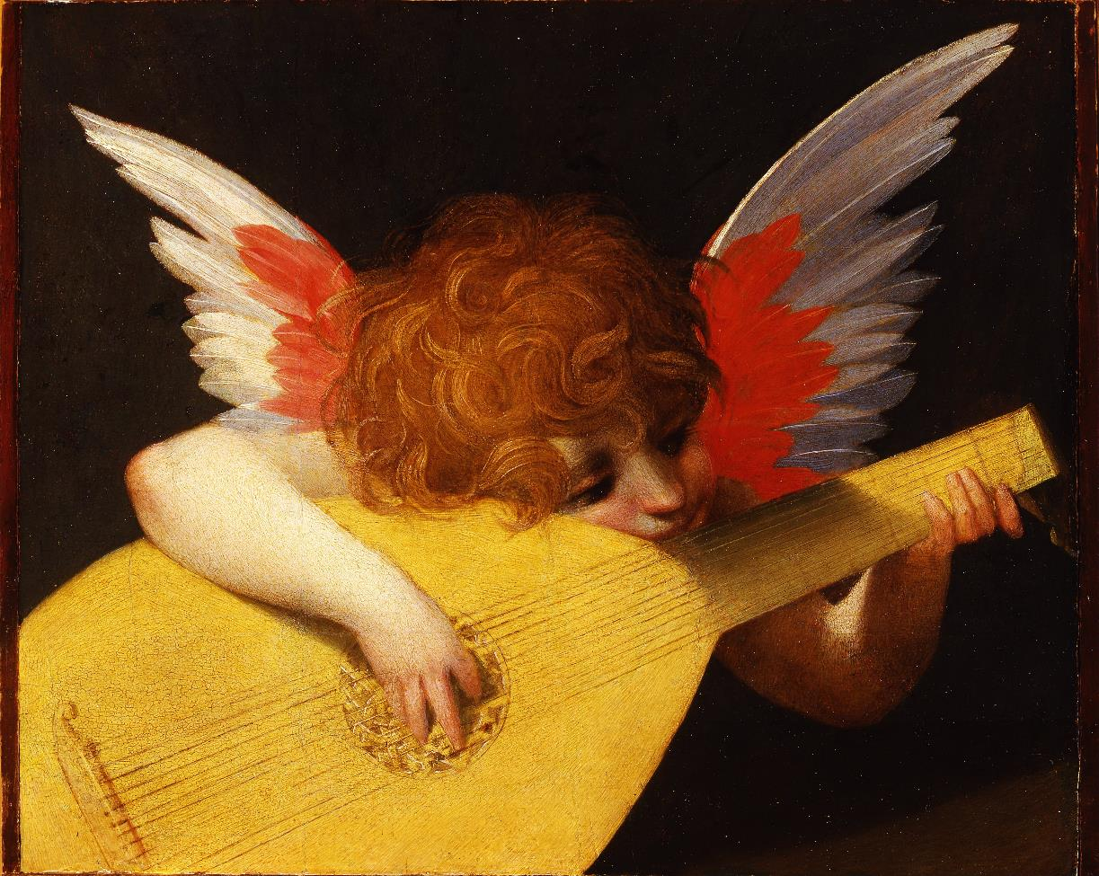
Small Angel Playiing (detail from Madonna of Spedalingo), Rosso Fiorentino, 1518

Slide 6
Where, O death, is your victory? Where, O death, is your sting?
1 Corinthians 15:55

Slide 7
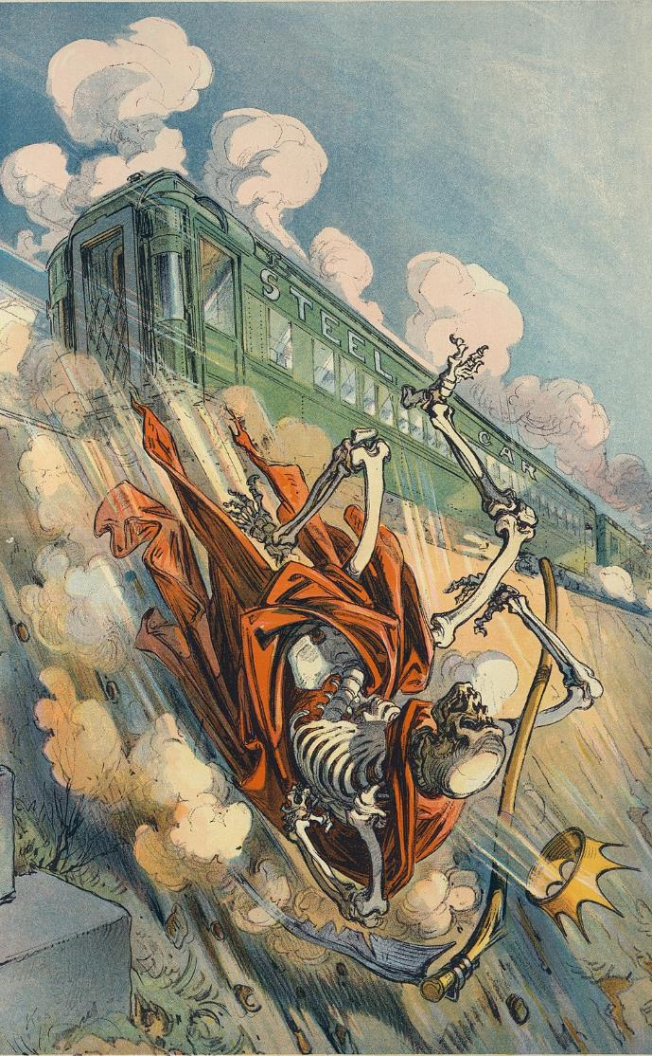
O Death, Where is Thy Sting?
Udo J. Keppler, 1913

Slide 8
He also told them a parable: “Can a blind person guide a blind person? Will not both fall into a pit?
Luke 6:39

Slide 9
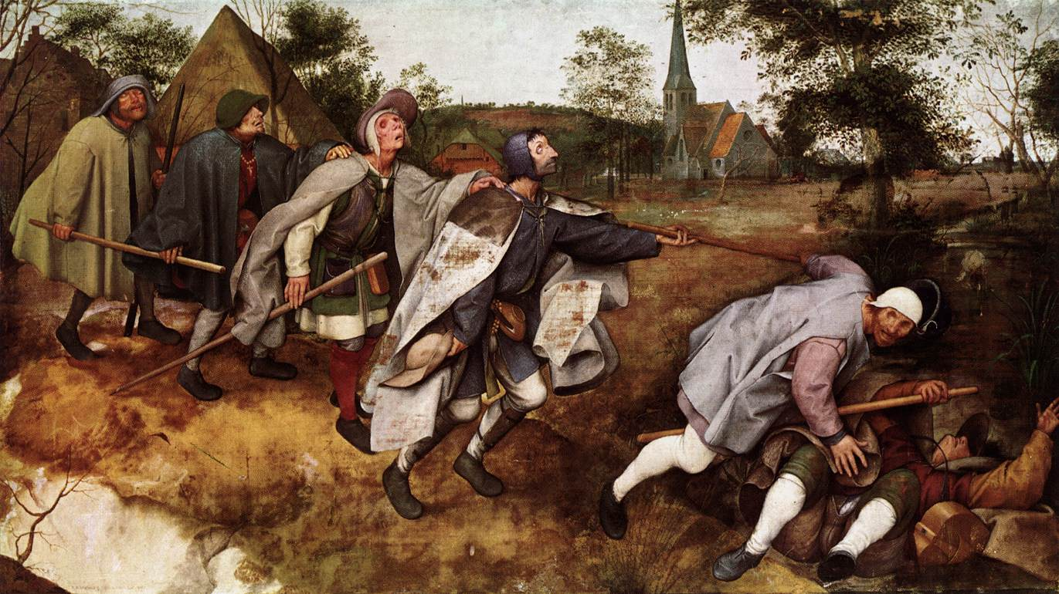
Calling of the Disciples -- JESUS MAFA, Cameroon

Slide 10
”No good tree bears bad fruit, nor again does a bad tree bear good fruit;”
Luke 6:43

Slide 11
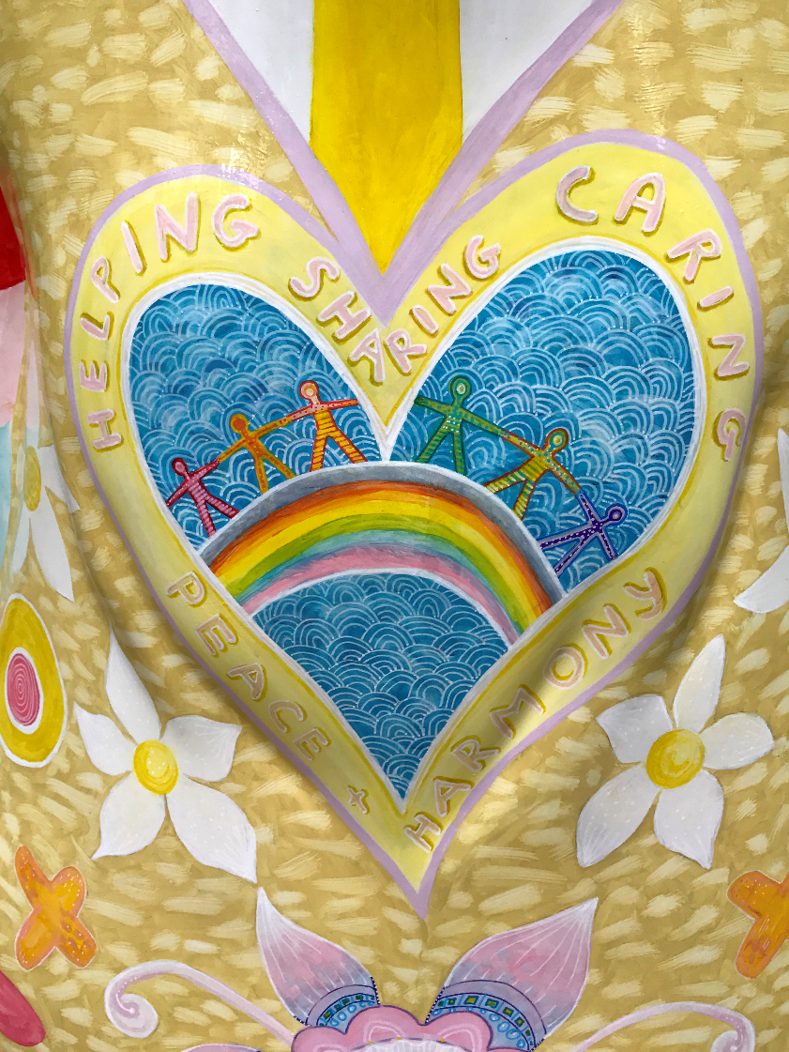
Helping, Sharing, Caring, Harmony, Peace
Birmingham, 2017

Slide 12
“That one is like a man building a house, who dug deeply and laid the foundation on rock;”
Luke 6:48a

Slide 13
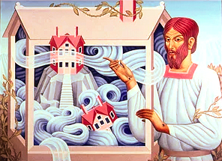
A House Built on Rock – Peter Koenig, 2018

Slide 14
“when a flood arose, the river burst against that house but could not shake it, because it had been well built.”
Luke 6:48b

Slide 15
A House Built on Rock
Peter Koenig,
2018

Slide 16
”But the one who hears and does not act is like a man who built a house on the ground without a foundation. When the river burst against it, immediately it fell, and great was the ruin of that house.”
Luke 6:49

Slide 17
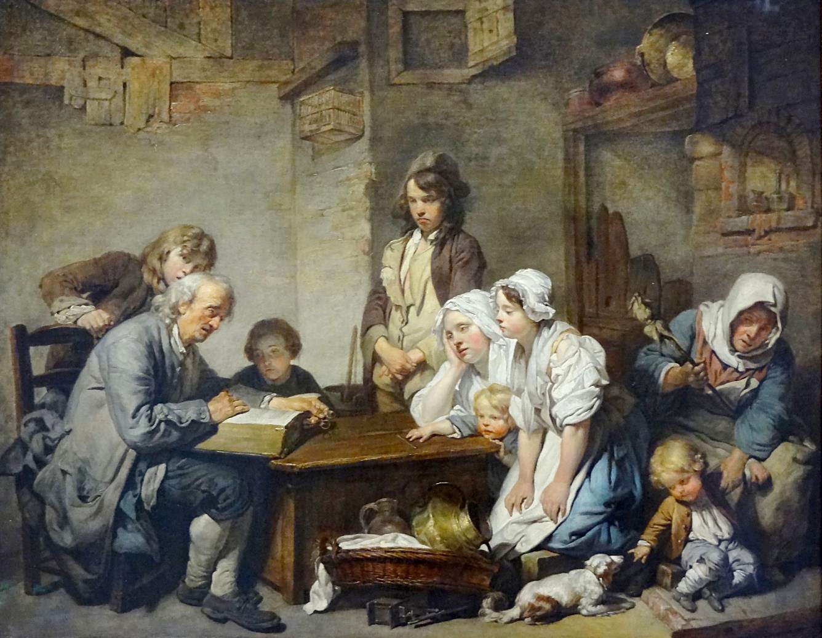
House Divided
Luke Siemens
2008
Reading the Bible -- Jean-Baptiste Greuze, Louvre, Paris, France

Slide 18
Credits
New Revised Standard Version Bible, copyright 1989, Division of Christian Education of the National Council of the Churches of Christ in the United States of America. Used by permission. All rights reserved.
http://commons.wikimedia.org/wiki/File:The_Rainbow_in_the_Berkshire_Hills_by_George_Inness,_1869.jpg
http://commons.wikimedia.org/wiki/File:Rosso_Fiorentino_-_Madonna_dello_Spedalingo_-_Google_Art_Project.jpghttp://diglib.library.vanderbilt.edu/act-imagelink.pl?RC=48379
https://commons.wikimedia.org/wiki/File:%22O_death,_where_is_thy_sting%3F%22_-_Kep._LCCN2011649640.jpg
http://commons.wikimedia.org/wiki/File:Pieter_Bruegel_the_Elder_-_The_Parable_of_the_Blind_Leading_the_Blind_-_WGA3511.jpg
https://www.flickr.com/photos/karen_roe/36068574913/
https://www.pwkoenig.co.uk/
https://www.pwkoenig.co.uk/
https://www.flickr.com/photos/125149010@N07/38719333905
Additional descriptions can be found at the Art in the Christian Tradition image library, a service of the Vanderbilt Divinity Library, http://diglib.library.vanderbilt.edu/. All images available via Creative Commons 3.0 License.

